Slide 1

VER_2026.05.SENTINEL
SENTINEL: THE ESSENTIAL IP MOAT FOR MACHINE VISION
Achieving 50 to 65 percent reduction in satellite bandwidth for remote industrial cameras.
SEED ROUND: $2,000,000
PREETAM MUKHERJEE & SOUMYAJIT MANDAL CO-FOUNDERS

Slide 2

THE BANDWIDTH BARRIER IN REMOTE INDUSTRIAL SITES
Offshore oil rigs and pipeline sites typically operate between 10 and 40 cameras simultaneously.
Standard codecs prioritize human visual perception over machine analytical requirements.
$10,000+
PER MBPS PER MONTH
95 percent of industrial video feeds directly into machine vision models for analysis.
Satellite bandwidth expenses remain the primary constraint for remote video surveillance.
Operators pay for high-resolution pixels that machine models do not require for accuracy.
ANALYSIS_REF: INDUSTRIAL_VIDEO_ECONOMICS_2026

Slide 3

DUAL-LAYER SVC: OPTIMIZED FOR MACHINE VISION
LEARNED VIDEO CODEC
ARCHITECTURE_DIAGRAM: SVC_01
~50–65% bitrate reduction while preserving full analytical precision.
LAYER 1: HUMAN PREVIEW
LAYER 2: MACHINE FEATURES
→
Dual-layer ensures operator awareness while delivering precise data for detection.
DUAL-LAYER SCALABLE CODING
Low-res human thumbnails plus feature-optimized AI streams delivered concurrently.
EDGE-NATIVE DEPLOYMENT
Runs on Jetson Orin NX for local execution and low latency.

Slide 4

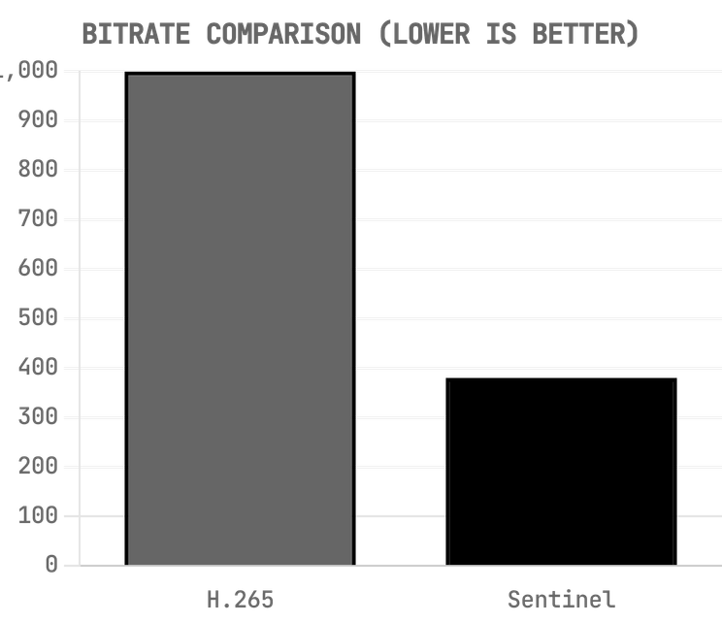
VALIDATED PERFORMANCE ON EDGE HARDWARE
CODEC
BITRATE (KBPS)
MAP ACCURACY
HARDWARE
H.265 Reference
1000
0.91
Jetson Orin NX
Sentinel Codec
380
0.90
Jetson Orin NX
Performance Delta
Negligible 1%
Same BOM
62% Reduction
Real-time performance exceeds 30 frames per second on standard Jetson modules.
DATA_SOURCE: INTERNAL_BENCHMARK_V2.4 TEST_ENVIRONMENT: NVIDIA_JETSON_ORIN_NX_16GB
Validation conducted using industrial surveillance datasets for object detection.
Hardware readiness includes a functional prototype with a scalable bill of materials.

Slide 5

THE THREE-PHASE IP MOAT STRATEGY
PHASE 1: MONTHS 0 TO 18
PHASE 2: MONTHS 12 TO 30
PHASE 3: MONTHS 24 TO 60
HARDWARE DEPLOYMENT
PATENT PORTFOLIO
IP LICENSING
Lease Sentinel Gateway edge appliances to industrial partners.
File defensible patents for dual-layer SVC in machine vision.
Transition to high-margin licensing for OEMs and chip manufacturers.
Establish initial revenue streams and real-world performance data.
Engage with the MPEG VCM working group as a technical contributor.
Achieve zero COGS through software-defined IP integration.
STRATEGY_OBJECTIVE: TRANSITION FROM HARDWARE DELIVERY TO PURE IP LICENSING

Slide 6

TARGETING HIGH-VALUE INDUSTRIAL SEGMENTS
MARKET SEGMENT
PROJECTED VALUE
STRATEGIC FOCUS
TAM: Global Video Surveillance
$162.4B (2035)
We focus on remote industrial sites where satellite backhaul costs reach $10,000 per Mbps monthly. These operators demonstrate a high willingness to pay for bandwidth reduction solutions that preserve analytical precision.
SAM: Remote Industrial Surveillance
$5B to $8B
SOM: Initial Seed Target
$120K to $360K ARR
GOAL: 10 to 20 gateways deployed with 5 design partners.
MARKET_DATA_REF: GLOBAL_SURVEILLANCE_CAGR_10.1%

Slide 7

MARKET PROOF POINTS AND DEVELOPMENT STATUS
COMPARABLE
MARKET VALIDATION
CURRENT STATUS
Successfully commercialized video compression for satellite backhaul.
Videosoft
[OK]
Prototype delivers 30+ fps on Jetson Orin NX hardware.
Secured $9M Series A for AI-based codecs without commercial deployments.
Deep Render
[OK]
Benchmarks confirm 62 percent bitrate reduction.
Established a viable market for Jetson-based AI gateways.
EverFocus
[>>]
Engagement initiated with two VSAT providers and one oil operator.
Generates $549M annually through strategic codec IP licensing.
[>>]
Patent filing strategy in progress for dual-layer SVC.
InterDigital
MILESTONE_REPORT: Q2_2026_VALIDATION

Slide 8
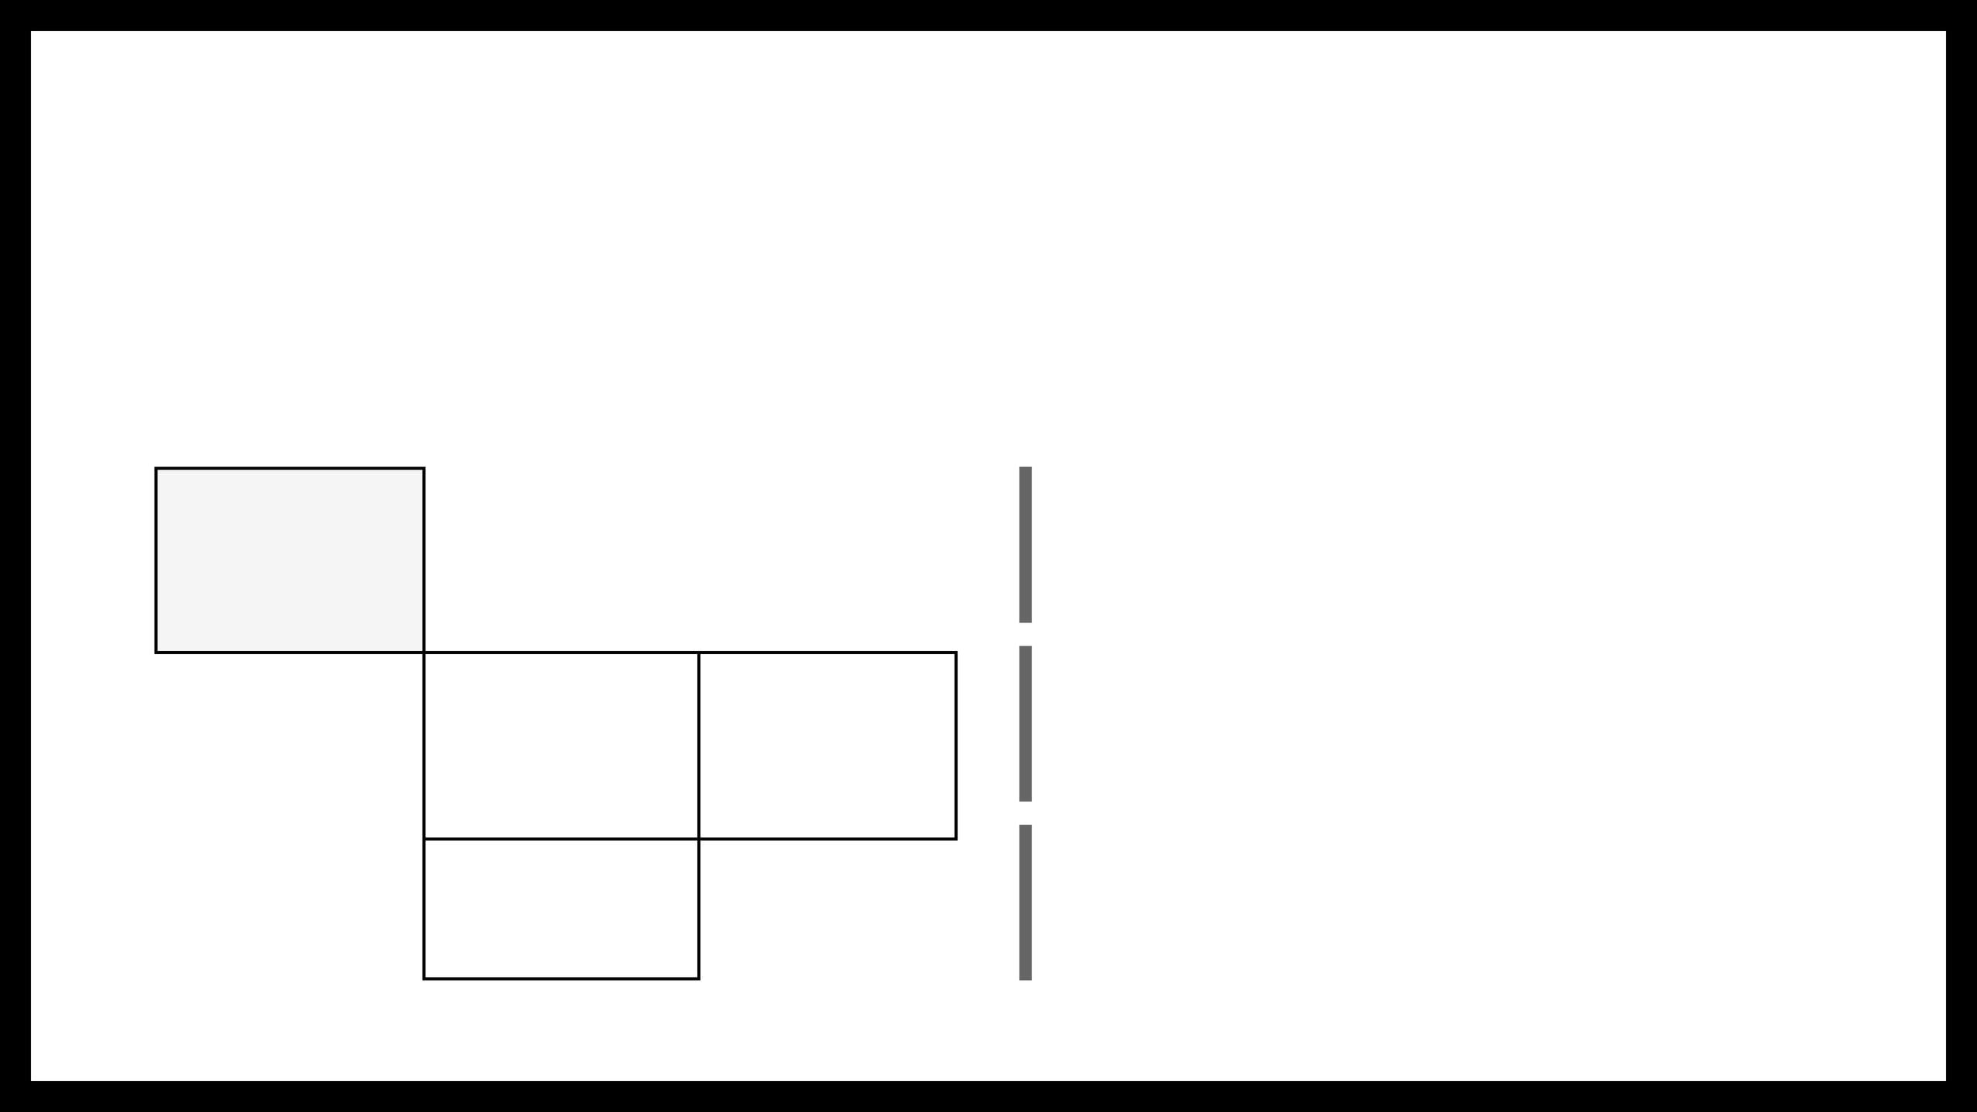
STRATEGIC ENGAGEMENT WITH MPEG STANDARDS
HUMAN VIEWING
MACHINE VISION
PATENT STRATEGY
Filing patents immediately for dual-layer SVC and machine feature coding.
STANDARDS BASED
H.264, H.265, AV1
MPEG VCM (2027)
STANDARD CONTRIBUTION
Engaging with the MPEG VCM working group to secure essential IP status.
PROPRIETARY
Deep Render
SENTINEL
MARKET POSITIONING
Building a proprietary moat before standardization completes to license back into the industry.
STRATEGY_REF: STANDARDS_ENGAGEMENT_V1

Slide 9

DEEP TECH LEADERSHIP AND INDUSTRY EXPERTISE
PREETAM MUKHERJEE
SOUMYAJIT MANDAL
CO-FOUNDER & CEO
CO-FOUNDER & CTO
Scaled a SaaS video platform from initial product to revenue generation.
Holds a PhD from MIT with a focus on signal processing and information theory.
Conducted research at UC Berkeley on novel video representations.
Developed real-time sensor networks and edge systems at Brookhaven National Laboratory.
Possesses deep understanding of video economics and industrial deployment constraints.
Expert in codec optimization for Jetson hardware and MPEG standards engagement.
TEAM_CAPABILITY: HYBRID EXPERTISE IN VIDEO RESEARCH AND EDGE OPERATIONS

Slide 10

CAPITAL ALLOCATION FOR 18-MONTH RUNWAY
USE OF FUNDS ($2.0M)
KEY MILESTONES
CATEGORY
ALLOCATION
M3
Secure 5 design partner LOIs.
Codec Engineering
40% ($800K)
M9
File 3 provisional patents for dual-layer SVC.
Patents & Standards
25% ($500K)
M12
Deploy 5 gateways to design partners.
Hardware Deployment
20% ($400K)
M18
Transition to paid customers and active MPEG engagement.
GTM & Channel Partners
15% ($300K)
FINANCIAL_PLAN_ID: SEED_ALLOCATION_2026_V1

Slide 11

INVESTMENT OPPORTUNITY AND STRATEGIC EXIT
ACQUIRER CATEGORY
STRATEGIC RATIONALE
SEED ROUND ASK
$2,000,000
Integration of machine-vision codecs into next-generation hardware.
Camera OEMs
VALUATION RANGE
$8M to $10M Pre-money
Chip Manufacturers
Acquisition of learned codec IP for ISP and encoder silicon.
Satcom Providers
Bundling bandwidth efficiency with existing satellite services.
TARGET INVESTORS
Deep Tech & Industrial Funds
Patent Aggregators
Strategic acquisition of essential codec IP portfolios.
PRECEDENT: InterDigital acquired Technicolor video patents for $150M in 2019.
FINANCIAL_STRATEGY: EXIT_VIA_IP_LICENSING_OR_ACQUISITION

Slide 12
DEFINING THE MACHINE VISION STANDARD
Machines analyze 95 percent of video today using codecs designed for human eyes.
JOIN THE VISION
Remote industrial sites pay for bandwidth they do not require for analytical accuracy.
CONTACT
Sentinel is building the essential IP portfolio for the next generation of machine vision.
Preetam Mukherjee
Soumyajit Mandal
RESOURCES
Our team combines deep technical research with practical edge deployment expertise.
sentinel.ai
linkedin.com/company/sentinel
SENTINEL_PITCH_DECK_2026 // END_OF_TRANSMISSION

