Slide 1

Multiple Object Recognition using Machine/Deep Learning Models
in Autonomous Vehicles
Midterm Check
Dataset: BDD100K
Platform: Raspberry Pi 5 + Hailo NPU
Ma Haoyi | Supervisor: Prof. Bharadwaj Veeravalli

Slide 2
Agenda
1. Background & Goal
2. Dataset & Metrics
3. Method & Experimental Design
4. Results & Analysis
5. On-device Deployment & Demo
6. Interim Conclusions & Next Steps
7. Q&A
On-Device Object Detection for Autonomous Driving

Slide 3
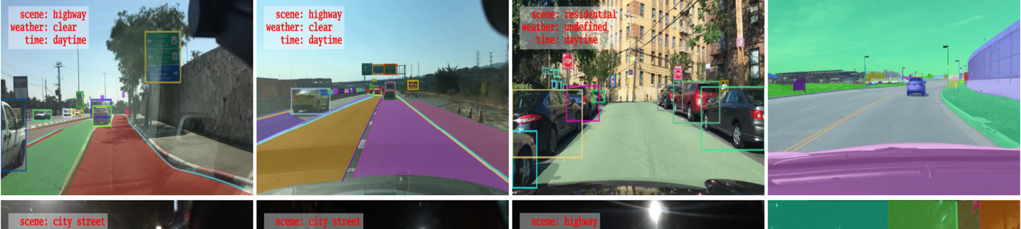
Problem & Motivation
Real-time multi-object detection under edge constraints
Safety-critical perception
Diverse driving conditions
Edge limitations
Detect road objects reliably
Support ADAS / autonomy
Day / night / weather variation
Occlusion & long-tail objects (train/traffic sign)
Low latency on-device
Limited compute & power
Goal: accuracy + real-time deployability on embedded hardware.
Ref: BDD100K overview & examples (BAIR blog, 2018).

Slide 4
Objectives & Deliverables
What we aim to achieve by the end of FYP
Implement & fine-tune detectors
Compare methods
Use driving-scene labels
Train multiple detector families
One-stage CNN vs transformer-based vs ML method
Trade-offs: accuracy vs speed
Evaluate performance
Deploy a working pipeline
Accuracy: mAP / Precision / Recall
Efficiency: FPS / latency / model size
Camera → inference → visualization
Embedded runtime constraints
Ref: DETR (Carion et al., ECCV 2020) for transformer-based detectors.

Slide 5
Target Platforms
Baseline CPU vs accelerated NPU deployment
Baseline: Raspberry Pi 5 (CPU)
Accelerated: Pi 5 + Hailo (NPU)
CPU-only baseline (no accelerator)
Used to understand bottlenecks & minimum FPS
Real-time may be challenging at 1080p
Primary target for real-time inference
Accelerator via PCIe (AI HAT+/AI Kit)
Quantized deployment (e.g., INT8) for speed
Stereo Camera(video input)
Raspberry Pi 5(CPU)
Hailo NPU
Display
Refs: Raspberry Pi AI HAT+ docs / product brief (Raspberry Pi Ltd.).

Slide 6
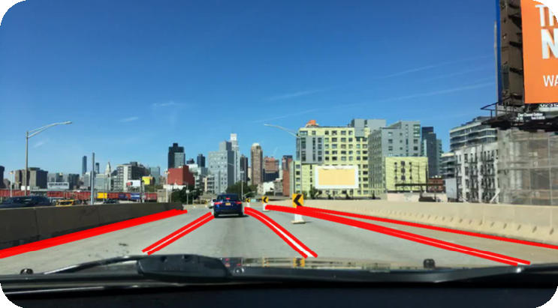
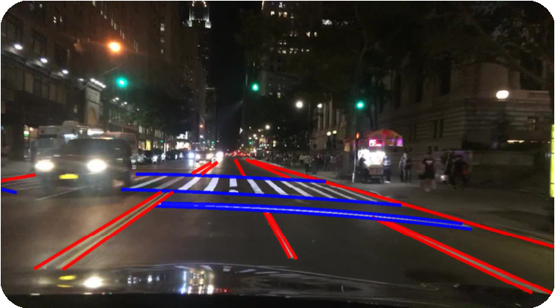
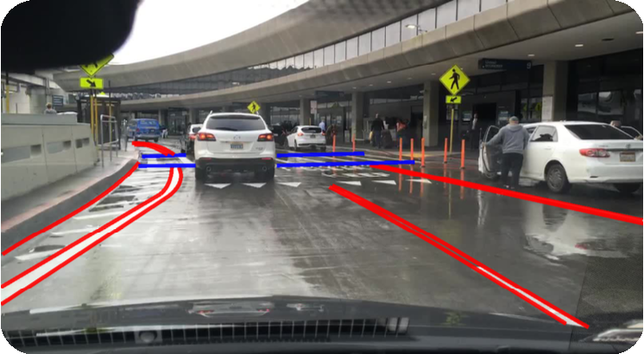
Dataset Strategy
Fine-tuning from official pretrained checkpoints on driving-domain data
Step 1 — Initialize from pretrained checkpoints
BDD100K at a glance
Use official weights (already pretrained by model authors)
Focus on domain adaptation rather than pretraining from scratch
100K driving videos (~40s, 720p, 30fps)
Annotated keyframes for detection + multi-task labels
Step 2 — Fine-tune & evaluate on BDD100K
Driving scenes with diverse conditions
Use standard detection metrics for comparison
Train 70000 / Val 10000
Day
Night
Rain
Why it fits our project
Contains day/night and adverse conditions
Matches embedded, real-world driving deployment scenarios
Images: BDD100K examples from BAIR blog (Yu, 2018).

Slide 7
Evaluation Metrics
How we measure accuracy and real-time deployability
Accuracy (offline/on-device)
Efficiency (on-device)
mAP@0.5 and mAP@[0.5:0.95] (COCO-style)
Precision / Recall / F1-score
Per-class AP for analysis
FPS and per-frame latency (ms)
Model size & memory footprint
Quantization impact (FP → INT8)
Thermal / power constraints
Latency (ms) ≈ 1000 / FPS
mAP@[0.5:0.95] averages IoU thresholds 0.50→0.95 (step 0.05)
Ref: COCO-style evaluation protocol widely used for object detection.

Slide 8
Background Literature: Detector Families for Driving Scenes
A compact view of the methods that motivate our model selection and edge deployment study.
One-stage CNN
Mobile-first
Transformer
YOLO family
PP-PicoDet
DETR family
• Strong real-time baseline with
mature tooling, but typically
relies on NMS.
• Designed for low-latency and small
models on ARM CPU—
our efficiency-first baseline.
• End-to-end set prediction without
NMS, offering global reasoning and
a clean pipeline.
Key milestones (representative works)
2020
2020
2021
2021
2024
YOLOv4 (CNN real-time)
DETR (set prediction)
Deformable DETR
PP-PicoDet (mobile)
RT-DETR (real-time)
Refs: Yu et al., BDD100K (CVPR 2020); Bochkovskiy et al., YOLOv4 (arXiv 2020); Carion et al., DETR (ECCV 2020); Zhu et al., Deformable DETR (ICLR 2021); Yu et al., PP-PicoDet (arXiv 2021); Zhao et al., RT-DETR (CVPR 2024).
1/3

Slide 9
YOLO Family: Efficient One-stage CNN Detectors
Why YOLO-style models remain the standard baseline for real-time deployment.
Typical pipeline
Why YOLO for real-time?
Key ideas (representative)
Input
Backbone
Neck
Head
NMS
• Unified one-stage design → fewer stages and higher FPS than two-stage detectors
• Training “bag of freebies” + architectural modules (e.g., CSP, PAN) improve accuracy at constant cost
• Open-source implementations provide scalable model sizes and robust exporters (ONNX/TFLite, etc.)
• In practice, projects often fine-tune from public checkpoints (commonly COCO-pretrained) rather than training from scratch
• Dense predictions at multiple feature scales
• Backbone/neck designs target a speed–accuracy sweet spot
• NMS resolves duplicate detections (bottleneck for some edge pipelines)
Takeaway: YOLO remains the most practical starting point for embedded real-time detection.
Refs: Bochkovskiy et al., YOLOv4 (arXiv 2020); Ultralytics YOLOv5/YOLOv8 documentation (model scaling & pretrained checkpoints).
2/3

Slide 10
PP-PicoDet & RT-DETR: Two Alternative Directions
Mobile-first CNN design vs. end-to-end Transformer detection.
PP-PicoDet (Mobile)
RT-DETR family (Transformer)
Design for mobile CPU latency
End-to-end set prediction
• Anchor-free strategy to reduce overhead and simplify tuning
• Light backbone (ESNet) + lightweight CSP-PAN neck
• Improved label assignment & loss design for stable training
• Strong speed–accuracy trade-off on ARM CPUs
• Uses object queries + bipartite matching → no NMS required
• Original DETR: strong concept, but slow convergence and heavy compute
• Deformable DETR: sparse attention improves convergence & small-object performance
• RT-DETR: aims for real-time speed while keeping end-to-end detection
Why we care: establishes a CPU-only baseline for embedded perception.
Why we care: compares CNN vs Transformer behavior on driving-domain data and edge constraints.
Refs: Yu et al., PP-PicoDet (arXiv 2021); Carion et al., DETR (ECCV 2020); Zhu et al., Deformable DETR (ICLR 2021); Zhao et al., RT-DETR (CVPR 2024).
3/3

Slide 11
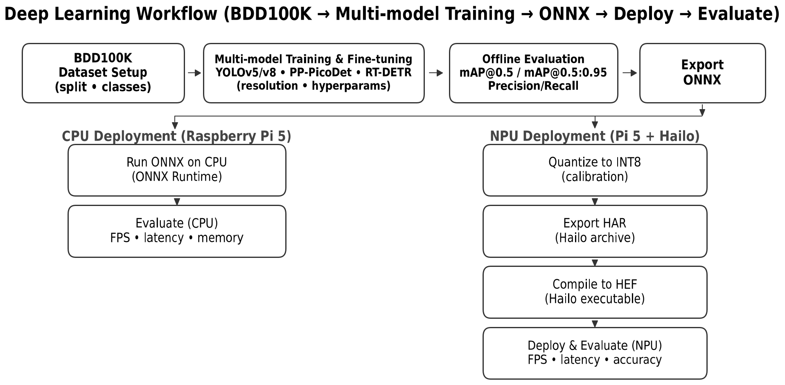
Deep Learning Workflow
BDD100K - Multi-model Training - ONNX - Deploy - Evaluate
3/3

Slide 12
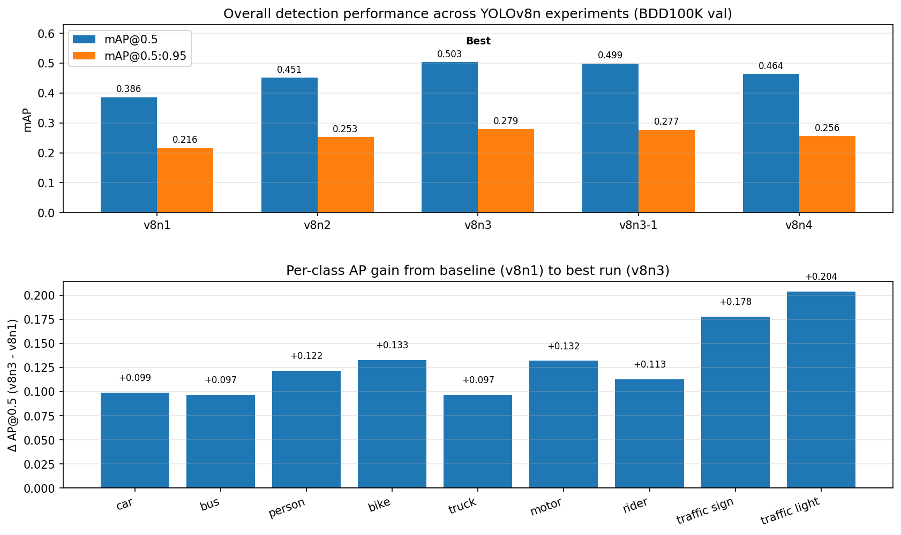
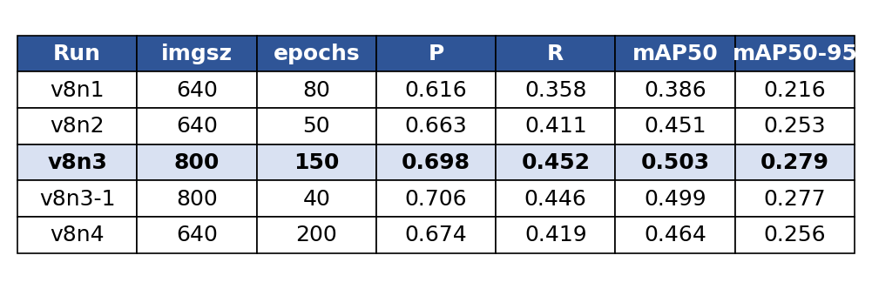
YOLOv8n Training Summary (BDD100K)
Experiments v8n1 → v8n4 | Validation set: 10,000 images | 10 classes
Key metrics (best row highlighted)
Takeaways
Best accuracy: v8n3 (imgsz=800) → mAP@0.5 = 0.503 (+0.117 vs v8n1).
Refinement (v8n3-1): Precision ↑ but mAP did not improve (slightly lower).
640-long training (v8n4) is stable but has lower ceiling for small objects.
Train class AP is nearly 0 due to extreme long-tail (15 instances in val).
Use higher LR to adapt quickly, then lower LR and tune augmentation to keep recall.

Slide 13
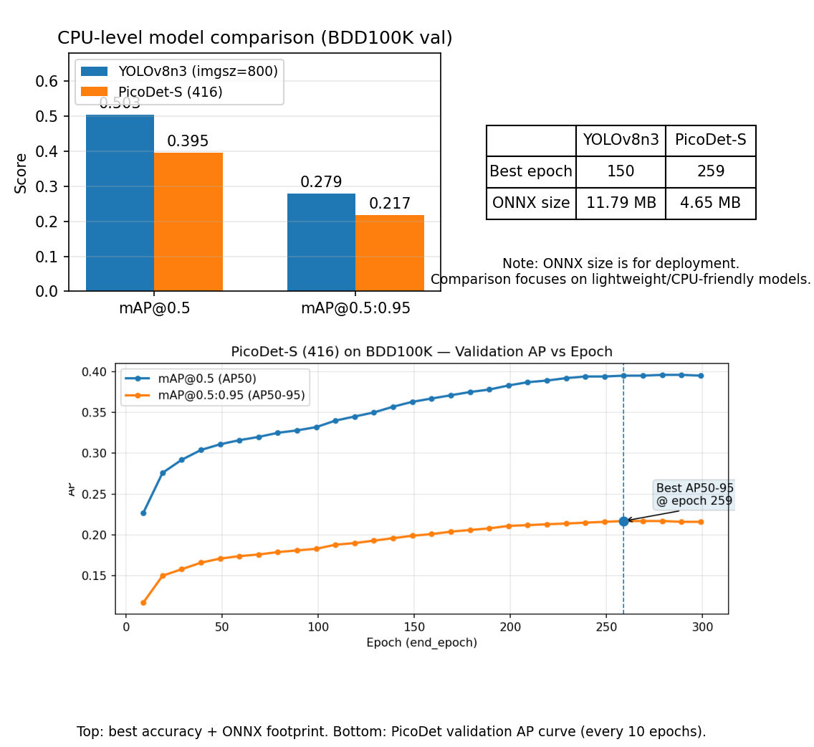
Picodet-s Training Summary (BDD100K)
Experiments picodet-s | Validation set: 10,000 images | 10 classes
Takeaways
Best AP50:95 = 0.217 @ epoch 260 (416×416), AP50 = 0.395; performance plateaus after ~200 epochs.
Strong scale gap: AP_small ≈ 0.049 vs AP_large ≈ 0.500, indicating 416 resolution bottlenecks small objects on BDD100K.
Training is stable with regular eval every 10 epochs; late-stage gains are marginal, suggesting diminishing returns without resolution/architecture changes.
Successfully exported Paddle inference model + ONNX (picodet_416.onnx) for deployment.
Size–accuracy tradeoff (CPU models): PicoDet-S is ~39% of YOLOv8n3’s ONNX size (4.65MB vs 11.79MB) while reaching ~78% of its accuracy (mAP50-95: 0.217 vs 0.279; similarly mAP50: 0.395 vs 0.503 → ~79%).

Slide 14
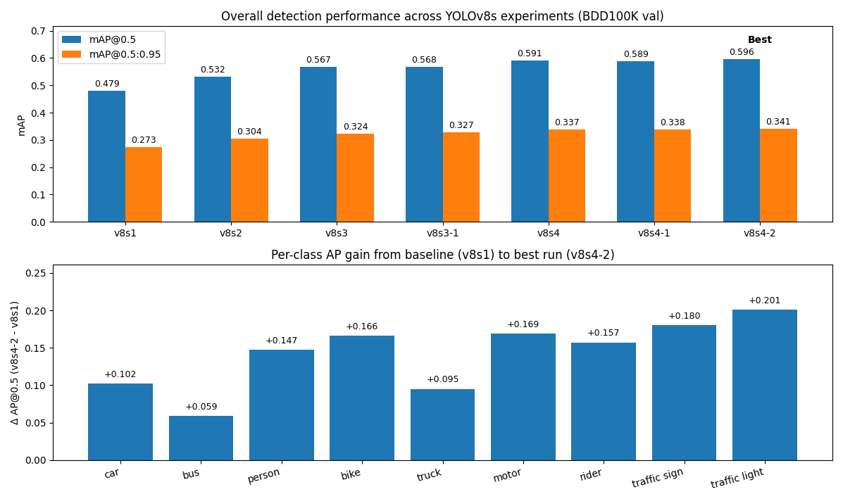
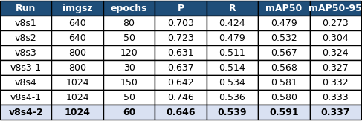
YOLOv8s Training Summary (BDD100K)
Experiments v8s1 → v8s4-2 | Validation set: 10,000 images | 10 classes
Key metrics (best row highlighted)
Takeaways
Best accuracy: v8s4-2 (imgsz=1024) → mAP@0.5 = 0.596 (+0.117 vs v8s1).
Resolution helps: 640 → 800 → 1024 generally improves mAP, indicating small-object sensitivity.
Long training at 640: stable curves but lower ceiling vs higher-resolution training.
Closing Mosaic and using conservative SGD stabilized localization and slightly improved mAP@0.5:0.95.

Slide 15
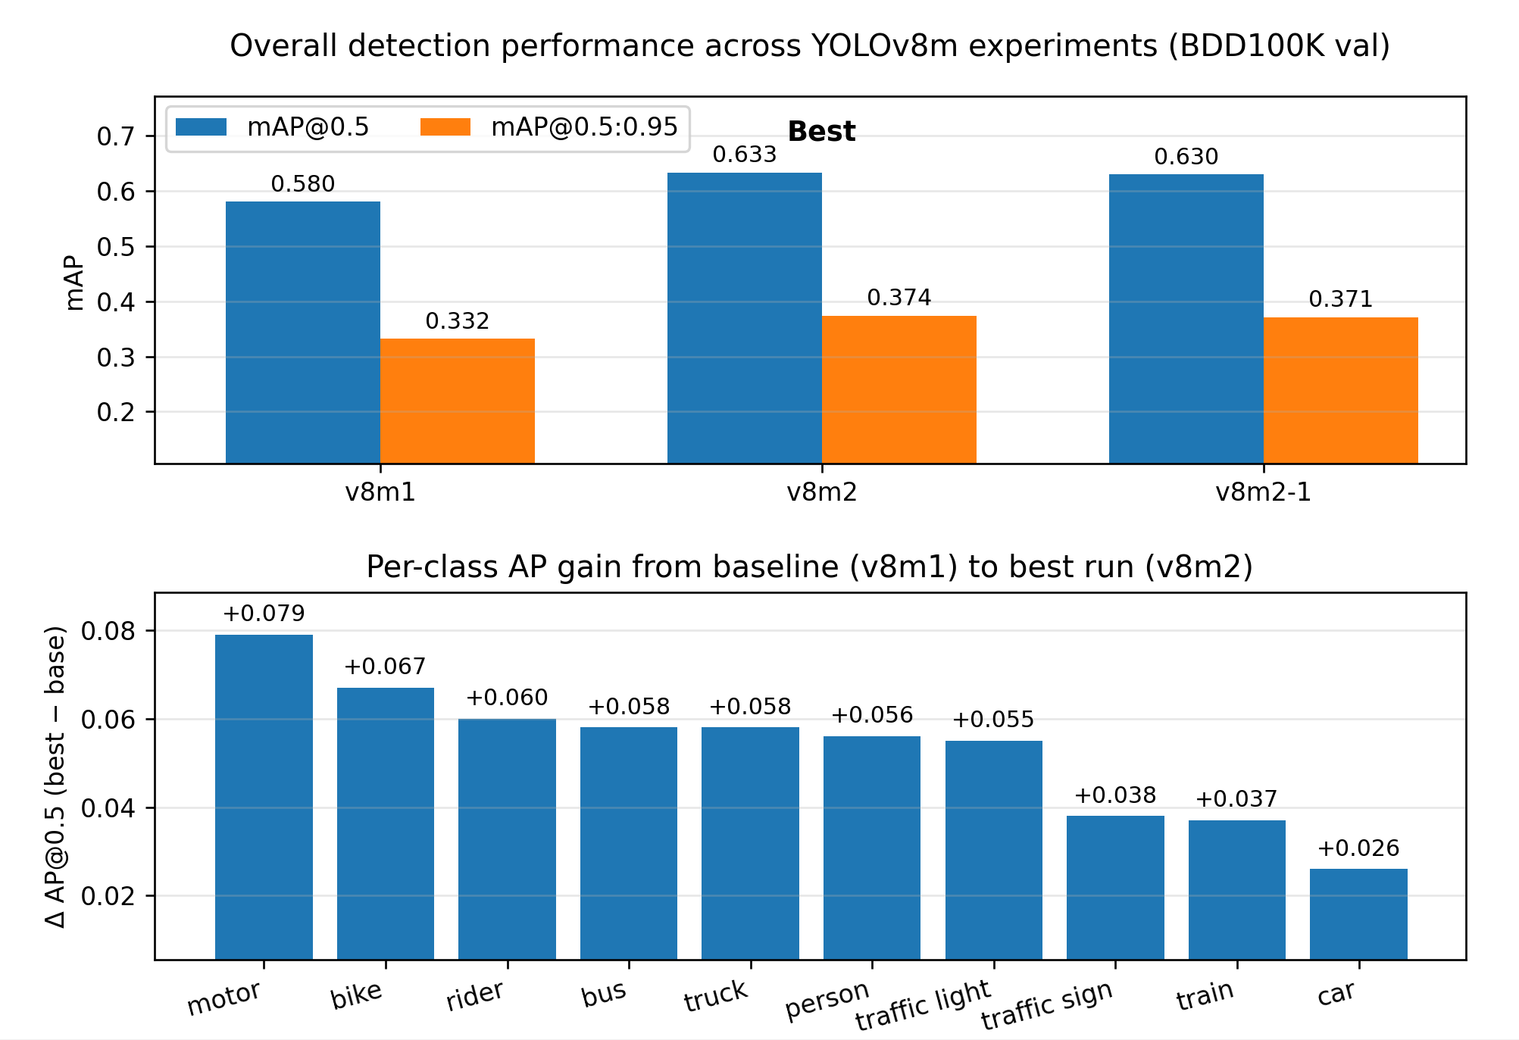
YOLOv8m Training Summary (BDD100K)
Experiments v8m1 → v8m2-1 | Validation set: 10,000 images | 10 classes
Takeaways
Best accuracy: v8m2 (imgsz=1280) → mAP@0.5 = 0.633 (+0.053 vs v8m1); mAP@0.5:0.95 = 0.374 (+0.042).
Resolution helps: 640 → 1280 noticeably lifts Recall and overall mAP, consistent with better small/medium-object sensitivity.
Biggest per-class gains (v8m1 → v8m2): motor +0.079, bike +0.067, rider +0.060, bus/truck +0.058, person +0.056 (AP@0.5).
Refinement run: v8m2-1 (continued from v8m2) → mAP plateaus/slightly drops (0.630 vs 0.633) and Precision drops (0.769 → 0.673).
Train class AP remains unreliable/low: caused by extreme long-tail (~15 val instances), not by epochs.

Slide 16
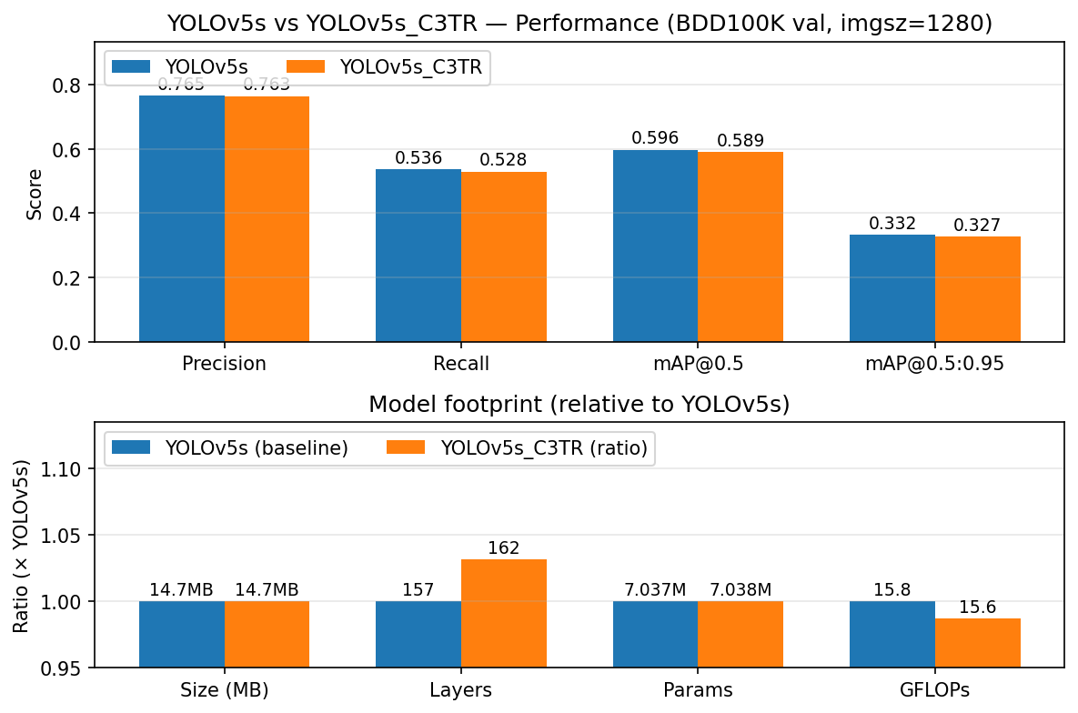
YOLOv5s Training Summary (BDD100K)
Experiments v5s v5s_cstr | Validation set: 10,000 images | 10 classes
Takeaways
Accuracy: YOLOv5s_C3TR is very close to YOLOv5s on the same dataset/resolution; improvements are marginal.
P–R balance: C3TR may slightly shift Precision/Recall, but mAP@0.5 and mAP@0.5:0.95 stay similar, so net gain is limited.
Footprint: Same size (~14.7 MB) and nearly same params (~7.04M); C3TR adds a few layers (157 → 162).
Compute: GFLOPs are effectively unchanged (15.8 → 15.6), so inference cost stays stable.
Takeaway: C3TR is a safe drop-in, but not a big accuracy lever—tuning resolution/data/training is likely more impactful.

Slide 17
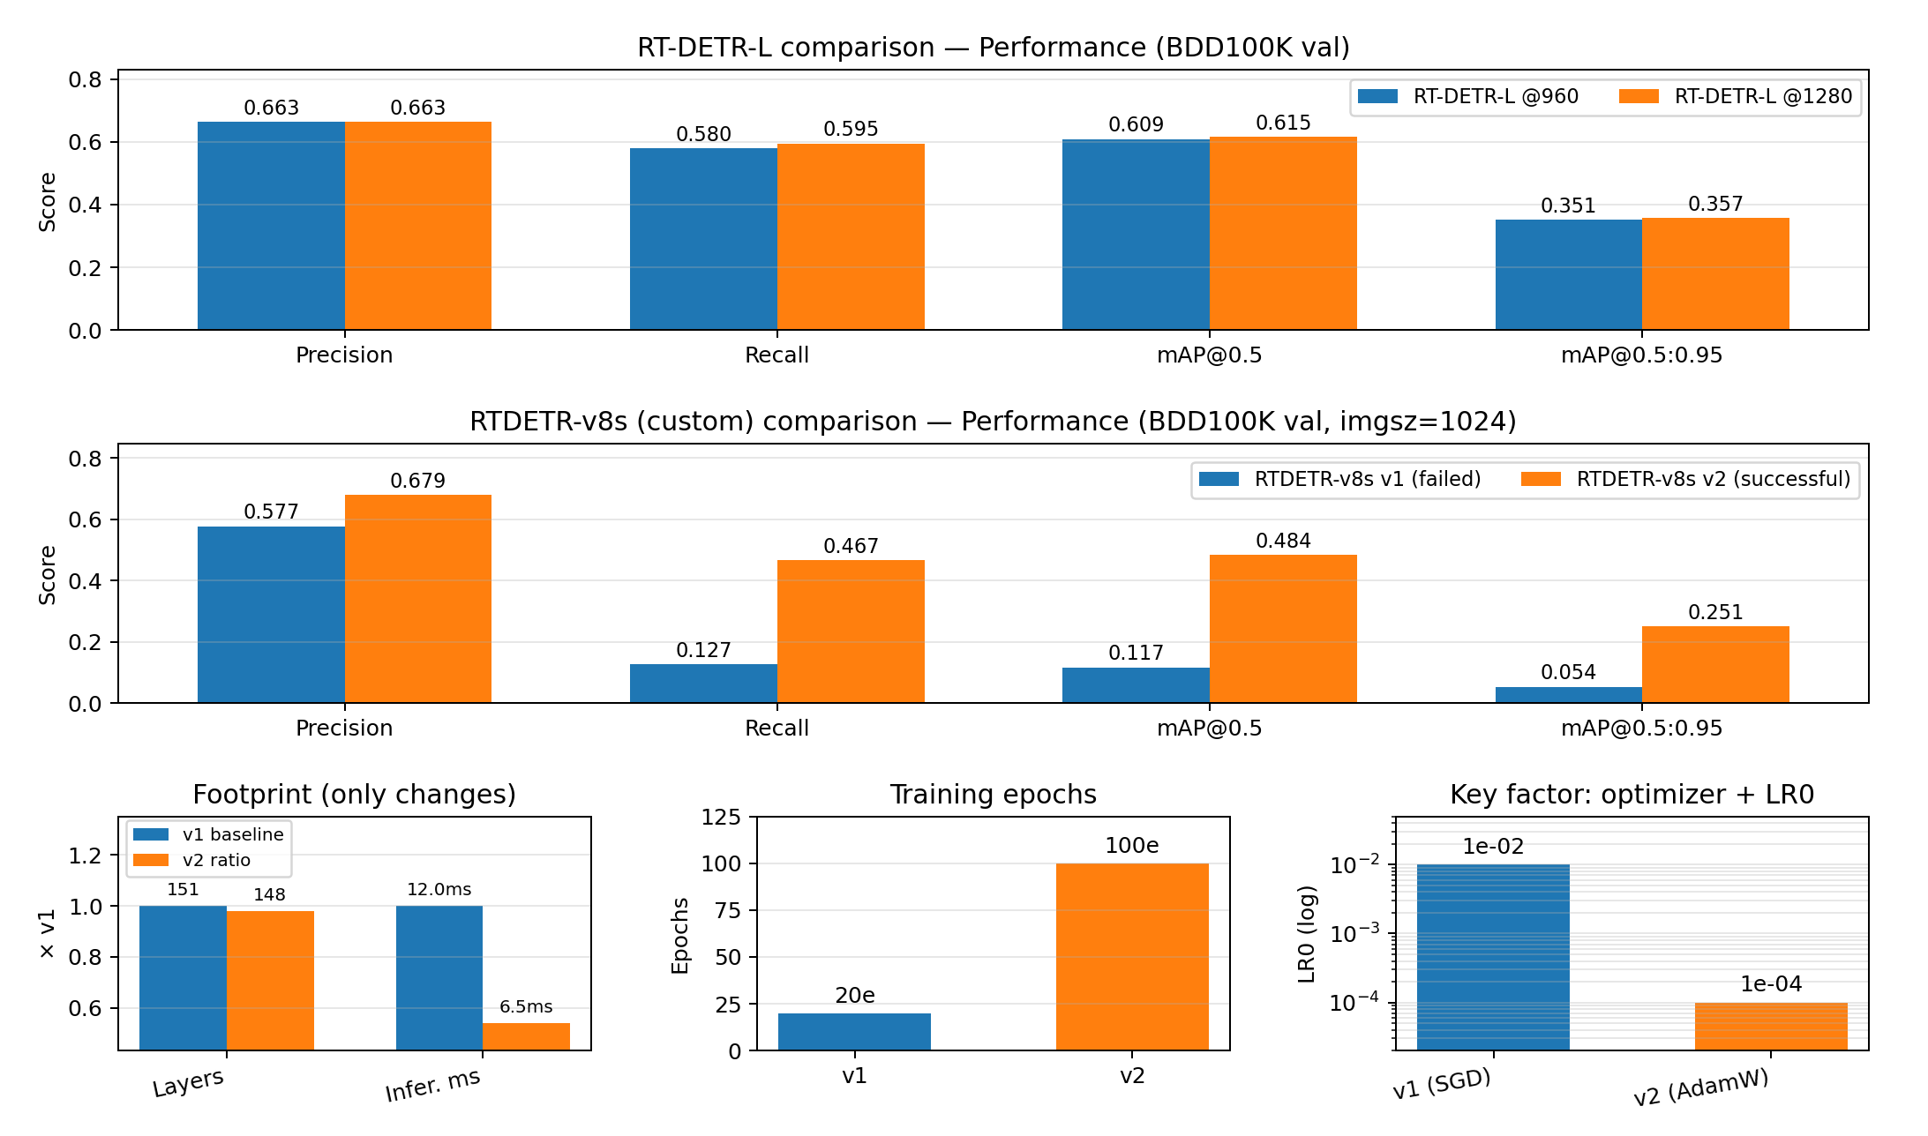
RT-DETR Training Summary (BDD100K)
Experiments rt-detr_l rt-detr_v8s | Validation set: 10,000 images | 10 classes
Takeaways
A) RT-DETR-L: 960 vs 1280
1280 > 960 in mAP, mainly from higher Recall (better small-object coverage).
Latency increases at 1280 due to larger input, while params/compute stay similar.
Train AP stays ~0 from extreme long-tail (≈15 val instances), not epochs.
B) RTDETR-v8s (custom): v1 vs v2
v1 failed: early stop (~20e) + mismatched recipe → Recall collapse.
v2 converged: AdamW + much lower LR + ~100e → large mAP/Recall jump at v8s-scale.
C3TR makes optimization more sensitive; SGD can be unstable. AdamW’s adaptive updates and decoupled weight decay improve stability, so training converges.

Slide 18
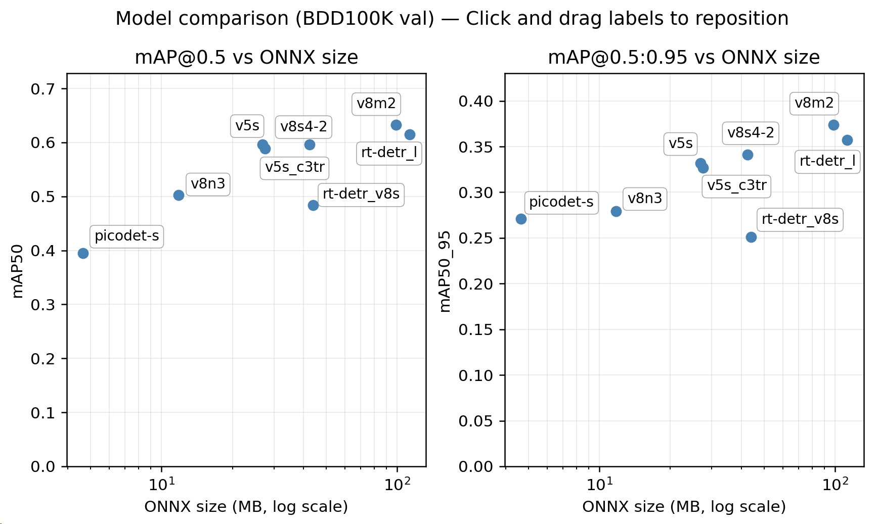
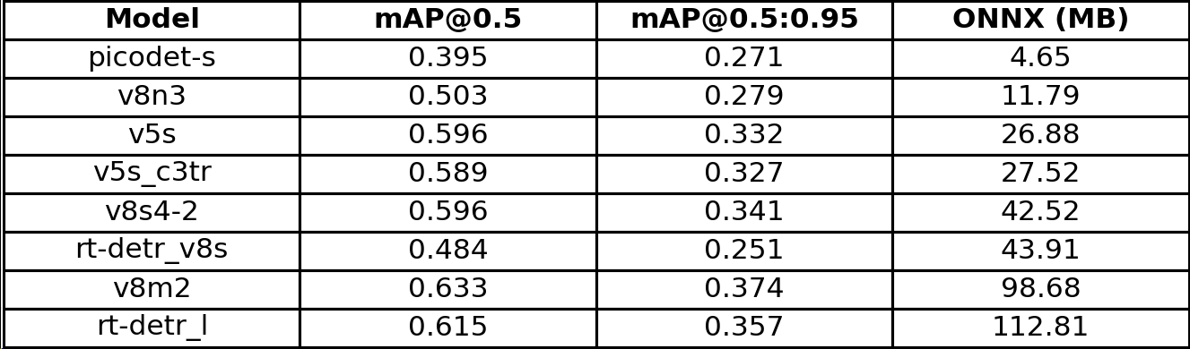
Model Comparison — Accuracy vs Efficiency (BDD100K val)
Experiments all models trained | Validation set: 10,000 images | 10 classes
Takeaways
Best accuracy: v8m2 achieves the highest mAP (0.633 / 0.374) but with a large ONNX (98.68MB).
Best “balanced” YOLO: v8s4-2 reaches 0.596 / 0.341 at 42.52MB, offering strong generalization without going to v8m-scale.
Small/CPU tier: PicoDet-S (4.65MB) delivers ~78% of v8n3’s mAP@0.5 (0.395 vs 0.503) at ~39% of the ONNX size, but has a lower ceiling for peak accuracy.
C3TR impact is marginal: v5s_c3tr is slightly worse than v5s while being similar in size → not a clear win in this setup.
Transformer tradeoff: RT-DETR v8s is larger than v8s4-2 but less accurate (0.484 / 0.251), while RT-DETR-L becomes competitive (0.615 / 0.357) at a heavy footprint (112.81MB).

Slide 19
Remaining / Future Work (Training Focus)
Goal: strengthen Transformer baselines vs YOLO and build a classical HOG+SVM reference for edge deployment.
A) Transformer Detectors (YOLO-level benchmark)
B) Classical Baseline (HOG + Linear SVM)
Establish strong baselines: RT-DETR / Deformable DETR-style models; match YOLO input sizes (640/800/1024).
Convergence-focused tuning: LR schedule, warmup, EMA, weight decay; check for under-training vs instability.
Small-object improvement: multi-scale training + higher resolution; analyze per-class AP for traffic signs/lights.
Efficiency path: export ONNX, run-time profiling, and apply pruning/quantization where supported (edge targets).
Build a lightweight reference for CPU-only inference (e.g., person/vehicle subsets).
Pipeline: HOG feature extraction → linear SVM → sliding window + image pyramid + NMS.
Training strategy: hard-negative mining; calibrate decision threshold for precision/recall trade-offs.
Evaluation: same BDD100K val protocol; report mAP/recall and latency on Raspberry Pi CPU.
Deliverable: classical vs deep learning comparison to justify model choice for edge deployment.

Slide 20
Deployment (On-device): CPU vs NPU
What makes deployment hard: compiling, quantization, and pipeline consistency
Targets
• Platform: Raspberry Pi 5 (baseline CPU) + Hailo-8 (primary NPU path)
• Detectors: YOLOv5 / YOLOv8n,s,m/ PicoDet_s / DETR-family
• Acceptance: stable boxes + correct classes + usable FPS on-device
Deployment difficulty ladder (our experience)
Easiest → Hardest
YOLOv5s: NPU path most straightforward (postprocess/NMS is key)
YOLOv8n,s,m: more sensitive to INT8 calibration & export details
PicoDet_s: ecosystem + postprocess differences (conversion friction)
DETR-series: transformer blocks stress compile/quantization; CPU often too slow
Driving scenes (BDD100K examples)
Key lesson
“Compiles” ≠ “works correctly”.
We validate in layers:
1) CPU correctness → 2) NPU compile/run → 3) INT8 stability → 4) FPS.
Images: BDD100K examples (BAIR blog, 2018). Refs: Raspberry Pi AI HAT+ docs; HailoRT; Ultralytics; PicoDet; DETR.
Notes:
[Sources] - BDD100K BAIR blog (images/examples): https://bair.berkeley.edu/blog/2018/05/30/bdd/ - Raspberry Pi AI HAT+ documentation: https://www.raspberrypi.com/documentation/accessories/ai-hat-plus.html - HailoRT repository (runtime/CLI): https://github.com/hailo-ai/hailort - Ultralytics YOLOv5 repo: https://github.com/ultralytics/yolov5 - Ultralytics YOLOv8 docs: https://docs.ultralytics.com/models/yolov8/ - PP-PicoDet paper (arXiv): https://arxiv.org/abs/2111.00902 - DETR paper (ECCV 2020 PDF): https://www.ecva.net/papers/eccv_2020/papers_ECCV/papers/123460205.pdf

Slide 21
End-to-end pipeline
Windows/WSL build chain + Raspberry Pi runtime; CPU baseline for correctness
Windows (Dev)
WSL (DFC build)
Raspberry Pi 5
Export ONNX
Prepare calib images
scp/ssh to Pi
Parse: ONNX→HAR
Optimize: INT8 calib
Compile: HAR→HEF
HailoRT loads HEF
Camera→infer→visualize
Measure FPS/latency
Why we keep a CPU path
Why NPU is the focus
Correctness baseline: verify preprocess + decode + NMS on the same frames
Debug tool: if CPU is correct but NPU is wrong → suspect INT8 / input scale / output vstreams
Fallback demo: when a model is not yet NPU-stable (e.g., DETR-series)
Real-time target on embedded hardware requires acceleration
Hailo-8L runs compiled HEF (often INT8) for high throughput
Key engineering work: compiler constraints + quantization stability + postprocess
Refs: Raspberry Pi AI Kit/HAT+ software docs; HailoRT runtime; Hailo model zoo optimization pipeline.
Notes:
[Sources] - Raspberry Pi AI Kit & AI HAT+ software guide: https://www.raspberrypi.com/documentation/computers/ai.html - Raspberry Pi AI HAT+ documentation: https://www.raspberrypi.com/documentation/accessories/ai-hat-plus.html - HailoRT repository (runtime/CLI): https://github.com/hailo-ai/hailort - Hailo Model Zoo optimization stage (pipeline concepts): https://github.com/hailo-ai/hailo_model_zoo/blob/master/docs/OPTIMIZATION.rst

Slide 22
$YOLOv5s$ on NPU: stable path, but postprocess matters
Typical issues: wrong output decoding / missing NMS → “no boxes” or “too many boxes”
What went wrong (YOLOv5s)
• No boxes: wrong output tensor/vstream selected or decode
shape mismatch
• Many duplicate boxes: running raw outputs without NMS (no-
NMS HEF)
• Threshold mismatch: conf/IoU tuned for FP path but not for INT8
output scale
Raw (no NMS)
After NMS
Fix (our approach)
• Layered validation: hailortcli run → image inference → camera
stream
• Make postprocess explicit: decode + NMS (conf/IoU/topK as
parameters)
• Use CPU baseline on the same frame to verify decode/NMS logic
Takeaway (YOLOv5s)
NPU path is reliable once decode + NMS are correct.
Most “bad results” were pipeline bugs, not the model itself.
Images: BDD100K examples (BAIR blog, 2018). Refs: Ultralytics YOLOv5; Hailo community guide on parsing YOLO models.
Notes:
[Sources] - Ultralytics YOLOv5 repository: https://github.com/ultralytics/yolov5 - Hailo community: parsing YOLOv5/YOLOv8 with DFC: https://community.hailo.ai/t/parsing-yolo-models-with-the-hailo-dataflow-compiler-tool/2384 - BDD100K BAIR blog (scene image): https://bair.berkeley.edu/blog/2018/05/30/bdd/ - HailoRT repository (runtime/CLI): https://github.com/hailo-ai/hailort

Slide 23
$YOLOv8s/m$: INT8 sensitivity & export details
CPU baseline helps isolate: preprocess/scale vs quantization instability
What was different vs YOLOv5
• INT8 calibration more sensitive: unstable boxes if calib-set or
input scale mismatches
• Export details matter: static shape + correct input name/layout
to help parser
• Engineering gotchas: wrong HEF path/version → “looks like
model changed” but actually didn’t
INT8 unstable (symptom)
After calib/export fix
Fix (our checklist)
Takeaway (YOLOv8)
• Lock preprocess: resize/letterbox + RGB/BGR + normalization +
NCHW consistently
• Rebuild calib_set with the same preprocessing as runtime
• CPU-vs-NPU A/B on the same frame: if CPU OK but NPU wrong
→ suspect INT8/scale
Most failures looked like “model is broken” but were input/scale/calib mismatches.
Static export + correct calib-set were the highest ROI fixes.
Images: BDD100K examples (BAIR blog, 2018). Refs: Ultralytics YOLOv8 docs; Hailo DFC YOLO parsing guide.
Notes:
[Sources] - Ultralytics YOLOv8 documentation: https://docs.ultralytics.com/models/yolov8/ - Hailo community: parsing YOLOv5/YOLOv8 with DFC: https://community.hailo.ai/t/parsing-yolo-models-with-the-hailo-dataflow-compiler-tool/2384 - BDD100K BAIR blog (scene image): https://bair.berkeley.edu/blog/2018/05/30/bdd/

Slide 24



$PicoDet_s$: lightweight, but “ecosystem friction”
Different heads & postprocess make NPU porting less straightforward than YOLO
What made PicoDet_s harder
Paddle/PicoDet config
model + head definitions
• Originates in Paddle ecosystem → ONNX graphs differ from
PyTorch YOLO exports
• Decode/postprocess is not the YOLO head; higher risk of
mismatched semantics
• Even if it compiles, aligning INT8 output & postprocess can take
longer
Export to ONNX
opset/layout constraints
DFC parse/optimize
operator support + INT8 calib
How we used it effectively
• CPU-first: validate output meaning and postprocess on recorded
frames
• Use as a lightweight CPU baseline or a “conversion difficulty”
case study
• Only invest in NPU once the CPU decode is fully verified
Friction: export + operator mapping
Pi NPU runtime Fail
CAN NOT decode & visualize
Refs: PP-PicoDet paper + PaddleDetection docs (PicoDet).
Notes:
[Sources] - PP-PicoDet paper (arXiv): https://arxiv.org/abs/2111.00902 - PaddleDetection PicoDet README: https://github.com/PaddlePaddle/PaddleDetection/blob/release/2.8.1/configs/picodet/README_en.md

Slide 25
DETR-series: transformer blocks stress NPU compilation
Hardest part: graph structure + quantization stability
Deployment pain points (DETR/RT-DETR)
CNN backbone → feature map
• Transformer components (attention/matmul/layernorm)
complicate parsing & INT8
• Export must be conservative: static shapes; avoid aggressive
simplification
• Even when CPU runs correctly, CPU-only FPS on Pi is often not
real-time
Transformer encoder/decoder (simplified)
Multi-head self-attention (MatMul-heavy)
Often the INT8/compile pain point
Strategy we used
• Treat as “boundary test”: define what fails (parse vs compile vs
INT8 stability)
• Use CPU baseline for correctness; use NPU attempts to map
compiler limits
• Prioritize YOLO for real-time demo; DETR supports the research
narrative
FFN / LayerNorm
Decoder + object queries → set predictions
Refs: DETR paper (Carion et al., ECCV 2020).
Notes:
[Sources] - DETR paper (ECCV 2020 PDF): https://www.ecva.net/papers/eccv_2020/papers_ECCV/papers/123460205.pdf

Slide 26
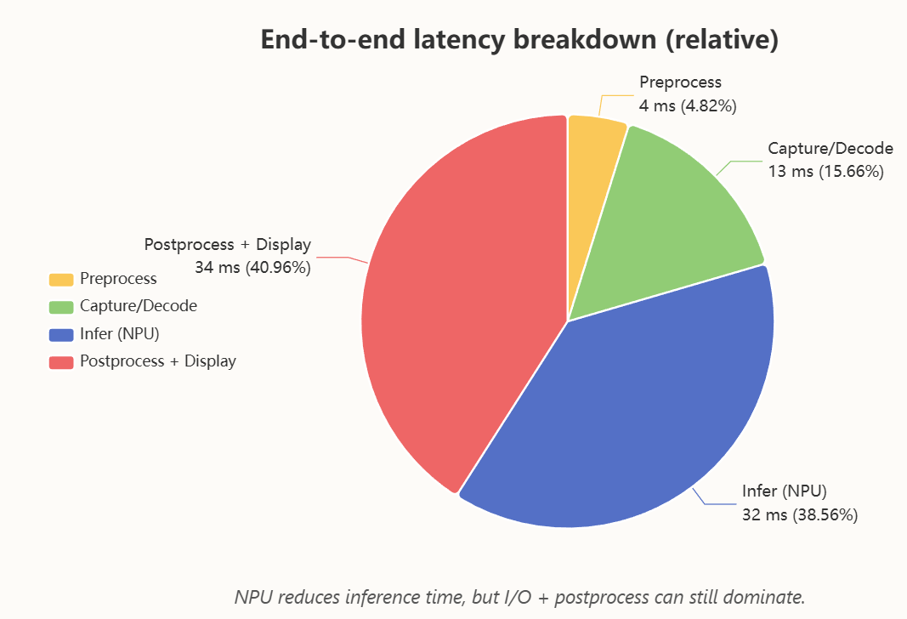
Performance: where FPS is lost (NPU)
Bottleneck is usually end-to-end pipeline, not only the accelerator
How we measure
• CPU baseline: end-to-end (camera → preprocess → CPU infer →
postprocess → display)
• NPU target: same pipeline but infer on Hailo-8 (HEF), typically
INT8
• Report: FPS, per-stage latency, and the impact of buffering /
threading
Optimization moves we used
• Camera buffering & read behavior tuning
(CAP_PROP_BUFFERSIZE: 1 → 2)
• Reduce display overhead
(display every N frames + headless benchmark)
• Stage-level profiling (cap / pre / infer / display) to locate the
bottleneck
Refs: HailoRT CLI (benchmarking), Raspberry Pi AI software docs.
Notes:
[Sources] - HailoRT repository (runtime/CLI): https://github.com/hailo-ai/hailort - Raspberry Pi AI Kit & AI HAT+ software guide: https://www.raspberrypi.com/documentation/computers/ai.html - Hailo community note on hailortcli run & postprocessing needs: https://community.hailo.ai/t/unable-to-access-output-when-using-hailortcli-to-run-the-pre-compiled-fast-depth-model-on-a-rpi5/9756

Slide 27
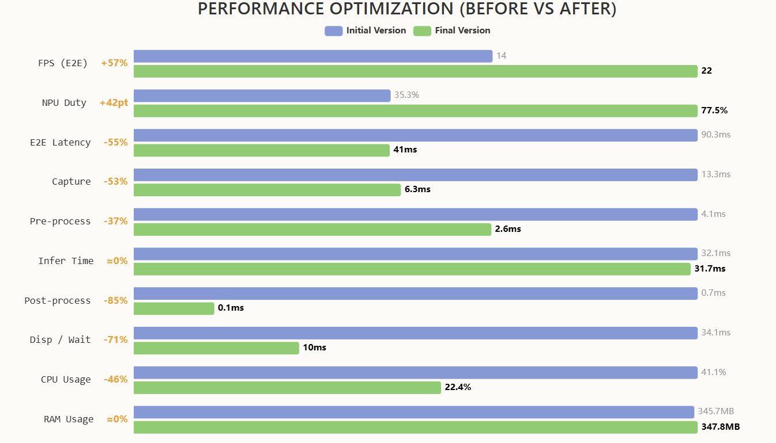
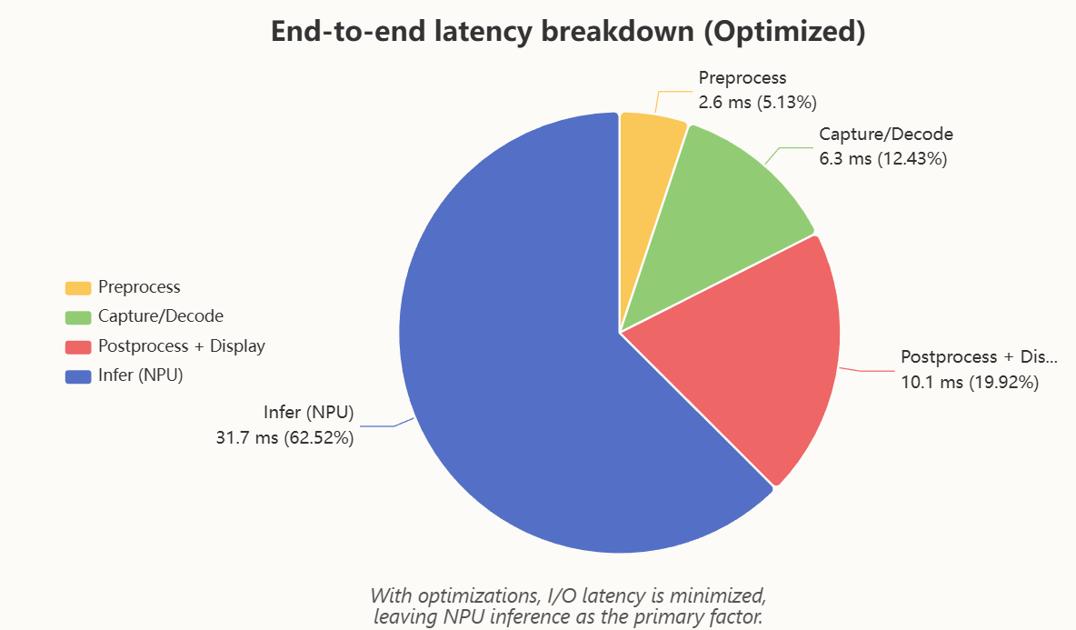
Performance: where FPS is improved (NPU)
Refs: HailoRT CLI (benchmarking), Raspberry Pi AI software docs.
Notes:
[Sources] - HailoRT repository (runtime/CLI): https://github.com/hailo-ai/hailort - Raspberry Pi AI Kit & AI HAT+ software guide: https://www.raspberrypi.com/documentation/computers/ai.html - Hailo community note on hailortcli run & postprocessing needs: https://community.hailo.ai/t/unable-to-access-output-when-using-hailortcli-to-run-the-pre-compiled-fast-depth-model-on-a-rpi5/9756

Slide 28
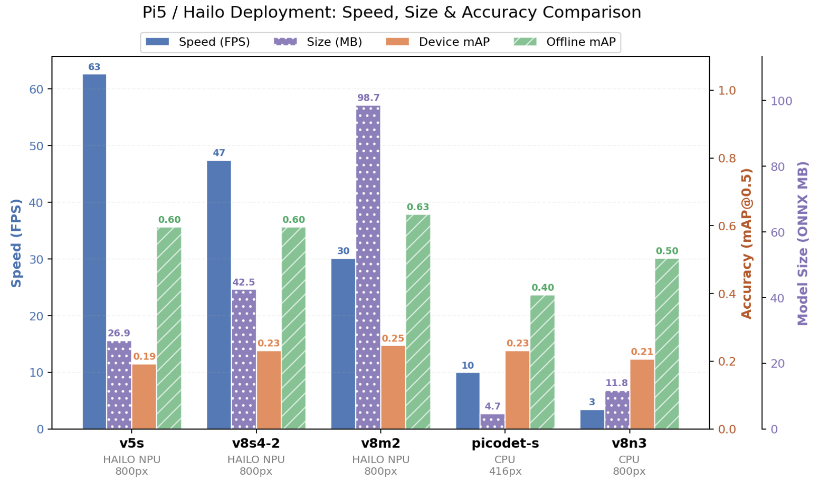
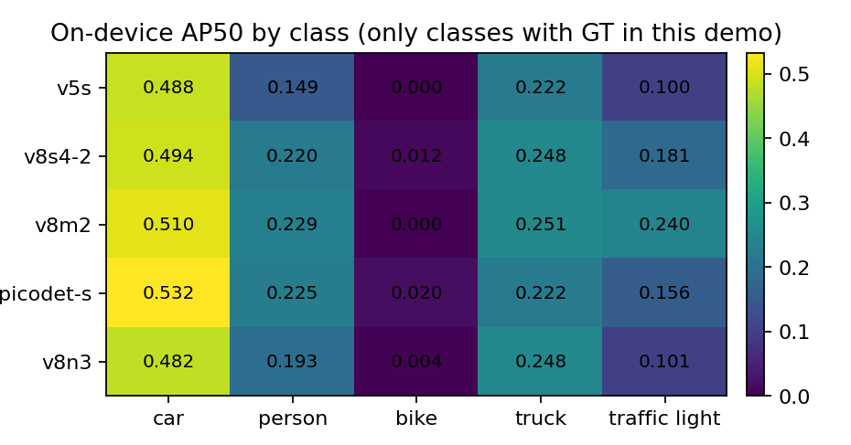
On-device Performance Evaluation on Raspberry Pi 5
Refs: HailoRT CLI (benchmarking), Raspberry Pi AI software docs.
Notes:
[Sources] - HailoRT repository (runtime/CLI): https://github.com/hailo-ai/hailort - Raspberry Pi AI Kit & AI HAT+ software guide: https://www.raspberrypi.com/documentation/computers/ai.html - Hailo community note on hailortcli run & postprocessing needs: https://community.hailo.ai/t/unable-to-access-output-when-using-hailortcli-to-run-the-pre-compiled-fast-depth-model-on-a-rpi5/9756

Slide 29
Deployment SOP & lessons learned
A repeatable checklist across YOLOv5/8, PicoDet_s, and DETR-series
SOP (repeatable steps)
Model-by-model outcome (deployment focus)
1) Export ONNX (static input, correct names/layout)
2) Build calib_set with runtime-identical preprocessing
3) DFC: parse → optimize(INT8) → compile(HEF)
4) Pi: hardware checks → hailortcli sanity run → camera demo
5) Validate: boxes stable + classes correct + FPS/latency measured
Model
CPU role
NPU pain point (typical)
YOLOv5s
Baseline + debug
Decode / NMS alignment (no-NMS HEF)
YOLOv8s
A/B vs NPU
INT8 calib / input scale sensitivity
YOLOv8m
A/B vs NPU
Same as v8s + larger compute footprint
Lessons learned
PicoDet_s
CPU-first verify
Conversion + head/postprocess mismatch
Most “deployment bugs” are consistency bugs: preprocess, scale, and postprocess.
CPU baseline is essential; NPU is essential for realtime.
Choosing model families is also choosing deployment complexity.
DETR-series
Correctness only
Transformer blocks stress compile/INT8; CPU too slow for realtime
Refs: Ultralytics YOLOv5/8; PP-PicoDet; DETR; HailoRT; Raspberry Pi AI HAT+ docs.
Notes:
[Sources] - Ultralytics YOLOv5 repository: https://github.com/ultralytics/yolov5 - Ultralytics YOLOv8 documentation: https://docs.ultralytics.com/models/yolov8/ - PP-PicoDet paper (arXiv): https://arxiv.org/abs/2111.00902 - PaddleDetection PicoDet README: https://github.com/PaddlePaddle/PaddleDetection/blob/release/2.8.1/configs/picodet/README_en.md - DETR paper (ECCV 2020 PDF): https://www.ecva.net/papers/eccv_2020/papers_ECCV/papers/123460205.pdf - Raspberry Pi AI HAT+ documentation: https://www.raspberrypi.com/documentation/accessories/ai-hat-plus.html - HailoRT repository (runtime/CLI): https://github.com/hailo-ai/hailort

Slide 30
Q & A
Thank you!
Ma Haoyi | Supervisor: Prof. Bharadwaj Veeravalli

