Slide 1

Mepco Schlenk Engineering College (Autonomous)
INDIAN FOOD IMAGE SEGMENTATION AND CLASSIFICATION
AISWERYAA R (Reg. No. : 201904007)
MAHASIVAPRIYA B (Reg. No. : 201904083)
Department of Computer Science and Engineering
1

Slide 2
Mepco Schlenk Engineering College (Autonomous)
PROBLEM STATEMENT
Food is taking a major role in our day-to-day life. It is important to maintain the health of a person to live a happy life. Humans can identify the food items once they see it. But this is not the case with computers. They have to be trained in order to carry out the process. Machines can be trained using Google Network (GoogleNet). Features are the properties which are used to determine the object. Classification is done using Google Net. Through the process of classification, the food items are recognized, understood and categorized into their respective food categories
Department of Computer Science and Engineering
2

Slide 3
Mepco Schlenk Engineering College (Autonomous)
OBJECTIVE
• To segment the food images using fuzzy c-means algorithm.
• To classify the food images using GoogleNet.
Department of Computer Science and Engineering
3

Slide 4
Mepco Schlenk Engineering College (Autonomous)
OUTCOMES
• Food image is segmented from the input image.
• Segmented image is classified into their respective food categories.
Department of Computer Science and Engineering
4

Slide 5
Mepco Schlenk Engineering College (Autonomous)
LITERATURE SURVEY
1) Fine-Grained Food Classification Methods on the UEC FOOD-100 Database by Berker Arslan, Sefer Memi¸s, Elena Battini Sönmez , and Okan Zafer Batur , Member, IEEE TRANSACTIONS, VOL. 3, NO. 2, APRIL 2022
Paper Description :
Food classification is experimented on the UEC Food-100 database, multifood images have been cropped and converted into single food images.
This result in a total of 14 000 available pictures, which are then randomly divided into (train, test) sets using (80, 20) percentage weights.
The new state-of-the-art performance on the UEC Food-100 database by reaching the best-shot accuracy of 90.02%
The best results have been achieved by the ensemble method averaging the predictions of ResNeXt and DenseNet models.
Department of Computer Science and Engineering
5

Slide 6
Mepco Schlenk Engineering College (Autonomous)
Limitations :
The main drawback is the lack of big and international databases, which are necessary to train the algorithms.
Despite the big importance of food classification systems, the current number of studies and improvements are still too limited.
New methods can help to improve the performance on available databases
Department of Computer Science and Engineering
6

Slide 7
Mepco Schlenk Engineering College (Autonomous)
2) Deepfood: Food Image Analysis And Dietary Assessment Via Deep Model by Xue liu and chenxi huang (2020)
Paper Description :
Three types of methods used to manually access dietary intake including diet records, 24 hour recall and food frequency questionaries.
For diet records, subjects need to record the food and beverage consumed over three consecutive days (two weekdays and one weekend day). Detailed instructions on how to record intake must be provided by trained staff and the completed records need to be entered into a application such as Nutrition Data System for Research for analysis.
By applying 24-hour recall, subjects are asked to report all food/meals consumed in the past 24 hours, which can be done via telephone call or face-to-face interview.
The data from subjects are required to be collected and analysed, an interview for details will be conducted by trained staff Subjects using FFQ method.
Most FFQs are available in paper or electronic format listing general questions about everyday diet and cooking practice. Software programs are deployed to calculate nutrient intake by multiplying the reported frequency of each food by the amount of nutrient in each food item.
Department of Computer Science and Engineering
7

Slide 8
Mepco Schlenk Engineering College (Autonomous)
Limitation :
Though it performs well on different types of datasets, there is still room for the improvement compared with some of the state-of-the-art models.
Department of Computer Science and Engineering
8

Slide 9
Mepco Schlenk Engineering College (Autonomous)
3) State Recognition Of Food Images Using Deep Features by Gianluigi Ciocca, Giovanni Micali, and Paolo Nnapoletano, IEEE on VOL . 8, FEBRUARY 24, 2020
Paper Description :
Computer vision techniques can help to build systems to automatically locate and recognize diverse foods as well as to estimate the food quantity.
The evaluation pipeline includes a feature extraction module and a classification module based on an SVM classifier with a radial basis function (RBF).
The validation set of the dataset is used for the choice of the RBF parameters. Learned features are extracted from several CNNs trained using the dataset.
Department of Computer Science and Engineering
9

Slide 10
Mepco Schlenk Engineering College (Autonomous)
Limitations :
These features outperform hand-crafted features by a large margin. Moreover, there is no significant advantages in combining hand-crafted features with learned ones.
Good results notwithstanding, which need to further investigate the robustness of machine learning methods to the variability of real world foods in images and videos in terms of illumination, scale, point of view, and cluttered scenes.
Department of Computer Science and Engineering
10

Slide 11
Mepco Schlenk Engineering College (Autonomous)
SYSTEM DESIGN
Food Image
Food Image Segmentation
Food Portion Recognition
Image Classification
Fuzzy C Means
GoogleNet
Department of Computer Science and Engineering
11

Slide 12
Mepco Schlenk Engineering College (Autonomous)
STEPS INVOLVED
Preprocessing steps :
Preprocessing steps such as, resized image, RGB to grayscale image, Image Histogram, gray to black and white image.
Resized image :
Image interpolation occurs when you resize or distort your image from one pixel grid to another. Image resizing is necessary when you need to increase or decrease the total number of pixels, whereas remapping can occur when you are correcting for lens distortion or rotating an image.
RGB to grayscale image :
To take the average of three colors. Since its an RGB image, so it means that you have add r with g with b and then divide it by 3 to get your desired grayscale image. Its done in this way, Grayscale = (R + G + B / 3)
Gray to black and white :
Binarization converts a grayscale image to a black/white image. This transformation is useful in detecting blobs and further reduces the computational complexity
Department of Computer Science and Engineering
12

Slide 13
Mepco Schlenk Engineering College (Autonomous)
DEFINITION AND DESCRIPTION OF MODULES
Food Image Segmentation
The process of partitioning a digital image into multiple image segments (image regions or objects). It is used to locate objects and boundaries in images. It is also a process of assigning a label to every pixel in an image. FCM clustering is used to partition N objects into C classes. N is equal to the number of pixels in the image. The FCM algorithm uses iterative optimization of an objective function based on a weighted similarity measure between the pixels in the image and each of the c-cluster centers.
Department of Computer Science and Engineering
13

Slide 14
Mepco Schlenk Engineering College (Autonomous)
DEFINITION AND DESCRIPTION OF MODULES(Contd.)
Food Image Classification
The process of categorizing and labeling groups of pixels or vectors within an image based on specific rules. The categorization law can be devised using one or more spectral or textural characteristics. Two general methods of classification are 'supervised' and 'unsupervised’. Google net is also used for food image classification by training the network with food images. Therefore, the cropped image must be resized as suitable to be fed to the input layer of GoogleNet. The features and labels from the training images are given as the input to the classifier model and it is trained and then the testing image is given to the model and the label is predicted.
Department of Computer Science and Engineering
14

Slide 15
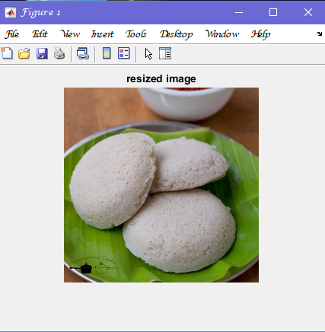
Mepco Schlenk Engineering College (Autonomous)
IMPLEMENTATION OF THE PROJECT
1. Resizing Image
The food image from Indian Food Image Dataset are given as input for the process of Resizing. Figure 1.1 describes resized image output for food item idli.
Fig 1.1 resized image of idli
Department of Computer Science and Engineering
15

Slide 16
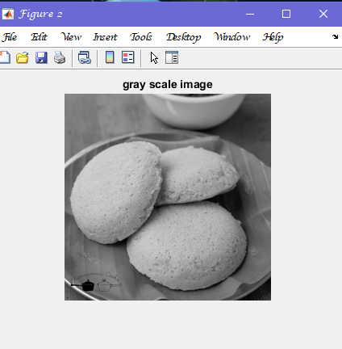
Mepco Schlenk Engineering College (Autonomous)
IMPLEMENTATION OF THE PROJECT (Contd.)
2. RGB to Gray Scale Image
The food images from Indian food Image Dataset are given as input for the process of RGB to Gray Scale Image. Figure 2.1 describes the RGB to Gray Scale Image process.
Fig 2.1 gray scale image of idli
Department of Computer Science and Engineering
16

Slide 17
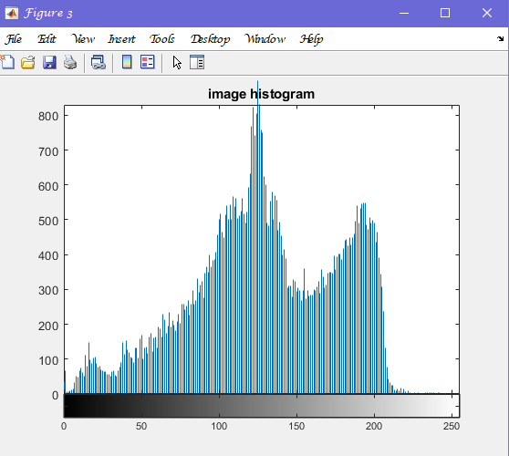
Mepco Schlenk Engineering College (Autonomous)
IMPLEMENTATION OF THE PROJECT (Contd.)
3. Image Histogram
Preprocessed Gray Scale Image is given as input for the process of Image Histogram. The output is in the form of Graphical representation. Figure 3.1 describes the Image Histogram Process.
Fig 3.1 histogram of idli
Department of Computer Science and Engineering
17

Slide 18
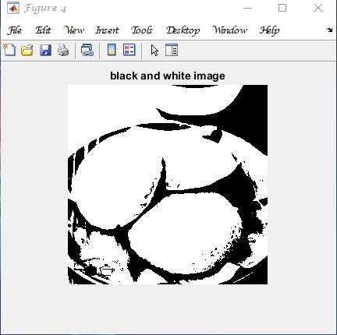
Mepco Schlenk Engineering College (Autonomous)
IMPLEMENTATION OF THE PROJECT (Contd.)
4. Gray to black and white Image
Food Image is given as input for the process of Gray to Black and White Image. Figure 4.1 describes the Gray to Black and White Image process.
Fig 4.1 black and white image of idli
Department of Computer Science and Engineering
18

Slide 19
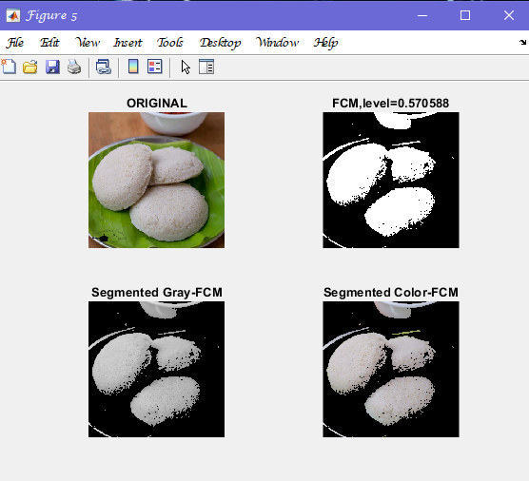
Mepco Schlenk Engineering College (Autonomous)
IMPLEMENTATION OF THE PROJECT (Contd.)
5. Food Image Segmentation using FCM
The input image is segmented using Fuzzy c-means algorithm. Food item is extracted from the original image. Figure 5.1 describes the Original image, level 1 FCM, Segmented Gray FCM, Segmented color FCM, Segmented image after morphology.
Fig 5.1 segmented image of idli
Department of Computer Science and Engineering
19

Slide 20
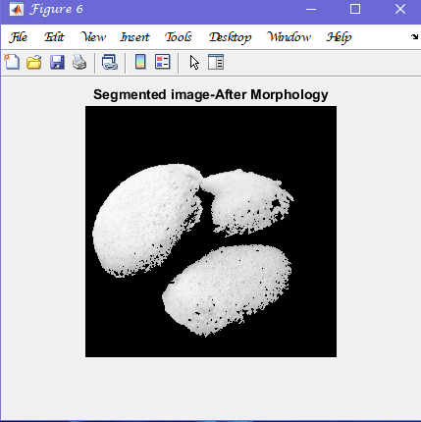
Mepco Schlenk Engineering College (Autonomous)
IMPLEMENTATION OF THE PROJECT (Contd.)
6. After Morphology
The segmented image of idli after morphology is shown in Fig 6.1 which is segmented using FCM algorithm.
Fig 6.1 Image After Morphology
Department of Computer Science and Engineering
20

Slide 21
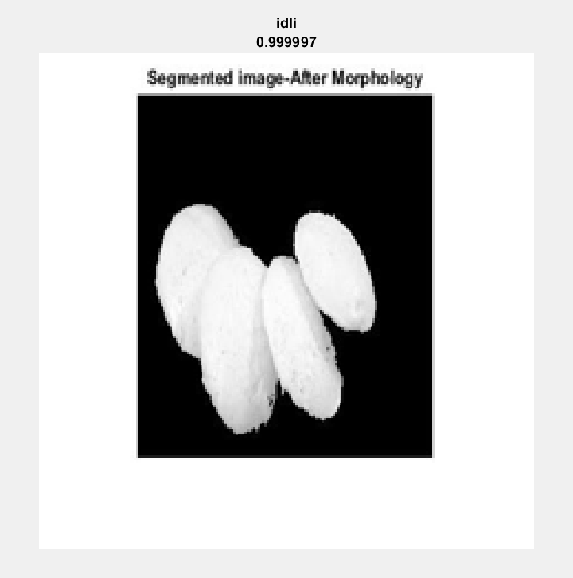
Mepco Schlenk Engineering College (Autonomous)
IMPLEMENTATION OF THE PROJECT (Contd.)
7. Food Image Classification using GoogleNet
After the Segmentation, food items are classified for training, the features along with the labels. Figure 7.1 describes the image containing only one object and then using the classifiers such as GoogleNet, the class labels are identified.
Fig 7.1 image is identified idli
Department of Computer Science and Engineering
21

Slide 22
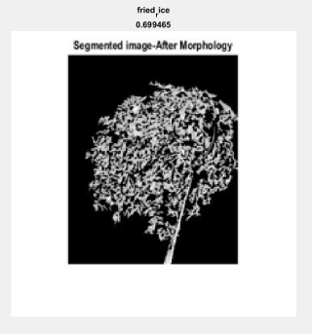
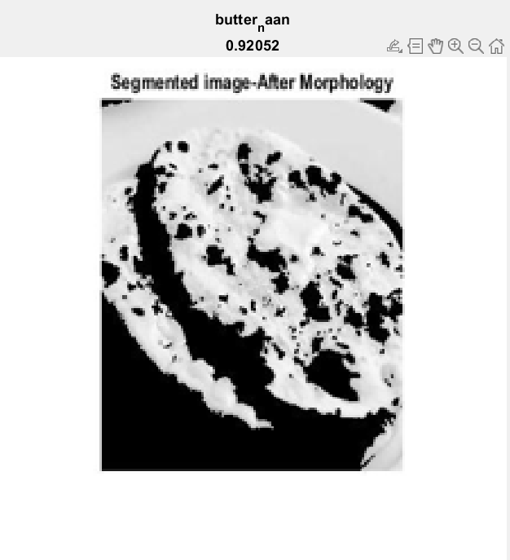
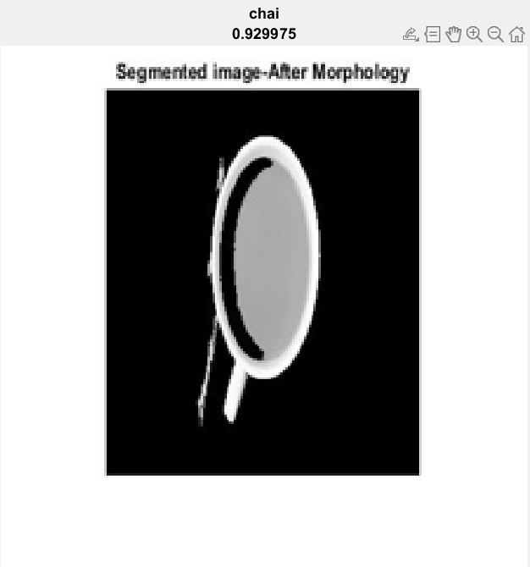
Mepco Schlenk Engineering College (Autonomous)
IMPLEMENTATION OF THE PROJECT (Contd.)
OUTPUT IMAGES :
Image is identified as fried rice, butter naan, chai
Department of Computer Science and Engineering
22

Slide 23
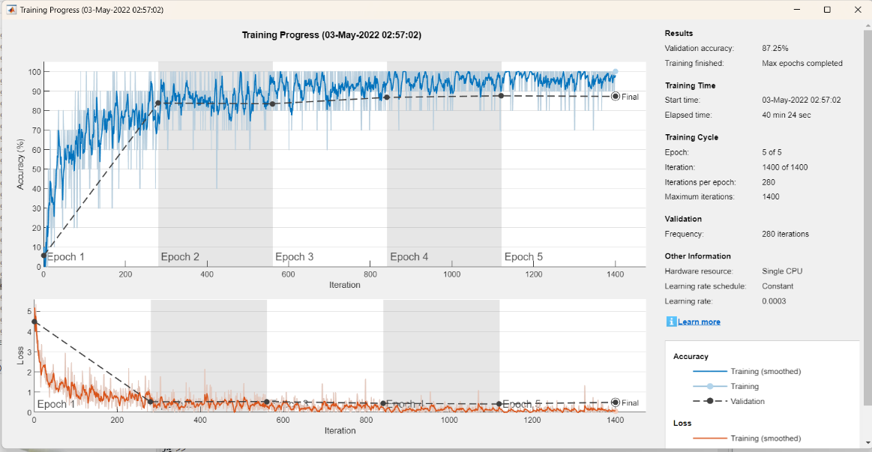
Mepco Schlenk Engineering College (Autonomous)
IMPLEMENTATION OF THE PROJECT (Contd.)
In our project, the GoogleNet architecture is trained with our own train and test datasets.
The accuracy of predictions is around 87.25%
Department of Computer Science and Engineering
23

Slide 24
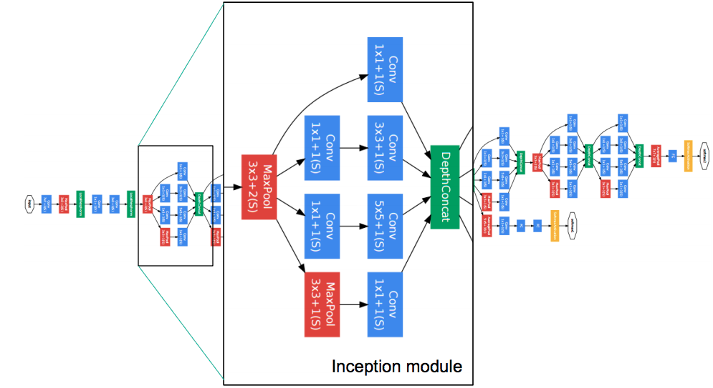
Mepco Schlenk Engineering College (Autonomous)
GOOGLENET ARCHITECTURE
Department of Computer Science and Engineering
24

Slide 25
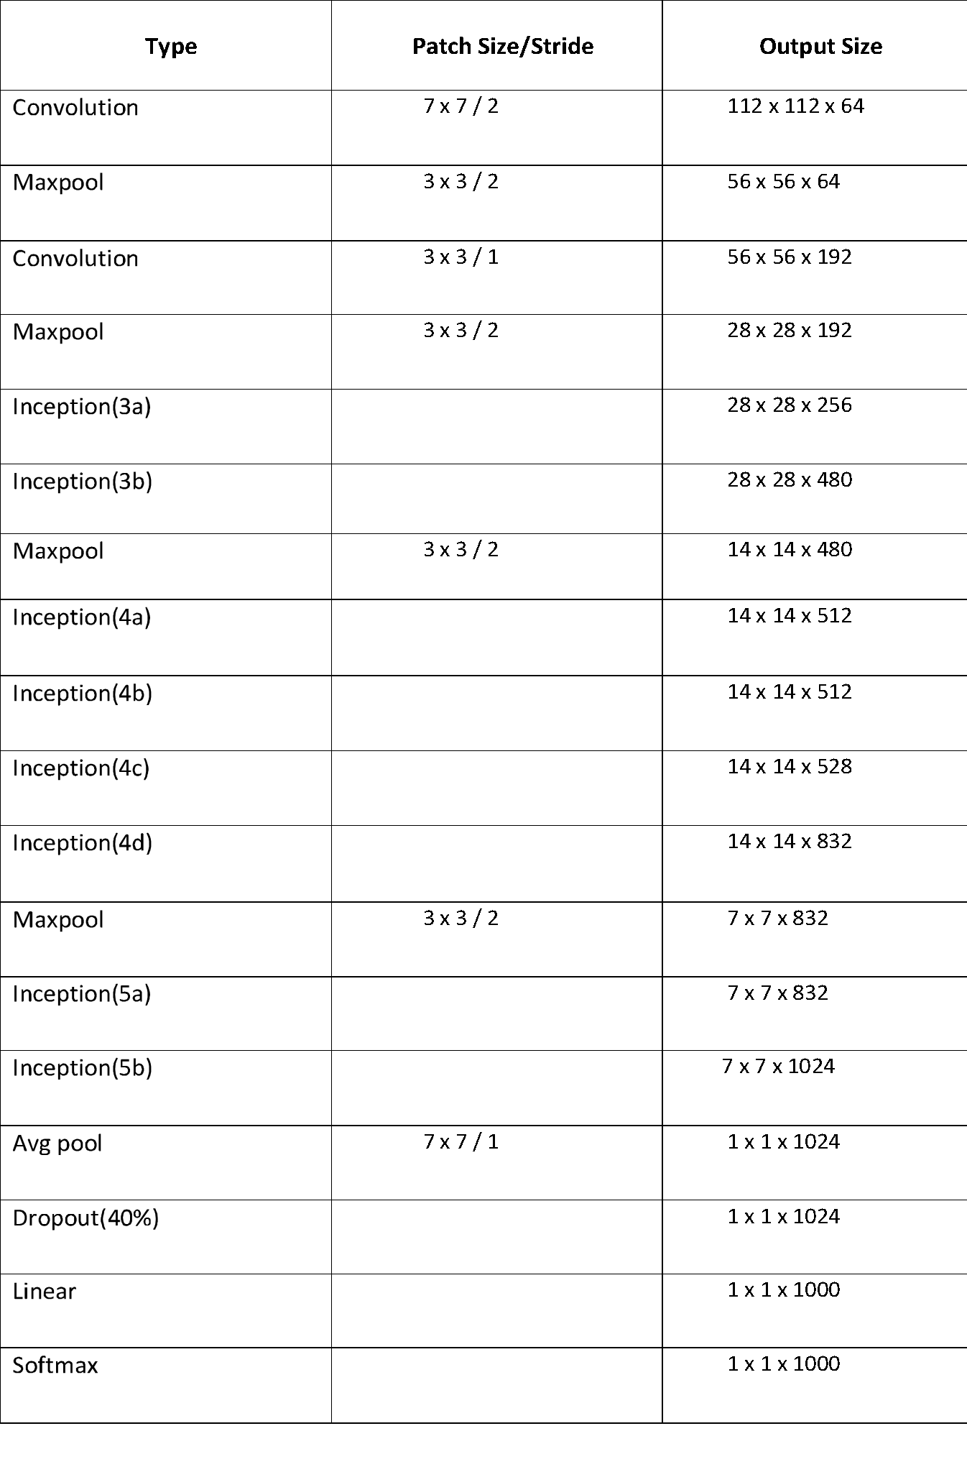
Mepco Schlenk Engineering College (Autonomous)
GOOGLENET ARCHITECTURE
Department of Computer Science and Engineering
25

Slide 26
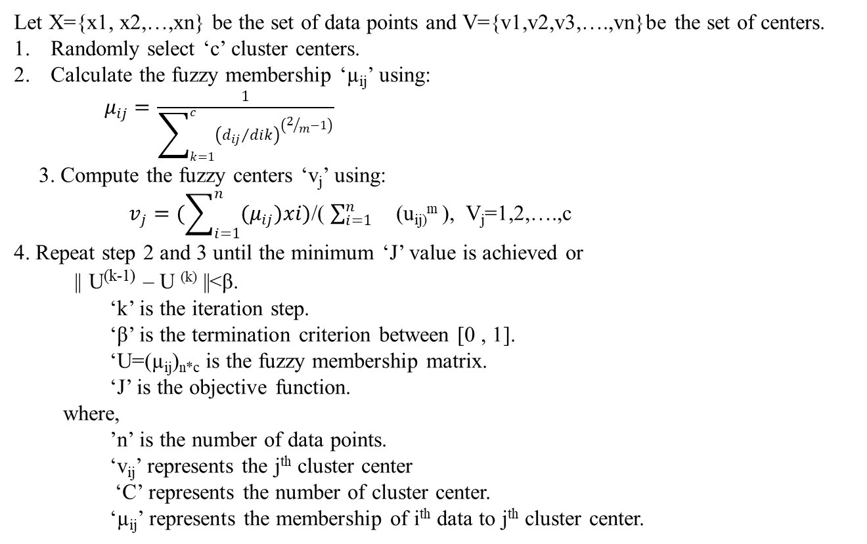
Mepco Schlenk Engineering College (Autonomous)
FCM ALGORITHM
Let X={x1, x2,…,xn} be the set of data points and V={v1,v2,v3,….,vn}be the set of centers.
Randomly select ‘c’ cluster centers.
Calculate the fuzzy membership ‘µ_{ij}’ using:
$μ_{ij}=\frac{1}{\sum_{k=1}^{c}{{\left({d_{ij}}/{dik}\right)}^{\left(2/m−1\right)}}}$
3. Compute the fuzzy centers ‘v_{j}’ using:
$v_{j}=(\sum_{i=1}^{n}{{(μ}_{ij})xi)}$/( $\sum_{i=1}^{n}{}$(u_{ij)}^{m} ), V_{j}=1,2,….,c
4. Repeat step 2 and 3 until the minimum ‘J’ value is achieved or
|| U^{(k-1)} – U ^{(k)} ||<β.
‘k’ is the iteration step.
‘β’ is the termination criterion between [0 , 1].
‘U=(µ_{ij})_{n*c} is the fuzzy membership matrix.
‘J’ is the objective function.
where,
’n’ is the number of data points.
‘v_{ij}’ represents the j^{th} cluster center
‘C’ represents the number of cluster center.
‘µ_{ij}’ represents the membership of i^{th} data to j^{th} cluster center.
Department of Computer Science and Engineering
26

Slide 27
Mepco Schlenk Engineering College (Autonomous)
CONCLUSION
The images loaded from Indian Food Image dataset is divided into training set and testing set. From the image, the objects (food items) are segmented. Then the features are extracted from these images also the labels are added to them. This process is done for training images. For testing, images are collected .Classifiers such as GoogleNet is used to train with the labels and then a model is obtained. Using this model and features from the testing image food category can be predicted.
Department of Computer Science and Engineering
27

Slide 28
Mepco Schlenk Engineering College (Autonomous)
FUTURE ENHANCEMENT
This work can be further extended by finding the calorie content in the food item which has been classified and then can be used for diet monitoring. The Pre-trained network which has been used for feature extraction, can be fine tuned to increase the accuracy. Food items can also be classified as healthy and non-healthy.
Department of Computer Science and Engineering
28

Slide 29
Mepco Schlenk Engineering College (Autonomous)
PLATFORM, LANGUAGES/TOOLS USED
Hardware Requirements
RAM :8GB
PROCESSOR: Intel core i5
Software Requirements
IDE: Matlab (Version R2021b)
OS : Windows
Department of Computer Science and Engineering
29

Slide 30
Mepco Schlenk Engineering College (Autonomous)
DATASET USED
We used dataset called Indian Food Image from Kaggle.
It consists of 20 categories like burger, butter naan, chai, chapathi, chole_bhature, dal_markhani, dhokla, fried rice, idli, jilabi, kathi rolls, kadai paneer, kulfi, masala dosa, momos, pani poori, pakode, pab bhajji, pizza, samosa
Each category contains 300-400 images (approx.)
Department of Computer Science and Engineering
30

Slide 31
Mepco Schlenk Engineering College (Autonomous)
REFERENCES
[1] Fine-Grained Food Classification Methods on the UEC FOOD-100 Database Berker Arslan, Sefer Memi¸s, Elena Battini Sönmez , and Okan Zafer Batur , Member, IEEE TRANSACTIONS, VOL. 3, NO. 2, APRIL 2022
[2] Deepfood: Food Image Analysis And Dietary Assessment Via Deep Model by Xue liu and chenxi huang (2020)
[3] State Recognition Of Food Images Using Deep Features by Gianluigi Ciocca, Giovanni Micali, and Paolo Nnapoletano, IEEE on VOL . 8, FEBRUARY 24, 2020
Department of Computer Science and Engineering
31

