Slide 1

Power-Efficient DRAM Sense Amplifier Design Using Power Gating in 45nm Technology
International Conference on Advancement in Communication and Computing Technology (INOACC 2025 )
PRESENTER NAME:- N.MAHENDRA KUMAR, K.REHAN CHANDRA,
K.UMA MAHESHWARA REDDY, M.PREETHIKA.
Affiliation to Jawaharlal Nehru technological university Anantapur
Paper ID: 1470

Slide 2

CONTENT
Objective
Abstract
Introduction
Literature survey
Existing method
Disadvantages
Proposed method
Advantages
Tools used
Results
References

Slide 3
OBJECTIVE
Power Efficiency: The objective could be to design sense amplifiers that consume less power while maintaining or even improving their functionality. This aligns with the general trend in semiconductor design towards energy efficiency, which is particularly crucial in mobile and battery-operated devices.

Slide 4
ABSTRACT
Power consumption is a critical consideration in the design of memory elements and digital systems within very large scale integration (VLSI) circuits. This study introduces a method for reducing power consumption in DRAM sense amplifiers, termed FSPA-VLSA (Foot Switch PMOS Access Voltage Latch Type Sense Amplifier). By implementing this technique within the open bit architecture of DRAM Cells during read operations, reduction in overall power consumption has been achieved. Additionally, this proposed circuit offers advantages for low-power VLSI/ULSI design. The circuit has been successfully designed and implemented using Cadence Virtuoso tools at 45nm technology.

Slide 5
INTRODUCTION
Semiconductor memories are crucial in electronic design, especially for data storage in computer systems. Memory needs vary by application, with storage often requiring more transistors than logic operations. Dynamic Random Access Memory (DRAM) is characterized by its simple structure, smaller size, and higher densities. It uses capacitors to store binary data, but requires periodic refreshing due to charge leakage, leading to information degradation over time.
The demand for portable systems has led to a focus on minimizing power consumption in very high-density Ultra-Large Scale Integration (ULSI) chips, driving innovations in low-power design. A fundamental sense amplifier consists of two cross-coupled inverters, PMOS and NMOS components, and an Equalizer (EQ) linked to both output ends. This is known as a positive feedback differential voltage sense amplifier or conventional sense amplifier.
The Foot Switch PMOS Access Voltage Latch Sense Amplifier (FSPA-VLSA) features an NMOS transistor at the circuit's bottom, serving as foot switch transistors. PMOS access involves accessing bit line and bit bar line voltages through PMOS transistors. This configuration is collectively termed the Foot Switch PMOS Access Voltage Latch Sense Amplifier.

Slide 6
Literature survey
S. NO | Authors | Title | Outcomes
1. | Y. L. Sung-MO Kang | Dynamic Random Access Memory (DRAM) | The book aims to equip students with the fundamentals of CMOS VLSI design, which is crucial for the development of advanced computer hardware.
2. | Arsovski | High-Speed Low-Power Sense Amplifier Design | In high-speed memory systems, signal integrity is paramount, and any noise introduced during the sensing process can degrade the accuracy of read operations.

Slide 7
Literature survey
3 | T. Meenu Rani Garg | A Study of Different Types of Voltage & Current Sense Amplifiers used in SRAM | In high-speed SRAM arrays, signal integrity is crucial, and any noise introduced during sensing or amplification can degrade the accuracy of read operations
4 | K. V. A.Hemprabha | Comparative analysis of sense amplifiers for memories | More sophisticated sensing techniques and circuit topologies may improve performance but require additional circuitry and resources, leading to increased chip area and manufacturing costs.

Slide 8
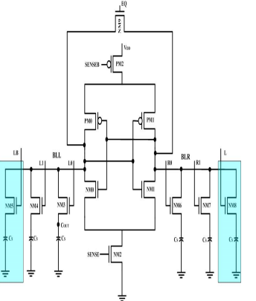
Existing method
The open bit architecture of a DRAM sense amplifier is particularly advantageous for DRAMs as it reduces the area of each memory cell array, crucial for increasing DRAM capacity. It also addresses noise sensitivity by sharing sense amplifiers across adjacent memory cell arrays, minimizing the impact of noise generated in one cell array block on the other side of the bit lines connected to the sense amplifier. This shared sense amplifier arrangement not only minimizes the area of each memory cell array but also enhances the DRAM's capacity while maintaining high performance and reliability.
Diagram of open bit architecture of DRAM sense amplifier

Slide 9
DISADVANTAGE
The overall power during read mode of operation in open bit architecture of DRAM sense amplifier using basic latch type sense amplifier is too high because the circuit always in the ON state of both the input(sense and senseb). Senseb is “0 V”; it drives the PMOS while sense is “0.7 V” it drives the NMOS. The overall circuit is always ON state.

Slide 10
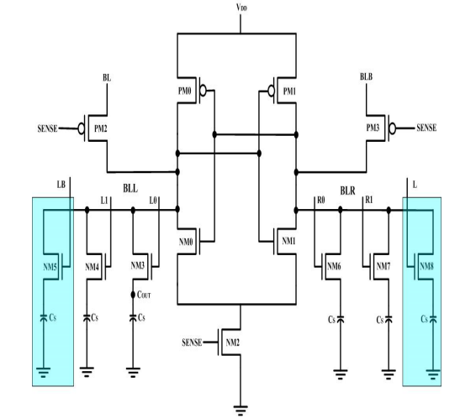
Proposed method
In the proposed approach, the DRAM sense amplifier is used with the FSPA-VLSA (Foot Switch PMOS Access Voltage Latch Type Sense Amplifier). The DRAM memory array is divided into two halves, with the FSPA-VLSA centrally placed. The input "SENSE" is applied to PM2, PM3, and NM2, and the bit lines BLL and BLR are connected to the FSPA-VLSA's output. Dummy cells, NM5 and NM8, are included for reference, with their storage capacitances "Cs" shown in the shaded area. Two DRAM cells, each with one NMOS and one capacitor, are positioned on either side of the FSPA-VLSA for data storage in the open bit architecture of the DRAM sense amplifier.
Fig. Diagram of proposed technique for Open bit architecture of DRAM sense amplifier

Slide 11
advantages
Reduced power consumption
Improved performance
Increased integration density

Slide 12
EXTENSION method
POWER GATING :
In this chapter, the modification in the proposed circuit for FF with asynchronous reset in this design we are going to add the power gating technique to the PMOS. Here, the PMOS is designed using POWER GATING Logic. Here, we also mention the detailed information relating to power gating technique and the advantages towards the modified design
INTRODUCTION TO POWER GATING TECHNIQUE:
Power gating is a technique used in integrated circuits to reduce power consumption by turning off the power supply to specific circuit blocks when they are not needed. This technique is particularly useful in modern chips, which often contain many different functional blocks that may not be used at all times

Slide 13
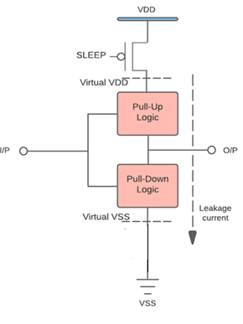
Fig: Block diagram of Power gating technique
Power gating works by inserting switches into the power supply paths of specific circuit blocks, which can be controlled by a power management unit. When the circuit block is not needed, the switch is turned off, cutting off the power supply and reducing the power consumption of the circuit

Slide 14
ADVANTAGES & APPLICATIONS
Energy Efficiency: The proposed flip-flop consumes minimal power due to its ultra-low-power design, making it ideal for energy-sensitive applications.
Low-Voltage Operation: The flip-flop operates effectively at near-threshold voltages, enhancing its performance in low-voltage environments, crucial for power-constrained systems.
Wearable Electronics: For devices like smart watches and fitness trackers, where battery life and compact circuit design are critical, this flip-flop can significantly enhance performance.
Internet of Things (IoT): The ultra-low power consumption makes it suitable for battery-powered IoT devices, which require long operation times with minimal energy use.

Slide 15
Tools required
Tool : Cadence virtuoso
Technology : 45NM

Slide 16
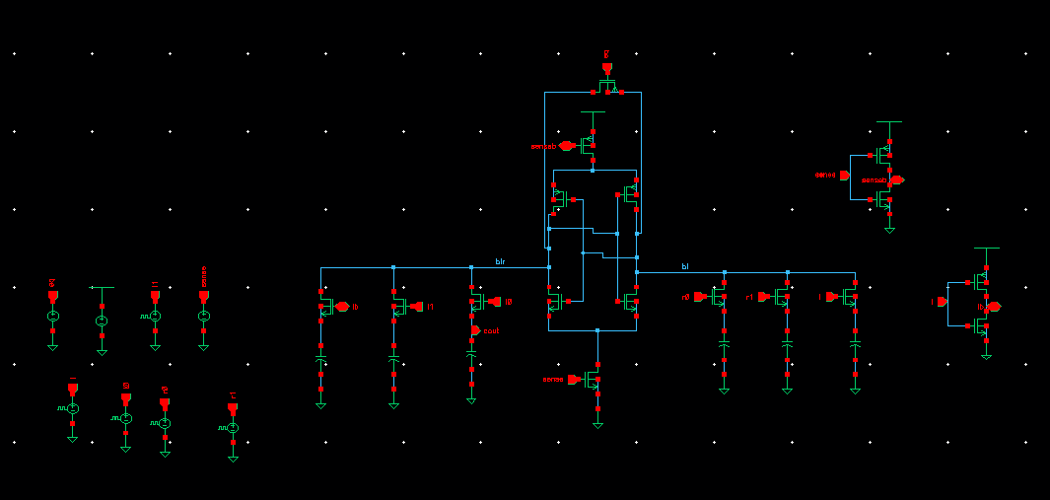
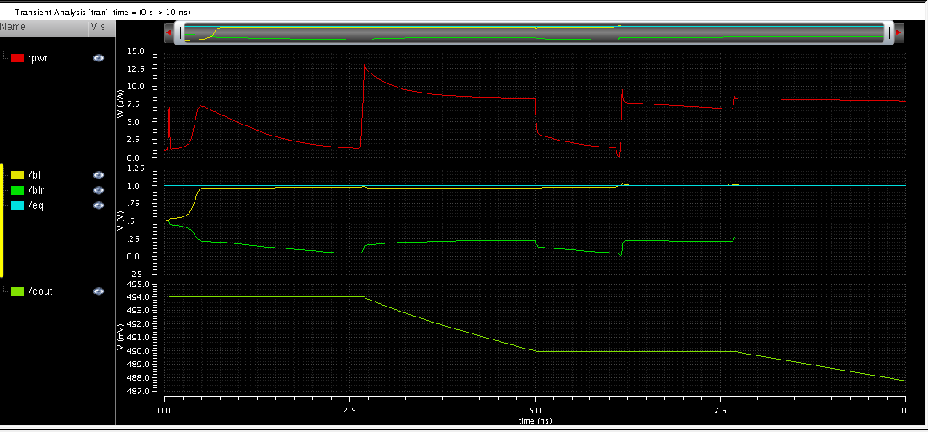
RESULTS
SCHEMATIC OF EXISTING METHOD
WAVEFORM OF EXISTING METHOD

Slide 17
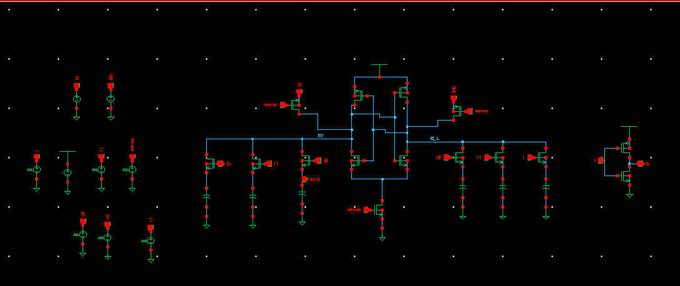
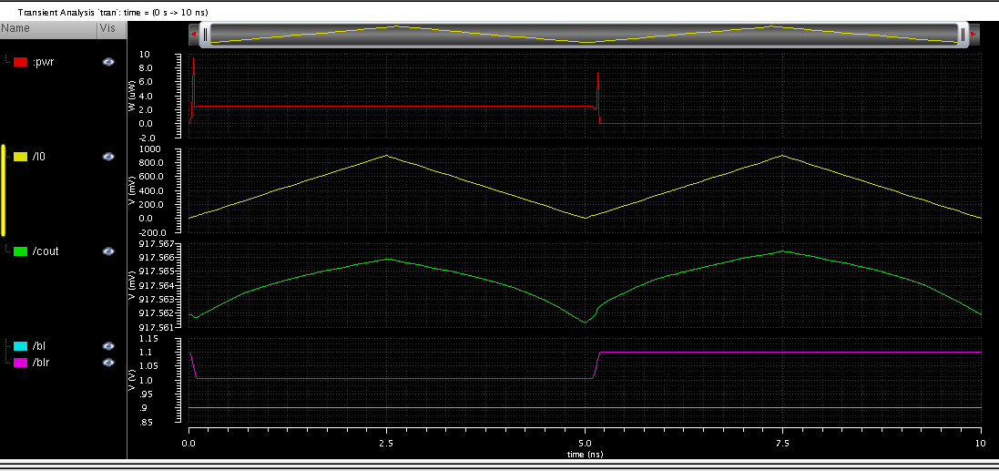
Schematic of Proposed DRAM sense amplifier
Waveform of Proposed DRAM Sense amplifier

Slide 18
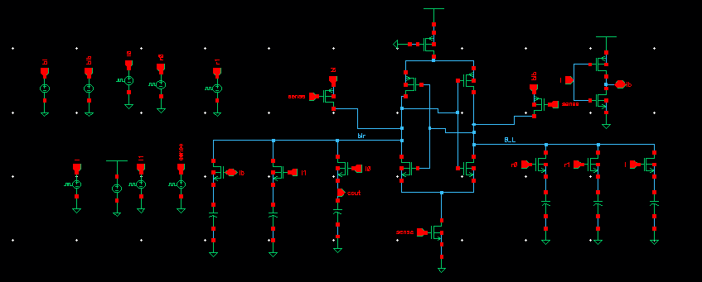
Schematic of Extension DRAM sense amplifier
Waveform of Extension DRAM Sense amplifier

Slide 19
COMPARISION TABLE
 | AREA(Transistors count) | Power (w)
Existing | 17 | 6.195 uw
Proposed | 15 | 1.328 uw
Extension | 16 | 919.2 nW

Slide 20
CONCLUSION
The proposed study evaluates the power consumption during read operations in the open bit architecture technique of DRAM sense amplifiers. It reveals that the power consumption in the proposed technique of DRAM sense amplifier using FSPA-VLSA is roughly 81% less than that of the open bit architecture of DRAM sense amplifier using a basic latch type sense amplifier. This reduction is attributed to the application of the same pulse to all circuit inputs. The PMOS transistor is active and the NMOS transistor is inactive for half the interval of time, followed by the NMOS transistor being active and the PMOS transistor inactive for the rest of the simulation time. Consequently, the circuit spends most of its time in a cut-off state, either due to the NMOS or PMOS, which results in a reduced overall power consumption.

Slide 21
REFERENCES
Y. L. Sung-MO Kang, "Dynamic Random Access Memory(DRAM)," in CMOS digital integrated circuits, new delhi, mcgraw hill, 2013, p. 655.
“VLSI Design Techniques for Analog and Digital Circuits”, mcgraw-hill international publication.
Arsovski, "High-Speed Low-Power Sense Amplifier Design," 12 NOV,2001.
A. T. Meenu Rani Garg, "A Study of Different Types of Voltage & Current Sense Amplifiers used in SRAM," International Journal of Advanced Research in Computer and Communication Engineering, p. 6, Vol. 4, Issue 5, May 2015.
Taehui Na, Seung-Han Woo, Jisu Kim "Comparative study of various latch type sense amplifier," IEEE Trans VlSI System, Feb,2014.
K. V. A.Hemprabha, "Comparative analysis of sense amplifiers for memories," IEEE, p. 6, 2015.

