Slide 1
Chapter 1 Introduction
Operating Systems
1

Slide 2
Outline and Objectives
Outline
What Operating Systems Do
Computer-System Organization and Architecture
Operating-System Structure and Operations
Major Operating Systems Concepts/Components/Functionalities
Process Management
Memory Management
Storage Management
Protection and Security
Computing Environments
Objectives
To provide a grand tour of the major operating systems components
To provide coverage of basic computer system organization
2

Slide 3
What is an operating system?
A program that acts as an intermediary between a user of a computer and the computer hardware
Operating system goals:
Execute user programs and make solving user problems easier
Make the computer system convenient to use
Use the computer hardware in an efficient manner
3

Slide 4
Computer System Structure
Computer system can be divided into four components
Hardware – provides basic computing resources
CPU, memory, I/O devices
Operating system
Controls and coordinates use of hardware among various applications and users
Application programs – define the ways in which the system resources are used to solve the computing problems of the users
Word processors, compilers, web browsers, database systems, video games
Users
People, machines, other computers
4

Slide 5
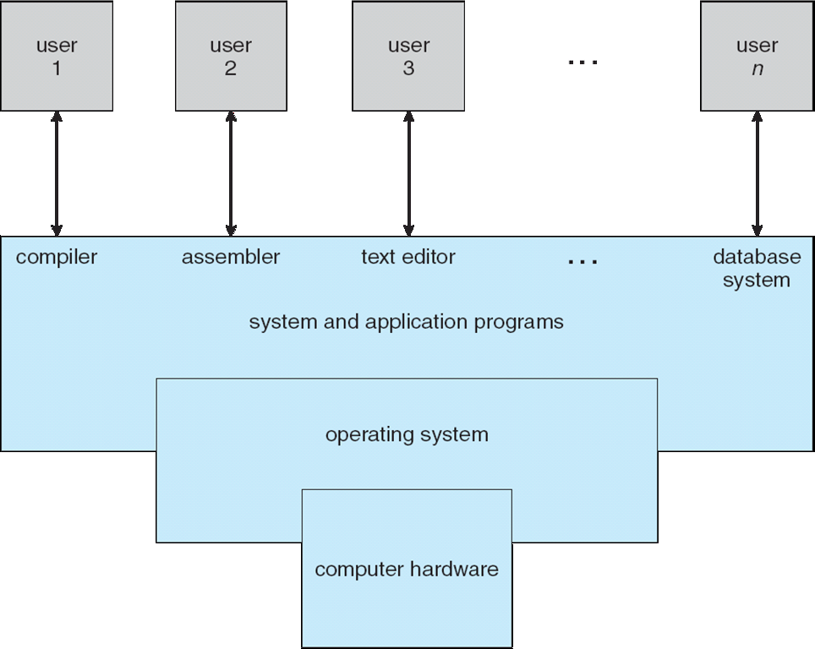
Four Components of a Computer System
CS352
…
….
CS342
CS 224
EE 212
CS 223
5

Slide 6
Operating System Definition
OS is a resource allocator
Manages all resources
Decides between conflicting requests for efficient and fair resource use
OS is a control program
Controls execution of programs to prevent errors and improper use of the computer
I/O is accessed via the operating system
6

Slide 7
Operating System Definition (cont.)
No universally accepted definition
“Everything a vendor ships when you order an operating system” is good approximation
But varies wildly
“The one program running at all times on the computer” is the kernel. Everything else is either a system program (ships with the operating system) or an application program
system
programs
+ you can install other applications
kernel
(Some application programs)
System programs: programs that are associated with the operating system
OS CD
7

Slide 8
Computer Startup
bootstrap program is loaded at power-up or reboot
Typically stored in ROM or EPROM,
generally known as firmware
Initializes all aspects of the system
Loads operating system kernel and starts execution
system/application programs
Kernel
hardware
8

Slide 9
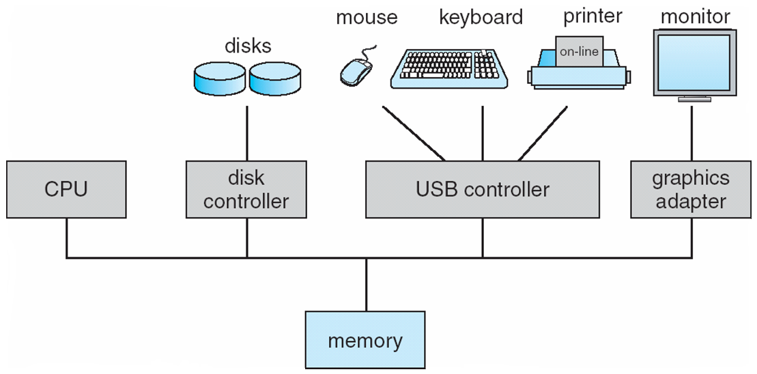
Computer System Organization (cs224 knowledge)
Computer-system operation
One or more CPUs, device controllers connect through common bus providing access to shared memory
Concurrent execution of CPUs and devices competing for memory cycles
Network cable
Network adapter
Bus
9

Slide 10
Computer system operation
I/O devices and the CPU can execute concurrently
Each device controller is in charge of a particular device type
Each device controller has a local buffer
CPU moves data from/to main memory to/from local buffers
I/O is from the device to local buffer of controller
Device controller informs CPU that it has finished its operation by causing an interrupt
10

Slide 11
Common Functions of Interrupts
An interrupt transfers control to the interrupt service routine generally, through the interrupt vector, which contains the addresses of all the service routines
Interrupt architecture must save the address of the interrupted instruction
Incoming interrupts are disabled while another interrupt is being processed to prevent a lost interrupt
A trap is a software-generated interrupt caused either by an error or a user request
An operating system (kernel) is interrupt-driven
event driven
11

Slide 12
Interrupt-Driven OS
Applications or System Programs running in CPU
software interrupt / trap
(due to system service requests or errors)
Kernel Code
hardware interrupt
Devices
disk, keyboard, timer, network adapter…
12

Slide 13
Interrupt Handling
The operating system preserves the state of the CPU by storing registers and the program counter
Determines which type of interrupt has occurred:
polling
vectored interrupt system
Separate segments of code determine what action should be taken for each type of interrupt
CPU
RAM
store
Registers
[Application in CPU] – Interrupt – [Service Routine in CPU]
13

Slide 14
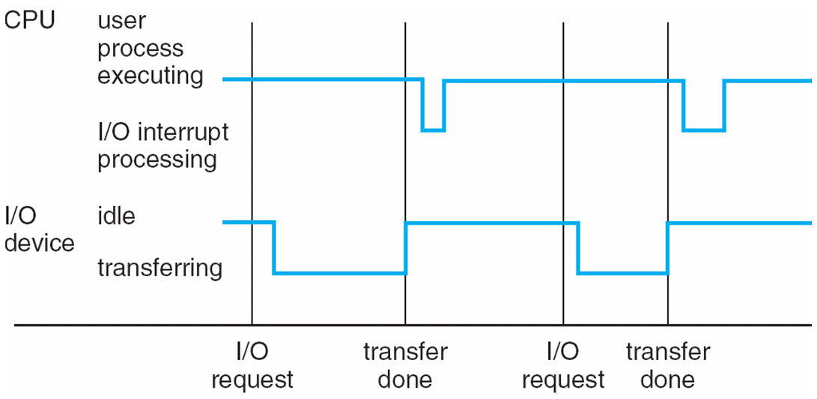
Interrupt Timeline
14

Slide 15
I/O Structure
Application programs can request I/O (read from a device or write to a device) via the help of operating system (kernel)
The request is done by calling a System Call (OS routine)
System call routine in OS performs the I/O via the help of device driver routines in OS.
OS maintains device status table: one entry per device. The entry keeps the state of the device, etc.
After issuing a system call, an application may wait for the call to finish (blocking call) or may continue to do something else (non-blocking call)
Application
System Call
Routines
Kernel
Device Driver
Device Controller
Device
15

Slide 16
Direct Memory Access Structure
Used for high-speed I/O devices able to transmit information at close to memory speeds
Device controller transfers blocks of data from buffer storage directly to main memory without CPU intervention
Only one interrupt is generated per block, rather than the one interrupt per byte
Main Memory
CPU
Device Controller
DMA
Controller Transfer
16

Slide 17
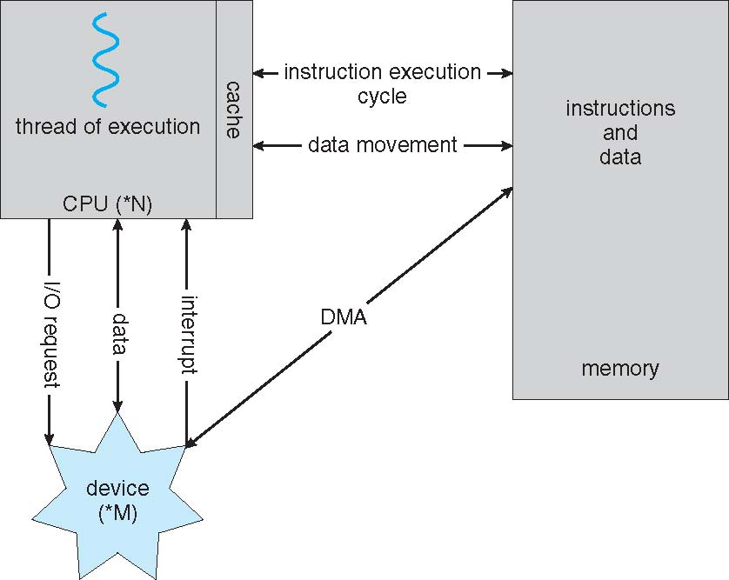
How a Modern Computer Works
17

Slide 18
Storage Structure
Main memory – only large storage media that the CPU can access directly
Secondary storage – extension of main memory that provides large nonvolatile storage capacity
Magnetic disks – rigid metal or glass platters covered with magnetic recording material
Disk surface is logically divided into tracks, which are subdivided into sectors
The disk controller determines the logical interaction between the device and the computer
CPU
Main
Memory
Disk
Controller
Spinning
Disk
secondary
storage
18

Slide 19
Storage Hierarchy
Storage systems organized in hierarchy
Speed
Cost
Volatility
Caching – copying information into faster storage system; main memory can be viewed as a last cache for secondary storage
results from tradeoff between size and speed
caching
small, fast
large, slow
19

Slide 20
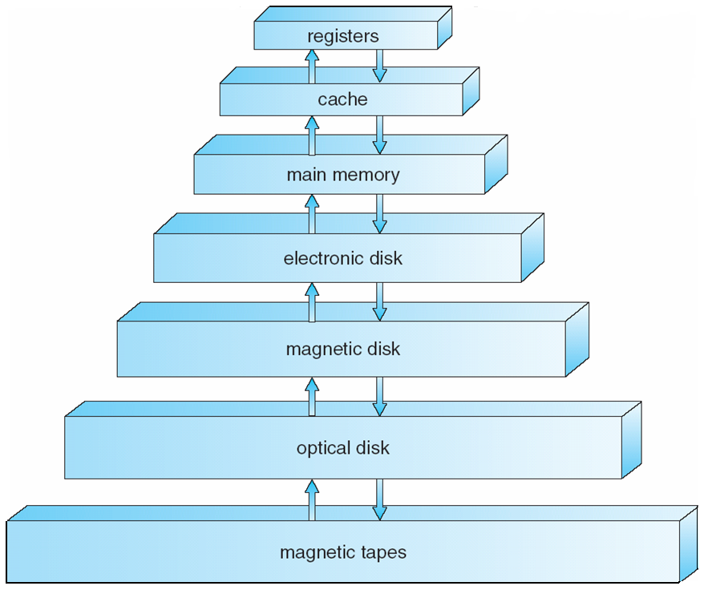
Storage-Device Hierarchy
20

Slide 21
Caching
Important principle, performed at many levels in a computer (in hardware, operating system, software)
Information in use copied from slower to faster storage temporarily
Faster storage (cache) checked first to determine if information is there
If it is, information used directly from the cache (fast)
If not, data copied to cache and used there
The cache is smaller than the storage being cached
Cache management important design problem
Cache size and replacement policy
size?
cache
replacement policy?
21

Slide 22
Caching
caching
small, fast
large, slow
Registers
Main Memory
Hardware cache L1, L2, etc
Main Memory
Main Memory
Hard Disk
Hard Disk
Tape
22

Slide 23
Computer System Architecture
Most systems use a single general-purpose processor (PDAs through mainframes)
Most systems have special-purpose processors as well
Multiprocessor systems growing in use and importance
Also known as parallel systems, tightly-coupled systems
Advantages include
Increased throughput
Economy of scale (cheaper than using multiple computers)
Increased reliability – graceful degradation or fault tolerance
Two types
Asymmetric Multiprocessing
Symmetric Multiprocessing
23

Slide 24
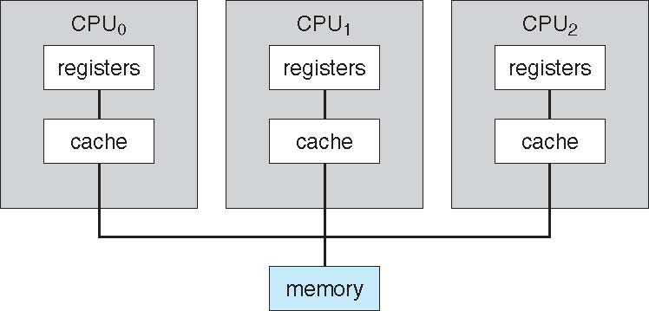
Symmetric Multiprocessing Architecture
24

Slide 25
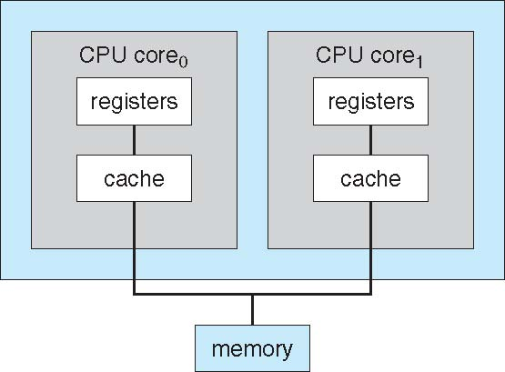
A Dual Core Design
25

Slide 26
Clustered Systems
Like multiprocessor systems, but multiple systems working together
Usually sharing storage via a storage-area network (SAN)
Provides a high-availability service which survives failures
Asymmetric clustering has one machine in hot-standby mode
Symmetric clustering has multiple nodes running applications, monitoring each other
Some clusters are for high-performance computing (HPC)
Applications must be written to use parallelization
PC
PC
SAN
PC
PC
Disk
Storage
26

Slide 27
Operating Systems Structure
Multiprogramming needed for efficiency
Single user cannot keep CPU and I/O devices busy at all times
Multiprogramming organizes jobs (code and data) so CPU always has one to execute
A subset of total jobs in system is kept in memory
One job selected and run via job scheduling
OS selects which job
When it has to wait (for I/O for example), OS switches to another job
Main Memory
CPU
Job
Job
I/O device
Job
I/O device
I/O device
Job
System
27

Slide 28
Operating Systems Structure
Timesharing (multitasking) is logical extension in which CPU switches jobs so frequently that users can interact with each job while it is running, creating interactive computing
Response time should be < 1 second
Each user has at least one program executing in memory process
If several jobs ready to run at the same time  CPU scheduling
If processes don’t fit in memory, swapping moves them in and out to run
Virtual memory allows execution of processes not completely in memory
28

Slide 29
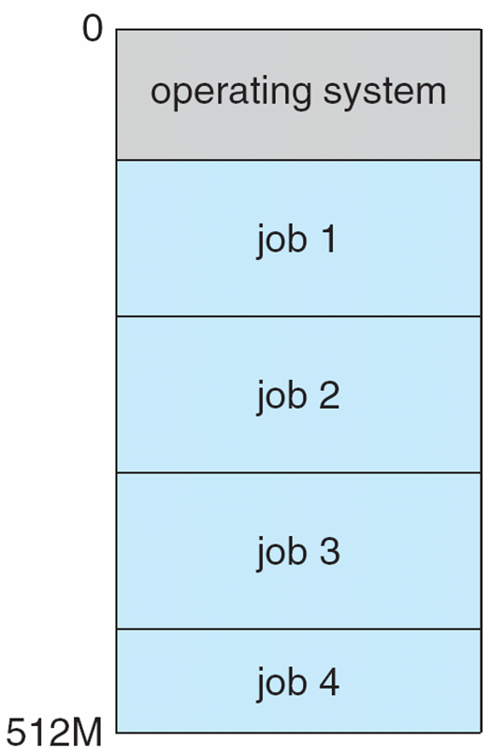
Memory Layout for Multi-programmed System
29

Slide 30
Operating System Operations
Interrupt driven by hardware
Hardware interrupt causes ISR to run (which is a routine of OS)
Software error or request creates exception or trap
Division by zero, for example (exception)
request for an operating system service (trap)
Other process problems include:
processes modifying each other or the operating system
Handle by dual mode
infinite loop
Handle infinite loop by use of timer interrupt
30

Slide 31
Operating System Operations
Dual-mode operation allows OS to protect itself and other system components
User mode and kernel mode
Mode bit provided by hardware
Provides ability to distinguish when system is running user code or kernel code
Some instructions designated as privileged, only executable in kernel mode
System call changes mode to kernel, return from call resets it to user
31

Slide 32
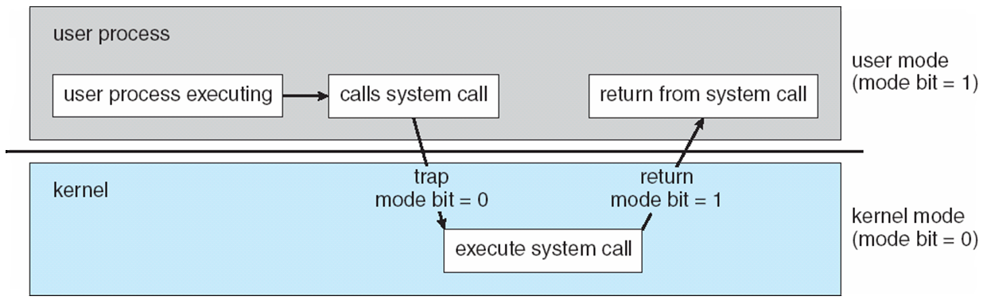
Operating System Operations
Dual mode system operation
Transition from User to Kernel Mode and Vice Versa
32

Slide 33
Preventing a Process Hogging Resources
Timer to prevent infinite loop / process hogging resources
1) Set the timer device to interrupt after a while
Can be a fixed or variable time period
2) CPU executes a program (a process)
3) Timer device sends an interrupt after that period
4) CPU starts executing timer handler: OS gains control
5) OS can schedule the same process or other process
6) OS sets the timer again before giving the CPU to the scheduled process
33

Slide 34
Major OS Concepts/Components/Functions
Process Management
Providing process abstraction and managing processes
Memory management
Sharing memory among many processes
Storage (disk) management
Providing file abstraction, managing files
Mapping files to disk blocks, disk scheduling
I/O control and management
Device derivers, buffering, providing uniform access interface
Protection and security
Controlled access to resources, preventing processes interfering with each other and OS
34

Slide 35
Process Management
A process is a program in execution. It is a unit of work within the system. Program is a passive entity, process is an active entity.
Process executes instructions sequentially, one at a time, until completion
Process needs resources to accomplish its task
CPU, memory, I/O, files
Typically system has many processes (some user, some operating system) running concurrently on one or more CPUs
Concurrency by multiplexing the CPUs among the processes / threads
Upon process termination, resources are released
35

Slide 36
Process Management Activities
The operating system is responsible for the following activities in connection with process management:
Creating and deleting both user and system processes
Suspending and resuming processes
Providing mechanisms for process synchronization
Providing mechanisms for process communication
Providing mechanisms for deadlock handling
36

Slide 37
Memory Management
All data in memory before and after processing
All instructions in memory in order to execute
Memory management determines what is in memory, where and when
Memory management activities
Keeping track of which parts of memory are currently being used and by whom
Deciding which processes (or parts of a process) and data to move into and out of memory
Allocating and deallocating memory space as needed
37

Slide 38
Process Address Space
max
stack
Physical
Main Memory
RAM
a process
(running application)
data
Mapping
(by OS)
instructions
a process has an
address space
(set of logical addresses process is using)
0
address space
of the process
38

Slide 39
Storage Management
OS provides uniform, logical view of information storage
Abstracts physical properties to logical storage unit - file
Each medium is controlled by a device (i.e., disk drive, tape drive)
Varying properties include access speed, capacity, data-transfer rate, access method (sequential or random)
File-System management
Files usually organized into directories
Access control on most systems to determine who can access what
OS activities include
Creating and deleting files and directories; Primitives to manipulate files/dirs; Mapping files onto secondary storage
39

Slide 40
Mass-Storage Management
Mass Storage: disk (secondary); tapes, CDs, etc. (tertiary)
Disk store data that does not fit into memory and to be stored for long time; Proper management is of central importance
Entire speed of computer operation may depend on the disk subsystem and its algorithms
OS activities
Free-space management; Storage allocation
Disk scheduling
Some storage need not be fast
Tertiary storage includes optical storage, magnetic tape
Still must be managed
40

Slide 41
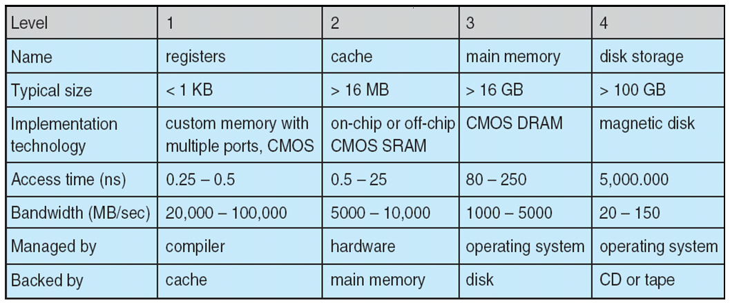
Performance of Various Levels of Storage
Movement between levels of storage hierarchy can be explicit or implicit
41

Slide 42
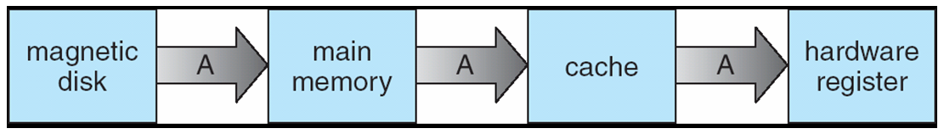
Migration of Integer A from Disk to Register
Multitasking environments must be careful to use most recent value, no matter where it is stored in the storage hierarchy
Multiprocessor environment must provide cache coherency in hardware such that all CPUs have the most recent value in their cache
CPU
CPU
CPU
Cache
Cache
Cache
Main Memory
42

Slide 43
Input/Output Subsystem
One purpose of OS is to hide peculiarities of hardware devices from the user
I/O subsystem responsible for
Memory management of I/O including buffering (storing data temporarily while it is being transferred), caching (storing parts of data in faster storage for performance), ..
General device-driver interface
Drivers for specific hardware devices
Buffering
Caching….
I/Os sub-system of Kernel
uniform driver interface
Device Derivers
43

Slide 44
Protection and Security
Protection – any mechanism for controlling access of processes or users to resources defined by the OS
Security – defense of the system against internal and external attacks
Huge range, including denial-of-service, worms, viruses, identity theft, theft of service
Systems generally first distinguish among users, to determine who can do what
User identities (user IDs, security IDs) include name and associated number, one per user
User ID then associated with all files, processes of that user to determine access control
44

Slide 45
Distributing Computing
Earlier systems executed tasks on a single system
Now we have systems interconnected (networked) together
Enabling distributed computing, resource sharing, etc.
Operating systems have support now for networking multiple systems, distributing file storage, accessing remote resources, etc.
Hence the computing environment is no longer a single system.
It can consist of many systems used in different ways
network
45

Slide 46
Computing Environments
Traditionally
mainframe computer
a single system with a user
dumb terminals
Computing and OS in a single machine
no computation here
46

Slide 47
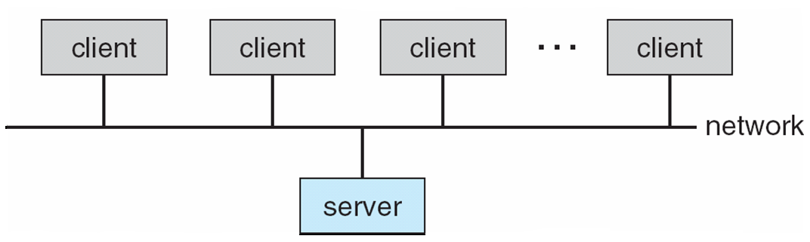
Computing Environments
Client-Server Computing
Dumb terminals replaced by smart PCs
Many systems now servers, responding to requests generated by clients
Compute-server provides an interface to client to request services (i.e. database)
File-server provides interface for clients to store and retrieve files
47

Slide 48
Peer-To-Peer Computing
Another model of distributed system
P2P does not distinguish clients and servers
Instead all nodes are considered peers
Each may act as a client, a server or both
A node must join P2P network
Registers its service with central lookup service on network, or
Broadcast request for service and respond to requests for service via resource discovery/lookup protocol
Examples include Napster and Gnutella
48

Slide 49
Web Based Computing
Web has become ubiquitous
More devices becoming networked to allow web access
OSs run web servers and web clients
Web based applications can be developed to run over web servers and clients.
Having a browser at the client is enough to run most of the applications
No special client software required
applications
HTTP
Web server
User
Web
browser
pages
49

Slide 50
Open-Source Operating Systems
Operating systems made available in source-code format rather than just binary closed-source
Counter to the copy protection movement
Examples include
GNU/Linux,
BSD UNIX (FreeBSD, etc.)
Sun Solaris
50

Slide 51
References
Operating System Concepts, 7th and 8th editions, Silberschatz et al. Wiley.
Modern Operating Systems, Andrew S. Tanenbaum, 3rd edition, 2009.
These slides are adapted/modified from the textbook and its slides: Operating System Concepts, Silberschatz et al., 7th and 8th editions, Wiley.
51

