Slide 1
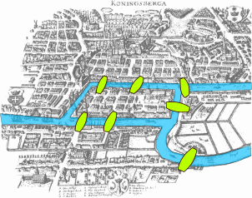
Introduction to Graphs

Slide 2
This Lecture
In this part we will study some basic graph theory.
Graph is a useful concept to model many problems in computer science.
Seven bridges of Konigsberg
Graphs, degrees
Isomorphism
Path, cycle, connectedness
Tree
Eulerian cycle

Slide 3
Seven Bridges of Königsberg
Is it possible to walk with a route that crosses each bridge exactly once?

Slide 4
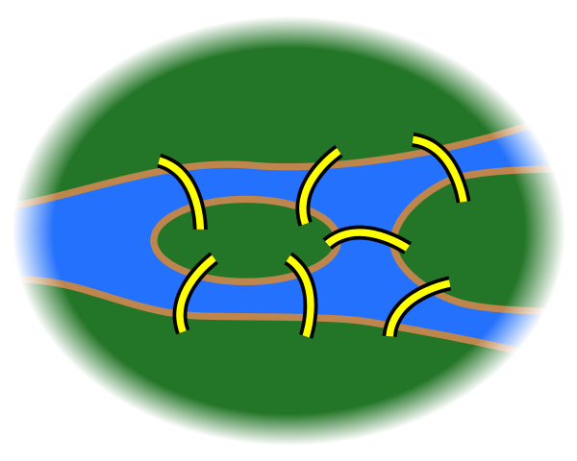
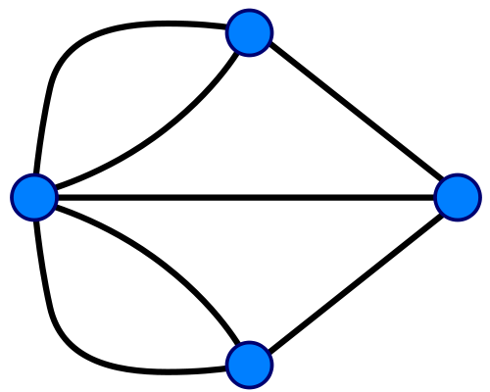
Seven Bridges of Königsberg
Forget unimportant details.
Forget even more.

Slide 5
A Graph
An edge
(or a line)
A vertex
(or a node,
or a point)
e6
d
e7
e5
e4
c
a
e3
e2
e1
b
So, what is the “Seven Bridges of Königsberg” problem now?
To find a walk that visits each edge exactly once.

Slide 6
Euler’s Solution
Question: Is it possible to find a walk that visits each edge exactly once.
e6
d
e7
e5
e4
v
c
a
e3
e2
e1
b
If there is such a walk, there is a starting point and an endpoint point.
For every “intermediate” point v, there must be the same number of
incoming and outgoing edges, and so v must have an even number of edges.

Slide 7
Euler’s Solution
Question: Is it possible to find a walk that visits each edge exactly once.
e6
d
So, at most two vertices can
have odd number of edges.
e7
e5
e4
In this graph, every vertex has an odd number of edges,
and so there is no walk which visits each edge exactly one.
c
a
e3
e2
e1
b
Suppose there is such a walk, there is a starting point and an endpoint point.
For every “intermediate” point v, there must be the same number of
incoming and outgoing edges, and so v must have an even number of edges.

Slide 8
Euler’s Solution
So Euler showed that the “Seven Bridges of Königsberg” is unsolvable.
When is it possible to have a walk that visits every edge exactly once?
Is it always possible to find such a walk if there are
at most two vertices with odd number of edges?

Slide 9
Euler’s Solution
So Euler showed that the “Seven Bridges of Königsberg” is unsolvable.
When is it possible to have a walk that visits every edge exactly once?
Is it always possible to find such a walk if there is
at most two vertices with odd number of edges?
NO!

Slide 10
Euler’s Solution
So Euler showed that the “Seven Bridges of Königsberg” is unsolvable.
When is it possible to have a walk that visits every edge exactly once?
Is it always possible to find such a walk if the graph is “connected”
and there are at most two vertices with odd number of edges?
YES!

Slide 11
Euler’s Solution
So Euler showed that the “Seven Bridges of Königsberg” is unsolvable.
When is it possible to have a walk that visits every edge exactly once?
Eulerian path
Euler’s theorem: A graph has an Eulerian path if and only if it is
“connected” and has at most two vertices with an odd number of edges.
This theorem was proved in 1736,
and was regarded as the starting point of graph theory.

Slide 12
This Lecture
Seven bridges of Konigsberg
Graphs, degrees
Isomorphism
Path, cycle, connectedness
Tree
Eulerian cycle

Slide 13
Types of Graphs
Will see later
Simple
Graph
Directed Graph
Multi-Graph
Eulerian path problem
Most of the problems in this course.

Slide 14
Simple Graphs
a
A graph G=(V,E) consists of:
A set of vertices, V
A set of undirected edges, E
b
f
c
V(G) = {a,b,c,d,e,f}
E(G) = {ad,af,bd,be,cd,ce,df}
e
d
G
Two vertices a,b are adjacent (neighbours) if the edge ab is present.
Symmetric and Irreflexive Binary Relation

Slide 15
Multi Graphs
Like simple graphs, but there may be more than one edge connecting two given nodes.
Parallel edges
E.g., nodes are cities, edges are segments of major highways.
Pseudo Graphs
Like a multigraph, but edges connecting a node to itself are allowed. (R may be reflexive.)
E.g., nodes are campsites in a state park, edges are hiking trails through the woods.

Slide 16
Vertex Degrees
An edge uv is incident on
the vertex u and the vertex v.
a
b
f
The neighbour set N(v) of a vertex v
is the set of vertices adjacent to it.
c
e.g. N(a) = {d,f}, N(d) = {a,b,c,f}, N(e) = {b,c}.
e
d
degree of a vertex = # of incident edges
e.g. deg(d) = 4, deg(a)=deg(b)=deg(c)=deg(e)=deg(f)=2.
the degree of a vertex v = the number of neighbours of v?
For multigraphs, NO.
For simple graphs, YES.

Slide 17
Degree Sequence
Is there a graph with degree sequence (2,2,2)?
YES.
Is there a graph with degree sequence (3,3,3,3)?
YES.
Is there a graph with degree sequence (2,2,1)?
NO.
2
2
1
Is there a graph with degree sequence (2,2,2,2,1)?
Where to go?
NO.
What’s wrong with these sequences?

Slide 18
Handshaking Lemma
For any graph, sum of degrees = twice # edges
Lemma.
Corollary.
Sum of degree is an even number.
Number of odd degree vertices is even.
Examples. 2+2+1 = odd, so impossible.
2+2+2+2+1 = odd, so impossible.

Slide 19
Handshaking Lemma
Lemma.
Proof.
Each edge contributes 2 to the sum on the right.
Q.E.D.
Question. Given a degree sequence, if the sum of degree is even,
is it true that there is a graph with such a degree sequence?
For simple graphs, NO, consider the degree sequence (3,3,3,1).
For multigraphs (with self loops), YES! (easy by induction)

Slide 20
The Havel-Hakimi Algorithm
Take as input a degree sequence S and determine if that sequence is graphical
That is, can we produce a graph with that degree sequence?
S = 4,3,3,3,1

Slide 21
Note: steps 1 and 2 are a pre-process

Slide 22
S = 4,3,3,3,1
S = 4,3,3,3,1

Slide 23
S = 4,3,3,3,1
S = 2,2,2,0

Slide 24
S = 4,3,3,3,1
S = 1,1,0

Slide 25
S = 4,3,3,3,1
S = 0,0
Report Success

Slide 26
This Lecture
Seven bridges of Konigsberg
Graphs, degrees
Isomorphism
Path, cycle, connectedness
Tree
Eulerian cycle

Slide 27
Same Graphs?
Same graph (different drawings)
257
122
257
122
145
99
306
67
99
67
306
145
Same graph (different labels)
257
122
145
Albert
Grant
Sharat
306
67
Christos
Sonya
99
Jessica

Slide 28
Graph Isomorphism
All that matters is the connections.
Graphs with the same connections are isomorphic.
Informally, two graphs are isomorphic if they are the same after renaming.
G₁ isomorphic to G₂ means there is an edge-preserving vertex matching.
relation preserving
renaming function
Graph isomorphism has applications like checking fingerprint, testing molecules…

Slide 29
Are These Isomorphic?
A bijection.
Hay
Dog
Pig
Corn
Cow
Cat
Meat
Tuna
f (Dog) = Meat
f (Cat) = Tuna
f (Cow) = Hay
f (Pig) = Corn

Slide 30
Are These Isomorphic?
A bijection.
Hay
Dog
Pig
Corn
Cow
Cat
Meat
Tuna
Edge preserved?
YES!
If there is an edge in the original graph, there is an edge after the mapping.

Slide 31
Are These Isomorphic?
A bijection.
Hay
Dog
Pig
Corn
Cow
Cat
Meat
Tuna
Non-Edge preserved?
YES!
If there is no edge in the original graph, there is no edge after the mapping.

Slide 32
Graph Isomorphism
G₁ isomorphic to G₂ means there is an edge-preserving vertex matching.
 bijection f: V₁ → V₂
u —v in E₁ iff f (u)—f (v) in E₂
uv is an edge in G1
f(u)f(v) is an edge in G2
If G1 and G2 are isomorphic, do they have the same number of vertices?
If G1 and G2 are isomorphic, do they have the same number of edges?
If G1 and G2 are isomorphic, do they have the same degree sequence?
If G1 and G2 have the same degree sequence, are they isomorphic?
YES
YES
YES
NO

Slide 33
Exercise
How to show two graphs are isomorphic?
Find a mapping and show that it is edge-preserving.
How to show two graphs are non-isomorphic?
Find some isomorphic-preserving properties
which is satisfied in one graph but not the other.
Non-isomorphic
degree 2
all degree 3

Slide 34
Exercise
Which is isomorphic to G1?
Testing graph isomorphism is not easy –
No known general method to test graph-ismorphism which is
much more efficient than checking all possibilities.

Slide 35
This Lecture
Seven bridges of Konigsberg
Graphs, degrees
Isomorphism
Path, cycle, connectedness
Tree
Eulerian cycle

Slide 36
Paths
Path: sequence of adjacent vertices
(
)

Slide 37
Simple Paths
Simple Path: all vertices different
(
)

Slide 38
Connectedness
Vertices v, w are connected if and only if
there is a path starting at v and ending at w.
A graph is connected iff every pair of vertices are connected.
Every graph consists of separate connected pieces called connected components
13
12
26
16
66
E17
E25
10
8
4
3 connected components
So a graph is connected if and only if it has only 1 connected component.

Slide 39
Cycles
A cycle is a path that begins and ends with same vertex.
v
a
w
b
cycle: v ···b ···w ···w ···a ···v
also: a ···v ···b ···w ···w ···a

Slide 40
Simple Cycles
A simple cycle is a cycle that doesn’t cross itself
In a simple cycle, every vertex is of degree exactly 2.
v
w
cycle: v ···w ···v
also: w ···v ···w

Slide 41
Shortest Paths
A path between u and v is a shortest path
if among all u-v paths it uses the minimum number of edges.
Is a shortest path between two vertices always simple?
Idea: remove the cycle will make the path shorter.
c
u
v

Slide 42
Shortest Paths
Lemma. A shortest path between two vertices is simple.
Proof (by contradiction):
Suppose there is a non-simple shortest path P=(u,…,v)
Let c be the first vertex that is visited twice.
Then P=(u,P1,c,P2,c,P3,v).
But P’=(u,P1,c,P3,v) is shorter, a contradiction.
c
P3
u
v
P1
P2
This is a simple cycle
without using vertices in P1

Slide 43
This Lecture
Seven bridges of Konigsberg
Graphs, degrees
Isomorphism
Path, cycle, connectedness
Tree
Eulerian cycle

Slide 44
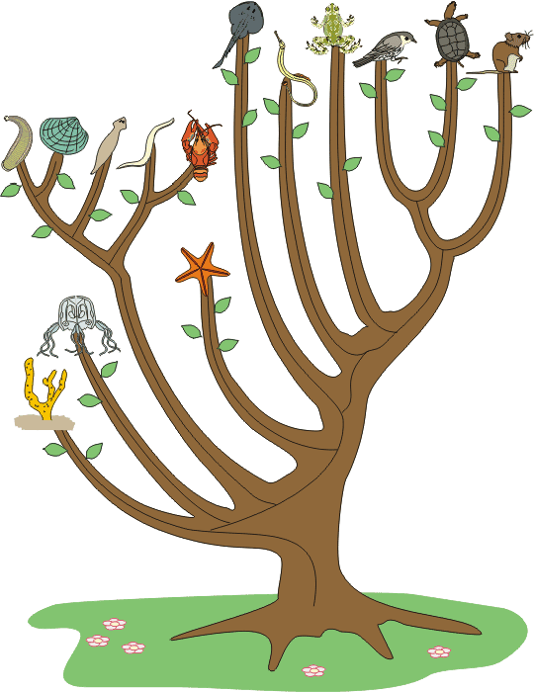
Tree
Graphs with no cycles?
A forest.
Connected graphs with no cycles?
A tree.

Slide 45
More Trees
leaf
leaf
A leaf is a vertex of degree 1.
More leaves.
Even more leaves.

Slide 46
Tree Characterization by Path
Definition. A tree is a connected graph with no cycles.
Can there be no path between u and v?
NO
Can there be more than one simple path between u and v?
NO
This will create cycles.
u
v
Claim. In a tree, there is a unique simple path between every pair of vertices.

Slide 47
Tree Characterization by Number of Edges
Definition. A tree is a connected graph with no cycles.
Can a tree has no leaves?
NO
Then every vertex has degree at least 2.
Go to unvisited edges as long as possible.
Cannot get stuck,
unless there is a cycle.

Slide 48
Tree Characterization by Number of Edges
Definition. A tree is a connected graph with no cycles.
Can a tree has no leaves?
NO
How many edges does a tree have?
n-1?
We usually use n to denote the number of vertices,
and use m to denote the number of edges in a graph.

Slide 49
Tree Characterization by Number of Edges
Definition. A tree is a connected graph with no cycles.
Can a tree has no leaves?
NO
How many edges does a tree have?
n-1?
v
Look at a leaf v.
Is T-v a tree?
YES
Can T-v has a cycle?
Is T-v connected?
NO
YES
By induction, T-v has (n-1)-1=n-2 edges.
So T has n-1 edges.

Slide 50
Tree Characterizations
Definition. A tree is a connected graph with no cycles.
Characterization by paths:
A graph is a tree if and only if
there is a unique simple path between every pair of vertices.
Characterization by number of edges:
A graph is a tree if and only if it is connected and has n-1 edges.

Slide 51
This Lecture
Seven bridges of Konigsberg
Graphs, degrees
Isomorphism
Path, cycle, connectedness
Tree
Eulerian cycle

Slide 52
Eulerian Graphs
Euler’s theorem: A graph has an Eulerian path if and only if it is
connected and has at most two vertices with an odd number of edges.
Can a graph have only 1
odd degree vertex?
Odd degree vertices.
Euler’s theorem: A graph has an Eulerian path if and only if
it has zero or two vertices with odd degrees.
Proof by induction.

Slide 53
Eulerian Cycle
Euler’s theorem: A connected graph has an Eulerian cycle if and only if
every vertex is of even degree.
First we find an Eulerian cycle in the below example.

Slide 54
Eulerian Cycle
Euler’s theorem: A connected graph has an Eulerian cycle if and only if
every vertex is of even degree.
Note that the edges can be partitioned into five simple cycles.
Vertices of the same color represent the same vertices.

Slide 55
Eulerian Cycle
Euler’s theorem: A connected graph has an Eulerian cycle if and only if
every vertex is of even degree.
The idea is that we can construct an Eulerian cycle by adding cycle one by one.
1
2
First transverse the first cycle.

Slide 56
Eulerian Cycle
Euler’s theorem: A connected graph has an Eulerian cycle if and only if
every vertex is of even degree.
The idea is that we can construct an Eulerian cycle by adding cycle one by one.
1
6
2
3
5
4
Then transverse the second cycle.

Slide 57
Eulerian Cycle
Euler’s theorem: A connected graph has an Eulerian cycle if and only if
every vertex is of even degree.
How to deal with the third cycle?
9
1
10
2
6
8
3
5
7
4
We can “detour” to the third cycle before finishing the second cycle.

Slide 58
Eulerian Cycle
Euler’s theorem: A connected graph has an Eulerian cycle if and only if
every vertex is of even degree.
We use the same idea to deal with the fourth cycle
13
1
14
10
2
6
12
3
5
11
9
7
4
8
We can “detour” to the fourth cycle at an “intersection point”.

Slide 59
Eulerian Cycle
Euler’s theorem: A connected graph has an Eulerian cycle if and only if
every vertex is of even degree.
15
16
12
13
1
14
10
9
14
2
6
12
10
3
5
11
9
13
11
7
4
8
We can “insert” the fifth cycle at an “intersection point”.

Slide 60
Eulerian Cycle
Euler’s theorem: A connected graph has an Eulerian cycle if and only if
every vertex is of even degree.
15
1
16
12
9
2
6
14
10
3
5
13
11
7
4
8
So we have an Eulerian cycle of this example

Slide 61
Idea
In general, if we have a “partial” Eulerian cycle C*,
and it intersects with a cycle C on a vertex v,
then we can extend the Eulerian cycle C* to include C.
C*
C
v
First follow C* until we visit v, then follow C until we go back to v,
and then follow C* from v to the end.

Slide 62
Proof
We have informally proved the following claim in the previous slides.
Claim 1. If the edges of a connected graph can be partitioned
into simple cycles, then we can construct an Eulerian cycle.
Euler’s theorem: A connected graph has an Eulerian cycle if and only if
every vertex is of even degree.
We can prove Euler’s theorem if we can prove the following claim.
Claim 2. If every vertex is of even degree, then
the edges can be partitioned into simple cycles.

Slide 63
Partitioned into Simple Cycles
Claim 2. If every vertex is of even degree, then
the edges can be partitioned into simple cycles.
First we can find one cycle by the same idea as before.
Start from any vertex.
Go to unvisited edges as long as possible.
Cannot get stuck before we find a cycle.

Slide 64
Partitioned into Simple Cycles
Claim 2. If every vertex is of even degree, then
the edges can be partitioned into simple cycles.

Slide 65
Partitioned into Simple Cycles
Claim 2. If every vertex is of even degree, then
the edges can be partitioned into simple cycles.

Slide 66
Partitioned into Simple Cycles
Claim 2. If every vertex is of even degree, then
the edges can be partitioned into simple cycles.

Slide 67
Partitioned into Simple Cycles
Claim 2. If every vertex is of even degree, then
the edges can be partitioned into simple cycles.

Slide 68
Partitioned into Simple Cycles
Claim 2. If every vertex is of even degree, then
the edges can be partitioned into simple cycles.

Slide 69
Partitioned into Simple Cycles
Claim 2. If every vertex is of even degree, then
the edges can be partitioned into simple cycles.

Slide 70
Partitioned into Simple Cycles
Claim 2. If every vertex is of even degree, then
the edges can be partitioned into simple cycles.

Slide 71
Partitioned into Simple Cycles
Claim 2. If every vertex is of even degree, then
the edges can be partitioned into simple cycles.

Slide 72
Partitioned into Simple Cycles
Claim 2. If every vertex is of even degree, then
the edges can be partitioned into simple cycles.

Slide 73
Partitioned into Simple Cycles
Claim 2. If every vertex is of even degree, then
the edges can be partitioned into simple cycles.

Slide 74
Partitioned into Simple Cycles
Claim 2. If every vertex is of even degree, then
the edges can be partitioned into simple cycles.
Proof. Let C be a simple cycle.
Remove the edges in C from the graph G and call the new graph G’.
So the degree of each vertex is either unchanged or decreased by two.
So every vertex of the graph G’ is still of even degree.
Note that G’ has fewer edges than G.
By induction, G’ can be partitioned into simple cycles C₁, C₂, …, C_{k}.
So the original graph G can be partitioned into simple cycles, C, C₁, C₂, …, C_{k}.

Slide 75
Proof
We have informally proved the following claim in the previous slides.
Claim 1. If the edges of a connected graph can be partitioned
into simple cycles, then we can construct an Eulerian cycle.
We proved the following claim by induction.
Claim 2. If every vertex is of even degree, then
the edges can be partitioned into simple cycles.
So now we have proved Euler’s theorem.
Euler’s theorem: A connected graph has an Eulerian cycle if and only if
every vertex is of even degree.

