Slide 1
Angular JS
JavaScript framework for creating web and mobile single page applications.
AngularJS is an open-source, JavaScript-based, front-end web application framework for dynamic web app development. It utilizes HTML as a template language. By extending HTML attributes with directives and binding data to HTML with expressions, AngularJS creates an environment that is readable, extraordinarily expressive and quick to develop.
Angular
Angular is the blanket term used to refer to Angular 2, Angular 4 & 6 and all other versions that come after AngularJS. Both Angular 2,4,5 and 6 are open-source, TypeScript-based front-end web application platforms.

Slide 2
AngularJS
The architecture of AngularJS is based on model-view-controller (MVC) design. The model is the central component that expresses the application's behavior and manages its data, logic, and rules. The view generates an output based on the information in the model. The controller accepts input, converts it into commands and sends the commands to the model and the view.
AngularJS is written in JavaScript
Angular
In Angular 2, controllers and $scope were replaced by components and directives. Components are directives with a template.
Disadvantages of AngularJS
Not secure : Being JavaScript only framework, application written in AngularJS are not safe. Server side authentication and authorization is must to keep an application secure.
Not degradable: If the user of your application disables JavaScript, then nothing would be visible, except the basic page.

Slide 3
Difference between Typescript and JavaScript:
TypesScript is known as Object oriented programming language whereas JavaScript is a scripting language.
TypeScript has a feature known as Static typing but JavaScript does not have this feature.
TypeScript gives support for modules whereas JavaScript does not support modules.
TypeScript has Interface but JavaScript does not have Interface.
TypeScript support optional parameter function but JavaScript does not support optional parameter function.

Slide 4
The biggest difference is that TypeScript checks the types of variable at the compile time , unlike at run time in Javascript.
Demo :
Suppose you want to create an add function which takes 2 numbers and return their sum
In Javascript
function add(num1 ,num2) {
return num1 + num2
}
add(1,2) // 3 // works fine
add(1 , “Hello”) // 1Hello
no compile error. Can cause unexpected results during “Run time” of the program. You don’t want num2 to accept anything other than a number.
Typescript solves such problems by using “types” in variables declaration
In Typescript
function add(num1: number ,num2:number) {
//num1 & num2 should be only and only of type "number"
return num1 + num2
}
add(1,2) // works fine
add(1,"two") // Compile time error in typescript.Easier Testing

Slide 5
TypeScript Configuration:
TypeScript is a primary language for Angular application development. It is a superset of JavaScript with design-time support for type safety and tooling.
Browsers can't execute TypeScript directly. Typescript must be "transpiled" into JavaScript using the tsc compiler, which requires some configuration.
This page covers some aspects of TypeScript configuration and the TypeScript environment that are important to Angular developers, including details about the following files:
tsconfig.json—TypeScript compiler configuration.

Slide 6
Angular Installation:
Download Nodejs-
https://nodejs.org/en/
Steps for Angular:
npm install -g @angular/cli (npm – node package manager)
ng new my-dream-app (ng means angular)
cd my-dream-app (current directory)
ng serve
ng new:
The Angular CLI makes it easy to create an application that already work.
ng generate
Generate components, routes, services and pipes with a simple command.
ng serve
Easily test your app locally while developing.

Slide 7
Template − This is used to render the view for the application. This contains the HTML that needs to be rendered in the application. This part also includes the binding and directives.
Class − This is like a class defined in any language such as C. This contains properties and methods. This has the code which is used to support the view. It is defined in TypeScript.
The class normally has the following syntax in TypeScript.
Syntax
class classname {
Propertyname: PropertyType = Value
}
Parameters
Classname − This is the name to be given to the class.
Propertyname − This is the name to be given to the property.
PropertyType − Since TypeScript is strongly typed, you need to give a type to the property.
Value − This is the value to be given to the property.

Slide 8
export class AppComponent {
appTitle: string = 'Welcome';
}
In the example, the following things need to be noted −
We are defining a class called AppComponent.
The export keyword is used so that the component can be used in other modules in the Angular JS application.
appTitle is the name of the property.
The property is given the type of string.
The property is given a value of ‘Welcome’.

Slide 9
Template
This is the view which needs to be rendered in the application.
Syntax
Template: '
<HTML code>
class properties
'
template: '
<div>
<h1>{{appTitle}}</h1>
<div>Hi Team </div>
</div>
'
In the example, the following things need to be noted −
We are defining the HTML code which will be rendered in our application
We are also referencing the appTitle property from our class.

Slide 10
Metadata − This has the extra data defined for the Angular class. It is defined with a decorator(A Decorator is a special kind of declaration that can be attached to a class declaration, method, accessor, property, or parameter. Decorators use the form @expression)
import { Component } from '@angular/core';
@Component ({
selector: 'my-app',
template: ` <div>
<h1>{{appTitle}}</h1>
<div> Hello Team</div>
</div> `,
})
export class AppComponent {
appTitle: string = 'Welcome';
}
In the above example, the following things need to be noted −
We are using the import keyword to import the ‘Component’ decorator from the angular/core module.
We are then using the decorator to define a component.
The component has a selector called ‘my-app’. This is nothing but our custom html tag which can be used in our main html page.

Slide 11
Module in Angular refers to a place where you can group the components, directives, pipes, and services, which are related to the application.
In case you are developing a website, the header, footer, left, center and the right section become part of a module.
When you create a new project using the Angular –cli command, the ngmodule is created in the app.module.ts file by default.
Declaration
It is an array of components created. If any new component gets created, it will be imported first and the reference will be included in declarations as shown below −
declarations: [
AppComponent,
NewCmpComponent
]
Import
It is an array of modules required to be used in the application. It can also be used by the components in the Declaration array. For example, right now in the @NgModule we see the Browser Module imported
import { FormsModule } from '@angular/forms';
The import in the @NgModule will be like the following −
imports: [
BrowserModule,
FormsModule
]

Slide 12
Expressions are used to bind application data to HTML. Expressions are written inside double curly braces such as in {{ expression}}
Using numbers:
<p>Expense on Books : {{cost * quantity}} Rs</p>
Using Strings:
<p>Hello {{student.firstname + " " + student.lastname}}!</p>
Using Object:
<p>Roll No: {{student.rollno}}</p>
Using Array:
<p>Marks(Math): {{marks[3]}}</p>

Slide 13
Directives are used to extend HTML. They are special attributes starting with ng-prefix. Let us discuss the following directives −
ng-app − This directive starts an Angular Application.
ng-init − This directive initializes application data.
ng-model − This directive defines the model that is variable to be used in Angular.
ng-repeat − This directive repeats HTML elements for each item in a collection.
The ng-app directive starts an Angular Application. It defines the root element. It automatically initializes or bootstraps the application when the web page containing Angular Application is loaded. It is also used to load various Angular modules in Angular Application.

Slide 14
Angular is application for tree of components
Angular Applications are Modular
Every Angular App has at least one module: the root app
Each Application has:
Declarations:
Exports:
Imports:
Providers:
Metadata:
Tell Angular how to process a class.
Selector:
TemplateURL
Providers:
Other Metdata decorators include:
@injectable, @Input, @Output

Slide 15
Example of angular 6 element
Now let’s begin with new component
Step1 : Ng g c temp
Components are the most basic UI building block of an Angular app. An Angular app contains a tree of Angular components.
A component controls a patch of screen called a view.

Slide 16

After Angular Installation
Create Component and Overview
<app-root> Root component
Single component contains “app”.
App.component.css
App.component.html
App.component.spec.ts (logic)
Above three files provide functionality
Add !!!
See change.
App.component.ts:
title = 'FirstAppApp';
appcompoent.css:
h1 {
color:green;
}

Slide 17
Creating your own component:
Every component has html ts & css files:
Binding data to component class:
<p>
date works! {{ message }}
</p>
export class DateComponent implements OnInit {
message: string = "hello";
message: string = new Date().toDateString();
Output: date works! Sat Nov 10 2018

Slide 18
Data binding and async
export class DateComponent implements OnInit {
message: string ;
constructor() {
//Angular6 setInterval
setInterval((){
let curr= new Date();
this.message = curr;
},1000
)
}

Slide 19
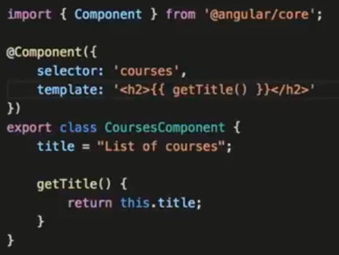
Angular Templates:

Slide 20
Template Interpolation:
{{ someNo + 1 }}
message: string ;
someNo : number = 10;
--
{{ addTwoNumbers(1,8)}}
addTwoNumbers(a: number, b:number){
return a+b;
}

Slide 21
ngFor:
<div>
<h1> {{ user.name }} </h1>
<h2> {{ user.title }} </h2>
<h3> {{ user.address }} </h3>
<!-- <h4> {{ user.phone[0] }} </h4>
<h4> {{ user.phone[1] }} </h4> -->
<h4 *ngFor="let phoneNo of user.phone">{{ phoneNo}}</h4>
</div>
this.user = {
name: 'HelloTeamm',
title: 'Developer',
address: '123456789',
phone: [
'123456789',
'158932142',
'158932142',
'123456789'
];
};

Slide 22
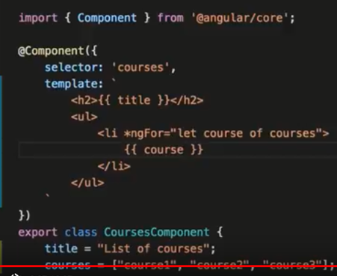
Directives:
AngularJS directives are extended HTML attributes with the prefix ng- . The ng-app directive initializes an AngularJS application. The ng-model directive binds the value of HTML controls (input, select, textarea) to application data.
Backtiks can be used to make more lines and readable.

Slide 23
Include Bootstrap:
Npm install bootstrap
and
Configure angular.json:
"styles": [
"node_modules/bootstrap/dist/css/bootstrap.min.css",
"styles.scss"
]
2: Import directly in src/style.css or src/style.scss:
@import '~bootstrap/dist/css/bootstrap.min.css';

Slide 24
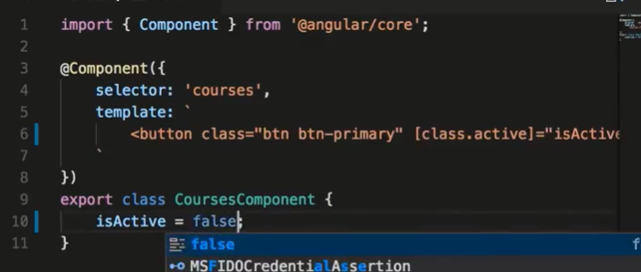
Add a Button After Bootstrap:
template: `
<button class='btn btn-primary'>Team </button>
`
Class Binding:
template: `
<button class='btn btn-primary' [class.active]="isActive">Team </button>
`

Slide 25

Two Way Binding:
import { Component, OnInit } from '@angular/core';
@Component({
selector: 'app-courses',
templateUrl: './courses.component.html',
styleUrls: ['./courses.component.css'] ,
template: `
<input [(ngModel)]="name" type="text"> {{ name }}
`
})
export class CoursesComponent implements OnInit {
name="";
constructor() { }
ngOnInit() {
}
}

Slide 26
Pipes:
import { Component, OnInit } from '@angular/core';
@Component({
selector: 'app-courses',
templateUrl: './courses.component.html',
styleUrls: ['./courses.component.css'] ,
template: `
{{course.title |uppercase}} <br/>
{{course.students | number}} <br/>
{{course.rating | number}} <br/>
{{course.price | currency:'AUD'}} <br/>
{{course.releaseDate | date:'shortDate' }}
`
})
export class CoursesComponent implements OnInit {
course = {
title: "Hi Team Angular Tutorial",
rating: 4.975,
students: 30124,
price: 190.25,
releaseDate: new Date(2018,4.1)
}
}

Slide 27
Angular routing:
Web applications can have different sections that correspond to different URLs, and supporting those sections programmatically is called routing.
In Simple words, As per Url, open different angular components is called routing.
URL Component
http://localhost:4200/home Home.component
http://localhost:4200/aboutus Aboutus.component
http://localhost:4200/contactus ContactUs.Component
Package that must be import:
import { Routes, RouterModule } from ‘@angular/Router’;

Slide 28
Example:
Step1 : First Create three components home,aboutus,contactus.
Step2: Configure app.module.ts as follows.
import { BrowserModule } from '@angular/platform-browser';
import { NgModule, Component } from '@angular/core';
import { FormsModule } from '@angular/forms';
import { HttpModule } from '@angular/http';
import { Routes, RouterModule } from '@angular/Router';
import { AppComponent } from './app.component';
import { AboutusComponent } from './aboutus/aboutus.component';
import { ContactusComponent } from './contactus/contactus.component';
import { HomeComponent } from './home/home.component';
const AppRoutes: Routes = [
{ path: 'about', component: AboutusComponent },
{ path: 'Home', component: HomeComponent },
{ path: 'ContactUs', component: ContactusComponent }
]
@NgModule({
declarations: [
AppComponent,
AboutusComponent,
ContactusComponent,
HomeComponent,
],
imports: [
BrowserModule,
FormsModule,
HttpModule,
RouterModule.forRoot(AppRoutes)
],
// Add provider
providers: [],
bootstrap: [AppComponent]
})
export class AppModule { }

Slide 29
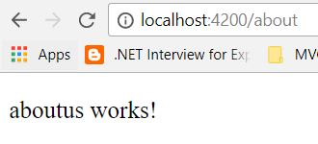
Make changes in app.component.ts as follows
import { Component } from '@angular/core';
@Component({
selector: 'app-root',
template: `
<router-outlet></router-outlet>
`,
styles: [`
p
{
background-color:silver;
font-size : 26px;
}
`],
})
export class AppComponent {
}

Slide 30
Services:
Services are written by just defining a typescript(with extension .service.ts) class
with decorator @Injectable annotation.
Step 1: First we create service using angular cli. Write following angular cli command
into integrated terminal
ng g service data
It will create two files named data.service.ts and data.service.spec.ts.
Step 2: Write the following code into service.ts
import { Injectable } from '@angular/core';
@Injectable()
export class DataService {
// Create array
hobbies = [
'dancing',
'singing',
'internet'
];
constructor() { }
// Create simple angular service method
servicemethod(){
return 'Its just a simple service method';
} }
In the above code block, an array “hobbies” and function “servicemethod” are defined which may be used by any components.

Slide 31
Step 3: Update app.module.ts (Pass the reference to newly created service and add providers)
import { DataService } from './data.service';
import { BrowserModule } from '@angular/platform-browser';
import { NgModule } from '@angular/core';
import { FormsModule } from '@angular/forms';
import { HttpModule } from '@angular/http';
import { AppComponent } from './app.component';
@NgModule({
declarations: [
AppComponent,
],
imports: [
BrowserModule,
FormsModule,
HttpModule
],
// Add provider
providers: [DataService],
bootstrap: [AppComponent]
})
export class AppModule { }

Slide 32
Step4 : Update app.component.ts as following code
import { Component } from '@angular/core';
@Component({
selector: 'app-root',
template: `
<p>hi {{data}}</p>
<li *ngFor="let h of itemsarray">
<b> {{h}} </b>
</li>
`,
styles: [`
p
{
background-color:green;
}
`],
// Don't forget to add reference of DataService
providers:[DataService]
})
export class AppComponent {
// String and array variable declartion
data;
itemsarray=[]
constructor(private dataservice: DataService) {
// use property of service
this.itemsarray = this.dataservice.hobbies;
// use method of service
this.data = this.dataservice.servicemethod();
}
}
In above code our custom service instance “dataservice” is created and using this instance we are
accessing the variable and function of angular custom service.
Next step:
Ng serve

