Slide 1

Student Details
Name: NAGA SURYA SATYA V MAHESH BASA
SkillsBuild email id: 21h41a0506@bvcits.edu.in
College Name: BONAM VENKATA CHALAMAYYA INSTITUTE OF TECHNOLOGY AND SCIENCE
COLLEGE STATE: ANDHRA PRADESH
Internship Domain: AI & ML
Internship Start and End Date: 07/05/2024 to 15/06/2024

Slide 2

Project title/problem statement
Project: EMPLOYEE BURNOUT
Problem: Identifying and mitigating employee burnout to improve workplace productivity and employee well-being. Objective: Use machine learning to predict employee burnout based on various workplace factors.

Slide 3
agenda
Introduction
Project Objective
Data Collection
Methodology
Model Training
Results
Conclusion

Slide 4
Project overview
What is EMPLOYEE BURNOUT?
Employee burnout is a state of physical, emotional, and mental exhaustion caused by prolonged stress.
It can lead to reduced productivity, high turnover and health issues.
Project Goal:
Our project aims to predict burnout using machine learning techniques.

Slide 5
Who are the end users of this project?
Who Benefits from This Project?
HR Departments: To identify at-risk employees and provide support.
Managers: To adjust workloads and improve team dynamics.
Employees: To gain insights into their own work habits and seek help if needed.

Slide 6
Your solution and its value proposition
Solution:
A predictive model that uses employee data
To identify those at risk of burnout
Value Proposition:
Early identification of burnout can lead to timely interventions
Improving employee well-being and productivity.

Slide 7
How did you customize the project and make it your own
How We Made It Unique:
Developed a synthetic dataset for demonstration purposes.
Used Random Forest Classifier for prediction due to its accuracy and robustness.
Standardized data to improve model performance.

Slide 8
modelling
Encoding Process:
Data Collection: Collected data on work hours, job satisfaction, and work-life balance.
Data Preprocessing: Standardized the features.
Model Training: Used Random Forest Classifier to train the model.
Evaluation: Assessed the model's performance using confusion matrix and classification report.

Slide 9
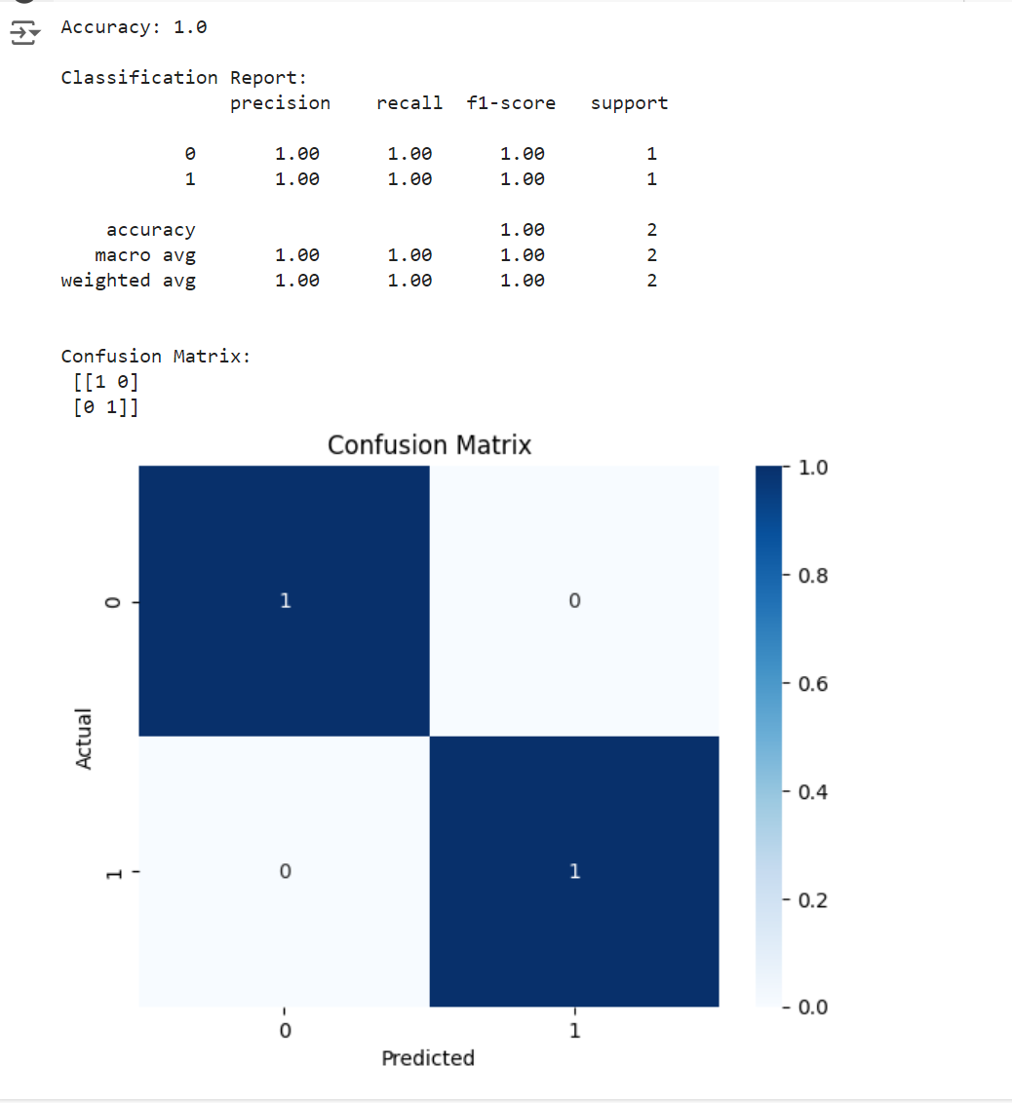
results
Confusion Matrix:
Correct Predictions: 4
Incorrect Predictions: 0
Classification Report:
Precision, Recall, F1-Score: 1.00 (Perfect for both classes)
Accuracy:
Accuracy: 100%
Key Points:
High accuracy in predicting burnout.
Early detection can prevent burnout.

Slide 10
links
Project Code:
GitHub Repository Link:
https://github.com/MAHESHBASA/EMPLOYEEBURNOUT.git
References:
Research papers and articles on burnout prediction and machine learning.
Data sources used for collecting employee burnout data.
Documentation on the machine learning techniques applied in this project.

Slide 11
conclusion
Summary:
Successfully developed a predictive model for employee burnout.
Early identification can help in taking proactive measures.
Future Work:
Incorporate more features and use real-world data for better accuracy.

