Slide 1

Customer Shopping Behavior Analysis
What 3,900 purchases reveal about spending, segments, products and subscriptions
Python • MySQL • Power BI

Slide 2




Project Overview & Dataset
3,900
18
37
purchases (rows)
columns / features
missing ratings (fixed)
Goal: uncover insights to guide business decisions on…
Spending patterns
Customer segments
Product preferences
Subscription behavior
Features cover demographics, purchase details and shopping behavior.

Slide 3




How We Analysed the Data
1. Python
2. Feature Engineering
3. MySQL
4. Power BI
Load, clean, fill missing ratings (median per category), snake_case columns
Created age_group & purchase frequency; dropped duplicate promo_code_used
Cleaned data loaded; 10 business questions answered with SQL
Interactive dashboard to present the insights visually
From raw data → clean data → SQL answers → visual dashboard.

Slide 4
Who Drives Revenue?
Male customers bring ~68% of revenue.
Avg spend is nearly equal ($59.87 vs $59.28), but only 899 of 3,316 customers subscribe.

Slide 5
Customer Segments & Loyalty
80%
of customers are “Loyal” (2,660 of 3,316)
Repeat buyers (>5 purchases)
Subscribers: 815 of 899 (91%)
Non-subscribers: 2,143 of 2,417 (89%)
Subscribers are only slightly more likely to be repeat buyers.

Slide 6
Product Insights
Highly rated items are great campaign leaders; discount-heavy items need margin watching.

Slide 7




Best-Selling Products by Category
Accessories
Clothing
Footwear
Outerwear
1. Jewelry – 146
2. Sunglasses – 144
3. Scarf – 136
1. Shirt – 149
2. Pants – 146
3. Sweater – 142
1. Sandals – 133
2. Shoes – 126
3. Boots – 125
1. Coat – 143
2. Jacket – 134
Numbers show total orders. Top-3 lists per category.

Slide 8
Shipping & Age Group
Express shoppers spend ~$2.47 more; young adults lead, but all age groups are close.

Slide 9
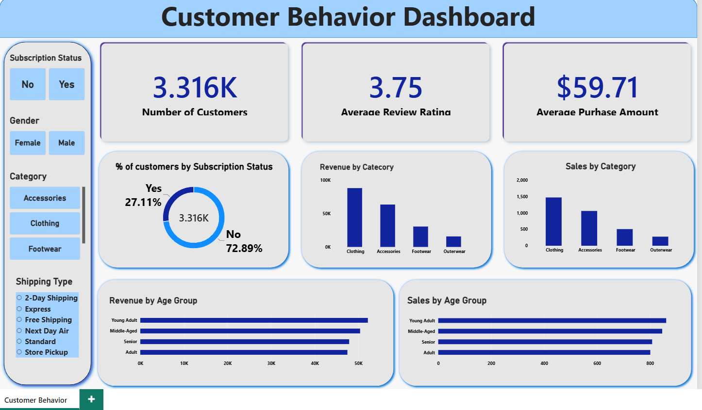
Power BI Dashboard
3.316K
Customers
3.75
Avg review rating
$59.71
Avg purchase amount
Filters: subscription, gender, category and shipping type.

Slide 10





Business Recommendations
Boost Subscriptions
Loyalty Programs
Review Discounts
Promote exclusive subscriber benefits
Reward repeat buyers to keep them “Loyal”
Balance sales boosts with margin control
Product Positioning
Targeted Marketing
Feature top-rated & best-selling items
Focus on high-revenue ages & express-shipping users
Thank you!

