Slide 1
MACHINE LEARNING OPERATIONS
Course Code: 24SDAD03
FINAL PROJECT REVIEW · PROJECT 28
Flow28 — AI-Based Traffic Prediction System with MLOps
K.Mahija · Sk.Anjum · P.Hasitha | 2400080129 · 2400080003 · 2400080005
Department of AIDS
Notes:
Project 28 — AI-Based Traffic Prediction System with MLOps. Team: K. Mahija (2400080129), Sk. Anjum (2400080003), P. Hasitha (2400080005). Course 24SDAD03, Department of AIDS. Final project review.

Slide 2
AI-Based Traffic Prediction System with MLOps
Project number : 28 — Flow28 traffic command deck
Student Name(s) : K. Mahija · Sk. Anjum · P. Hasitha
Registration Number(s) : 2400080129 · 2400080003 · 2400080005
Course / Department : 24SDAD03 · Department of AIDS
Batch / Section : ______________________
Faculty / Guide : ______________________

Slide 3
Problem Statement
Demand is not static — hour, weekday, season, weather, events and junction all move traffic volume, so one static estimate is wrong for most of the day.
Data is not the bottleneck — 48,120 hourly records for four junctions (Nov 2015 – Jun 2017) are public; turning them into a live, trustworthy forecast is the hard part.
Student projects stop at a notebook — an RMSE is printed once, then nothing is versioned, monitored or served to anyone.
No operational safety net — nothing gates a bad model, reports input drift, or keeps forecasting when the network link drops.
Why this needs an MLOps solution — a forecast is useful only if it can be retrained, promoted on evidence, monitored for drift and served continuously.
Notes:
Frame the gap: the dataset is public and a notebook already prints a good RMSE. What is missing is the lifecycle around it — versioning, promotion, drift, serving and offline fallback.

Slide 4
Objectives
Reproducible lifecycle — validate, engineer features, train, register, serve and monitor from one command.
Next-hour forecast per junction — plus a 6–48 h recursive outlook for day-ahead planning.
Evidence-gated promotion — a candidate replaces the champion only on a better holdout RMSE for the same dataset.
Drift before damage — PSI on input features turns data change into a reviewed retrain decision, not a silent failure.
Operator workspace — a FastAPI service plus a fifteen-module Streamlit UI for alerts, control, advisory and reports.
Expected outcome — an auditable, versioned, deployable traffic-forecasting service with offline edge fallback.

Slide 5
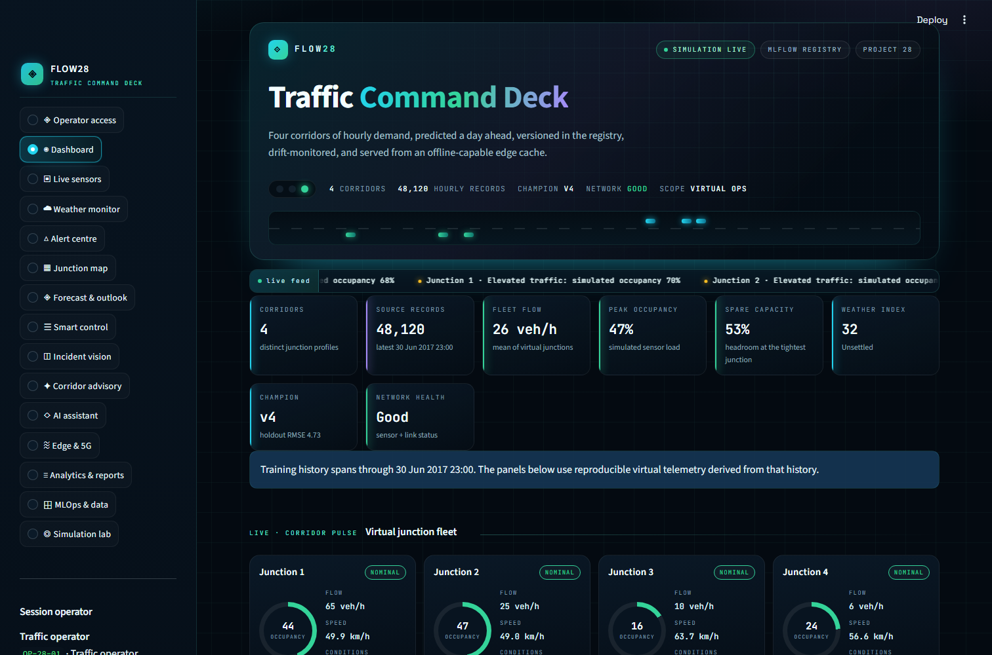
Proposed Solution
One lifecycle, one dataset — validate, engineer, train, register, promote, serve, monitor, retrain.
Two surfaces — FastAPI serves forecasts; a CSS-only Streamlit workspace adds fifteen operator modules.
Registry, not preference — the champion alias moves only when holdout RMSE improves.
Digital twin — virtual sensors, weather, 5G link, edge latency and five controllable devices.
Explainable advisory — every alert, signal plan and corridor recommendation is rule-based and unit-tested.

Slide 6
System Architecture
Data Source
Processing
Features
Training
Registry
Serving
Monitoring
Kaggle traffic.csv · 4 junctions · 48,120 hourly rows
Schema validation, de-duplication, cyclical time encoding
16 features: lags 1/2/3/24/168, rolling 24 h mean, calendar
RandomForest pipeline · chronological 80/20 holdout
MLflow 3.17 · runs, metrics, versions, champion alias
FastAPI service + Streamlit 15-module workspace
PSI drift check, edge cache, reviewed retrain
Cross-cutting controls
Promotion gate
Champion alias moves only when holdout RMSE improves on the same dataset tag.
Drift monitor
PSI on four input features against the baseline; 0.2 threshold raises drift_detected.
Edge cache
Champion mirrored as a skops artifact; inference continues when the link drops.
Advisory engine
Alerts, signal plans, corridor rankings and scene triage, all rule-based.
Request path — /predict (next hour) · /forecast/horizon (6–48 h) · /train · /monitor · /simulation/tick → Streamlit workspace, 15 modules → SQLite: predictions, incidents, actions, devices, telemetry, alerts
Feedback loop — PSI ≥ 0.2 → reviewed retrain → new version registered → champion alias moves only if holdout RMSE improves.
Notes:
Walk left to right: data, processing, features, training, registry, serving, monitoring. Serving and monitoring are red because they are the MLOps edges. The four cards below are the cross-cutting controls: promotion gate, drift monitor, edge cache and advisory engine.

Slide 7
Technology Stack
Layer | Technology | Role in Flow28
Data | pandas · NumPy · Kaggle traffic CSV | Validation, de-duplication, lag and rolling features
Model | scikit-learn Pipeline + RandomForestRegressor | OneHotEncoder(junction) + 120 trees, 16 features
Tracking & registry | MLflow 3.17 — SQLite store, file artifacts | Runs, metrics, model versions, champion alias
Serving | FastAPI + Uvicorn | 8 endpoints: predict, horizon, train, monitor, simulation
Workspace | Streamlit 1.66 + custom CSS design system | 15 operator modules, zero JavaScript
Operations | SQLite · skops edge cache · Pillow · unittest | Persistence, offline failover, scene triage, 13 tests
Deployment target — Docker + docker-compose on a single host (API, dashboard, MLflow store). No GPU, no cloud dependency required for the demo.

Slide 8
Dataset & Data Preparation
48,120
hourly records across 4 junctions
20 months
November 2015 to June 2017, hourly
47,444
supervised rows after lag windows
Source — Kaggle Traffic Prediction Dataset (fedesoriano): hourly vehicle counts recorded at four junctions.
Volume — junctions 1–3 hold 14,592 rows each; junction 4 has 4,344 rows and starts on 1 Jan 2017.
Preprocessing — timestamp parsing, duplicate removal on (timestamp, junction), invalid counts dropped, temperature defaulted to 20 °C, counts clipped at zero.
Split — chronological 80/20 on timestamps: 35,904 train and 11,540 holdout rows, cutoff 2 Mar 2017 18:00. Never shuffled — shuffling leaks the future.
Target — vehicle count one hour ahead, per junction.
Notes:
48,120 raw hourly rows reduce to 47,444 supervised rows after lag windows. The split is chronological with cutoff 2 Mar 2017 18:00 — 35,904 train and 11,540 holdout. Never shuffled, because shuffling leaks the future.

Slide 9
ML Model
4.73
holdout RMSE (vehicles)
2.94
holdout MAE (vehicles)
0.9686
R² on 11,540 unseen rows
Algorithm — RandomForestRegressor inside a scikit-learn Pipeline: OneHotEncoder for junction, passthrough numerics.
Hyperparameters — 120 trees, max_depth 20, min_samples_leaf 3, max_features 0.6, random_state 42.
Features (16) — lag_1/2/3/24/168, rolling_mean_24, cyclical hour, weekday and month, temperature_c, is_event, junction.
Training — chronological 80/20 split; the pipeline is logged with a signature and input example so serving accepts the same schema.
Why this model — tree ensembles capture non-linear peaks and interactions without scaling, and lag features encode the daily and weekly cycle.

Slide 10
MLOps Pipeline
1 Validate
2 Features
3 Train + log
4 Register
5 Promote gate
6 Serve
Schema, duplicates, time zones
16 lag, rolling and calendar features
RandomForest pipeline + MLflow run
New version + dataset tag
Champion alias only if RMSE improves
FastAPI, Streamlit, edge cache
Promotion rule
Every run is registered, but the champion alias moves only when holdout RMSE improves on the same dataset tag. A dataset change resets the comparison baseline.
Edge mirror
On promotion the artifact is copied to edge_cache/version-N with champion.json (skops format), so the dashboard and API keep serving without MLflow.
How it is measured — PSI compares the baseline 70% with the recent 30% on four features.
Current reading — rolling_mean_24 0.592 (drift_detected); vehicles and lag_1 ≈ 0.116.
A prompt, not a switch — drift queues a reviewed retrain that must still pass the promotion gate.
Audit trail — every monitor run logs psi_* metrics and a monitoring_window tag to MLflow.
Notes:
Every stage maps to a command or API endpoint. Promote gate and serve are red: no model reaches serving without beating the champion's holdout RMSE for the same dataset tag. The chart is the PSI reading from the latest monitor run — rolling_mean_24 at 0.592 is above the 0.2 threshold.

Slide 11
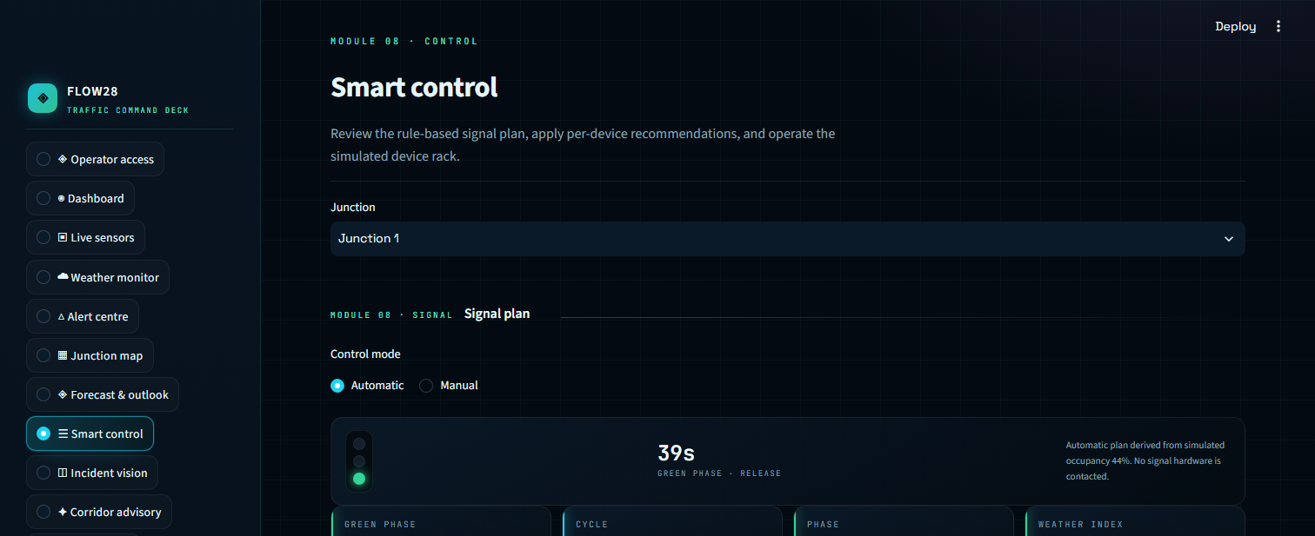
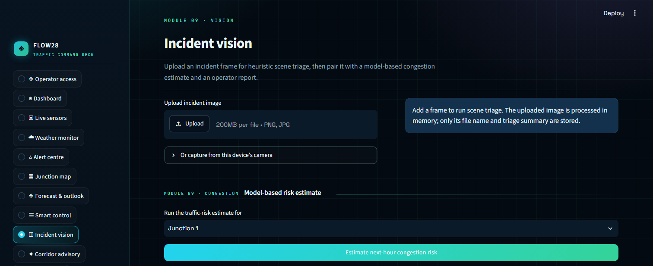
Implementation Progress
Workspace — fifteen Streamlit modules on one CSS design system, no JavaScript.
Service — FastAPI with eight endpoints; the same champion powers UI and API.
Registry — MLflow 3.17 on a SQLite store with file artifacts; champion alias points at version 4.
Code — app.py, ten traffic_mlops modules, thirteen tests, and the screenshot pipeline in docs/.
Status — running locally: API on port 8000, dashboard on 8501, champion v4 live, drift flagged, 21 simulated alerts stored.

Slide 12
Initial Results
6.65
Junction 1 RMSE
3.11
Junction 2 RMSE
5.43
Junction 3 RMSE
2.49
Junction 4 RMSE
Accuracy — average error of 2.94 vehicles and R² 0.969 on 11,540 unseen rows.
Per junction — the busiest junction is hardest: J1 RMSE 6.65 against J4 at 2.49.
Peaks — rare spikes are under-predicted (134 actual vs 106 predicted), the known limit of a point forecast.
Drift — rolling_mean_24 PSI 0.592 is flagged, so retraining is queued for review rather than applied silently.
When | Junction | Actual | Predicted | Error
2017-03-31 23:00 | J1 | 63 | 62.0 | -1.0
2017-05-22 19:00 | J2 | 47 | 41.9 | -5.1
2017-06-22 14:00 | J3 | 83 | 88.6 | +5.6
2017-04-18 00:00 | J4 | 6 | 5.8 | -0.2
2017-06-06 16:00 | J1 | 134 | 105.8 | -28.2
Real holdout rows scored by champion v4. The final row is a rare spike, where the model under-predicts.
Notes:
Metrics are from champion v4 on 11,540 unseen rows. Junction 1 is the busiest and hardest to forecast. The table shows real holdout rows; the last row is a rare spike the model under-predicts, which is the known limit of a point forecast.

Slide 13
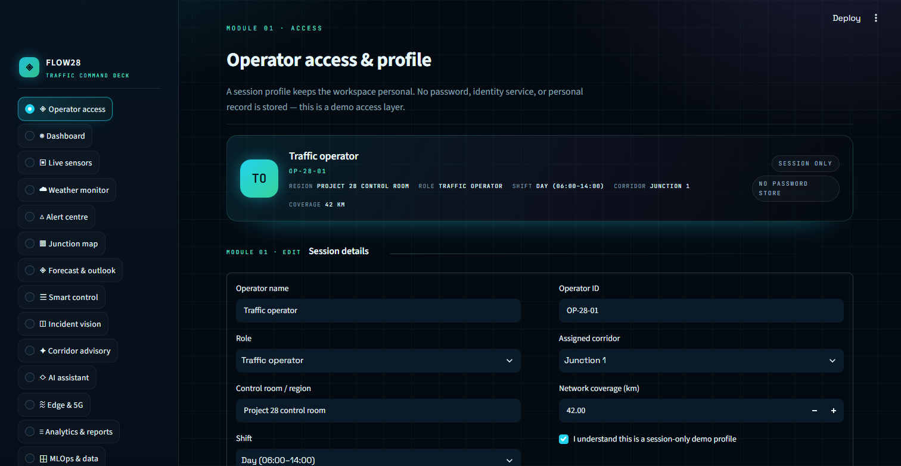
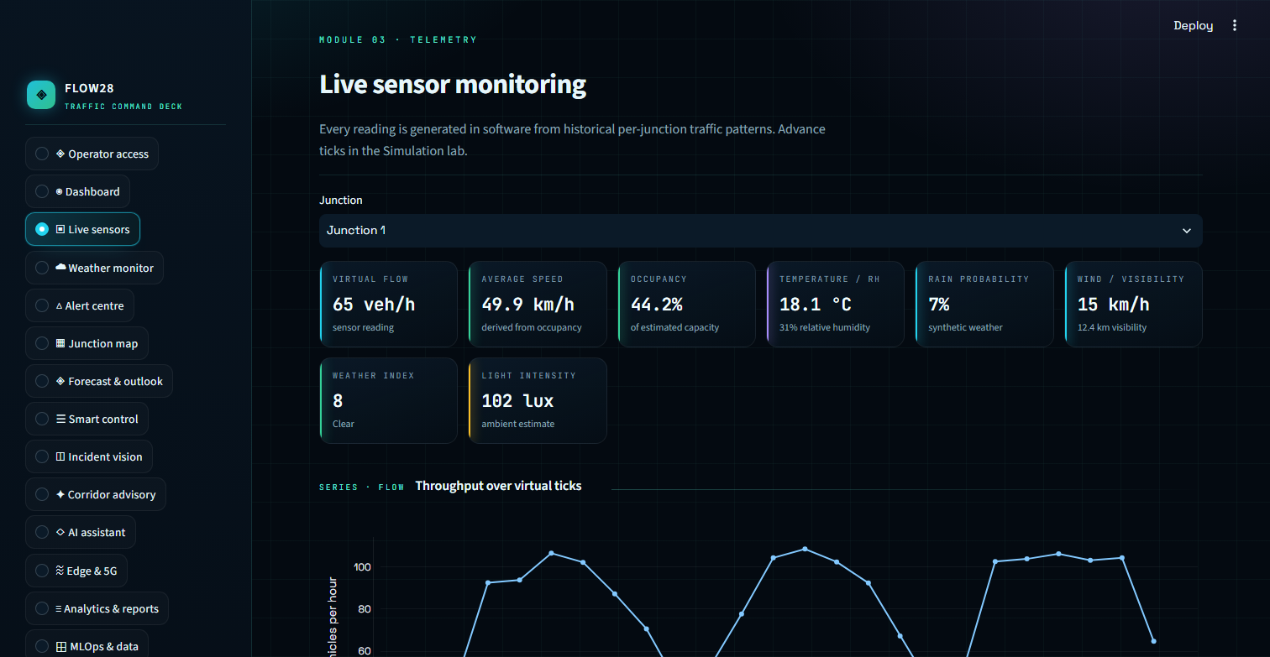
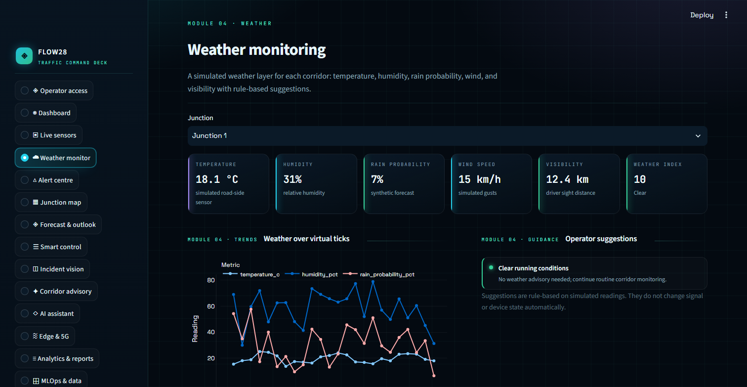
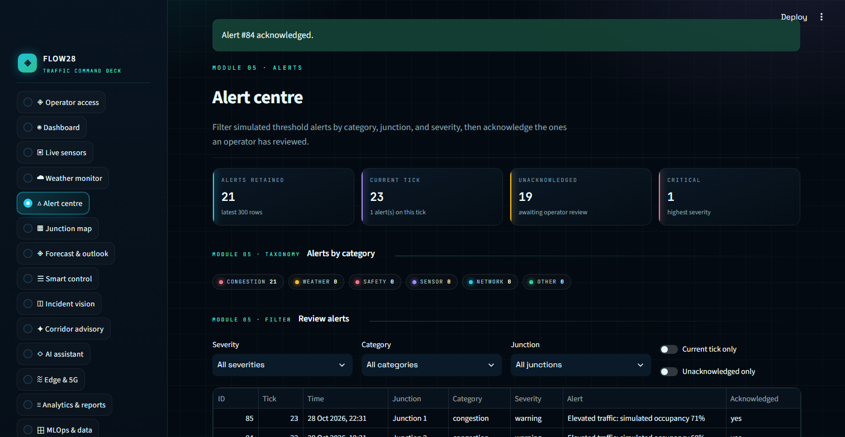
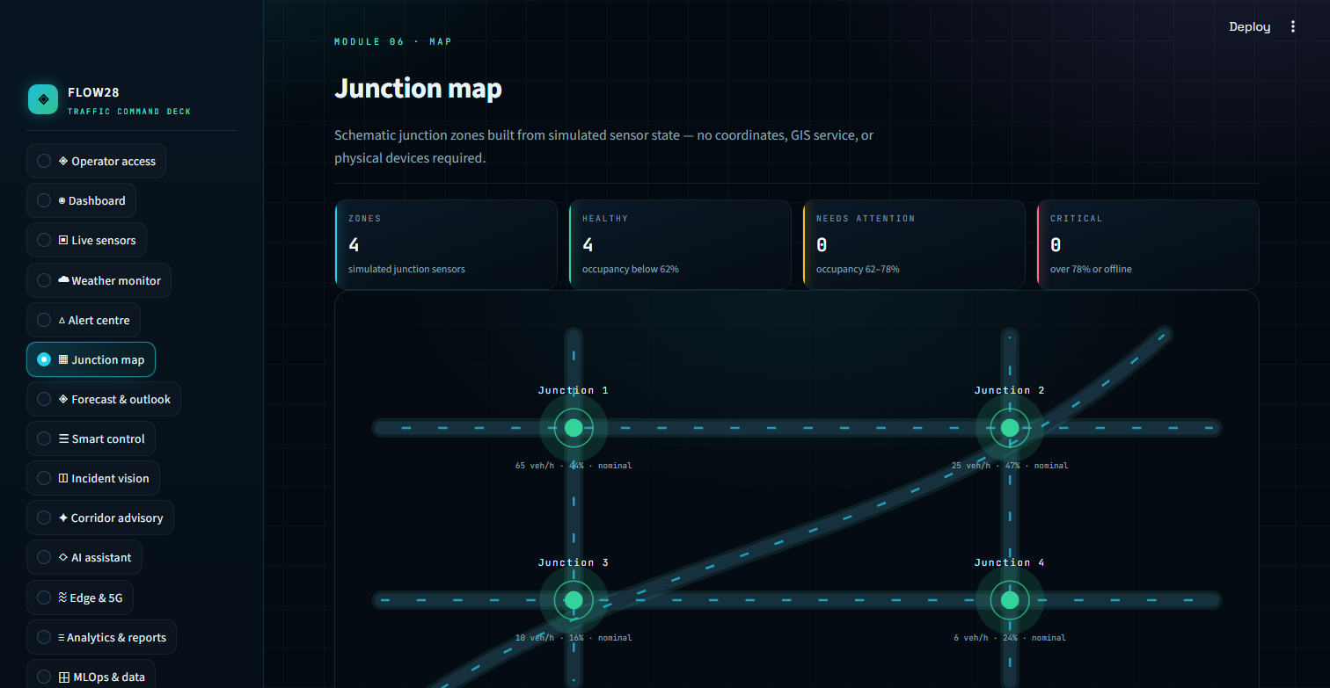
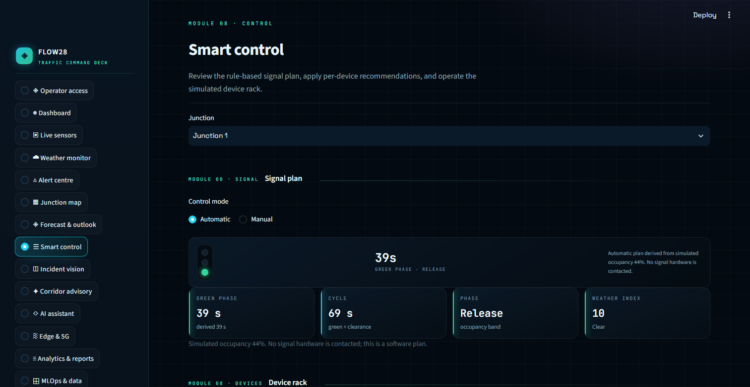
Workspace in Action — Daily Operations
Login & operator profile
Live sensor network
Weather & air quality
Alerts & acknowledgements
Junction map & flow
Smart control & signal plan
Captured from the running Flow28 dashboard — fifteen modules on one CSS design system, no JavaScript.

Slide 14
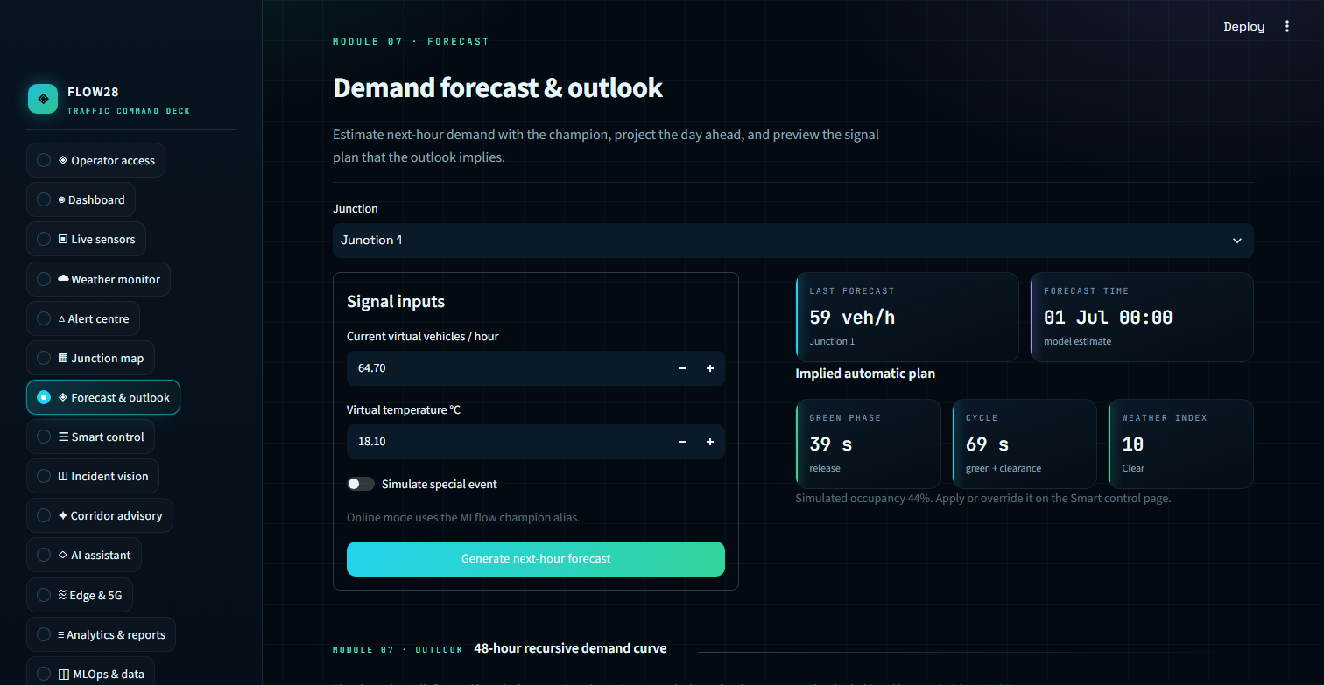
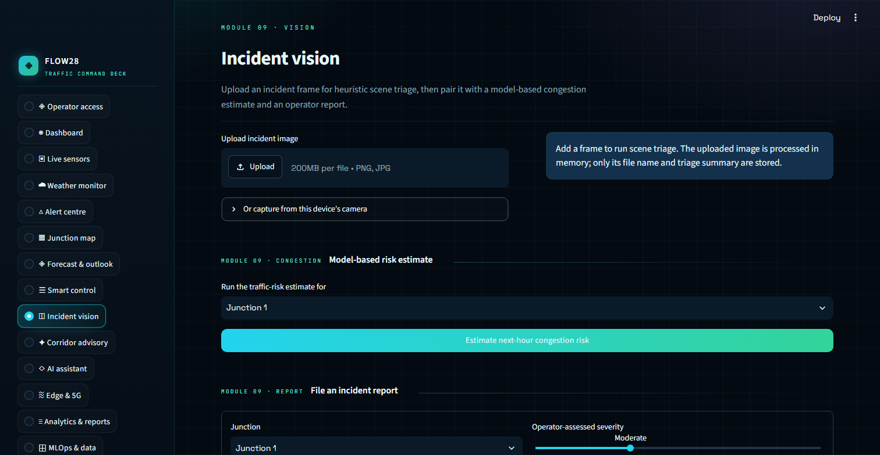
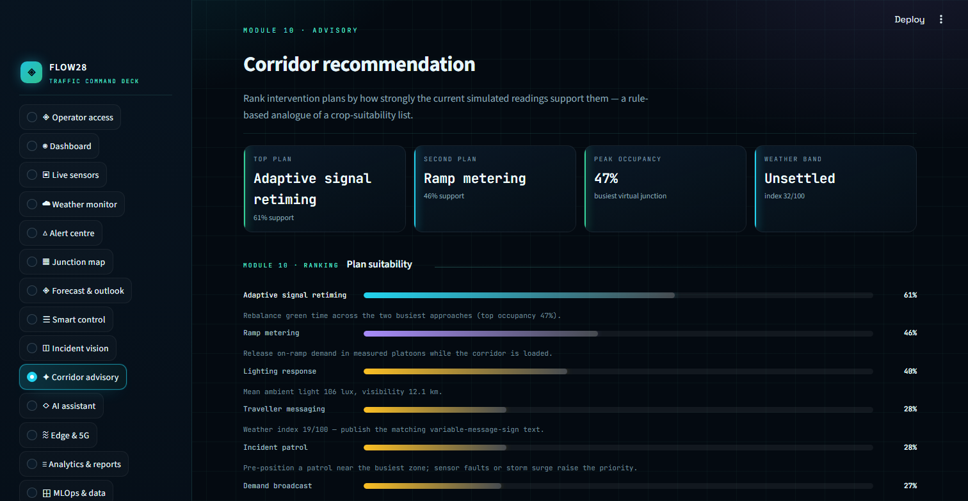
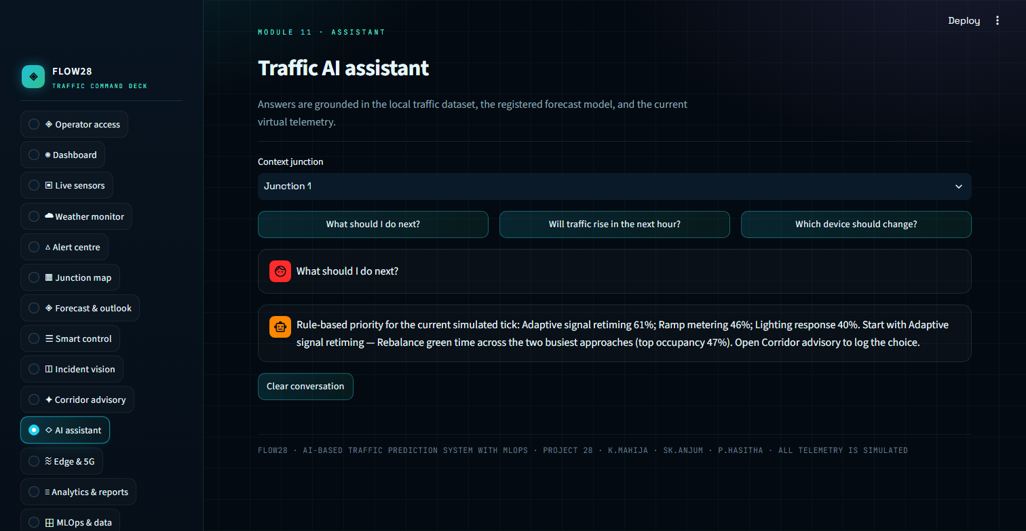
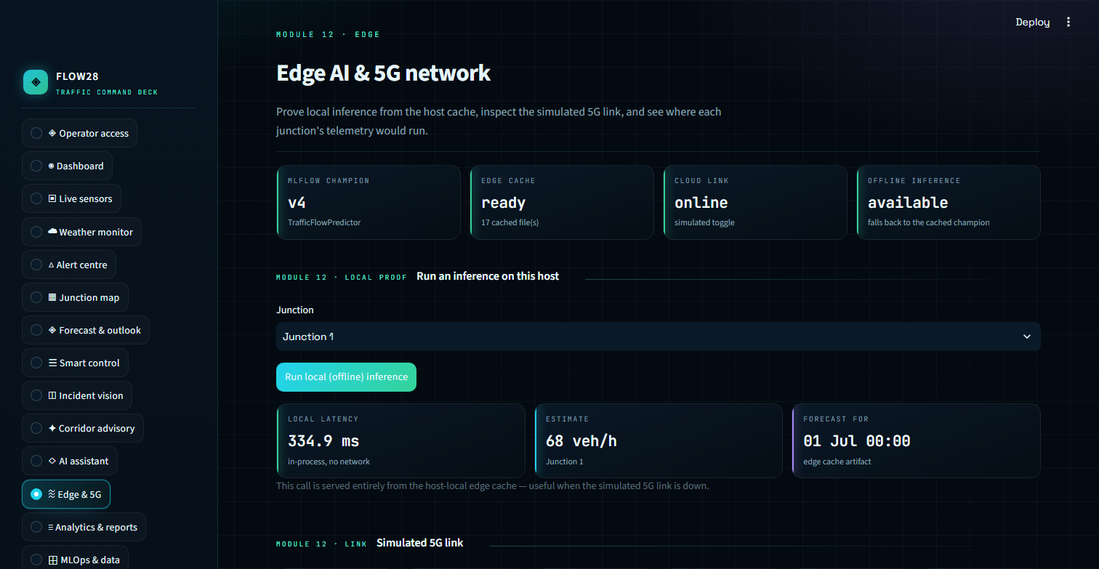
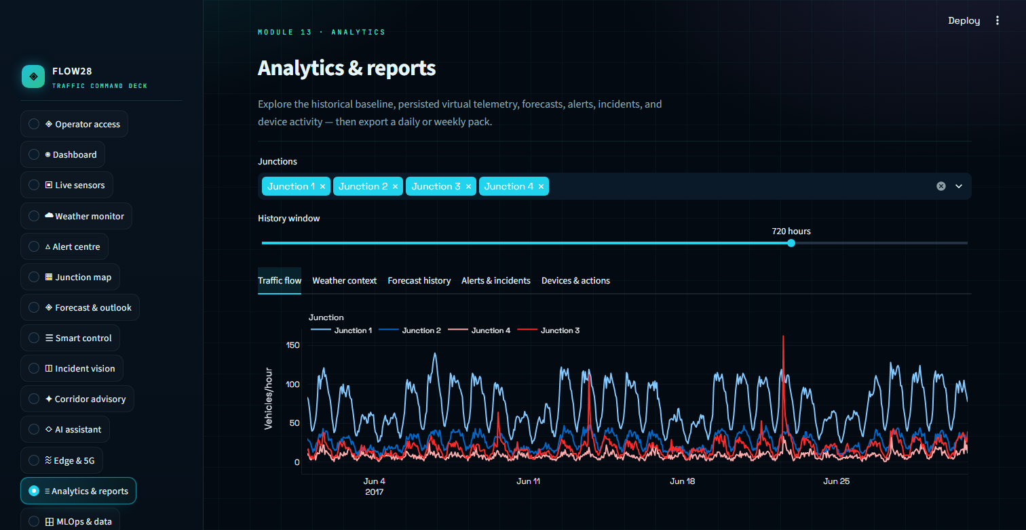
Workspace in Action — Forecast & Advisory
Forecast & 24 h outlook
Incident vision triage
Corridor advisory
Operator assistant
Edge AI offline fallback
Analytics & reports
Every forecast, alert and advisory on these screens is produced by champion v4 — the same model that serves the API.

Slide 15
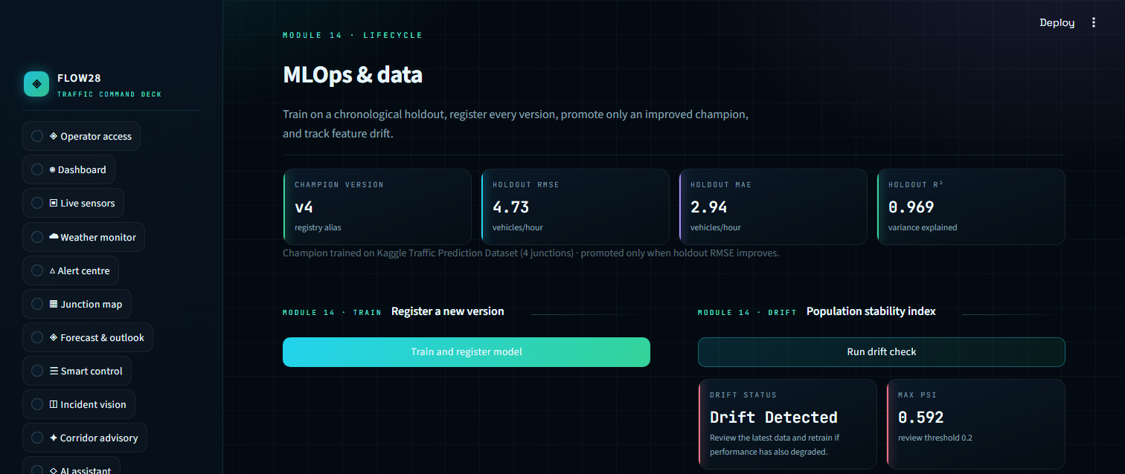
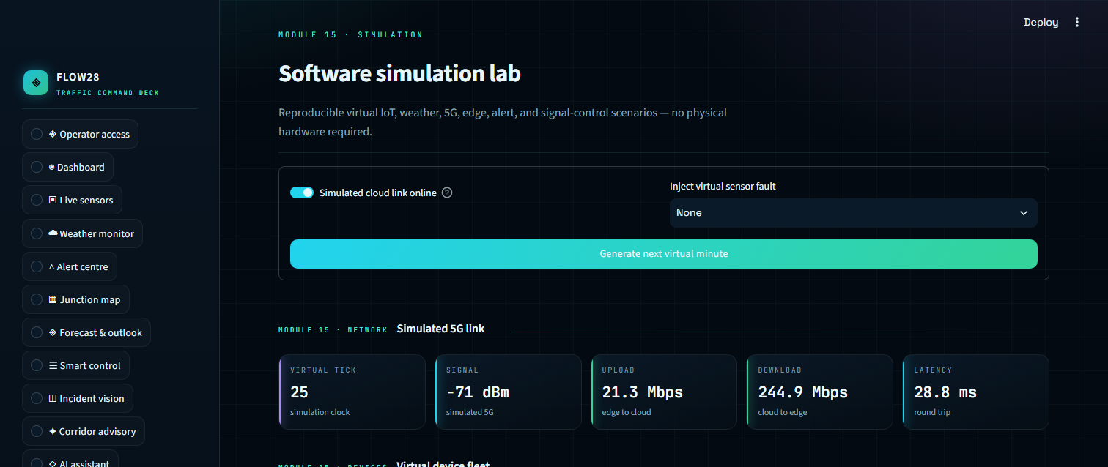
Workflow in Action — MLOps Evidence
MLflow tracking
Every training run logs params, metrics, signature and artifact; each model version is registered with its dataset tag.
Champion & edge cache
Version 4 holds the champion alias and is mirrored to edge_cache as a skops file, so forecasting survives a dropped link.
MLOps & data — versions, metrics and drift status in one view
Tests & alerts
Thirteen unit tests cover validation, the promotion gate and advisory rules; twenty-one simulated alerts are stored in SQLite.
Software simulation lab — the digital twin behind the demo
Notes:
These two screens are the evidence trail: the MLOps & data page shows model versions, metrics and the drift flag; the simulation lab shows the virtual-tick feed that powers the demo when no live data source is connected.

Slide 16
Challenges & Solutions
Time-series leakage → shuffled splits teach the model the future, so every split is chronological on timestamps.
A registry that always promotes → added a dataset-tagged RMSE comparison, so a worse candidate is registered but never served.
Unreadable trend charts → moved every history view onto virtual-tick axes and reseeded the feed, so the plots read at a glance.
A model nobody could use → wrapped it in FastAPI and a fifteen-module workspace, so every number ends in an operator action.
Demo without a network → the champion is mirrored to an edge cache in skops format, so forecasting survives a dropped link.

Slide 17
Work Planned — Review-2 & Beyond
Deployment — containerised API and dashboard on Docker Compose, with a managed MLflow store and CI on every push.
Live data — replace the historical feed with sensor or ANPR ingestion and a scheduled retrain job.
Model — benchmark gradient boosting and temporal models, and move from point forecasts to quantile bands.
Incident vision — replace the Pillow heuristic triage with a trained scene classifier.
Access — a real identity provider with roles and an audit trail, replacing the session-only profile.
Evaluation — backtest the 24 h outlook against rolling ground truth and measure the drift-to-accuracy link.

Slide 18
Conclusion
Delivered — a complete MLOps lifecycle around a real four-junction dataset, from validation to a monitored, versioned service.
Evidence — champion v4 scores RMSE 4.73 and R² 0.969 on 11,540 held-out rows, and it was promoted by rule, not by choice.
Operated — fifteen workspace modules, eight API endpoints, 21 simulated alerts, five controllable devices and persisted acknowledgements.
Trustworthy — drift is measured (PSI 0.592), promotion is gated on RMSE, and offline fallback is real, not a slide.
Next — live ingestion, a learned incident model and a managed deployment for a real corridor.

Slide 19
Q&A
Thank You
Questions & Discussion
Flow28 · Project 28 · K.Mahija (2400080129) · Sk.Anjum (2400080003) · P.Hasitha (2400080005)
Notes:
Thank the panel and invite questions on the model choice, the promotion rule, the drift threshold or the edge fallback.

