Slide 1


High Distinction Assignment Project Database Project on: Online Book Store
Name:Mahjabeen Mohiuddin
Student Id:24610507
Subject: Database (32606)
Course: Data Science and Innovation

Slide 2


Database Functionality
This Database is based on the tranaction that takes place behind the website, how each table is created, and the functionality that each table performs.
The Online BookStore sells books that belong to different genres.
Each book is written by one author, to help customers identify the book written by which author, author’s name, and author id are referenced to the book id.
These books sold are obtained by the Online BookStore company from different publishers in advance to maintain the stocks of book.
When the customer creates his account, the customer id is generated to reference his credentials.
After the payment is done by the customer, the purchase id is generated and the customer details, book id, shipping details are stored in Purchase Information table.
Online BookStore company has employees that hold different positions in different departments of the company, these employees reports to their respective department managers.
s

Slide 3
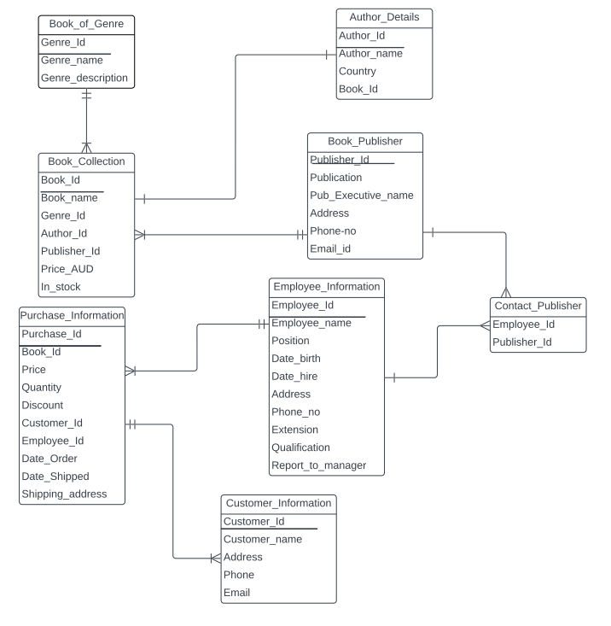
ERD OF ONLINE BOOK STORE

Slide 4

One to Many Relationship
Explaining the relationship between Book Genre and Book Collection.
Book Collection contains different Genres of books.
At least one book should be there in Book Genre.

Slide 5

Many to Many Relationship
Relationship between Employees and Publishers.
To give orders more than one employee of Online BookSotre company has to speak to various departments representative of a publishing house.
To enquire about order details more than one employee of the publishing house has to speak with one or more employees of the BookStore company that holds the information of an order.

Slide 6
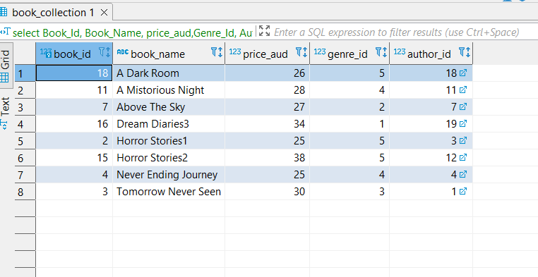
1.QUERY
A simple query of a single table:
List Book IDs, Book Names, Price in AUD, Genre IDs, and Author IDs from the Book Collection table, who has a price greater than or equal to 25 and whose stock is more than or equal to 20. Finally, order the result by Book Name in ascending order.
Query:
select Book_Id
,Book_Name
, price_aud,Genre_Id
, Author_Id
from book_collection
where in_stock >=20 and price_aud >=25
order by book_name asc;

Slide 7
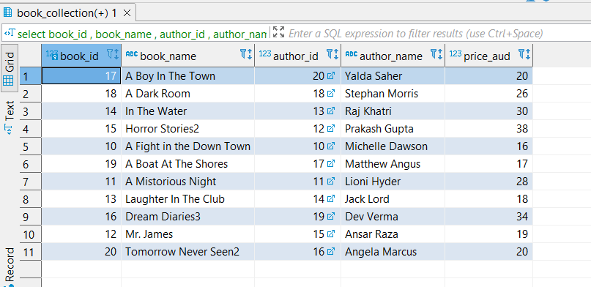
2.QUERY
2Q.A query that uses natural join
List all book IDs, Book Names, Author IDs, Author Names, and their price in AUD, from the Book Collection table using natural join, whose Author's ID is between 10 and 20, and order the result by Author Name in descending order.
Query:
select book_id
, book_name
, author_id
, author_name
, price_aud
from book_collection natural join author_details
where author_id between 10 and 20
order by author_name desc;

Slide 8
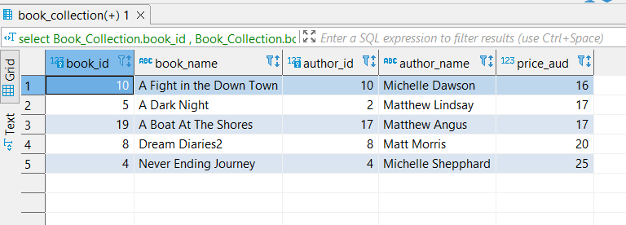
3.QUERY
3Q.The cross product is equivalent to the "natural join" query above.
List Book IDs, Book Names, Author IDs, Author Names using the cross product and list all the authors whose name starts with M and then order the query by price in ascending order.
Query:
select Book_Collection.book_id
, Book_Collection.book_name
, Author_Details.author_id
, Author_Details.author_name
,Book_Collection.price_aud
from Book_Collection, Author_Details
where Author_Details.author_id = Book_Collection.author_id
and author_name like 'M%'
order by price_aud asc;

Slide 9
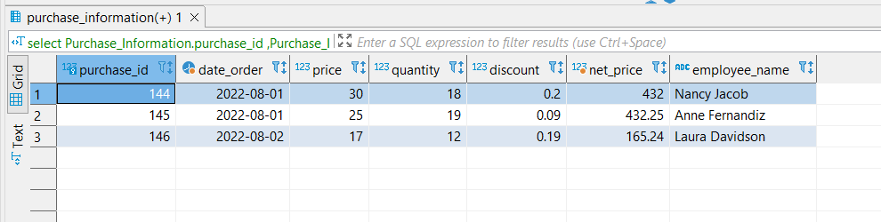
4.QUERY
4Q. A query involving a “Group by”, perhaps also with a “HAVING”.
List Purchase IDs, order date, price, discount,
The net price of orders(net price = price* quantity *(1-discount)),
and employee names from tables Purchase Information. Employee Information.
Use group by along with having condition. Display the above list whose order month is august and order by order date in ascending order.
Query:
select Purchase_Information.purchase_id
,Purchase_Information.Date_Order
,Purchase_Information.price
,Purchase_Information.quantity
,Purchase_Information.discount
,Purchase_Information.quantity *(1-Purchase_Information.discount)*Purchase_Information.price as Net_Price
,Employee_Information.employee_name
from Purchase_Information inner join Employee_Information on Purchase_Information.employee_id = Employee_Information.employee_id
group by Purchase_Information.purchase_id ,Employee_Information.employee_name
having Extract('month' from date_order::date) = 08
order by purchase_Information.Date_Order asc;

Slide 10
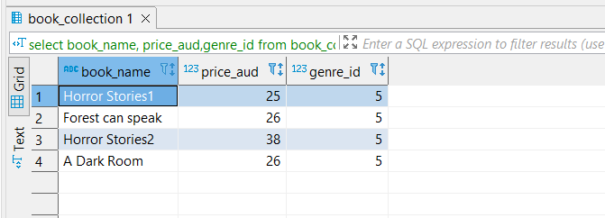
5.QUERY
5Q.A query which uses a sub query.
List all the Book names, Prices of books, and Genre IDs from the Book Collection table. It contains a sub-query that filters and extracts Books from the list of books with a minimum price
and these books must belong to Genre Id 5.
Query:
select book_name
, price_aud
, genre_id
from book_collection
where genre_id =5
and price_aud >=(
select min(price_aud)
from book_collection
where genre_id =5);

Slide 11
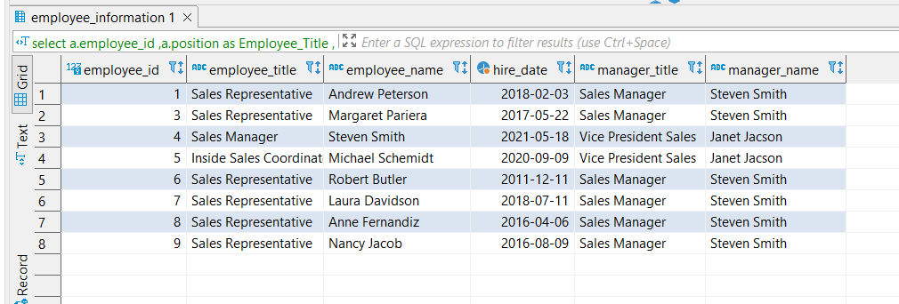
6.QUERY
6Q. A cross-product that cannot be implemented using the words “natural join” (e.g. self join).
List all the employees, their position, and date of hire and these employees should report to the manager from the Employee Information table using self-join.
Query:
select a.employee_id
,a.position as Employee_Title
,a.employee_name as Employee_Name
,a.Date_Hire as Hire_Date
, b.position as Manager_Title
, b.employee_name as Manager_Name
from employee_information as a,employee_information as b
where a.report_to_manager=b.employee_id;

Slide 12
CONSTRAINTS
UNIQUE CONSTRAINT
(The name of a book must be unique, it should not be similar to any other book)
create table Book_Collection
(
Book_Id smallint,
Book_Namecharacter varying not null,
Genre_Id integer,
Author_Idinteger,
Publisher_Id integer,
Price_AUDinteger,
In_Stock integer,
constraint Book_Collectionpk primary key (Book_Id),
constraint Book_Collectionfk_Book_Genres foreign key (Genre_Id) references Book_Genres,
constraint Book_Collectionfk_Author_Details foreign key (Author_Id) references Author_Details,
constraint Book_Collectionfk_Book_Publisher foreign key (Publisher_Id) references Book_Publisher,
constraint unq_Book_Collection_book_name unique (book_name));
CHECK CONSTRAINT
(The format of the phone number should be varchar(11) and the phone number should not be a digit.
create table Employee_Information
(
Employee_Idsmallint,
Employee_Name character varying(40) not null,
Position character varying(40),
Date_Birth DATE,
Date_Hire DATE,
Address character varying(40),
Phone_No varchar(11),
Extension integer,
Qualification character varying(40),
Report_to_Manager smallint,
constraint Employee_Informationpk primary key(Employee_Id),
constraint Employee_Information_Phone_No check (Phone_No not like '%[^0-9]%')
);

Slide 13
CONSTRAINTS
CHECK CONSTRAINT (Applying condition on Price > 0, Price of a book should be greater than zero)
create table Purchase_Information
(
Purchase_Id integer,
Book_Id integer,
Price integer,
Quantity integer,
Discount float,
Customer_Id integer,
Employee_Id integer,
Date_Order Date,
Date_Shipped character varying,
Shipping_Addresscharacter varying,
constraint Purchase_Informationpk primary key (Purchase_Id),
constraint Purchase_Informationfk_Book_Collection foreign key (Book_Id) references Book_Collection,
constraint Purchase_Information_Price check (Price > 0),
constraint Book_Purchasefk_Customer_Information foreign key (Customer_Id) references Customer_Information,
constraint Book_Purchasefk_Employee_Information foreign key (Employee_Id) references Employee_Information );
CHECK CONSTRAINT (Applying condition on email format, if the email format is incorrect, postgresql will throw an error).
create table Customer_Information
(
Customer_id integer,
Customer_Namecharacter varying,
Address character varying,
Phone integer,
Email character varying,
constraint Customer_Informationpk primary key(Customer_Id),
constraint Customer_Information_Customer_Id check (Customer_Id is not null),
constraint Customer_Information_Email check (Email ~* '^[A-Za-z0-9._+%-]+@[A-Za-z0-9.-]+[.][A-Za-z]+$')
);

Slide 14
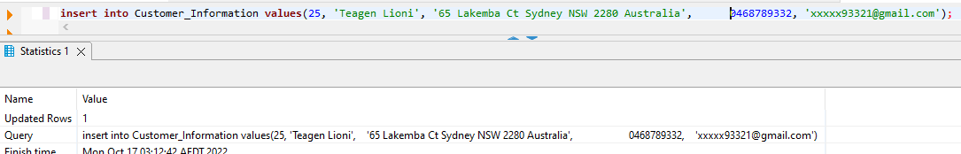
INSERT-ACTION STATEMENT-1
ADDING A NEW VALUE INTO A TABLE.
Query:
insert into Customer_Information values(25, 'Teagen Lioni', '65 Lakemba Ct Sydney NSW 2280 Australia', 0468789332, 'xxxxx93321@gmail.com');
Earlier there were 24 id’s in the Customer_Information table, now I am adding a new entry into Customer_Informatio. In total now there are 25 entries in Customer_Information Table.
OUTPUT:

Slide 15
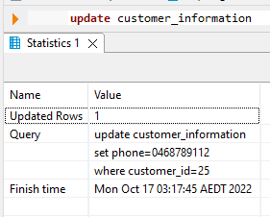
UPDATE-ACTION STATEMENT-2
UPDATE CUSTOMER INFORMATION TABLE.
Query:
update customer_information set phone=0468789112 where customer_id=25;
Customer of ID 25 has recently changed her phone number, now we are updating her phone number.
OUTPUT:

Slide 16
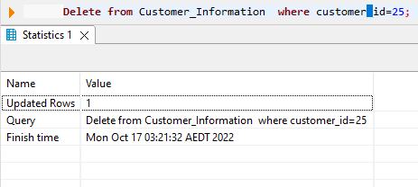
DELETE-ACTION STATEMENT-3
DELETE STATEMENT TO DELETE AN ENTRY FROM TABLE.
Query:
Delete from Customer_Information where customer_id=25;
Here we are deleting an entire row of Customer_Information table.
The entry of Customer_id = 25 is deleted successfully.
OUTPUT:

Slide 17
ON DELETE RESTRICT
create table Purchase_Information (
Purchase_Id integer,
Book_Id integer,
Price integer,
Quantity integer,
Discount float,
Customer_Id integer,
Employee_Id integer,
Date_Order Date,
Date_Shipped character varying,
Shipping_Addresscharacter varying,
constraint Purchase_Informationpk primary key (Purchase_Id),
constraint Purchase_Informationfk_Book_Collection foreign key (Book_Id) references Book_Collection,
constraint Purchase_Information_Price check (Price > 0),
constraint Book_Purchasefk_Customer_Information foreign key (Customer_Id) references Customer_Information on delete restrict,
constraint Book_Purchasefk_Employee_Information foreign key (Employee_Id) references Employee_Information );
On Delete Restrict specifies that the row in the parent table can be deleted if no other row depends on it. If a dependent row exists in the relationship, the DELETE fails. The check for dependent rows is performed immediately.
Here the parent table is the customer table, if the customer order has been served then the row in the child table i.e. Purchase Information can be deleted, but if the order of a customer is still pending to be shipped on the given address, then the customer Id from the Customer Information of that specific customer can’t be deleted.
If we try to delete the customer id of a customer from the Customer Information table whose order is still pending, then the DELETE fails.
we can use ON DELETE RESTRICT only when declaring a foreign key. This can be done either at the same time as creating the table, or afterward, with ALTER TABLE, to add the foreign key.
QUERY FOR ON DELETE RESTRICT.
Query:
delete from customer_information where customer_id =24;

Slide 18
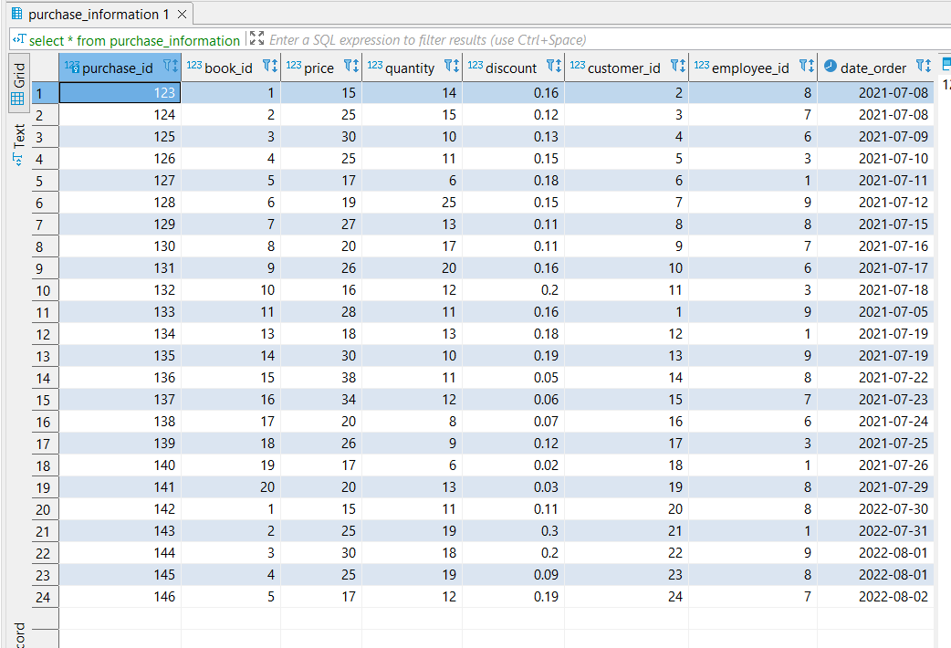
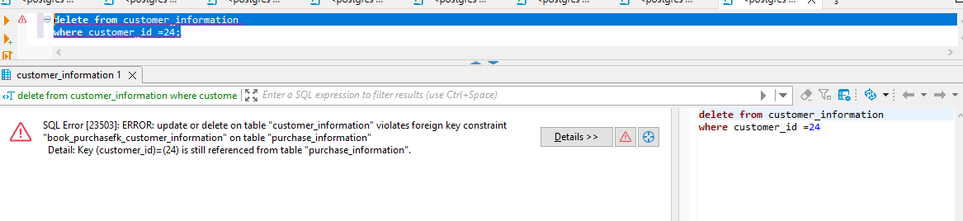
ON DELETE RESTRICT ON CUSTOMER INFORMATION TABLE
OutPut after applying “On Delete Restrict” Constraint.
Purchase Information Table that contain Customer_Id which we want to delete.

Slide 19
ON DELETE CASCADE
create table Book_Collection
(
Book_Id smallint,
Book_Namecharacter varying not null,
Genre_Id integer,
Author_Idinteger,
Publisher_Id integer,
Price_AUDinteger,
In_Stock integer,
constraint Book_Collectionpk primary key (Book_Id),
constraint Book_Collectionfk_Book_Genres foreign key (Genre_Id) references Book_Genres on delete cascade,
constraint Book_Collectionfk_Author_Details foreign key (Author_Id) references Author_Details,
constraint Book_Collectionfk_Book_Publisher foreign key (Publisher_Id) references Book_Publisher,
constraint unq_Book_Collection_book_name unique (book_name) );
On delete cascade is applied on the foreign key of a parent record. Here the parent record is in Book_Genre i.e. Genre_Id. If any genre_book is deleted, then the corresponding records in the child (Book_Collection) Table will automatically be deleted.
A foreign key with cascade delete can be created using either a CREATE TABLE statement or an ALTER TABLE statement.
QUERY FOR ON DELETE CASCADE ON BOOK_GENRES.
Query:
delete from book_genres where genre_id =1;

Slide 20
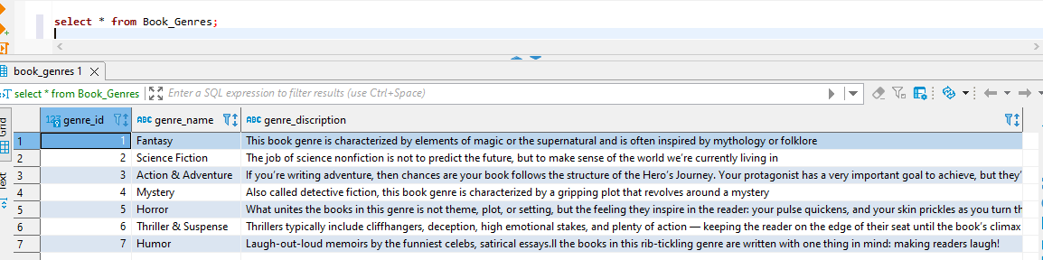
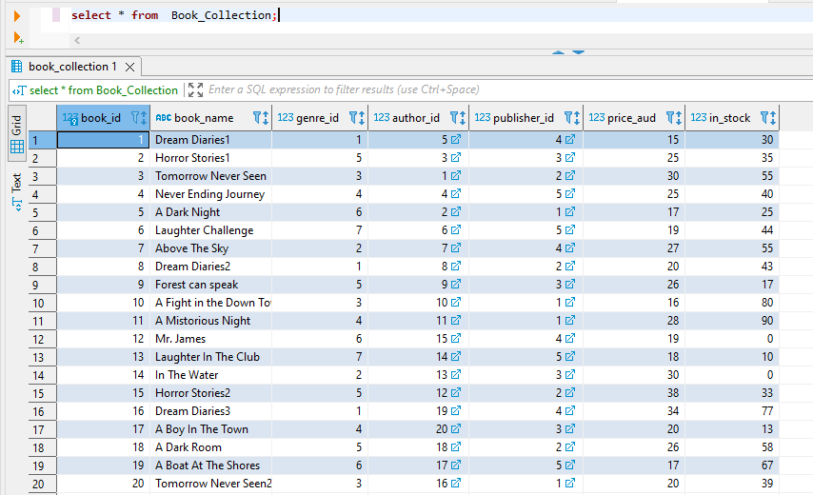
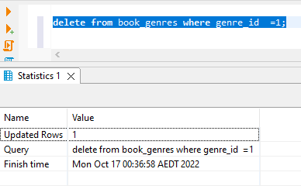
ON DELETE CASCADE EXAMPLE
Table of Book_Genres before applying “On Delete Cascade”
Table of Book_Collection before applying “On Delete Cascade”
OutPut after applying “On Delete Cascade on Book_ Genres

Slide 21
CREATING VIEW
If we give access to users to run the query on the table, they can get all data from the table that includes sensitive information too. To avoid this situation, by creating a view we can give access to only selected columns in the table and hide the secured information from the end users. . Users can work on the view without having an idea of what the table contains. Views are created with all or some specific columns from the table as per requirement. By using view, we combine data from various tables and make it one table to use.
The tables that are used to create the view are called base tables.
create view BookinGenres as
select Genre_Id
, Genre_name
, Book_Id
, Book_name
, Publisher_Id
, Price_aud
, In_stock
from Book_Genres natural join book_collection
where genre_name = 'Horror' ;

Slide 22
Creating view
create view OrderDetails as
select Purchase_Id
,Book_Id
,Price
,Quantity
,Discount
,Date_Order
,Employee_Id
,Employee_Name
,Customer_id
,Customer_Name
from Purchase_Information natural join Customer_Information natural join employee_information
where price > 15
order by Date_Order;
Creating a virtual table based on SQL query referring to other tables in the database.
Joining three tables i.e. Purchase_Information, Customer_Information, and Employee_Information.
Excluding shipping address. Shipped date, Customer Phone number, Customer, Email, and Employee Address.
All these columns contain sensitive data and it should not be visible to the end users to whom we give access to the database to run queries.
Creating a view by joining three tables and naming it as OrderDetails.

Slide 23
REFRENCE
1.Booktopia - Books, Online Books, #1 Australian online bookstore, Buy Discount Books, eBooks and DVDs from Australia and the world.
2. Book Depository: Free delivery worldwide on over 20 million books.
3. Books | Online Bookshop | QBD

Slide 24
THANK YOU.

