Slide 1
Virtual Keyboard
Usability, Performance & Implementation
Research Paper Analysis & Technical Implementation
Based on Pangestu et al. (2014) & Findlater et al. (2015)

Slide 2
Why Virtual Keyboards Matter
Virtual keyboards have become essential input interfaces with the rise of touchscreen devices and wearables.
Touchscreen Dominance: Most mobile interactions occur via touch interfaces
Wearable Computing: Smartwatches and smartglasses need text input
Space Constraints: Space is at a premium on diminutive screens
User Expectations: Users expect familiar QWERTY layouts
"Text entry on devices with very small screens becomes increasingly relevant and challenging."— Findlater et al. (2015)

Slide 3
Research Overview: Two Perspectives
Paper 1: Usability Testing
Paper 2: Text Entry Performance
Pangestu et al. (2014)
Findlater et al. (2015)
Focus: Usability Evaluation
Focus: Performance Metrics
Investigates learnability and memorability of virtual keyboard interfaces using questionnaire-based usability testing with 68 users.
Compares three QWERTY-based techniques (ZoomBoard, Callout, ZShift) for tiny touchscreens using controlled user studies.
Key Question: How easily can users learn and remember virtual keyboard functions?
Key Question: Which technique performs best for different screen sizes?

Slide 4
Usability Characteristics
1. Effectiveness
2. Efficiency
How accurately users accomplish goals
How quickly users perform tasks
3. Safety
4. Utility
Protection against accidental errors
Functionality meets user needs
5. Learnability
6. Memorability
Easy for novices to accomplish tasks
Easy to re-establish proficiency
Source: Pangestu et al. (2014)

Slide 5
User Expertise Levels
Novice Users
Knowledgeable Intermittent
Expert Frequent
First-time users who understand task concepts but have low interface knowledge
Users thoroughly familiar with both task concepts and interface interactions
Users with stable task concepts and wide interface knowledge, but struggle to remember structure
Design Needs:
Design Needs:
Design Needs:
Limited choices
Consistent structure
Keyboard shortcuts
Informative feedback
Clear interface
Macro support
User manuals
Protection from errors
Abbreviations
Effective tutorials
Easy exploration
Power user features

Slide 6
Usability Testing Results (Pangestu et al.)
✓
Shift Button (93-94% success)
Well-known by users due to familiarity with physical keyboards. Excellent learnability.
✓
"?123" and "ABC" Buttons (97-100%)
Clear visual cues help users understand function. Very high recognition rates.
!
"1/3", "2/3", "3/3" Buttons (Confusion)
Poor learnability. Numbers don't mirror what will be shown on screen.
Key Insight: Buttons that mirror physical keyboard behavior or provide clear visual cues achieve better usability.

Slide 7
Text Entry Techniques for Tiny Screens
ZoomBoard
Callout
ZShift
Keyboard zooms in when tapped, allowing character selection on enlarged view. Requires 2 taps per character.
Shows a callout popup above the touched key, displaying the character for confirmation before release.
Combines callout with zoomed view. Shows enlarged copy of occluded area with visual key feedback.
Characteristics:
Characteristics:
Characteristics:
Visual magnification
Single-tap entry
Zoomed callout
Iterative zoom levels
Visual feedback
1-step interaction
Lower error rate
Finger position adjustable
Lowest KSPC
Best for: Smallest screens (16mm)
Best for: Medium screens (24mm)
Best for: Larger tiny screens (32mm)

Slide 8
Performance Metrics Explained
Words Per Minute (WPM)
Keystrokes Per Character (KSPC)
Character Error Rate (CER)
Measures typing speed
Measures efficiency
Measures accuracy
A "word" is defined as 5 consecutive characters including spaces.
Device-dependent measure. Lower is better. ZoomBoard has minimum of 2.0.
Uses Damerau-Levenshtein distance between submitted and reference text.
Example: 6 WPM on small screens
Example: Callout/ZShift achieve ~1.5
Example: ZoomBoard shows lower CER

Slide 9
Key Research Findings (Findlater et al.)
1
Screen Size Matters
Performance improved as screen size increased. Different screen sizes demand different assistance types.
2
Single-Tap Preferred
Users preferred techniques requiring 1-step interaction. ZoomBoard's 2-tap approach was "irritating on larger screens."
3
Rapid Learning
Users quickly familiarized with all techniques. Learning effects observed across all conditions (R² > 0.8).
Design Recommendation: Use ZoomBoard for very small devices (necklaces, earrings). Use ZShift for mid-sized devices (smartwatches, bracelets).

Slide 10
Implementation Architecture
Framework: Kivy
Architecture Diagram
Open-source Python framework for multitouch applications. Cross-platform support.
KeyboardApp
│
└── KeyboardDemo (BoxLayout)
Widget Hierarchy
├── TextInput (20%)
KeyboardApp (App)
└── VKeyboard (80%)
Main application class
Key Features
KeyboardDemo (BoxLayout)
Vertical layout orientation
Root widget container
Event-driven key handling
Size hints for responsiveness
TextInput + VKeyboard
Text display and keyboard

Slide 11
Code Walkthrough: Main Structure
Import Statements
Application Entry Point
from kivy.app import App
from kivy.uix.boxlayout import BoxLayout
from kivy.uix.textinput import TextInput
from kivy.uix.vkeyboard import VKeyboard
class KeyboardApp(App):
def build(self):
return KeyboardDemo()
if __name__ == "__main__":
KeyboardApp().run()
Widget Initialization
Key Components
class KeyboardDemo(BoxLayout):
def __init__(self, **kwargs):
super().__init__(**kwargs)
self.orientation = "vertical"
self.text_input = TextInput(
multiline=False,
font_size=24,
size_hint=(1, 0.2)
)
self.keyboard = VKeyboard(
on_key_up=self.key_released
)
BoxLayout: Vertical stacking container
TextInput: Single-line text display
VKeyboard: Built-in virtual keyboard
on_key_up: Event callback binding

Slide 12
Key Technical Features
Event Handler with Keycode Fix
Feature Breakdown
def key_released(self, keyboard, keycode, *args):
# Extract character from tuple: (97, 'a') -> 'a'
key = keycode[1] if isinstance(keycode, tuple) else keycode
if key == 'backspace':
self.text_input.text = self.text_input.text[:-1]
elif key == 'spacebar':
self.text_input.text += ' '
elif len(key) == 1:
self.text_input.text += key
Tuple Extraction Fix
VKeyboard returns (code, char). Extract character.
Backspace Handling
Removes last character. Supports error correction.
Spacebar Support
Explicit handling for space character.
Character Validation
len(key)==1 ensures only single chars added.

Slide 13
Bridging Research and Implementation
Learnability (Pangestu)
→
Our Implementation
Users need familiar interfaces that leverage existing knowledge
VKeyboard uses standard QWERTY layout familiar to all users
Memorability (Pangestu)
→
Our Implementation
Shift button well-known from physical keyboards (93% success)
VKeyboard includes standard shift/caps functionality
Error Correction (Findlater)
→
Our Implementation
Users need mechanisms to fix typing mistakes efficiently
Backspace handler removes last character with single tap
Occlusion Problem (Findlater)
→
Our Implementation
Finger covers target; need visual feedback above keyboard
TextInput displays above keyboard (Callout-style)

Slide 14
Lessons Learned and Recommendations
Design Lessons
Implementation Insights
Leverage Familiarity
Event-Driven Architecture
Use QWERTY layout and standard button labels
Kivy's callback system enables clean handling
Clear Visual Feedback
Type Safety
Buttons should indicate what will happen
isinstance check prevents runtime errors
Match Technique to Size
Future Enhancements
Different sizes need different approaches
Word prediction for improved WPM
Auto-correction for common typos
Support Error Recovery
Swipe gestures for space/delete
Haptic feedback on key press
Easy backspace/correction mechanisms

Slide 15
Conclusion
Key Takeaways
References
Pangestu, H. (2014). Usability Testing of Virtual Keyboard in Touch Screen with Questionnaire Method. CommIT, 8(1), 17-21.
Usability First: Good design must prioritize learnability and memorability.
DOI: 10.21512/commit.v8i1.591
Findlater, L. et al. (2015). Text Entry on Tiny QWERTY Soft Keyboards. CHI '15, Seoul, Korea.
Context Matters: Screen size determines optimal interaction technique.
DOI: 10.1145/2702123.2702388
Implementation: Kivy provides effective tools for virtual keyboard apps.
Research to Practice: Academic research informs implementation decisions.

Slide 16
Updated Implementation: Caps Lock Support
New Features
Key Code Changes
Caps Lock Toggle
# Track Caps Lock state
self.caps_lock_active = False
elif key == 'capslock':
self.caps_lock_active = \\
not self.caps_lock_active
elif len(key) == 1:
char = key.upper() \\
if self.caps_lock_active else key
self.text_input.text += char
Track and toggle uppercase mode
State Management
Boolean flag caps_lock_active
Character Transform
Convert to uppercase when active
Visual Feedback
Console prints ON/OFF status

Slide 17
Full Code: Imports and Class Definition
Import Statements
Class Definition
from kivy.app import App
from kivy.uix.boxlayout import BoxLayout
from kivy.uix.textinput import TextInput
from kivy.uix.vkeyboard import VKeyboard
class KeyboardDemo(BoxLayout):
"""
A widget with a permanent virtual keyboard
that updates a TextInput.
Supports Caps Lock for uppercase letters.
"""
App: Base class for Kivy applications
Inherits from BoxLayout for vertical arrangement of child widgets (TextInput + VKeyboard).
BoxLayout: Container for vertical stacking
TextInput: Single-line text display
VKeyboard: Virtual keyboard widget
Docstring Purpose
Documents the class purpose, features, and behavior for maintainability.

Slide 18
Full Code: __init__ Method
Initialization Part 1
Initialization Part 2
def __init__(self, **kwargs):
super().__init__(**kwargs)
self.orientation = "vertical"
# Track whether Caps Lock is active
self.caps_lock_active = False
# ----- TextInput setup -----
self.text_input = TextInput(
multiline=False,
font_size=24,
size_hint=(1, 0.2),
hint_text="Click here..."
)
self.add_widget(self.text_input)
# ----- Virtual keyboard -----
self.keyboard = VKeyboard(
on_key_up=self.key_released
)
self.add_widget(self.keyboard)
super().__init__: Call parent class constructor
orientation: Stack children vertically
caps_lock_active: State flag for Caps Lock
multiline=False: Single line input
size_hint=(1, 0.2): 20% height
on_key_up: Bind key release event

Slide 19
Full Code: Key Handler Method
Method Signature and Key Extraction
Caps Lock Handler
def key_released(self, keyboard, keycode, *args):
"""Handle key releases from virtual keyboard."""
# Extract key symbol from tuple
key = keycode[1] if isinstance(
keycode, tuple) else keycode
print("Key pressed:", key)
elif key == 'capslock’:
# Toggle Caps Lock state
self.caps_lock_active = \\
not self.caps_lock_active
print(
f"Caps Lock {'ON' if ... else 'OFF'}"
)
keyboard: The VKeyboard instance that fired the event
Toggle: not operator flips boolean state
keycode: Tuple (scancode, symbol) e.g., (97, 'a')
Feedback: Print status for debugging
isinstance check: Handles both tuple and string formats

Slide 20
Full Code: Key Handler Method
Special Keys - Backspace and Space
Character Input with Caps Lock
if key == 'backspace’:
self.text_input.text = self.text_input.text[:-1]
elif key == 'spacebar':
self.text_input.text += ' '
elif len(key) == 1:
# Apply Caps Lock if active
char = key.upper() \\
if self.caps_lock_active else key
self.text_input.text += char
backspace: Remove last char with slice [:-1]
len(key)==1: Filter single-character keys only
spacebar: Add space character explicitly
.upper(): Convert to uppercase when active
+= char: Append character to text

Slide 21
Full Code: App Class and Entry Point
KeyboardApp Class
Entry Point
class KeyboardApp(App):
"""
Kivy application that displays
the KeyboardDemo widget.
"""
def build(self):
return KeyboardDemo()
if __name__ == "__main__":
KeyboardApp().run()
__name__ check: Only runs when script executed directly
.run(): Starts the Kivy application event loop
App: Base class required for all Kivy applications
How It Works
build(): Returns the root widget to display
KeyboardDemo(): Instantiates our custom widget
1. Python loads the script and creates KeyboardApp instance
2. .run() initializes Kivy and calls build()
3. KeyboardDemo widget tree is created and displayed
4. Event loop waits for user interaction (key presses)

Slide 22
Code Implementation Summary
Widget Architecture
Key Handling
KeyboardDemo (BoxLayout)
Backspace
Root container with vertical layout
Remove last char via slicing
TextInput (20% height)
Spacebar
Single-line text display
Append space character
VKeyboard (80% height)
Caps Lock
QWERTY virtual keyboard
Toggle uppercase mode flag
Event Flow
Characters
1. User taps key
Apply uppercase if Caps Lock active
VKeyboard fires on_key_up event
Key Fix: keycode is tuple (scancode, symbol). Use isinstance check to extract symbol safely.
2. key_released callback
Processes keycode, updates text

Slide 23
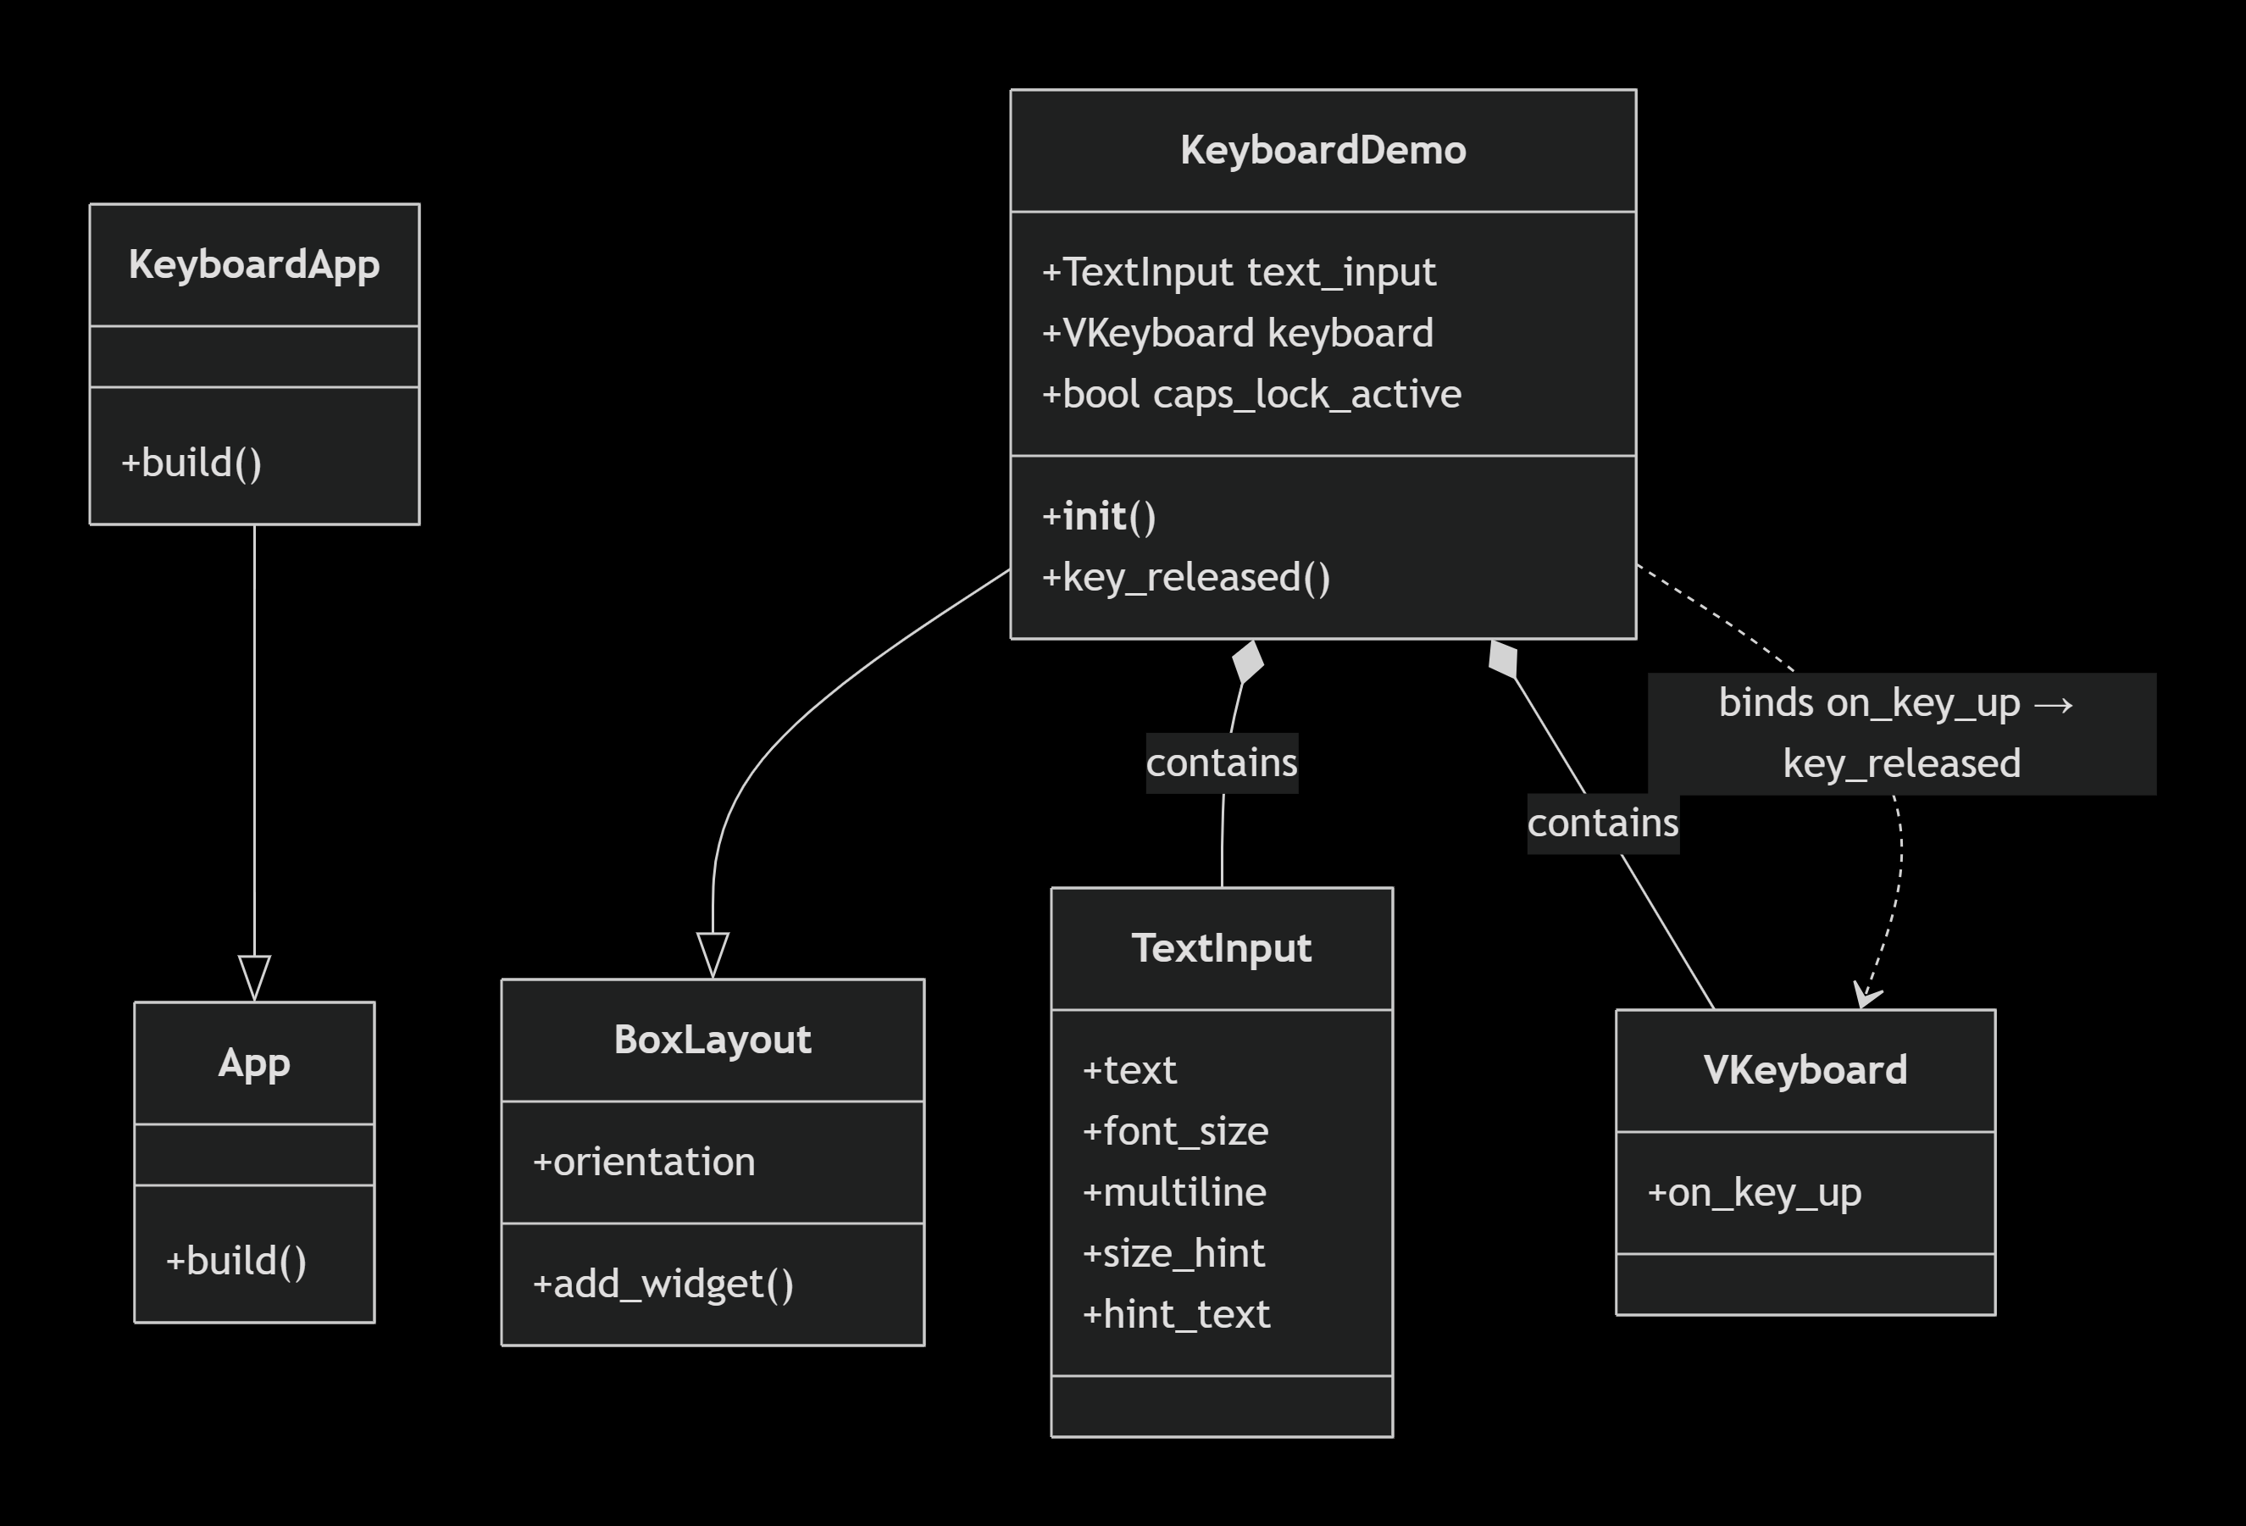
Class Diagram

Slide 24
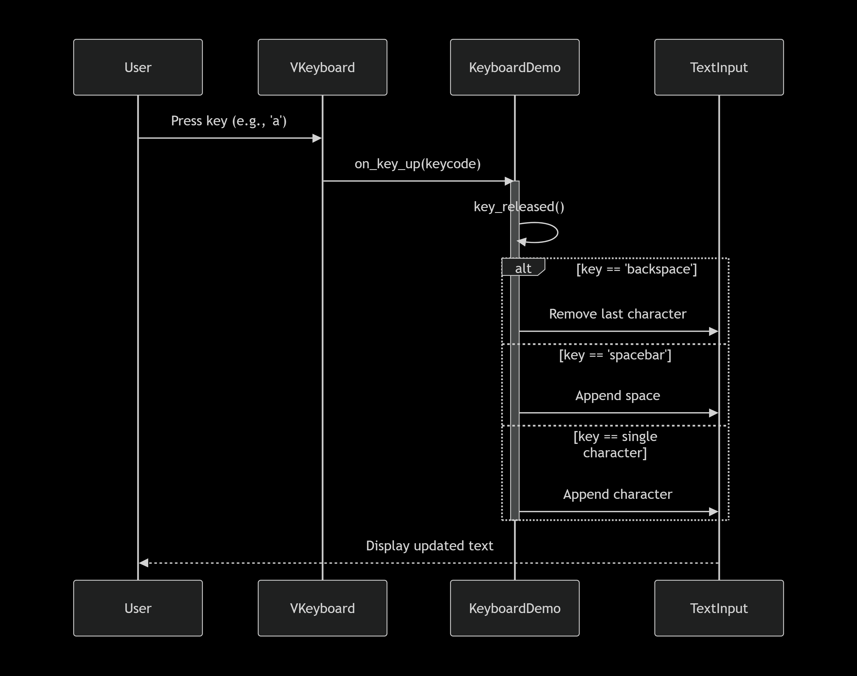
Sequence Diagram (Key Press Flow)

Slide 25
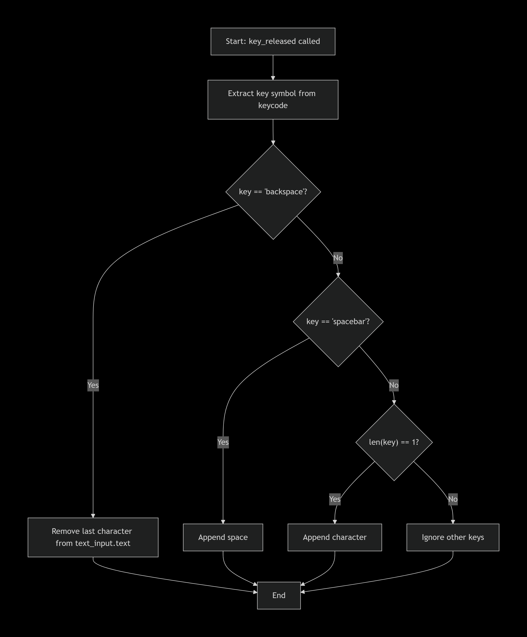
Flowchart of key_released Method

