Slide 1



Panel Interview
Claims & Helpline Dashboards
Every visual, every KPI, every finding - read straight from the Power BI report pages
CANDIDATE
Mahmoud Abdallah
ROLE
Data Intelligence Reporting Specialist – IPMI
PANEL
Monday 28 September 2026 · 3:00 PM Dubai · 90 minutes
REQ ID / PN
96969 / 5000136861
Task 1 · Claims & Policy Performance : 5 pages, 22 visuals Task 2 · Helpline Performance : 1 page, 9 visuals Task 3 · SQL : walked through from the PDF
1 / 24
Notes:
OPENING (about 1 minute).
"Good afternoon. I'm Mahmoud Abdallah, and this is my submission for the Data Intelligence Reporting Specialist role in IPMI: two Power BI dashboards and a set of SQL queries. I'll walk the two dashboards page by page - every visual and every KPI on the page, and what it actually tells us - then the SQL from the PDF, and then it is your time."
Set expectations on time: about 20 minutes on the claims dashboard, 15 on the helpline dashboard, 10 on the SQL, and 40 minutes kept for the panel. Offer to open the live .pbix at any point.
BEFORE THIS SESSION (do not skip):
1) Task1.pbix: remove the "Top 20 Member_ID" visual-level filter from the 8 visuals it sits on (Cost Concentration, the three Trend Analysis charts, Top 10 Diagnoses, Interactive Centrepiece, Outliers Finder, Claim detail table). Until then those visuals show a tenth of the book. Every number in this deck comes from the full dataset.
2) Task1.pbix: sort "Total Paid by policy month" and "The October Spike" by UWY Month No ascending (they export sorted by value).
3) Task2.pbix: hide or delete the disconnected CallID_Counts table, rename "Page 1" to "Helpline performance".
4) Re-export Task 1 to PDF and swap the interim charts on slides 8, 10, 11, 12 and 13 for the real screenshots.

Slide 2
How we'll use the 90 minutes
AGENDA
5 min
20 min
15 min
10 min
40 min
0'
5'
25'
40'
50'
90'
Opening
Who I am, the three tasks, how each visual is presented
Every visual, the same way
Task 1 · Claims dashboard
5 pages · 22 visuals - each one as a finding
The visual
what is on the page and how it is built
Task 2 · Helpline dashboard
1 page · 9 visuals - each one as a finding
What we found
the number, then the pattern behind it
Task 3 · SQL (from the PDF)
Three queries, the optimisation choices, two indexes
What it means
the issue it raises and the action it points to
Discussion & Q&A
Live drill into either .pbix, panel questions, next steps
2 / 24
Notes:
AGENDA (about 1 minute).
Walk the bar: 5 minutes opening, 20 minutes on the claims dashboard (five pages, 22 visuals), 15 on the helpline dashboard (one page, nine visuals), 10 on the SQL from the PDF, and 40 minutes for the panel.
Say the method once: for every visual - what it is, what we found, what it means. Then stop and take questions before moving on. If the panel prefers to interrupt as you go, agree immediately, the 40-minute buffer makes that safe.

Slide 3
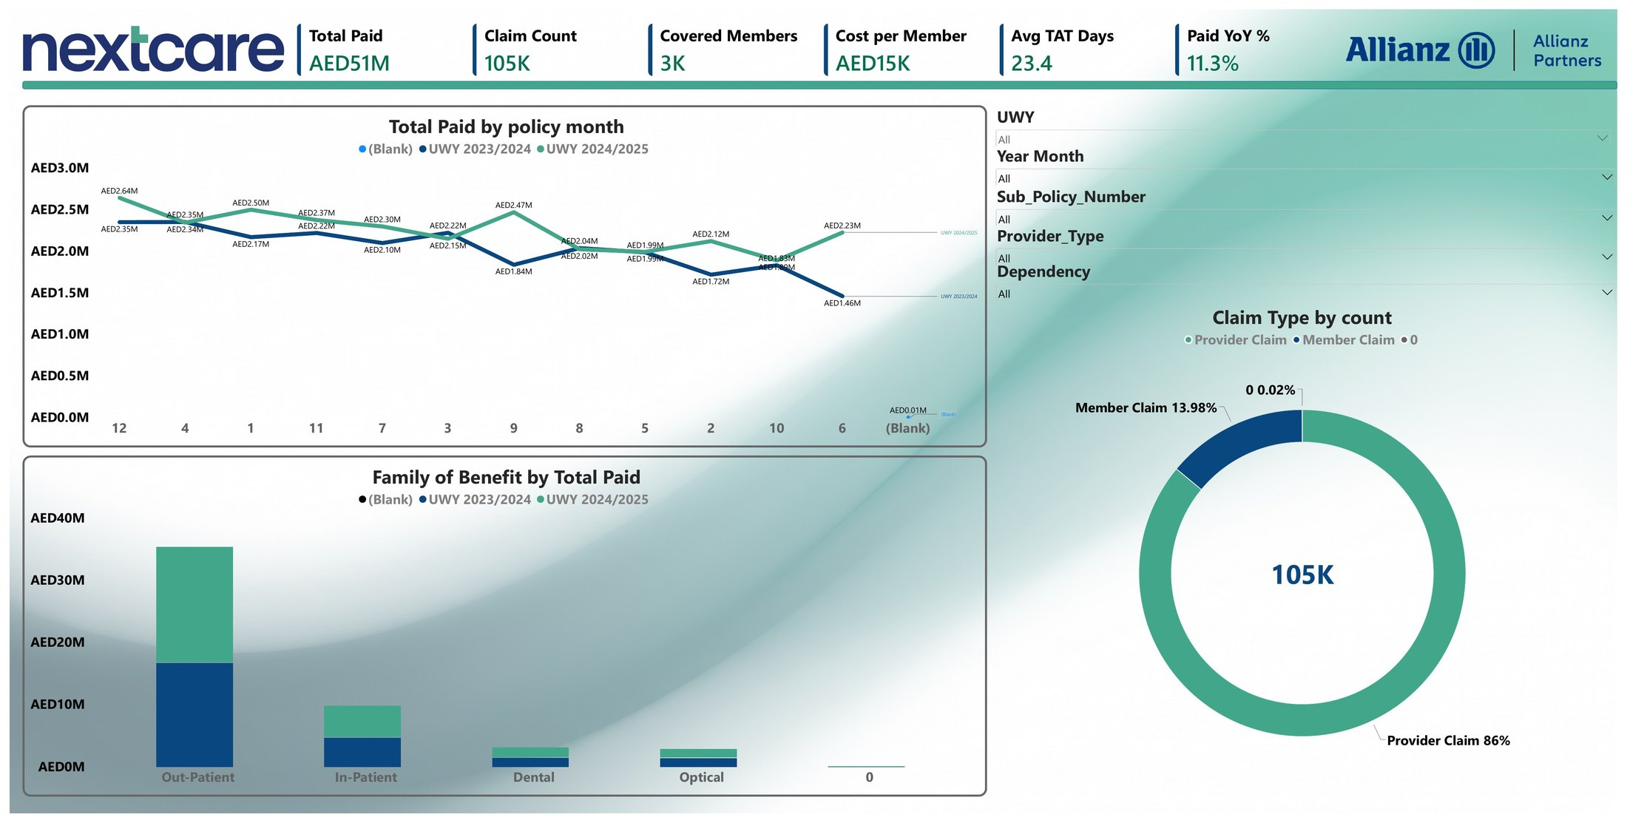
Claims & policy performance - five pages, 22 visuals
TASK 1 · POWER BI · MAP
1 Policy performance
6 KPI cards · Total Paid by policy month · Family of Benefit by Total Paid · Claim Type by count · 5 slicers
2 Abnormal findings
3 KPI cards · The October Spike · Automation Rate · Cost Concentration · Zero Value Claims · Data Quality Table
3 High utilisation drivers
Interactive Centrepiece (decomposition tree) · Outliers Finder · Top 10 Diagnoses · Most Common Outlier card · Demographics
4 Trend analysis
5 KPI tiles · Total Paid by UWY month split by UWY · Cost per Member with trend line · Avg TAT by settlement month
5 Claim detail
Drill-through table - one row per claim line, reachable from any diagnosis, member or provider
Report page 1 - Policy performance (KPI strip, policy-month line, benefit mix, claim-type donut, five slicers)
Over two years we paid AED 51.3 million across 105,000 claim lines for 3,468 members. Costs are rising - and the pages show exactly why.
3 / 24
Notes:
TASK 1 - MAP (about 1 minute). Start the 20-minute block here.
Lead with the number: "Over two policy years - 1 November to 31 October - we paid AED 51.3 million across about 105,000 claim lines for 3,468 covered members."
Then the five pages in the order the brief asked for: policy performance, abnormal findings, high-utilisation drivers, trend analysis, and a drill-through to the claim line. 22 visuals in total, I'll take them page by page.
Data behind it: sheet_1.xlsx, four tables - Claims (one row per claim line), Enrolment (one row per member per year), Member, Provider - plus a calendar table, a UWY table, an ICD reference and a policy reference.

Slide 4
Page 1 · the six scorecards
TASK 1 · PAGE 1 · VISUAL 1 OF 4
TOTAL PAID
CLAIM COUNT
COVERED MEMBERS
AED 51.3M
104,985
3,468
AED 24.3M in 2023/24 → AED 27.0M in 2024/25. Sum of Claim_Value over every claim line.
Claim lines (103,499 claim numbers). 50,504 → 54,461, up 7.8% year on year.
Distinct members from Enrolment, not Claims: 2,992 → 3,160 (+5.6%). Card rounds to 3K.
COST PER MEMBER
AVG TAT DAYS
PAID YOY %
AED 14,793
23.4
+11.3%
Both years on the card. Per policy year: AED 8,113 → AED 8,551, up 5.4%.
Received → settled. 25.9 days in year one, 21.2 in year two, 25% of settled claims took more than 30 days.
Roughly half from more members (+5.6%) and half from cost per member (+5.4%).
Six numbers, one story: paid is up 11%, only half of that is growth in members - the other half is real cost inflation per head.
4 / 24
Notes:
PAGE 1 - KPI STRIP (about 2 minutes). One card visual with six measures.
Total Paid AED 51.3M - 24.3M in year one, 27.0M in year two.
Claim Count 104,985 lines - 103,499 claim numbers, because a claim can have more than one line, 50,504 → 54,461 (+7.8%).
Covered Members 3,468 - read from Enrolment, not Claims, on purpose: Enrolment has everyone who was covered, Claims only the people who claimed. In this dataset both are 3,468, but reading the wrong table would break silently the moment a member does not claim. 2,992 members in year one, 3,160 in year two.
Cost per Member AED 14,793 on the card = both years together. Per policy year: 8,113 → 8,551, up 5.4%. Split: frequency 16.9 → 17.2 claims per member (+2.1%), severity AED 481 → 496 per claim (+3.2%).
Avg TAT 23.4 days - average Total_TurnAroundTime_Days (received to settled); 25.9 in year one, 21.2 in year two, about a quarter of settled claims exceed 30 days (the SLA Breach % measure exists in the model for that).
Paid YoY +11.3% - computed against the prior UWY index, half from members, half from cost per head.
If asked why the card shows AED 15K while the slide says 8,100 and 8,550: the card has no year filter, so it is two years of paid divided by the distinct members - select a UWY in the slicer and it reads 8.1K / 8.6K.

Slide 5
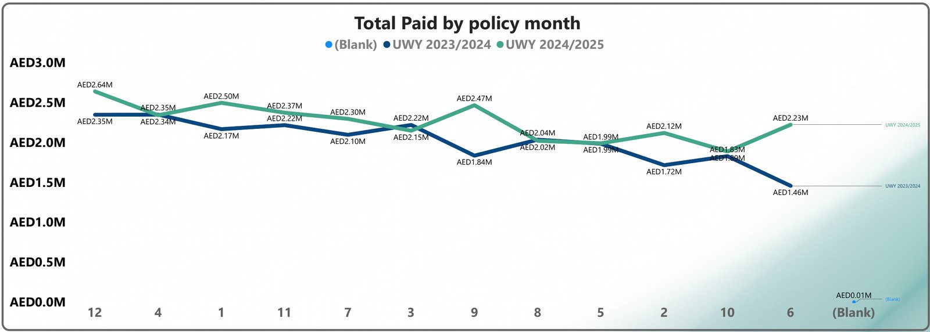
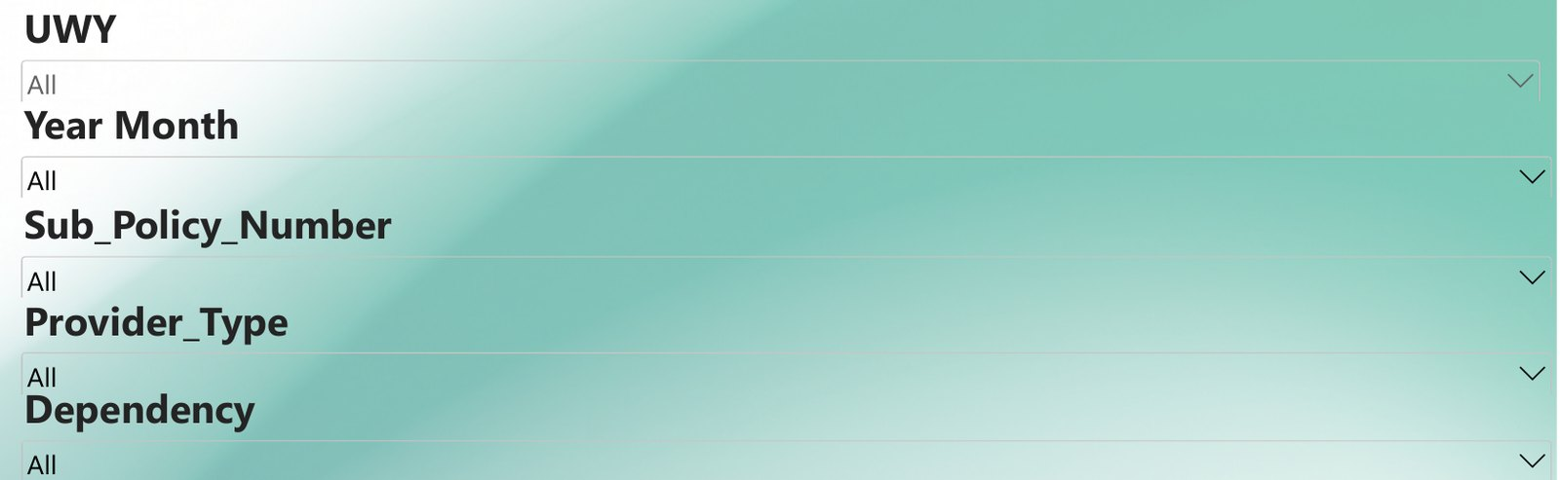
Page 1 · paid by policy month, and the slicers
TASK 1 · PAGE 1 · VISUALS 2–3 OF 4
Total Paid by policy month - line, one series per UWY (X axis = policy-year month, November = 1)
Slicer panel:
UWY
Year Month
Sub-policy
Provider type
Dependency
WHAT WE FOUND:
Five drop-down slicers, synced to every page (hidden copies sit on pages 2–5), so a selection made here follows the reader to the abnormal-findings, drivers, trend and drill-through pages.
2 underwriting years
38 year-months
12 sub-policies
11 provider types
3 dependency classes.
The whole story below can be re-read for any one of them.
Export note: the axis is sorted by value in this PDF, in the live file it is sorted 1 → 12.
WHAT WE FOUND:
Year two runs above year one in 9 of the 12 policy months.
Both years peak in month 12 (October: AED 2.35M → 2.64M) and dip in month 2 (December: 1.72M → 2.12M).
The single lowest month is April of year one (AED 1.46M).
The biggest year-on-year gaps are April (+52%) and July (+34%). The '(Blank)' series at the far right is the 20 incomplete rows.
5 / 24
Notes:
PAGE 1 - LINE CHART AND SLICERS (about 2 minutes).
Total Paid by policy month: the X axis is policy-year month number, not the calendar date. The policy year runs 1 November to 31 October, so a calendar axis would split one policy year across two calendar years and hide the pattern, renumbering November as month 1 lines both years up like-for-like. Year two is above year one in 9 of 12 months, both peak in month 12 (October) and dip in December, April of year one is the lowest month at AED 1.46M and April of year two is 52% higher - that is the single biggest year-on-year gap, followed by July (+34%). Year two is below year one only in January, February and June, and only just.
Slicer panel: UWY, Year Month, Sub_Policy_Number (12 sub-policies), Provider_Type (11 types) and Dependency (Principal, Spouse, Child). They are synced across all five pages - the hidden copies on pages 2–5 are what make the whole report follow one selection.
If asked why the exported axis reads 12, 4, 1, 11…: it was sorted by value when exported, the live file is sorted by UWY Month No ascending.

Slide 6
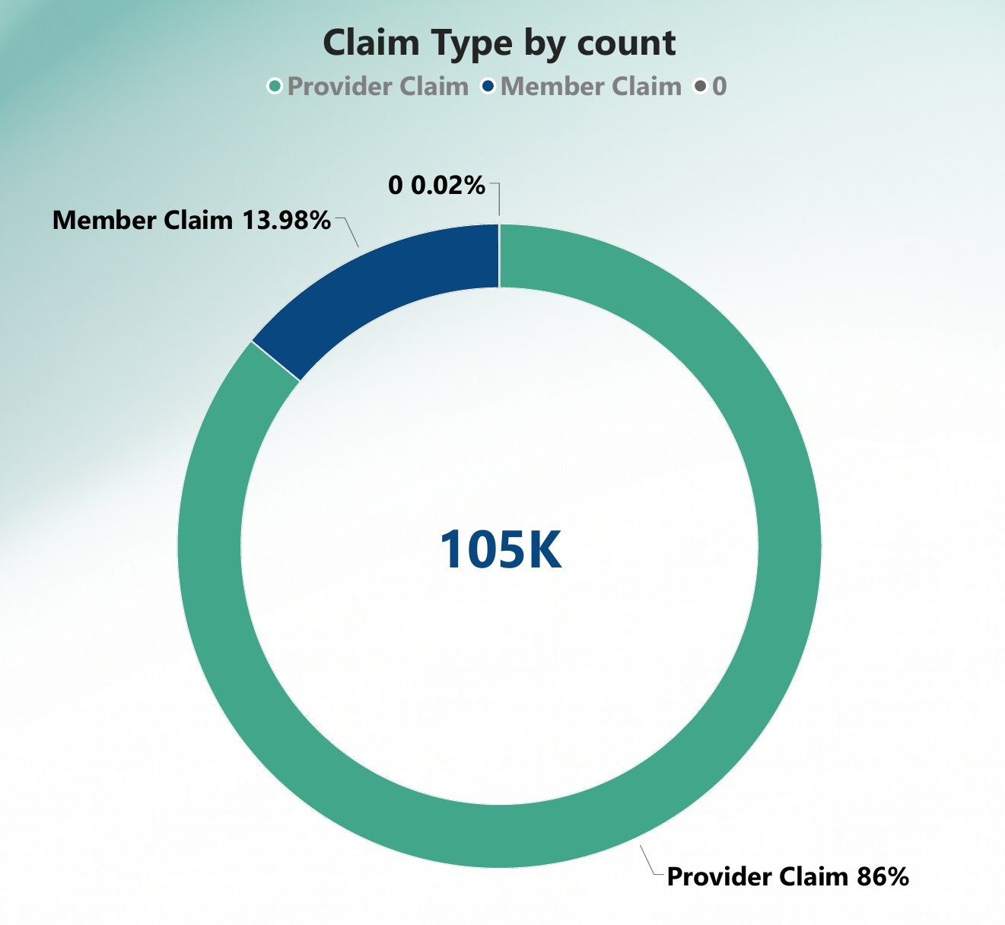
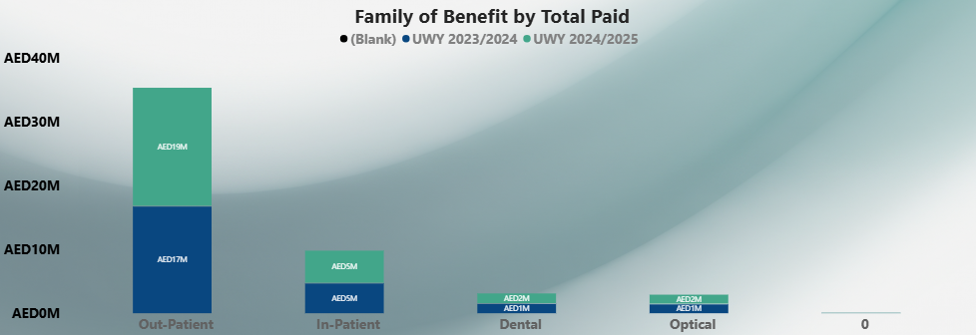
Page 1 · benefit mix, and claim type
TASK 1 · PAGE 1 · VISUAL 4 OF 4 + DONUT
Family of Benefit by Total Paid - clustered column, one bar per UWY
Claim Type by count - donut
WHAT WE FOUND
Out-patient is 69% of every dirham paid (AED 35.4M)
In-patient 19% (9.8M)
dental 6% (3.1M)
optical 6% (2.9M).
All four families grew between 10% and 13% year on year (dental +13%, out-patient +11.5%, in-patient +10.6%, optical +10.2%) - the rise is across the board, not one benefit.
Average claim: in-patient AED 6,851 versus out-patient AED 378 (18×). The '0' bar is the 20 incomplete rows.
WHAT WE FOUND
Provider (network) claims are 86% of claim lines (90,286) but only 70% of
paid. member reimbursement claims are 14% of lines (14,679) but 30% of paid.
A reimbursement claim averages AED 1,046 against AED 398 for a network claim (2.6×) larger per claim, which makes the reimbursement channel the one to control for cost and for turnaround.
The 0.02% slice is the 20 incomplete rows.
6 / 24
Notes:
PAGE 1 - BENEFIT MIX AND CLAIM TYPE (about 2 minutes).
Family of Benefit: out-patient AED 35.4M (69%), in-patient 9.8M (19%), dental 3.1M (6%), optical 2.9M (6%). Every family grew 10–13% year on year, so the cost rise is broad-based. In-patient is 1.4% of claim lines but 19% of spend - average AED 6,851 per claim against AED 378 out-patient.
Claim Type: provider claims (billed directly by the network) are 86% of lines but 70% of value, member claims (reimbursements) are 14% of lines but 30% of value - AED 1,046 per claim on average, 2.6× a network claim. That is worth a look: reimbursements are where the larger, less-controlled amounts sit, and they are also the manual channel.
The '0' category and the 0.02% slice are the same 20 incomplete rows flagged on page 2 - kept so the totals reconcile to the source file.

Slide 7
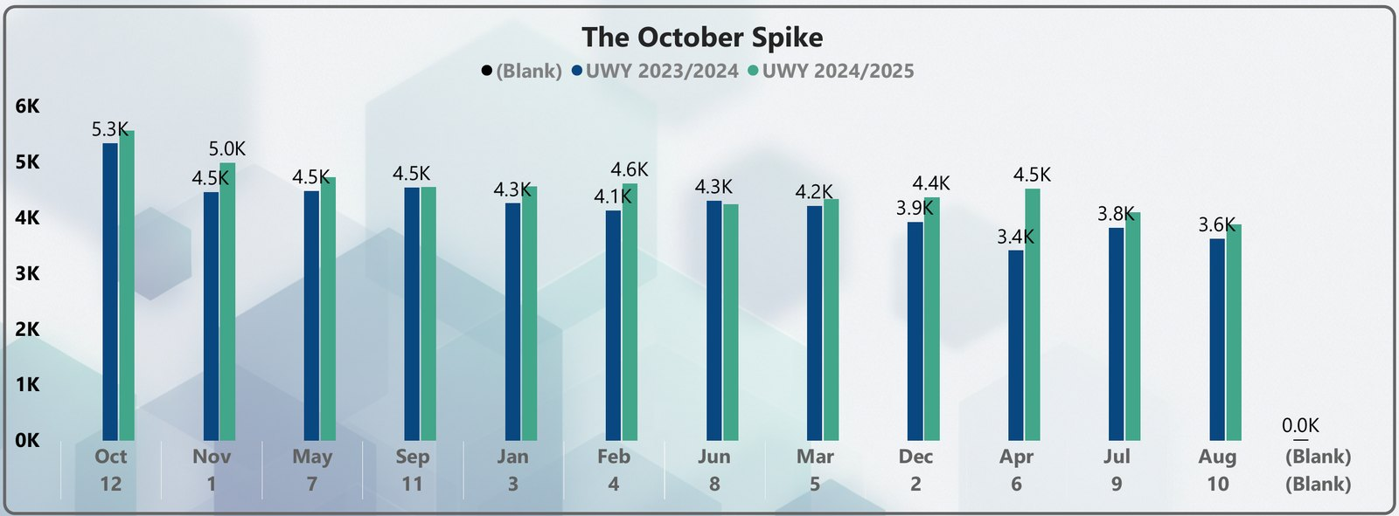
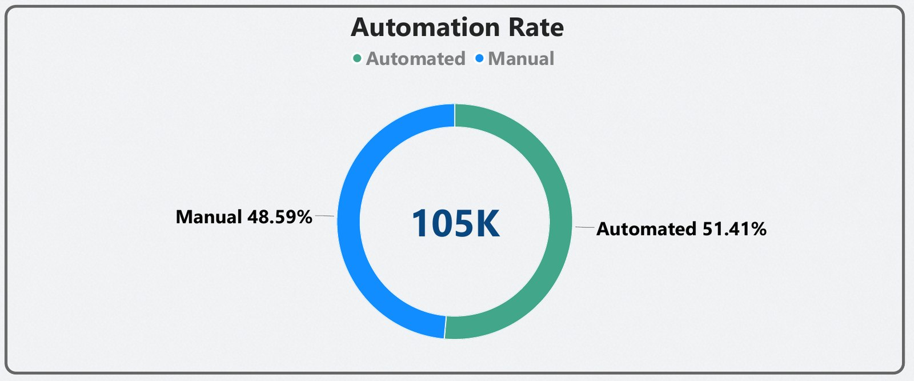
Page 2 · scorecards, October Spike, Automation
TASK 1 · PAGE 2 · VISUALS 1–3 OF 6
AUTO ADJUDICATED %
ZERO VALUE CLAIMS
ZERO VALUE %
51.4%
7,398
7.0%
53,976 of 104,985 lines processed by one system account (User_000083) - no human handles 54,000 claims in two years.
Claim lines settled at AED 0 (Value_Band = 'Zero value’), 6,557 of them are out-patient.
One claim in fourteen goes through the whole pipeline and pays nothing - volume without value.
The October Spike - clustered column, claim count by policy month, one bar per UWY
Automation Rate - donut on Processing_Channel
Export note: bars sorted by value in this PDF, sorted 1 → 12 in the live file.
WHAT WE FOUND
Month 12 (October) is the busiest month both years:
5,334 claims in 2023/2024 against an average of 4,106 for months 1–11 (+30%), and 5,566 in 2024/2025 against 4,445 (+25%).
Paid value rises about 18–19% in the same month.
The quietest months are April of year one (3,412) and August (3,625 / 3,884).
Benefit-reset behaviour, repeating two years running.
WHAT WE FOUND
51.41% automated / 48.59% manual.
Automated lines settle in a median 18 days versus 30 for manual but carry only 26% of paid value (AED 249 per line against AED 743 manual) - the manual half is where both the money and the delay sit.
7 / 24
Notes:
PAGE 2 - KPI STRIP, OCTOBER SPIKE, AUTOMATION RATE (about 2.5 minutes).
Auto Adjudicated % 51.4%: one processing-user ID covers 53,976 of the 104,985 lines. No human processes 54,000 claims in two years, so it had to be a system account, it was flagged as Processing_Channel in Power Query so the automated-versus-manual split is reusable on every visual, including the TAT comparison.
Zero Value Claims 7,398 and Zero Value % 7.0%: lines that pay nothing but still go through the pipeline - 89% of them out-patient.
The October Spike: month 12 = 5,334 and 5,566 claims versus about 4,100 and 4,450 for an average month - +30% and +25%. Paid rises 18–19%. Members using benefits before they reset on 1 November, it is predictable and it repeats.
Automation Rate: 51.41% automated. Median TAT 18 days automated versus 30 manual (means 19 and 28). Automated lines average AED 249, manual AED 743 - so automation covers the small, frequent claims and the manual half holds 74% of the money.
Export note: the October Spike bars are sorted by value in the PDF (October first); live they are sorted 1 → 12 so the spike sits at the right-hand end.

Slide 8
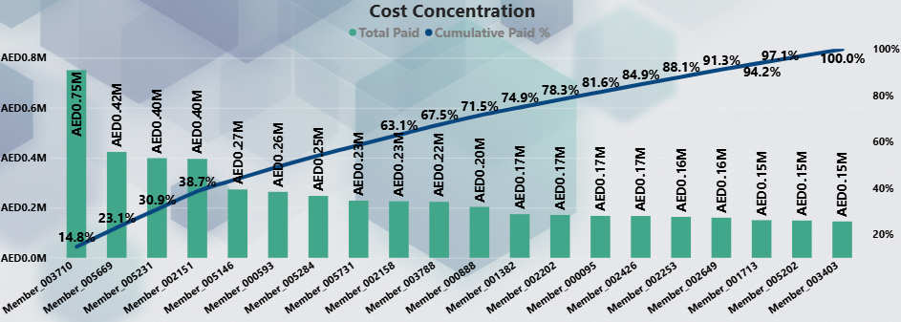
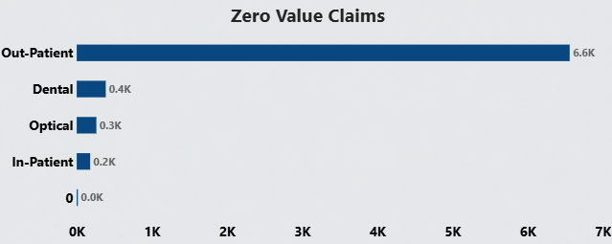
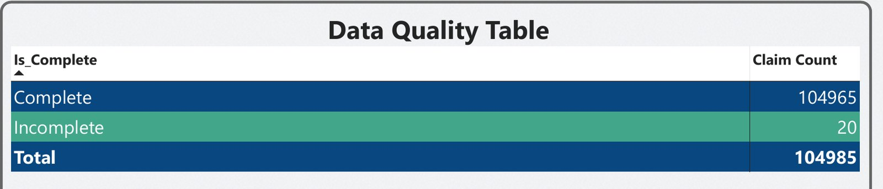
Page 2 · concentration, zero-value, data quality
TASK 1 · PAGE 2 · VISUALS 4–6 OF 6
Cost Concentration - Pareto: Total Paid per member (bars) and Cumulative Paid % (line), members ranked by spend
Zero Value Claims - bar by Family of Benefit
WHAT WE FOUND
6,557 of the 7,398 zero-value lines are out-patient (89%), dental 386, optical 261, in-patient 179.
Volume that costs handling time and inflates frequency without paying anything.
Data Quality Table - Is_Complete × Claim Count
Interim chart from the full dataset (3,468 members) - replace with the page-2 visual after the Top-10 filter is removed.
WHAT WE FOUND
The top 1% of members (35 people) carry 13.2% of all spend.
The top 5% carry 30%.
The top 10% carry 42%.
The top 20% carry 59%.
The single highest member is AED 751K (pulmonary hypertension, in-patient).
The top 20 members together are AED 5.09M, 9.9% of the book.
Half of everything we pay goes to 14% of the people we cover.
WHAT WE FOUND
104,965 complete, 20 incomplete, 104,985 total, reconciles to the source file line for line.
The 20 rows have blank dates and '0' categories and are what shows as '(Blank)' and '0' on the other visuals.
8 / 24
Notes:
PAGE 2 - COST CONCENTRATION, ZERO VALUE, DATA QUALITY (about 2.5 minutes).
Cost Concentration: a ranked cumulative chart (Pareto) shows the SHAPE of the risk, not just a top-10 list. Top 1% of members = 13.2% of spend, top 5% = 30%; top 10% = 42%; top 20% = 59%. The top member alone is AED 751K, the top 20 are AED 5.09M (9.9%). The Cumulative Paid % measure ranks members with ALLSELECTED so the curve respects the slicers.
IMPORTANT: the exported visual still carries a 'Top 20 Member_ID' filter, which is why its line reaches 100% after 20 members. Remove the filter and re-export before the session, this slide shows the full-dataset curve in the meantime.
Zero Value Claims by benefit: 6,557 out-patient, 386 dental, 261 optical, 179 in-patient, 15 in the '0' bucket.
Data Quality Table: 104,965 complete + 20 incomplete = 104,985, matching the source file. The 20 rows are kept, not deleted, so the totals reconcile and the issue can go back to the data owner.
If asked about declined claims: Declined_Reasons is null on every complete row, so there is nothing to analyse on declines in this extract.

Slide 9
Page 3 · Interactive Centrepiece (decomposition tree)
TASK 1 · PAGE 3 · VISUAL 1 OF 5
Analyze Total Paid → explain by Family of Benefit → ICD chapter → ICD description → Provider type (tooltip: Cumulative Paid %). One path expanded, full dataset:
Total Paid
Family of Benefit
ICD chapter (Out-Patient)
ICD description (M)
Provider type (low back pain)
Total
AED 51.30M
Out-Patient
AED 35.38M · 69%
M · Musculoskeletal
AED 8.55M
Low back pain (M54.5)
AED 2.63M
Polyclinic
AED 2.37M · 90%
In-Patient
AED 9.82M · 19%
R · Symptoms & signs
AED 4.94M
Cervicalgia (M54.2)
AED 1.92M
Hospital
AED 0.17M
Dental
AED 3.11M · 6%
J · Respiratory
AED 4.20M
Lumbago with sciatica
AED 0.23M
Pharmacy
AED 0.08M
Optical
AED 2.91M · 6%
E · Endocrine / metabolic
AED 3.47M
Myalgia
AED 0.16M
I · Circulatory
AED 1.86M
WHAT WE FOUND
Follow the money and it narrows fast:
69% of spend is out-patient, inside it the musculoskeletal chapter is the largest (AED 8.55M, 17% of the whole book).
Inside that, two codes, low back pain and neck pain, are AED 4.56M (8.9% of everything, up 38% year on year, average claim AED 1,128 versus AED 378 for a normal out-patient visit).
90% of the low-back-pain money is billed by polyclinics.
In-patient tells a different story:
Respiratory, pregnancy (chapter O, AED 1.14M), circulatory and digestive, and hospitals carry AED 20.5M overall.
That path is the physiotherapy recommendation.
9 / 24
Notes:
PAGE 3 - INTERACTIVE CENTREPIECE (about 2 minutes).
The decomposition tree analyses Total Paid and lets the reader expand by Family of Benefit, ICD chapter, ICD description and Provider type, Cumulative Paid % sits in the tooltip. Walk one path live if you can: Total 51.3M → Out-Patient 35.4M → chapter M (musculoskeletal) 8.55M → Low back pain 2.63M → Polyclinic 2.37M.
Other branches worth knowing: out-patient chapters after M are R (symptoms and signs, 4.94M), J (respiratory, 4.20M), E (endocrine, incl. diabetes, 3.47M), I (circulatory, 1.86M). In-patient: J 1.47M, O (pregnancy and childbirth) 1.14M, I 1.08M, K (digestive) 1.05M. Provider type overall: Hospital 20.5M, Polyclinic 18.3M, Pharmacy 8.5M, Optometry 2.6M, Dental centre 1.1M.
Back and neck pain together (M54.5 + M54.2): AED 4.56M, 8.9% of spend, +38% year on year, average claim AED 1,128 - three times a normal out-patient claim - 2,524 + 1,513 lines, 73% manual. This is where the physiotherapy review-step recommendation comes from.
IMPORTANT: in the exported PDF the tree root reads AED 5.09M because of the Top-10 filter, remove it before the session and the root reads AED 51.3M. Every number on this slide is from the full dataset.

Slide 10
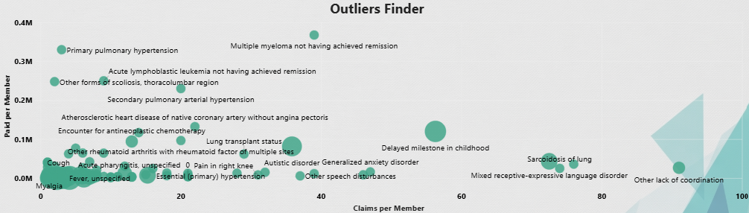
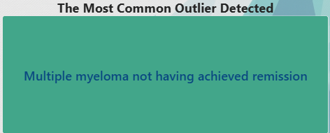
Page 3 · Outliers Finder, and the outlier card
TASK 1 · PAGE 3 · VISUALS 2–3 OF 5
Outliers Finder - scatter by ICD description: X = Claims per Member, Y = Paid per Member (AED K), bubble = Members Affected
The Most Common Outlier Detected - card
Interim chart from the full dataset (60 diagnoses with ≥15 claims per member or ≥AED 40K per member) - replace with the page-3 visual after the filter is removed.
WHAT WE FOUND
The card scores every diagnosis on claims-per-member and paid-per-member (each divided by its maximum) and returns the highest.
'Multiple myeloma not having achieved remission' - one member, 39 claims, AED 368K over two years.
Runners-up on the same score:
sarcoidosis of lung, other lack of coordination, primary pulmonary hypertension. The answer is the same with or without the stray filter.
WHAT WE FOUND
Two corners matter.
Top-left (few claims, huge cost):
Multiple myeloma AED 368K per member, primary pulmonary hypertension 330K, acute lymphoblastic leukaemia 250K, secondary pulmonary hypertension 230K, thoracolumbar scoliosis 124K, acromegaly 117K (one or two members each).
Bottom-right (many claims per member):
Sarcoidosis of lung 74 claims per member, lack of coordination 74 (5 children), cluster headache 59–63, mixed language disorder 51
(6 children), delayed milestone 42 (20 children).
The developmental cluster is the frequency problem:
The oncology / cardiopulmonary cluster is the severity problem.
10 / 24
Notes:
PAGE 3 - OUTLIERS FINDER AND THE OUTLIER CARD (about 2 minutes).
Outliers Finder: one bubble per ICD description, X = claims per member (Claim Count / Claimants), Y = paid per member (Total Paid / Claimants), bubble size = members affected. The reader looks at two corners.
Severity corner (top-left): multiple myeloma AED 368K per member (1 member, 39 claims); primary pulmonary hypertension 330K (1 member, 3 claims); acute lymphoblastic leukaemia 250K (1 member, 9 claims); secondary pulmonary hypertension 230K, thoracolumbar scoliosis 124K (2 members); acromegaly 117K.
Frequency corner (bottom-right): sarcoidosis of lung 74 claims per member, other lack of coordination 74 (5 members, 368 claims); chronic / episodic cluster headache 63 and 59, mixed receptive-expressive language disorder 51 (6 members); delayed milestone in childhood 42 (20 members, 834 claims, AED 1.13M).
Cross-referenced against ICD chapter: F/R developmental codes cluster separately from C oncology codes - two distinct groups, which is why the slides call them two clusters.
The Most Common Outlier Detected card: DAX scores every diagnosis as claims-per-member ÷ max + paid-per-member ÷ max and returns the top one - multiple myeloma. Same answer on the full data.
If asked "what would you do with the outliers": case management for the severity corner (few people, very high cost), a session-count review step for the frequency corner (therapy programmes).

Slide 11
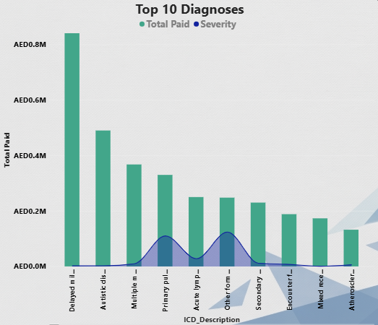
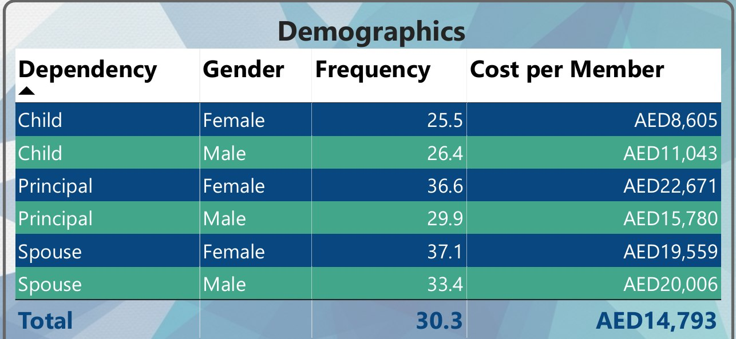
Page 3 · Top 10 Diagnoses, and Demographics
TASK 1 · PAGE 3 · VISUALS 4–5 OF 5
Top 10 Diagnoses - Total Paid (bars) with Severity, i.e. AED per claim (line)
Demographics - table: Dependency × Gender → Frequency, Cost per Member
Interim chart from the full dataset - the exported visual shows 'Delayed milestone' first because of the Top-10 filter, replace after re-export.
WHAT WE FOUND
Low back pain leads at AED 2.64M (5.1% of spend, 2,524 claims).
Cervicalgia AED 1.92M (3.7%).
Delayed milestone in childhood 1.13M.
Upper respiratory infection 1.05M.
Hypertension 1.00M.
Refraction disorders 1.00M.
Dental caries 0.89M.
Acute bronchitis 0.76M.
Myopia 0.68M.
fever 0.65M.
The severity line separates two kinds of cost:
delayed milestone (AED 1,350 per claim) and back / neck pain (1,045–1,268) are expensive per visit.
respiratory infections and fever are cheap (176–217) but very frequent (3,300–6,000 claims each).
WHAT WE FOUND
Adult women cost the most per head:
principal female AED 22,671 (frequency 36.6) and spouse female 19,559 (37.1 - the highest frequency).
Principal males are the biggest group - 1,321 members, AED 15,780 each, 41% of all spend.
Children are cheapest per head (AED 8,605 girls, 11,043 boys) yet 24% of spend, and they hold the therapy outliers.
Book total: 30.3 claims and AED 14,793 per member over two years.
11 / 24
Notes:
PAGE 3 - TOP 10 DIAGNOSES AND DEMOGRAPHICS (about 2 minutes).
Top 10 Diagnoses, full data: low back pain AED 2.64M (5.1%), cervicalgia 1.92M (3.7%), delayed milestone in childhood 1.13M (2.2%), acute upper respiratory infection 1.05M, essential hypertension 1.00M, other disorders of refraction 1.00M, dental caries 0.89M, acute bronchitis 0.76M, bilateral myopia 0.68M, fever 0.65M. Severity (AED per claim): delayed milestone 1,350, cervicalgia 1,268, low back pain 1,045, refraction 873, myopia 768, caries 739, hypertension 412, bronchitis 217, fever 195, URTI 176.
Read: two kinds of cost - expensive-per-visit programmes (therapy, physio) and cheap-but-constant primary care (URTI 5,958 claims, bronchitis 3,509, fever 3,327).
IMPORTANT: the exported chart shows 'Delayed milestone in childhood' first only because of the Top-10 filter, on the full data it is low back pain. Fix before the session.
Demographics table (unaffected by the filter): Child F 25.5 / AED 8,605, Child M 26.4 / 11,043, Principal F 36.6 / 22,671, Principal M 29.9 / 15,780, Spouse F 37.1 / 19,559, Spouse M 33.4 / 20,006 (36 members only); total 30.3 / 14,793. Principal males are 1,321 of the 3,468 members and AED 20.8M of spend, children are 1,247 members and AED 12.3M.

Slide 12
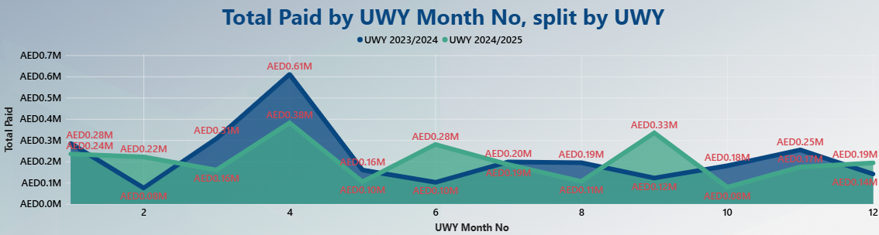
Page 4 · KPI tiles, and paid by UWY month
TASK 1 · PAGE 4 · VISUALS 1–2 OF 4
OUT-PATIENT
THIRD PARTY ASSISTANCE
NETWORK_7
SPOUSE
EMERGENCY = YES
AED 35.4M
AED 0.0M
AED 2.6M
AED 14.1M
AED 3.0M
Family of Benefit · 69% of paid
Provider type · one claim, AED 367
Provider network · 5.1% (Network_3 leads at 41%)
Dependency · 27% of paid, 719 members
Emergency flag · 5.9% of paid, 2,295 claims
Total Paid by UWY Month No, split by UWY - both policy years on one axis (AED M)
What the five tiles are
WHAT WE FOUND
Five KPI visuals, each with Total Paid as the indicator and a category column as the trend axis (benefit family, provider type, network, dependency, emergency flag).
Each tile displays the last category on its axis - a quick read of five different cuts of the same AED 51.3M.
The goal field is a count placeholder, so the variance % on the tiles is not meaningful: replace it with a budget or prior-year target.
Interim chart from the full dataset - replace after re-export.
WHAT WE FOUND
Same series as page 1, read as a gap: year two is above year one in 9 of 12 months, with the widest gaps in April (+52%) and July (+34%), it drops just below year one only in January, February and June. October is the top of both curves.
12 / 24
Notes:
PAGE 4 - KPI TILES AND THE SPLIT-BY-UWY LINE (about 2 minutes).
The five KPI visuals each carry Total Paid as the indicator with a category column as the trend axis: Family_of_Benefit (shows Out-Patient AED 35.4M), Provider_Type (Third Party Assistance Companies - AED 367, one claim), Provider_Network (Network_7 AED 2.6M, 5.1%; Network_3 is the largest at 41%, Network_5 24%, Network_1 20%), Dependency (Spouse AED 14.1M, 27%), Emergency (Yes AED 3.0M, 5.9%, 2,295 claims).
Be honest if asked about the "goal" shown on each tile: it is a count of the category column - a placeholder - so the +37,678% style variance means nothing. The fix is a real target measure (budget, or prior UWY paid) or removing the goal.
Total Paid by UWY Month No split by UWY: the same numbers as the page-1 line, but as overlapping areas so the year-two gap is visible: above year one in 9 of 12 months, April +52%, July +34%; slightly below in January, February and June, both peak in October.
IMPORTANT: the exported chart tops out at AED 0.61M because of the Top-10 filter (a tenth of the book) - fix before the session.

Slide 13
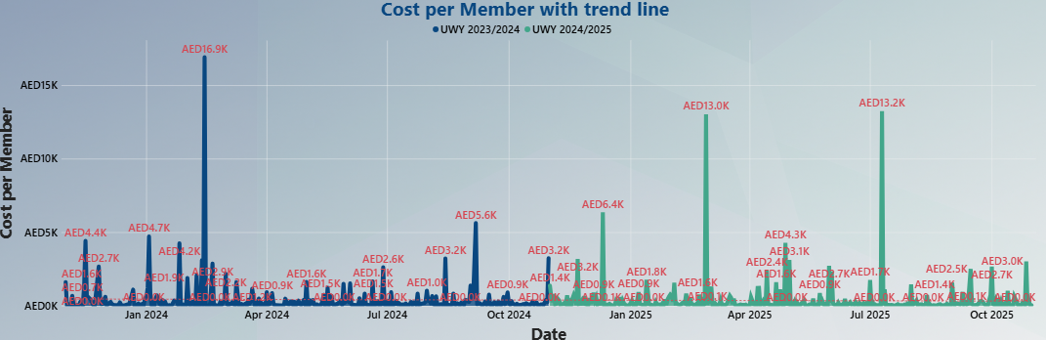
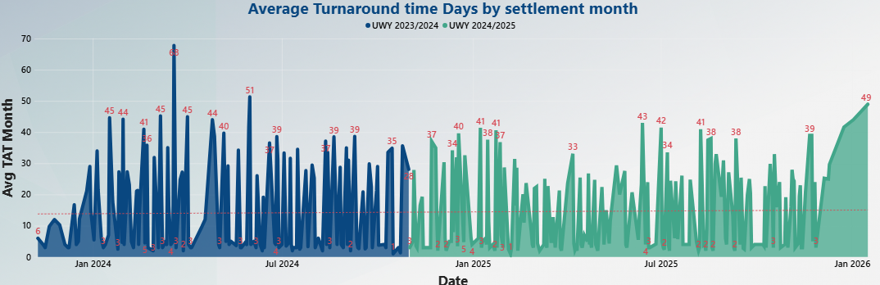
Page 4 · cost per member trend, and TAT trend
TASK 1 · PAGE 4 · VISUALS 3–4 OF 4
Cost per Member with trend line - line by date, one series per UWY
Average Turnaround time Days by settlement month - line by date, one series per UWY
Interim: monthly cost per member from the full dataset - replace with the daily visual after re-export.
Interim: monthly average TAT by settlement month from the full dataset - replace after re-export.
WHAT WE FOUND
Read monthly, cost per member runs AED 490–840 a month: year two sits at AED 600–840 and peaks in October (AED 836) and November (791).
The page's daily view is spiky on purpose - single in-patient events land on one date: the biggest day is AED 388K (14 Feb 2024) against a median day of AED 66K, and those spikes are the outliers from page 3 arriving.
WHAT WE FOUND
Processing got faster and steadier.
Claims settled in year one averaged 25.0 days with peaks of 36.6 (April) and 33.3 (August): year two averaged 22.4 days and stayed in a 19–29 band.
5,375 claims settled after the second policy year closed (run-off) at 23.9 days. Automated claims are the reason: the automated share settles in a median 18 days.
13 / 24
Notes:
PAGE 4 - COST PER MEMBER TREND AND TAT BY SETTLEMENT MONTH (about 2 minutes).
Cost per Member with trend line: on the page it is daily - Total Paid on that date divided by covered members - so it is spiky by design, each spike is a large in-patient event landing on one date (largest day AED 388K on 14 Feb 2024, 10 Jul 2025 AED 349K, 27 Feb 2025 AED 290K, median day AED 66K). Monthly, cost per member is AED 490–840, year two is higher in 8 of 12 months and peaks in October (836) and November (791).
Average Turnaround time Days by settlement month: the measure uses USERELATIONSHIP to switch the calendar to Settled_Date, so this is 'how long did the claims we closed that month take'. Year one 25.0 days on average with peaks at 36.6 (April) and 33.3 (August); year two 22.4 days, in a 19–29 band. Run-off after October 2025: 5,375 claims at 23.9 days. Faster and steadier, driven by the automated half (median 18 days).
IMPORTANT: both exported charts carry the Top-10 filter (year-one values of AED 16.9K per member per day are 20 members' claims divided by 20). Fix before the session, this slide shows monthly full-dataset series in the meantime.

Slide 14
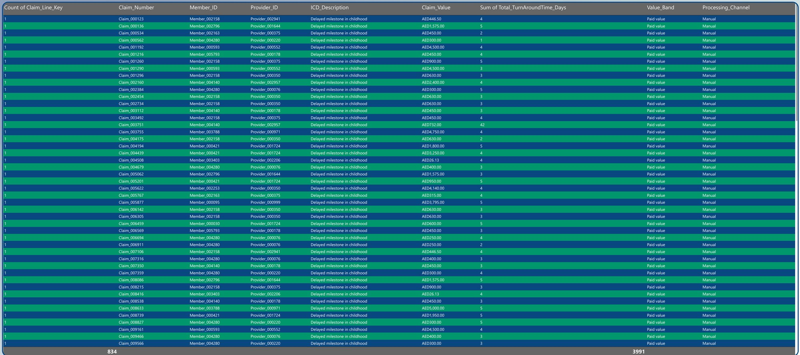
Page 5 · Claim details drill-through
TASK 1 · PAGE 5 · VISUAL 1 OF 1
Claim details - table, one row per claim line, reached by right-click → drill through from any diagnosis, member or provider
Why it is on the dashboard
Drill-through fields
ICD_Description
Member_ID
Provider_ID
Columns
Count of Claim_Line_Key
Claim_Number
Member_ID
Provider_ID
ICD_Description
Claim_Value
Sum of Total_TurnAroundTime_Days
Value_Band
Processing_Channel
WHAT WE FOUND
Every finding on pages 1–4 is an aggregate, this page is the evidence behind it.
It is the hand-over list for a case manager (drill from a member), the audit list for a provider (drill from a provider), and the session list for a therapy review (drill from a diagnosis).
Nothing on the summary pages needs to be trusted blindly - it can be opened to the claim line in two clicks.
WHAT WE FOUND
Nine columns: claim line count, claim number, member, provider, diagnosis, claim value, turnaround days, value band, processing channel.
The export shows the drill from 'Delayed milestone in childhood’:
834 lines across 20 children every one processed manually, 26–5,000 AED per session, 3,991 turnaround days in total (4.8 per line).
The same drill on low back pain returns 2,524 lines, 695 members, 449 providers, median AED 406, 73% manual, 15 days average TAT.
14 / 24
Notes:
PAGE 5 - CLAIM DETAIL DRILL-THROUGH (about 1.5 minutes).
A drill-through page bound to three fields - ICD_Description, Member_ID and Provider_ID - so any bar, bubble or table row on pages 1–4 can be right-clicked to open the claim lines behind it. Nine columns: Count of Claim_Line_Key, Claim_Number, Member_ID, Provider_ID, ICD_Description, Claim_Value, Sum of Total_TurnAroundTime_Days, Value_Band, Processing_Channel.
The export shows the drill from 'Delayed milestone in childhood': 834 lines, 20 members, all Manual, AED 26–5,000 per line, 3,991 turnaround days in total (4.8 days per line - these are fast, repetitive out-patient sessions). Low back pain drill: 2,524 lines, 695 members, 449 providers, median AED 406, average 1,045, 73% manual, 15.5 days average TAT.
Use in the interview: this is the list a case manager or a provider auditor would actually work from. Say the column name Total_TurnAroundTime_Days as it is.

Slide 15
Task 1 - what we should do next
TASK 1 · RECOMMENDATIONS
1
Review step on therapy claims
2
Case manager for the top list
3
October pricing and benefit design
Put a review in front of physiotherapy and long-running therapy claims once they pass a few sessions.
Assign a case manager to the highest-cost members - a short list, big impact.
Re-examine October pricing and benefit design ahead of the next renewal and plan claims capacity for month 12.
Why Back/neck pain (M54.5 / M54.2) is AED 4.6M, 8.9% of spend, up 38% YoY, average claim 3× the out-patient norm, paediatric therapy is the fastest-growing cluster (+15%).
Why Top 1% of members (35 people) carry 13% of spend, the severity corner of the scatter is six conditions and a handful of people, the drill-through page hands over their claim lines.
Why Claims run 25–30% above a normal month every October, two years running, paid +18–19%.
Watch on the dashboard Decomposition tree, Out-Patient → M and R chapters, the frequency corner of the Outliers Finder.
Watch on the dashboard Cost Concentration: the cumulative % for the first 1% of members should fall below 13%.
Watch on the dashboard The October Spike: month 12 versus the average of months 1–11 - the gap should narrow next renewal.
Known limitation We don't yet have premium or benefit-limit data, so we can't calculate a loss ratio - that's the natural next step once we have it. The two levers we can see are frequency (visits) and severity (cost per visit), each recommendation targets one of them. Also worth adding: a real target on the page-4 KPI tiles, and the reimbursement channel (30% of paid on 14% of claims) as a fourth lever.
15 / 24
Notes:
TASK 1 - RECOMMENDATIONS (about 1 minute, then take questions before Task 2).
1. Review step on physio and long-running therapy after a few sessions - from the decomposition tree (M chapter, back/neck pain AED 4.6M, +38%) and the frequency corner of the outliers scatter (developmental therapy, +15%).
2. Case manager for the highest-cost members - from the Pareto (top 1% = 13%) and the severity corner of the scatter, page 5 is the hand-over list.
3. October pricing and benefit design before renewal - from the October Spike (+25–30% claims, +18–19% paid).
Say the limitation out loud: no premium or benefit-limit fields, so no loss ratio yet. Two more things the pages suggest: put a real target on the page-4 KPI tiles, and look at the reimbursement channel - 14% of claims, 30% of paid, average AED 1,046.
Then: "That's the claims dashboard - happy to open the live file or take questions now before I move to the helpline."

Slide 16
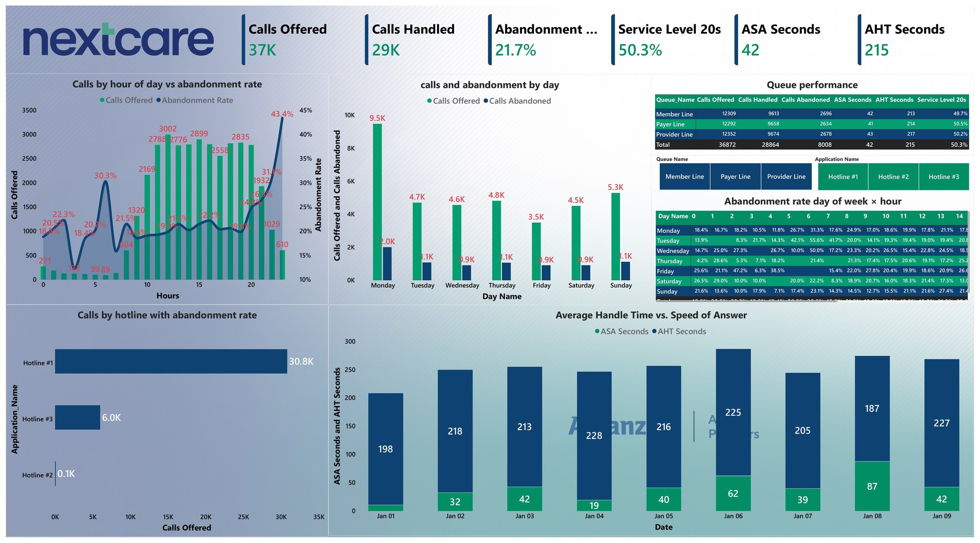
Helpline performance - one page, nine visuals
TASK 2 · POWER BI · MAP
The nine visuals
KPI strip - Calls Offered · Calls Handled · Abandonment Rate · Service Level 20s · ASA · AHT
Calls by hour of day vs abandonment rate (combo)
Calls and abandonment by day (clustered column)
Queue performance (table)
Slicer buttons - Queue Name
Slicer buttons - Application Name (Hotline #)
Abandonment rate day of week × hour (matrix heat map)
Calls by hotline with abandonment rate (bar)
Average Handle Time vs Speed of Answer by date (stacked column)
Built to the brief: 5–10 KPIs (six), several time frames (hour, weekday, date, day × hour), drill-down by Hotline # and by Queue Name.
The single report page - six KPIs, filterable by Hotline # (Application Name) and by Queue Name, 9 days of call records (1–9 January 2023)
We handled 37K calls in nine days.
One in five callers hung up before we answered - and it's worse than it looks, because it isn't spread evenly.
16 / 24
Notes:
TASK 2 - MAP (about 1 minute). Start the 15-minute block.
Open with the number: "36,872 calls offered over nine days, about 29,000 handled, 21.7% abandoned. One in five callers hung up before we answered - and it isn't spread evenly."
One page, nine visuals, built to the brief: six KPIs on the strip (brief asked for 5–10); several time frames - hour of day, day of week, date, and a day × hour matrix, and the two drill-downs asked for - Hotline # (Application Name) and Queue Name - as slicer buttons that every visual responds to.
Data: sheet_2.xlsx, 36,991 rows, one row per call leg, 1–9 January 2023, DataTable as the fact plus a DateTable and a TimeTable, and a Measurements table for the DAX.

Slide 17
Helpline · the six scorecards
TASK 2 · VISUAL 1 OF 9
CALLS OFFERED
CALLS HANDLED
ABANDONMENT RATE
36,872
28,864
21.7%
Distinct call IDs, not rows: 36,991 rows minus 119 transfer legs (117 calls handled by two agents). Counts callers, not legs.
78.3% of callers reached an agent. 120 agent extensions answered - about 240 handled calls each over nine days.
8,008 callers hung up before an answer. Those who abandoned had waited a median 75 seconds (mean 118) - that is the patience limit.
SERVICE LEVEL 20s
ASA SECONDS
AHT SECONDS
50.3%
42
215
Half of all offered calls were answered within 20 seconds, the other half waited longer or abandoned. 52% on Hotline #1, 39% on Hotline #3.
Average speed of answer for handled calls, the median is 8 seconds and the 90th percentile 126 - a long tail, not a slow floor.
Average handle time for handled calls (about 3.5 minutes): 177 s talk + 35 s hold + 3 s wrap-up. Steady every day.
Six numbers, one read: when we answer, we answer fast and handle well - the loss is entirely in the queue before the answer.
17 / 24
Notes:
HELPLINE - KPI STRIP (about 2 minutes). One card visual, six measures.
Calls Offered 36,872 - DISTINCTCOUNT of the call identifier ('Node ID - Session ID - Sequence Number'), not a row count. 117 calls were transferred between agents and appear as two rows, counting rows would inflate callers by 119. The difference (36,991 rows vs 36,872) is the proof the de-duplication works. No Is_Transfer_Leg column exists - the de-duplication is purely the measure.
Calls Handled 28,864 (78.3%) - 120 distinct agent extensions, about 240 handled calls each.
Abandonment Rate 21.7% - 8,008 callers. Abandoned callers waited a median of 75 seconds before hanging up (from Queue_Time); handled callers were answered in a median of 8 seconds.
Service Level 20s 50.3% - handled within 20 seconds ÷ offered. Hotline #1 52%, Hotline #3 39%.
ASA 42 seconds - average queue time of handled calls, median 8 s, p90 126 s.
AHT 215 seconds - talk 177 + hold 35 + work 3. Both ASA and AHT filter to handled calls only: an abandoned caller has no handle time, and including them would understate the service once connected.

Slide 18
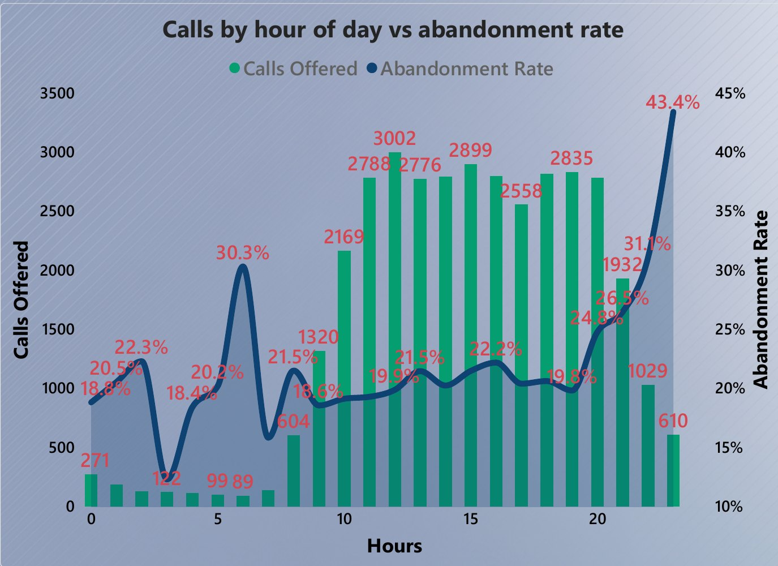
Helpline · Calls by hour of day vs abandonment rate
TASK 2 · VISUAL 2 OF 9
Combo chart - Calls Offered (columns) and Abandonment Rate (line, secondary axis) by hour
≈ 19–22%
43.4%
abandonment, 9 am – 7 pm
abandonment at 11 pm
2,787
37%
calls still arriving at 8 pm
of all abandoned calls fall 6–11 pm
WHAT IT MEANS
This is a staffing timing problem, not a staffing size problem.
Volume does not fade when the line climbs - it is still 2,800 calls an hour at 8 pm - so the evening roster is simply thinner than the demand.
Putting volume and rate on one chart is what makes that visible, a rate-only chart would let someone dismiss the evening as low volume.
SOLUTION
Shift part of the roster into the 6–11 pm window - same team, same skill.
Watch the line flatten toward the daytime 20%.
WHAT WE FOUND Volume builds from 8 am, holds at 2,500–3,000 calls an hour from 11 am to 8 pm, then tails off. Abandonment sits at 19–22% through business hours, then climbs from 8 pm - 25%, 27%, 31% - to 43.4% at 11 pm. The 6–11 pm window is 12,014 calls (33% of volume) but 2,932 abandoned calls (37% of everything we lose). The early-morning spikes (30% at 6 am) are on 89–130 calls - noise.
18 / 24
Notes:
HELPLINE - CALLS BY HOUR (about 3 minutes). The most important helpline visual.
Read the columns: volume builds from 8 am (604), 9 am (1,320), 10 am (2,169), then 2,500–3,000 an hour from 11 am to 8 pm, then 1,932 at 9 pm, 1,029 at 10 pm, 610 at 11 pm.
Read the line: 19–22% through business hours, 24.8% at 8 pm, 26.5% at 9 pm, 31.1% at 10 pm, 43.4% at 11 pm.
6–11 pm: 12,014 calls (33%) and 2,932 abandons (37%). 8–11 pm alone: 6,358 calls at 28% abandonment.
Small hours (midnight to 7 am): 89–271 calls an hour - the 30% at 6 am is 27 abandons on 89 calls, do not over-read it.
Data prep, only if asked: the timestamp arrived as text ('Mon Jan 09 00:00:33 GST 2023'); converting it directly produced 36,991 errors, so it was parsed with custom M code before an Hour column existed.
The read: timing, not headcount. Recommendation 1 comes from here.

Slide 19
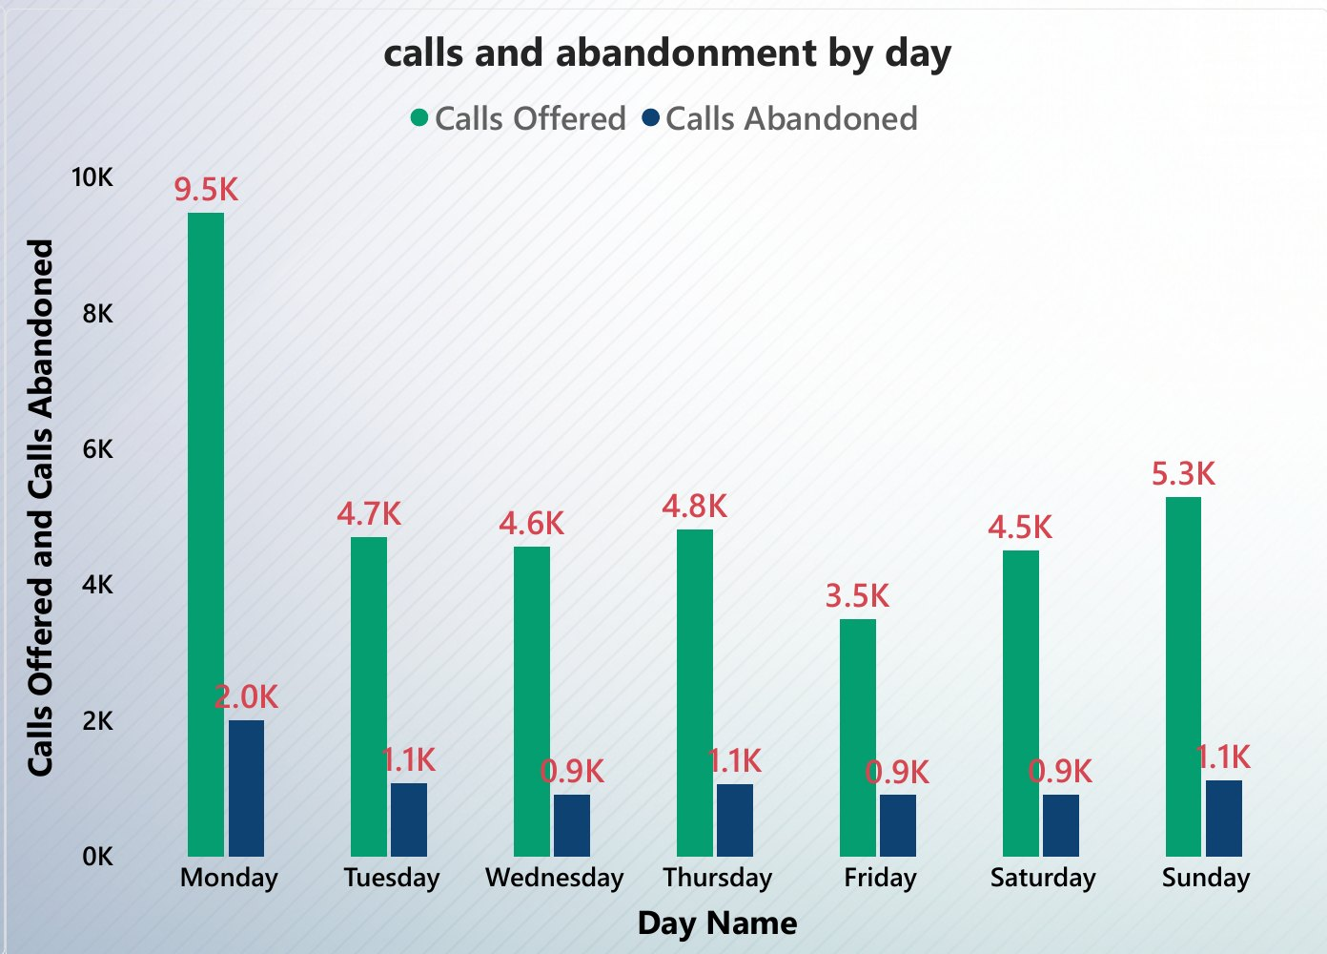
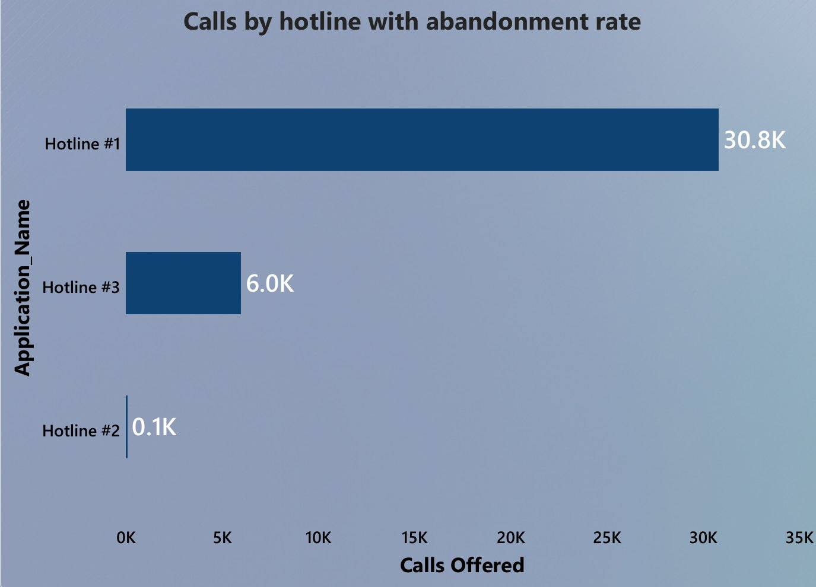
Helpline · by day of week, and by hotline
TASK 2 · VISUALS 3 & 8 OF 9
Calls and abandonment by day - clustered column on Day Name (sorted by a hidden Day Number)
Calls by hotline with abandonment rate - bar on Application Name (rate in the tooltip)
WHAT WE FOUND
Mondays are almost double any other day - 9,500 calls versus roughly 4,000 to 5,000 the rest of the week - and Monday's abandonment (21%) is no better than average, so the extra volume is not being absorbed.
Friday is the quietest day (3,493 calls) yet has the highest abandonment rate (26%) - the Friday roster is thinner than its demand.
Tuesday 22.8%, Thursday 22.3%, Wednesday 20.0%, Saturday 20.2%, Sunday 21.1%.
WHAT WE FOUND
Hotline #1 carries 83.6% of every call (30,820) at 19.5% abandonment, ASA 41 s, SL20 52%. Hotline #3 is 16.2% (5,978) and performs worse on every measure, 33.5% abandonment, ASA 50 s, AHT 269 s, SL20 39%.
Hotline #2 is 74 calls in nine days - too few to judge, so it is left out of the narrative. Each hotline splits evenly across the three queues (about a third each).
19 / 24
Notes:
HELPLINE - DAY OF WEEK AND HOTLINE (about 3 minutes).
Day of week (as submitted): "Mondays are almost double any other day - 9,500 calls versus roughly 4,000 to 5,000 the rest of the week." Monday abandonment 21%, no better than average. Also visible: Friday is the quietest day (3,493) but the worst abandonment (26%). Day names sort alphabetically by default, a hidden Day Number column is the sort-by column so the axis reads Monday → Sunday.
IMPORTANT - BE READY FOR THIS QUESTION. The nine days run Sunday 1 Jan to Monday 9 Jan 2023, so the window contains TWO Mondays (Jan 2: 4,433, Jan 9: 5,047) and TWO Sundays (Jan 1: 1,572 - New Year's Day, Jan 8: 3,730). The 9,500 is two Mondays added together, per Monday it is about 4,750, in line with Tuesday–Thursday (4,560–4,820). If a panellist raises it, own it in one sentence: "Correct - the day-of-week view sums two Mondays, per day, weekdays are flat at about 4,500–4,800 and Friday and Sunday are lighter. Nine days can't separate a real weekly pattern from one specific week, which is exactly why the recommendation says extend beyond nine days." Then move on. The evening-window finding is unaffected.
Hotline: #1 30,820 calls (83.6%), abandonment 19.5%, ASA 41 s, AHT 206 s, SL20 52%. #3 5,978 (16.2%), abandonment 33.5%, ASA 50 s, AHT 269 s, SL20 39% - worse on every measure, worth its own look. #2 74 distinct calls (76 rows) - too small. Each hotline is split about evenly across Member, Payer and Provider queues, so the hotline difference is not a queue-mix effect.

Slide 20
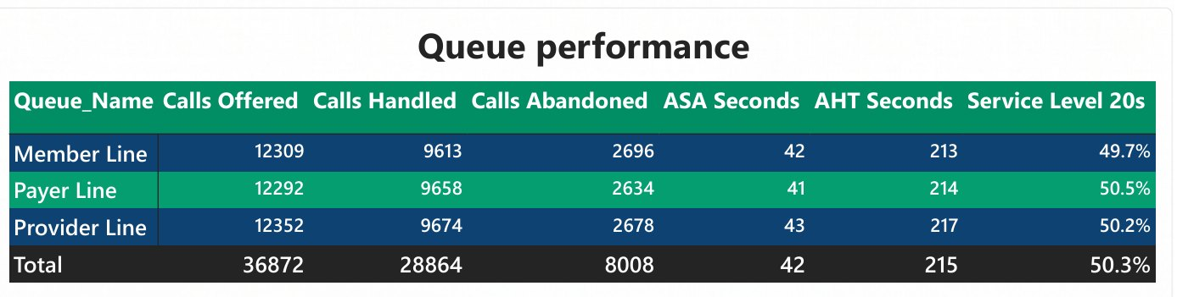
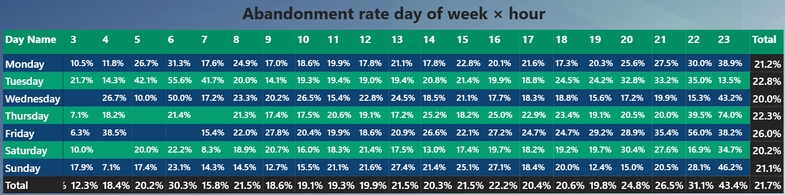
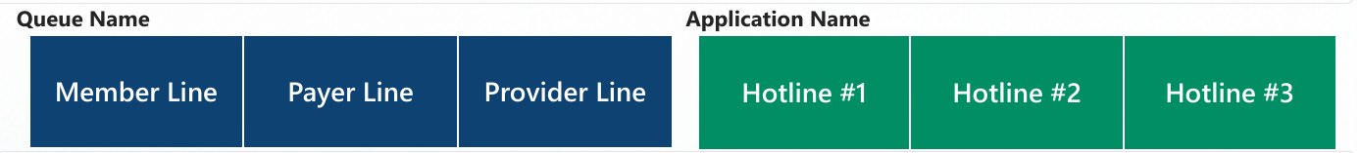
Helpline · queues, slicers, and the heat map
TASK 2 · VISUALS 4–7 OF 9
Queue performance - table: one row per Queue Name, six measures
Abandonment rate day of week × hour - matrix heat map (rows = day, columns = hour)
WHAT WE FOUND
The three queues are statistically identical: Member 12,309 / Payer 12,292 / Provider 12,352 calls, abandoned 2,696 / 2,634 / 2,678 (21.4–21.9%), ASA 42 / 41 / 43 s, AHT 213 / 214 / 217 s, SL20 49.7 / 50.5 / 50.2%.
No queue is the problem - the problem is when the calls arrive.
WHAT WE FOUND
Every row turns red after 8 pm - the evening problem is daily, not one bad night.
With at least 150 calls in the cell, the worst are Thursday 10 pm (39%), Friday 9 pm (35%), Tuesday 8–9 pm (33%), Saturday 8 pm (30%), Monday 10 pm (30%).
Daytime cells sit at 15–25% on every day.
Cells on fewer than 100 calls (greyed) are colour, not signal. Friday is red from 2 pm onwards, matching its 26%-day rate.
Slicer buttons - Queue Name (Member · Payer · Provider) and Application Name (Hotline #1 · #2 · #3)
Top: the exported visual (cut at hour 14 by its width, it scrolls to 23 live). Below: the same matrix, 8 am–11 pm, from the full dataset.
WHAT WE FOUND
The two drill-downs the brief required, as button slicers so every visual on the page - KPIs, charts, table and heat map - re-computes for the selection.
Select Hotline #3 and the abandonment card reads 33.5%; select Payer Line and nothing moves - which is itself a finding.
20 / 24
Notes:
HELPLINE - QUEUE TABLE, SLICERS, HEAT MAP (about 3 minutes).
Queue performance table: Member Line 12,309 offered / 9,613 handled / 2,696 abandoned / ASA 42 / AHT 213 / SL 49.7%; Payer Line 12,292 / 9,658 / 2,634 / 41 / 214 / 50.5%; Provider Line 12,352 / 9,674 / 2,678 / 43 / 217 / 50.2%; total 36,872 / 28,864 / 8,008 / 42 / 215 / 50.3%. The three queues are as alike as three queues can be - so nothing about a particular queue's process explains the abandonment. That rules out one hypothesis and points at timing.
Slicer buttons: Queue Name and Application Name (the brief's 'Hotline #'). Everything on the page responds. Demo: click Hotline #3 → abandonment 33.5%, SL20 39%; click Payer Line → nothing changes.
Heat map: rows Monday–Sunday, columns 0–23, value = Abandonment Rate. Reading rules: only trust cells with real volume. Worst cells with ≥150 calls: Thu 22h 39% (190 calls), Fri 21h 35% (192), Tue 21h 33% (283), Tue 20h 33% (436), Sat 20h 30% (395), Mon 22h 30% (240). Daytime cells 15–25% every day. Cells like Thursday 23h 74% or Tuesday 5–6 am 42–56% sit on under 100 calls - ignore them. Every day is red after 8 pm - that is what makes the evening finding robust even on nine days.
Export note: the heat map is cut off at hour 14 in the PDF because of the visual's width, in the live file it scrolls to 23.

Slide 21
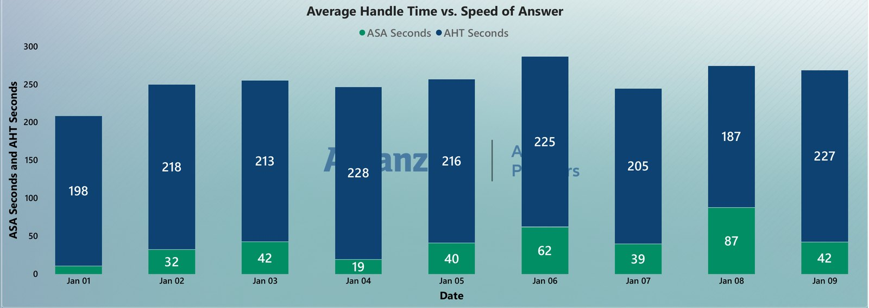
Helpline · handle time vs speed of answer, by date
TASK 2 · VISUAL 9 OF 9
Stacked column by date - ASA Seconds (green) and AHT Seconds (navy), handled calls only
WHAT WE FOUND
Handle time is steady every single day - 187 to 228 seconds - so the agents' work is consistent.
Speed of answer is not: 10 s on Sunday 1 January (the quietest day, 1,572 calls, SL20 81%), 19 s on the 4th, then 62 s on Friday the 6th (26% abandonment) and 87 s on Sunday the 8th - the worst day of the nine: 24% abandoned, only 28% answered within 20 seconds, and AHT the lowest (187 s) as agents rushed. Monday the 9th, the busiest day (5,047 calls), was answered in 42 s.
21 / 24
Notes:
HELPLINE - AHT vs ASA BY DATE (about 2 minutes).
AHT (navy): 198, 218, 213, 228, 216, 225, 205, 187, 227 seconds - a flat band, agents handle calls the same way every day.
ASA (green): 10, 32, 42, 19, 40, 62, 39, 87, 42 seconds - that is the variable, and it is a coverage variable.
Worst day: Sunday 8 January - 3,730 calls (below average) but 87 s ASA, 24% abandonment and only 28% answered within 20 seconds, AHT was also the lowest (187 s), which is what agents do under queue pressure. Friday 6 January is second-worst: 62 s ASA, 26% abandonment, 40% SL20. Best day: Sunday 1 January - New Year's Day - 1,572 calls, 10 s ASA, 81% SL20.
Busiest day: Monday 9 January (5,047) was answered in 42 s at 22% abandonment - volume alone does not create the problem, the roster against the volume does.
Both measures filter to handled calls only - an abandoned caller has no handle time, so including them would corrupt both averages.
Recommendation 1 (evening window) and the day-level view both say the same thing: the loss is where coverage is thin, not where calls are many.

Slide 22
Task 2 - what we should do next
TASK 2 · RECOMMENDATIONS
1
Shift coverage into the evening
2
Add coverage on Mondays
3
Keep Hotline #1 the priority
Move part of the roster into the 6–11 pm window, where abandonment climbs from 20% to 43%.
Add Monday-specific coverage on top of the weekday pattern - and check Friday and Sunday rosters.
Point any staffing or system investment at Hotline #1 first, and put Hotline #3 on the watch list.
Why A third of calls and 37% of abandons land in the evening, volume is still 2,800 calls an hour at 8 pm, every day of the week turns red after 8 pm on the heat map.
Why Mondays carry about 9,500 calls against 4,000–5,000 on other days, with abandonment no better than average, Friday and Sunday 8 January show the thinnest coverage (ASA 62 s and 87 s).
Why Hotline #1 is 83.6% of every call, Hotline #3 abandons one call in three (33.5%) with slower answer and longer handle times.
Watch on the dashboard Calls by hour vs abandonment: the line after 8 pm should flatten toward the daytime 20%.
Watch on the dashboard Calls and abandonment by day: Monday's abandoned bar should fall below the 21% average, ASA by date should stop spiking.
Watch on the dashboard Filter by Application Name: Hotline #1 SL20 and abandonment first, Hotline #3's 33.5% next.
Same team, same skill - just point more of them at the hours we're losing callers. The queue table proves it is not a process problem: all three queues answer in 42 seconds and handle in 3.5 minutes. Honest limitation nine days cannot separate a real weekly pattern from one unusual week, extend the extract before locking a roster, then link helpline effort to claims outcomes.
22 / 24
Notes:
TASK 2 - RECOMMENDATIONS (about 1 minute, then take questions before the SQL).
1. Shift some staff coverage into the evening window (hour chart + heat map).
2. Add coverage on Mondays specifically (day chart) - and if challenged on the two-Monday window, give the one-sentence answer from the day-of-week slide's notes, note Friday and Sunday 8 January as the thinnest-coverage days from the ASA-by-date chart.
3. Keep Hotline #1 the priority for any staffing or system investment (hotline chart); watch Hotline #3.
Close with: "Same team, same skill - just point more of them at the hours we're actually losing callers." And the limitation: nine days only, extend before locking a roster.
Bonus-task answer if it comes up ("how would you use tasks 2 and 3 to build an efficiency-focused productivity model on top of the task-1 model?"): add the helpline fact (one row per call leg) and a staff/roster dimension to the claims model, joined through the shared date table and, where the call relates to a member or claim, the member key. Productivity measures then sit next to claims measures: handled calls per agent-hour, TAT on claims that generated a call versus those that did not, cost-to-serve per member (claims paid + call-handling minutes). Agents Active and Calls per Agent already exist in the helpline model as the starting point.

Slide 23
Task 3 - General SQL: switching to the PDF
TASK 3 · SQL · 10 MINUTES
Three queries against the fictional schema (Members · MembershipClub · Promotion · Staff · MemberOrder · Roster)
Graded on optimisation and load time
Query 1
Staff details for staff 105, 108, 110 and 113
Two supporting indexes proposed:
IX_MemberOrder_MemberNo ON MemberOrder (MemberNo) INCLUDE (Price) - covering index for Query 2
IX_MemberOrder_PromotionID ON MemberOrder (PromotionID) - supports the LEFT JOIN in Query 3
Verify with execution plans and SET STATISTICS IO, not by eye.
Explicit five-column list, WHERE StaffNo IN (…) with unquoted integers - an index seek on the primary key, not a scan.
Query 2
Member full name, number of orders and total price
Aggregate MemberOrder first (COUNT_BIG, SUM), then INNER JOIN to Members - text columns never enter the aggregation, and the join is one-to-one.
Query 3
Order details with the member's name and the promotion, if it exists
SQL Answer-Task3.pdf
Walk the three queries in order, one sentence on the 'why' behind each - about 10 minutes including questions.
MemberOrder drives the query, INNER JOIN Members (a member is mandatory), LEFT JOIN Promotion (a promotion is optional).
23 / 24
Notes:
TASK 3 - SQL BRIDGE (10 minutes total, walked through from the PDF, not from slides).
Say: "The third task is SQL. I'll switch to the PDF I submitted and walk the three queries in order." Then share SQL Answer-Task3.pdf.
For each query lead with WHY, because the brief says the queries are graded on optimisation technique and minimum load time:
Q1 - explicit column list, not SELECT *; unquoted integers in the IN list because StaffNo is an INT primary key (quoting forces an implicit conversion that can block the index seek).
Q2 - GROUP BY on MemberOrder alone BEFORE the join, so the two text columns never go through the aggregation, COUNT_BIG rather than COUNT (no overflow past 2.1 billion rows, and required for an indexed view); the join is then one-to-one.
Q3 - two join types on purpose: a member is mandatory, so INNER JOIN, a promotion is optional ('if it exists'), so LEFT JOIN - otherwise every order without a promotion would silently disappear. MemberOrder drives the query because one row per order is the grain asked for.
Indexes: covering index on MemberOrder(MemberNo) INCLUDE (Price) for Q2, index on MemberOrder(PromotionID) for Q3. Confirm with execution plans and SET STATISTICS IO.
Most likely follow-up: "why LEFT JOIN on Promotion but INNER on Members?" - one sentence: a member is mandatory, a promotion is optional. Come back to this deck for the close.

Slide 24
In one line each - and over to you
CLOSE · DISCUSSION & Q&A
Task 1 · Claims
Costs are up 5.4% per member from more visits and pricier visits, 10% of members carry 42% of spend, back and neck pain alone are 8.9% and growing 38%; October repeats at +25%; half the book is automated and 12 days faster.
Happy to go deeper on
Any visual, live in the .pbix files
How each measure was defined
Loss ratio, once premium data exists
Linking helpline effort to claims outcomes (the bonus productivity model)
Query plans for the SQL answers
Review therapy claims · case-manage the top list · redesign October
Task 2 · Helpline
One in five callers hangs up - 43% by 11 pm, on every day of the week - while answered calls are served in 42 seconds and handled in 3.5 minutes on all three queues. A timing problem, not a size problem.
Evening coverage · Monday coverage · Hotline #1 first
Task 3 · SQL
Three queries written for the optimiser: explicit columns, aggregate-before-join, INNER where mandatory and LEFT were optional, plus two supporting indexes.
Verify with execution plans
Thank you - Mahmoud Abdallah
Data Intelligence Reporting Specialist – IPMI
Questions welcome
24 / 24
Notes:
CLOSE (about 1 minute), then the remaining time is the panel's.
One line per task, then: "That's everything I brought. I'm happy to open either dashboard live, walk through any measure, or take the discussion wherever is most useful to you."
Ground rules for the Q&A:
- Lead every answer with the number, then the chart, then the mechanism. Do not open Power Query or a DAX formula unless asked to see it.
- Use the real names of the pages, visuals and columns: 'the drill-through page', 'the Outliers Finder', 'the queue table', 'Total_TurnAroundTime_Days', 'Calender_Table' (own the spelling in one line if it comes up).
- Say the limitations plainly when they come up: no premium data (no loss ratio), nine days of helpline data (no seasonality), the two-Monday window, Hotline #2 too small to judge, the placeholder goal on the page-4 KPI tiles.
- If the bonus task comes up, use the answer in the Task 2 recommendations notes.
Time check: this slide should be on screen by about minute 50. If the panel has run ahead with questions, that is fine - the buffer exists for exactly that.

