Slide 1
Newsstand

Slide 2
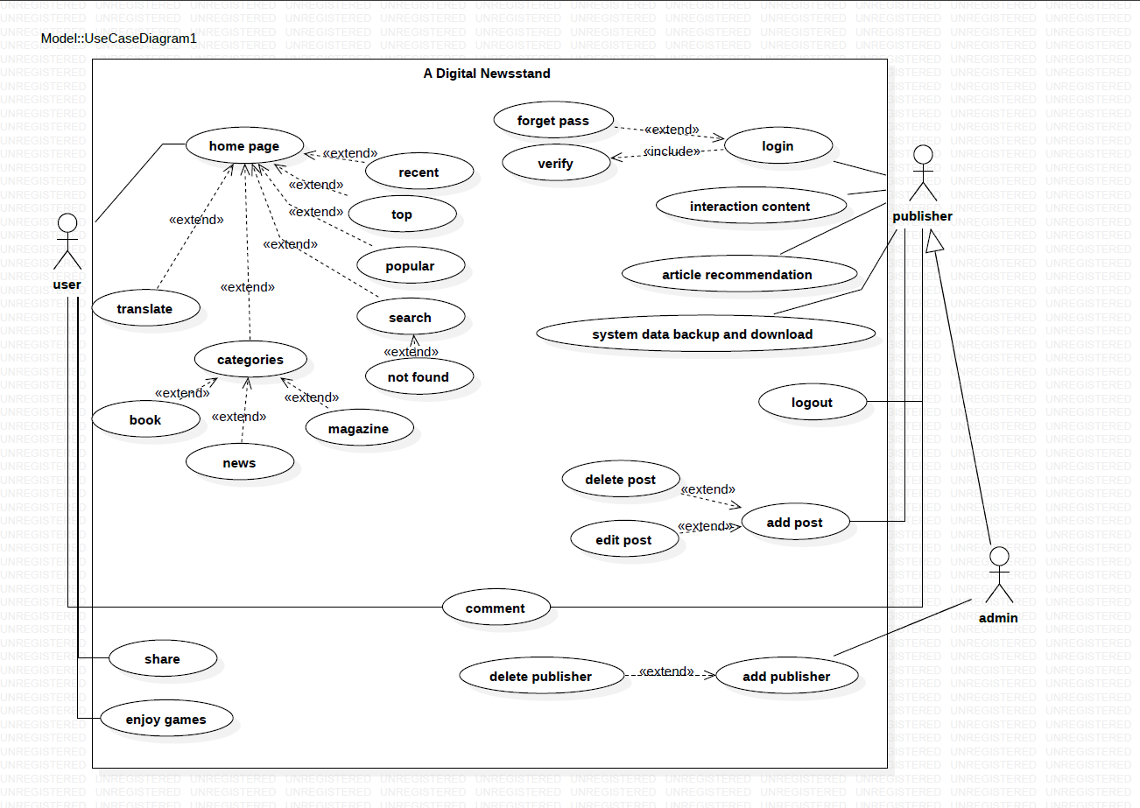

Slide 3
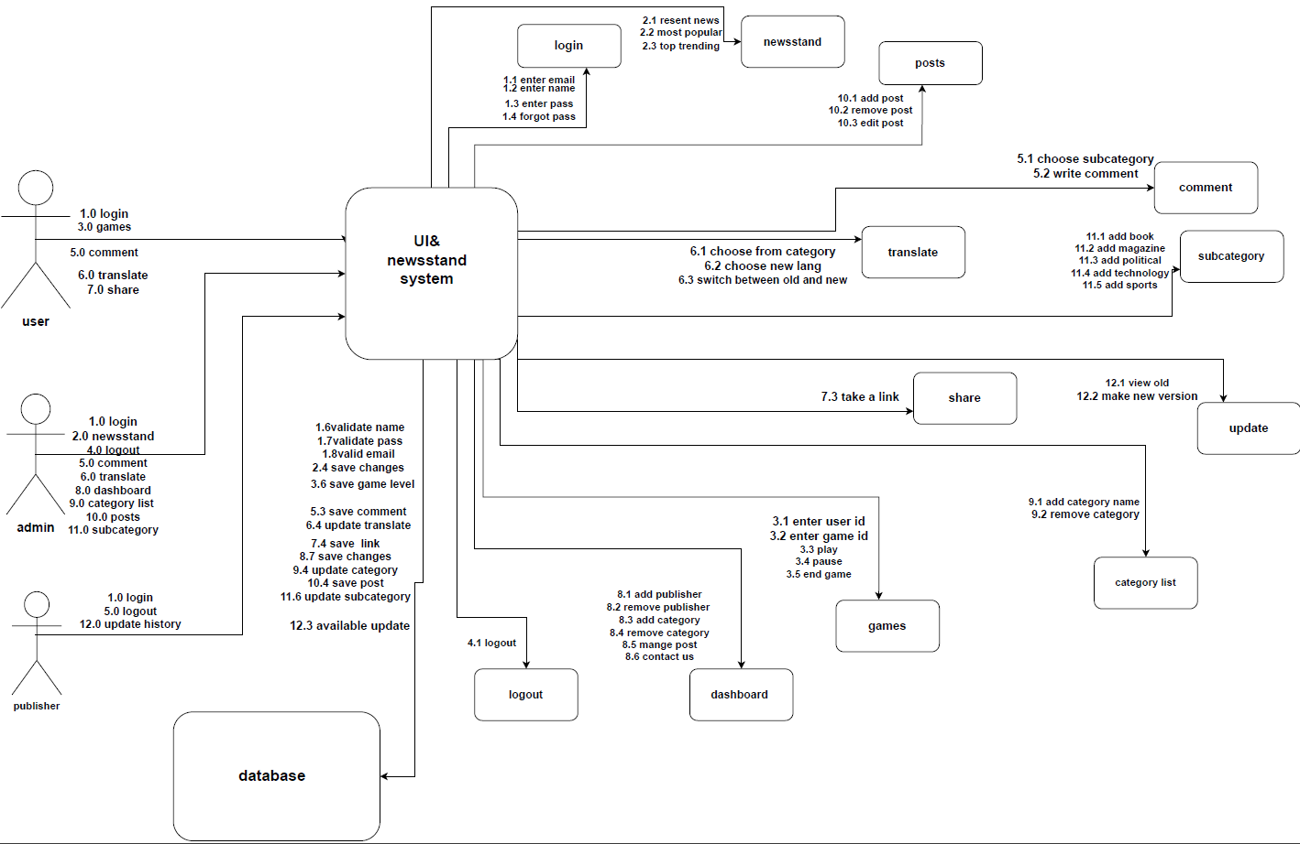

Slide 4
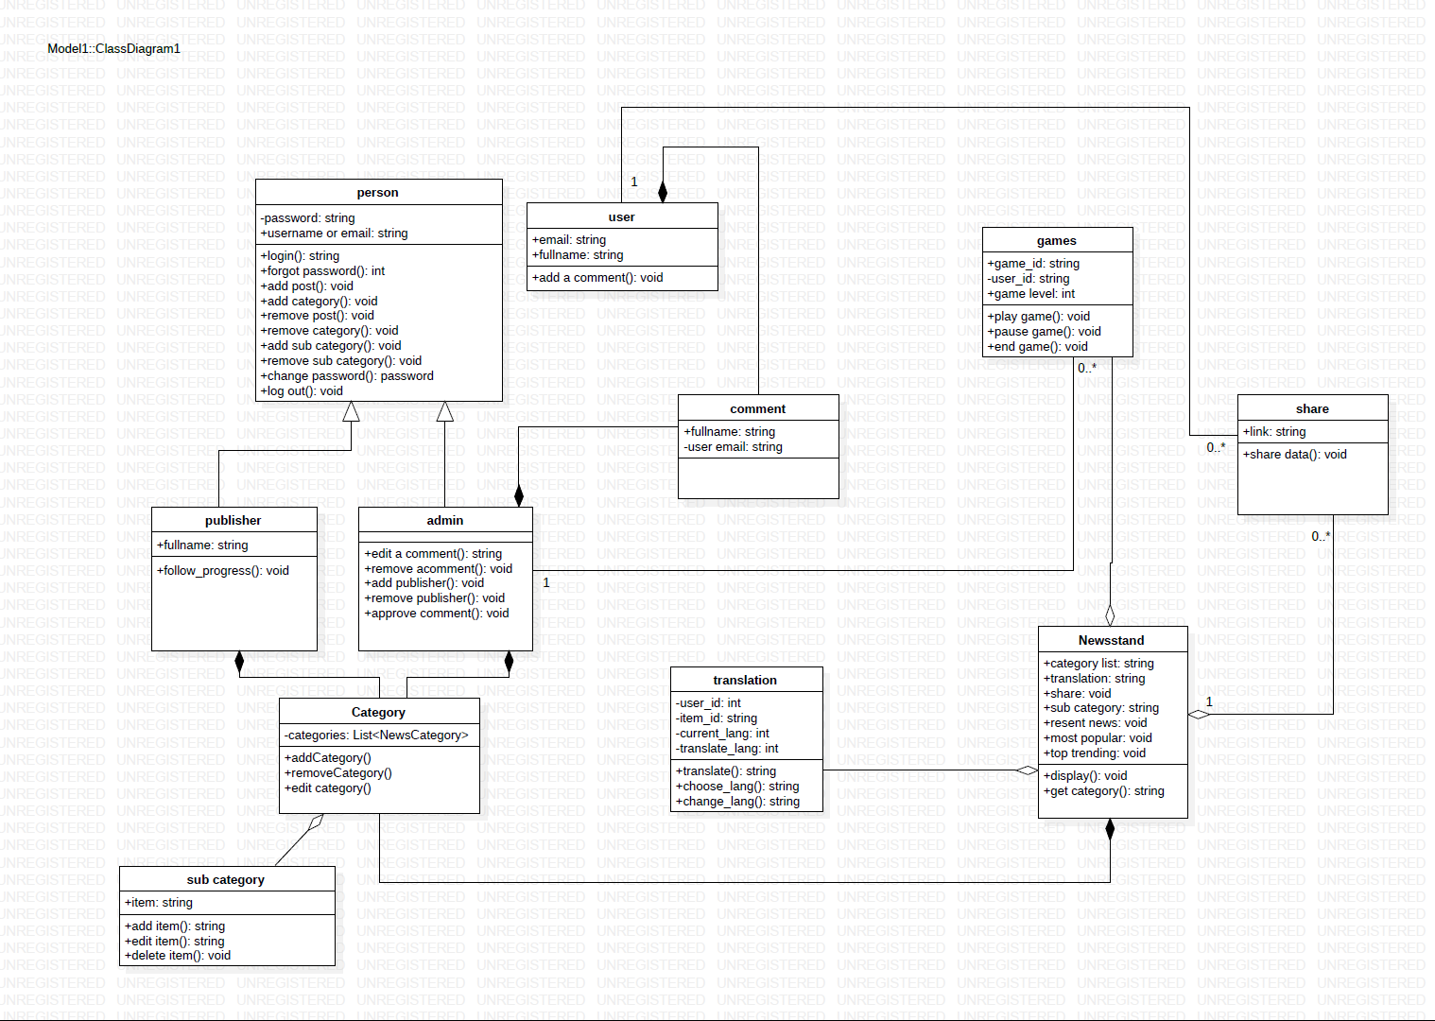

Slide 5
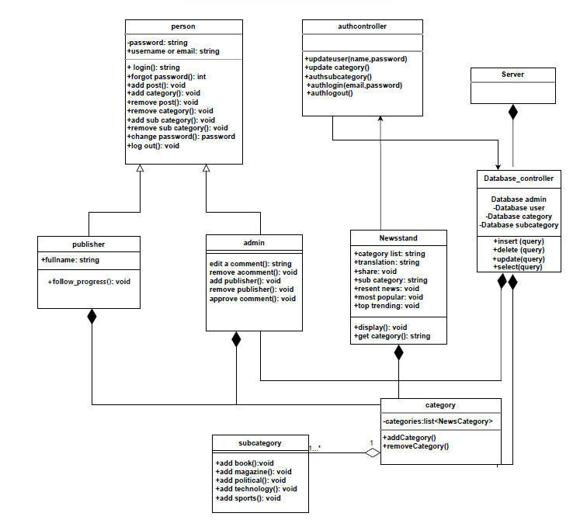

Slide 6
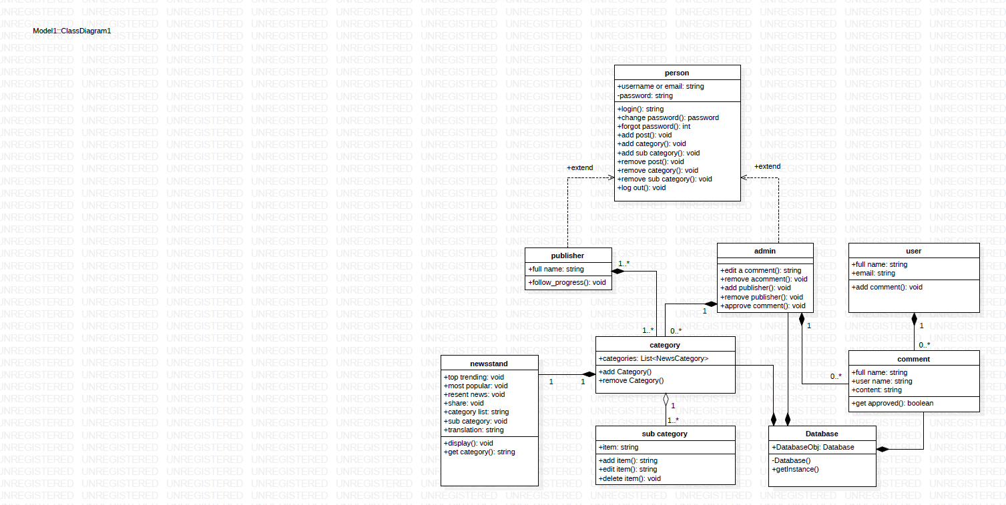

Slide 7

Design pattern:
Creational: singleton pattern
Context:
It is very common to find classes for which only one
instance should exist (singleton)
Problem:
How do you ensure that it is never possible to create
more than one instance of a Database class. And provide
a global point of access to it.
Forces:
• The use of a public constructor cannot guarantee
that no more than one instance will be created.
• The singleton instance must also be accessible to all
classes that require it, therefore it must often be public.
Solution:
• Have the constructor private( Database() ) to ensure
that no other class will be able to create an instance
of the class singleton.
• Define a public static method( getInstance()), The
first time this method is called , it creates the single
instance of the class “Database” and stores a reference
to that object in a static private variable “DatabaseObj”.

Slide 8
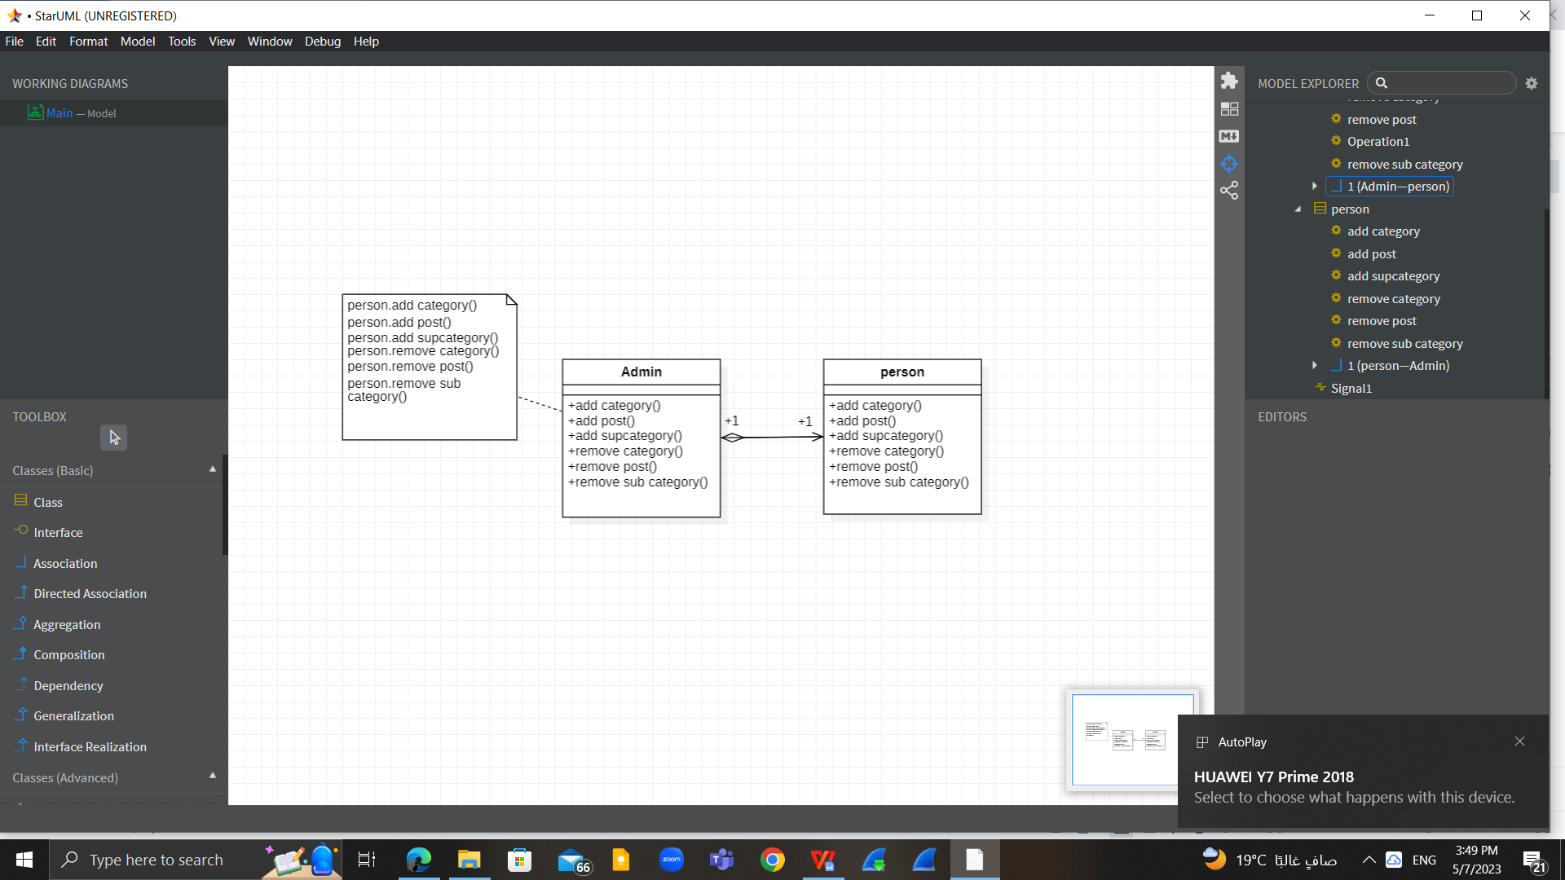
Design pattern 2 (Delegation pattern)
Context:
You are designing a method in a class. You realize that another class has a
method which provides the required service.
Problem:
How can you most effectively make use of a method that already exists in the
other class?
Forces:
✴ You want to minimize development cost by reusing methods.
Solution:
The delegation methods (add post ,add category,add supcategory ,remove post,remove category,remove subcategory ) in the delegator class (person) calls a methods in the delegate clas(person) to perform the required task
An association must exist between the delegator and delegate class.

Slide 9
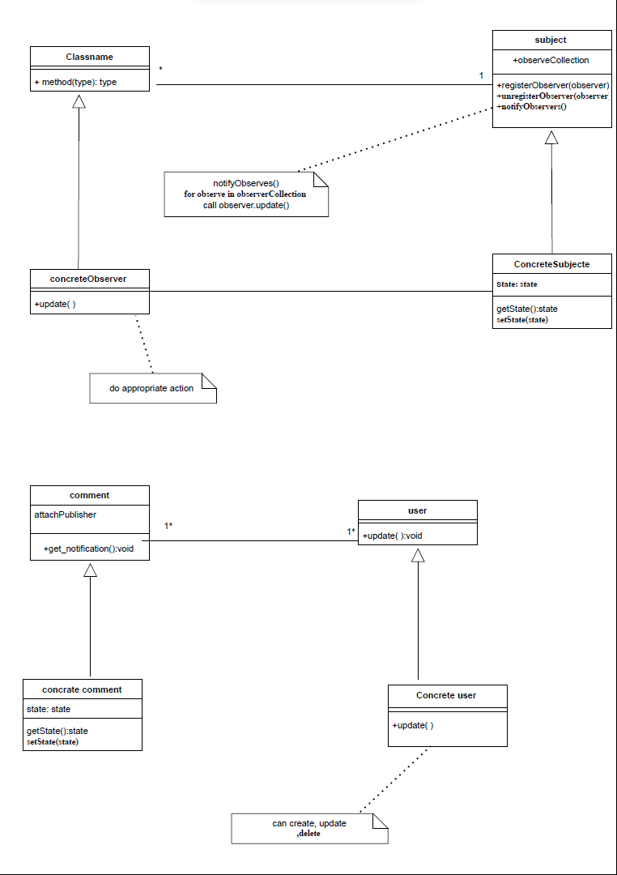

Slide 10
