Slide 1
Database II
Subject : Database Recovery
Presentation made by :
Helayel Hamayel
Mahmoud Barakat : 11614168
Helayel Hamayel : 11717166

Slide 2

Contents of the topic :-
transaction
Transaction management
Recovery
Database Recovery
Type of recover and How to make different type of recovery
Type of recover
database failure definition and types of failures
failure

Slide 3
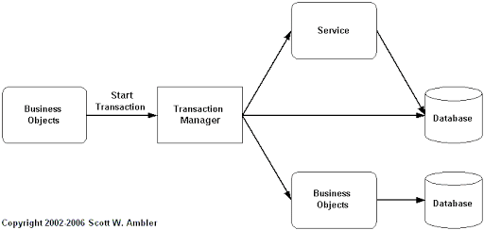
Transaction management
What is a transaction?
Any action that reads from and/or writes to a database may consist of
Simple SELECT statement to generate a list of table contents
A series of related UPDATE statements to change the values of attributes in various tables
A series of INSERT statements to add rows to one or more tables
A combination of SELECT, UPDATE, and INSERT statements
Transaction boundaries:
Begin and End transaction.
An application program may contain several transactions separated by the Begin and End transaction boundaries

Slide 4
Transaction management
What is a transaction?
A logical unit of work that must be either entirely completed or aborted
Successful transaction changes the database from one consistent state to another
One in which all data integrity constraints are satisfied
Most real-world database transactions are formed by two or more database requests
The equivalent of a single SQL statement in an application program or transaction
database in a consistent state
database in a consistent state
Account A Fred Bloggs $1000
Transfer $500
Account A Fred Bloggs $500
Account B Sue Smith $0
Account B Sue Smith $500
begin Transaction
execution of Transaction
end Transaction
database may be temporarily in an inconsistent state during execution

Slide 5
Transaction management
Transaction boundaries:
A transaction begins with the first executable SQL statement.
A transaction ends with one of the following events:
A COMMIT or ROLLBACK statement is issued
A DDL or DCL statement executes (automatic commit)
The user exits SQL*Plus
The system crashes

Slide 6
Transaction management
Examples of Transactions :
Banks
Withdraw $100 to account A.
Transfer $50 from account A to B.
Begin transaction
read balance from A
add $100 to A balance
write balance to A
read balance from B
Schools
Register course #409.433 for student #4321.
Airlines
Check if two seats are available on flight #453.
Reserve the two seats on flight #453.
Companies
Increase every employee’s salary by 5%.

Slide 7
Transaction management
Example An Informal :
Transfer 800$ from checking account to savings account
For a user it is one activity
To database:
Read balance of checking account: read( A)
Read balance of savings account: read (B)
Subtract 800$ from A
Add 800 $to B
Write new value of A back to disk
Write new value of B back to disk

Slide 8
Transaction management
Read and Write Operations in Database :
A database is represented as a collection of named data items
Read-item (A)
Find the address of the disk block that contains item A
Copy the disk block into a buffer in main memory
Copy the item A from the buffer to the program variable named A
Write-item (A)
Find the address of the disk block that contains item A.
Copy that disk block into a buffer in main memory
Copy item A from the program variable named A into its correct location in the buffer.
Store the updated block from the buffer back to disk (either immediately or at some later point in time).

Slide 9
Transaction management
Transaction Processing :
a transaction may involve
The creation of a new invoice
Insertion of an row in the LINE table
Decreasing the quantity on hand by 1
Updating the customer balance
Creating a new account transaction row
If the system fails between the first and last step, the database will no longer be in a consistent state

Slide 10

Transaction management
Properties of a Transaction :
ACID properties
Atomicity : “all or nothing”.
Consistency (Correctness)
Move from a consistent state to another consistent state.
Isolation
Should not be interfered by other transactions
(concurrency).
Durability
The effect of a completed transaction should be durable & public.

Slide 11
Atomicity - Either all operations of the transaction are properly reflected in the database or none are. “all or nothing”. “Transfer $50 from account A to account B” Begin transaction read(A,a) a = a-50 write(A,a) read(B,b) b = b+50 write(B,b) End Transaction Atomicity :If the program fails after phase 4 and before phase 7, and thus the transaction, the DBMS must guarantee that either the changes to A are not mirrored in the database, or that the transaction is done when the machine comes back online.
Transaction management

Slide 12
Transaction management
Consistency
Move from a consistent state to another consistent state.
“Withdraw $100 from account A”
Begin transaction
read(A,a)
a = a-100 //What if A only had $20?
write(A,a)
End Transaction
Responsibility of programmer
Consistency : The Deduct of A remains unaffected as the trade remains done, no money is wasted accidentally.

Slide 13
Transaction management
Isolation
Should not be interfered by other transactions (concurrency)
“Transaction T1” “Transaction T2”
Begin transaction Begin transaction
read(A,a1) read(A,a2)
a1 = a1-50 a2 = a2-100
write(A,a1) write(A,a2)
read(B,b1) End Transaction
b1 = b1+50
write(B,b1)
End Transaction
Serial Execution VS Concurrent Execution
Isolation : transaction is allowed to access the partially updated database, it would see an inconsistent database
Isolation can be ensured trivially by running transactions serially.
However, executing multiple transactions concurrently has significant benefits, as we will see later.

Slide 14
Transaction management
Durability
The effect of a completed transaction should be durable & public
“Withdraw $100 from account A”
Begin transaction
read (A,a)
a = a-100
write(A,a)
End Transaction
…
*buffer flush*
The changes it has made to the database persist, even if there are system failures.
Durability : Once the transaction has been notified to the user, updates to the transaction database must persist even in future system failures.
crash

Slide 15
Transaction management
Transaction Management with SQL
ANSI has specified guidelines covering SQL database transactions Support for transactions is given by two SQL statements: COMMIT and ROLLBACK
ANSI guidelines specify that, when a transaction series is started
by a user or computer system, all subsequent SQL statements will proceed before one of four events occurs.

Slide 16
Transaction management
Transaction Management with SQL
A COMMIT declaration is achieved-all modifications are permanently registered in the database
A ROLLBACK is made-all adjustments are abandoned and the database is returned to a stable former state
The program finishes successfully – equivalent to a COMMIT
The program terminates abnormally and a rollback occurs

Slide 17
Transaction management
The Transaction Log
Keeps track of all transactions that update the database. It contains:
A record for transaction startup
For every part of the transaction (SQL statement) :
Type of operation being performed (update, delete, insert)
Names of objects affected by the transaction (the name of the table)
“Before” and “after” values for updated fields
Pointers to previous and next transaction log entries for the same transaction
Increases workload capacity but is worth the investment to be able to recover a compromised database

Slide 18
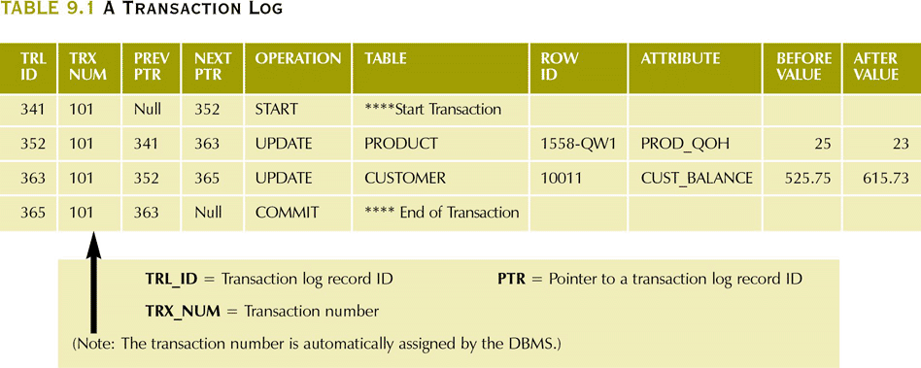
Transaction management
The Transaction Log
Increases workload capacity but is worth the investment to be able to recover a compromised database.
In the case of a server malfunction, the DBMS would search the log for any uncommitted or missing transactions and restore the record to a previous state.
Logging a database itself and preserving its credibility, several DBMSs would deploy it on many separate disks to reduce the possibility of device failure.

Slide 19
Transaction management
Concurrency Control
The management of simultaneous transaction execution in a multiprocessing network is regarded as concurrency control
Competitiveness tests seek to ensure the serializability of transactions in a multi-user database environment.
Concurrent transaction execution over a shared database will produce many data validity and accuracy problems.
The three main issues are:
lost updates
Two transactions update the same item
Second update overwrites the first (last wins)
uncommitted data-Dirty Read (Temporary Update)
A transaction updates an item, then fails
The item is accessed by another transaction before rollback
inconsistent retrievals

Slide 20
Database Recovery
Database recovery :-
is the process of restoring the database to the most recent consistent state that existed just before the failure.
Data recovery is important in managing a database system.
Having a good plan will help make a quick and successful recovery from a failures.
Recovery Algorithms
Recovery algorithms are techniques to ensure database consistency and transaction atomicity and durability despite failures.
Recovery algorithms have two parts :-
Actions taken during normal transaction processing to ensure enough information exists to recover from failures
Actions taken after a failure to recover the database contents to a state that ensures atomicity, consistency and durability

Slide 21
Database Recovery
Transaction Failures and Recovery
Transaction Failures:
failures caused by unplanned, abnormal program termination.
<e.g.> arithmetic overflow
divided by zero
storage protection violation
log overflow...
How to recover transaction failures ?
System force a rollback.
the rollback is coordinated by Recovery Manager.
working backward through the log
to undo changes (replace new value by old value)
until the “BEGIN TRANSACTION” is encountered.

Slide 22
Database Recovery
UNDO Logic and REDO Logic
UNDO Logic.
cause the rollback procedure to be restarted from the beginning.
Idempotent Property : [Gray '78]
UNDO ( UNDO ( UNDO ( ... ( x ) ) ) = UNDO ( x ) for all x
i.e. undoing a given change any number of times is the same as undoing it exactly once.
REDO Logic
REDO (REDO (REDO (...(x))) = REDO (x) for all x.
UNDO
failure
failure again

Slide 23
Database Recovery
UNDO Logic and REDO Logic
UNDO and REDO: lists of transactions
UNDO = all transactions running at the last checkpoint
REDO = empty
For each entry in the log, starting at the last checkpoint
If a BEGIN TRANSACTION entry is found for T
Add T to UNDO
If a COMMIT entry is found for T
Move T from UNDO to REDO

Slide 24
Database Recovery
UNDO Logic and REDO Logic
T₁
T₂
T₃
T₄
T₅
Checkpoint
Failure
UNDO: T₂, T₃
Last Checkpoint
Active transactions: T₂, T₃
REDO:

Slide 25
Database Recovery
UNDO Logic and REDO Logic
T₁
T₂
T₃
T₄
T₅
Checkpoint
Failure
UNDO: T₂, T₃, T₄
T4 Begins
Add T₄ to UNDO
REDO:

Slide 26
Database Recovery
UNDO Logic and REDO Logic
T₁
T₂
T₃
T₄
T₅
Checkpoint
Failure
UNDO: T₂, T₃, T₄, T₅
T₅ begins
Add T₅ to UNDO
REDO:

Slide 27
Database Recovery
UNDO Logic and REDO Logic
T₁
T₂
T₃
T₄
T₅
Checkpoint
Failure
UNDO: T₃, T₄, T₅
T₂ Commits
Move T₂ to REDO
REDO: T₂

Slide 28
Database Recovery
UNDO Logic and REDO Logic
T₁
T₂
T₃
T₄
T₅
Checkpoint
Failure
UNDO: T₃, T₅
T₄ Commits
Move T₄ to REDO
REDO: T₂, T₄

Slide 29
Database Recovery
What is the need for recovery of data ?
The storage of data usually includes four types of media with an increasing amount of reliability:
The main memory.
The magnetic disk.
The magnetic tape.
The the optical disk.
Many different forms of failure can affect database processing and/or transaction, and each of them has to be dealt with differently.
Some data failures can affect the main memory only, while others involve non-volatile or secondary storage also.

Slide 30
Database Recovery
Recovery facilities
Every DBMS should offer the following facilities to help out with the recovery mechanism:
Backup mechanism makes backup copies at a specific interval for the database.
Logging facilities keep tracing the current state of transactions and any changes made to the database.
Checkpoint facility allows updates to the database for getting the latest patches to be made permanent and keep secure from vulnerability.
Recovery manager allows the database system for restoring the database to a reliable and steady-state after any failure occurs.

Slide 31
Database Recovery
Storage Structure
Volatile storage:
does not survive system crashes
examples: main memory, cache memory
Nonvolatile storage:
survives system crashes
examples: disk, tape, flash memory, non-volatile (battery backed up) RAM
Stable storage:
a mythical form of storage that survives all failures
approximated by maintaining multiple copies on distinct nonvolatile media

Slide 32
Database Recovery
Stable-Storage Implementation
Maintain multiple copies of each block on separate disks
copies can be at remote sites to protect against disasters such as fire or flooding.
Failure during data transfer can still result in inconsistent copies: Block transfer can result in
Successful completion
Partial failure: destination block has incorrect information
Total failure: destination block was never updated
Protecting storage media from failure during data transfer (one solution):
Execute output operation as follows (assuming two copies of each block):
Write the information onto the first physical block.
When the first write successfully completes, write the same information onto the second physical block.
The output is completed only after the second write successfully completes.

Slide 33
Database Recovery
Stable-Storage Implementation (cont)
Protecting storage media from failure during data transfer (cont.):
Copies of a block may differ due to failure during output operation. To recover from failure:
First find inconsistent blocks:
Expensive solution : Compare the two copies of every disk block.
Better solution:
Record in-progress disk writes on non-volatile storage (Non-volatile RAM or special area of disk).
Use this information during recovery to find blocks that may be inconsistent, and only compare copies of these.
Used in hardware RAID systems
If either copy of an inconsistent block is detected to have an error (bad checksum), overwrite it by the other copy. If both have no error, but are different, overwrite the second block by the first block.

Slide 34
Database Recovery
Data Access
Physical blocks are those blocks residing on the disk.
Buffer blocks are the blocks residing temporarily in main memory.
Block movements between disk and main memory are initiated through the following two operations:
input(B) transfers the physical block B to main memory.
output(B) transfers the buffer block B to the disk, and replaces the appropriate physical block there.
Each transaction T_{i} has its private work-area in which local copies of all data items accessed and updated by it are kept.
T_{i}'s local copy of a data item X is called x_{i}.
We assume, for simplicity, that each data item fits in, and is stored inside, a single block.

Slide 35
Database Recovery
Data Access
Transaction transfers data items between system buffer blocks and its private work-area using the following operations :
read(X) assigns the value of data item X to the local variable x_{i}.
write(X) assigns the value of local variable x_{i} to data item {X} in the buffer block.
both these commands may necessitate the issue of an input(B_{X}) instruction before the assignment, if the block B_{X} in which X resides is not already in memory.
Transactions
Perform read(X) while accessing X for the first time;
All subsequent accesses are to the local copy.
After last access, transaction executes write(X).
output(B_{X}) need not immediately follow write(X). System can perform the output operation when it deems fit.

Slide 36
Database Recovery
Example of Data Access
buffer
Buffer Block A
x
input(A)
Buffer Block B
Y
A
output(B)
B
read(X)
write(Y)
x₂
disk
x₁
y₁
work area
of T₁
work area
of T₂
memory

Slide 37
Database Recovery
Recovery and Atomicity
Modifying the database without ensuring that the transaction will commit may leave the database in an inconsistent state.
Consider transaction T_{i} that transfers $50 from account A to account B; goal is either to perform all database modifications made by T_{i} or none at all.
Several output operations may be required for T_{i} (to output A and B). A failure may occur after one of these modifications have been made but before all of them are made.

Slide 38
Database Recovery
Recovery and Atomicity
To ensure atomicity despite failures, we first output information describing the modifications to stable storage without modifying the database itself.
We study two approaches:
log-based recovery
shadow-paging
We assume (initially) that transactions run serially, that is, one after the other.

Slide 39
Database Recovery
Log-Based Recovery
A log is kept on stable storage.
The log is a sequence of log records, and maintains a record of update activities on the database.
When transaction T_{i} starts, it registers itself by writing a <T_{i} start>log record
Before T_{i} executes write(X), a log record <T_{i}, X, V₁, V₂> is written, where V₁ is the value of X before the write, and V₂ is the value to be written to X.
Log record notes that T_{i} has performed a write on data item X_{j} X_{j} had value V₁ before the write, and will have value V₂ after the write.
When T_{i} finishes it last statement, the log record <T_{i} commit> is written.
We assume for now that log records are written directly to stable storage (that is, they are not buffered)
Two approaches using logs
Deferred database modification
Immediate database modification

Slide 40
Database Recovery
Deferred Database Modification
The deferred database modification scheme records all modifications to the log, but defers all the writes to after partial commit.
Assume that transactions execute serially
Transaction starts by writing <T_{i} start> record to log.
A write(X) operation results in a log record <T_{i}, X, V> being written, where V is the new value for X
Note: old value is not needed for this scheme.
The write is not performed on X at this time, but is deferred.
When T_{i} partially commits, <T_{i} commit> is written to the log
Finally, the log records are read and used to actually execute the previously deferred writes.

Slide 41
Database Recovery
Deferred Database Modification(cont)
During recovery after a crash, a transaction needs to be redone if and only if both <T_{i} start> and<T_{i} commit> are there in the log.
Redoing a transaction T_{i} ( redoT_{i}) sets the value of all data items updated by the transaction to the new values.
Crashes can occur while
the transaction is executing the original updates, or
while recovery action is being taken
example transactions T₀ and T₁ (T₀ executes before T₁):
T₀: read (A) T₁ : read (C)
A: - A - 50 C:-C- 100
Write (A) write (C)
read (B)
B:- B + 50
write (B)

Slide 42
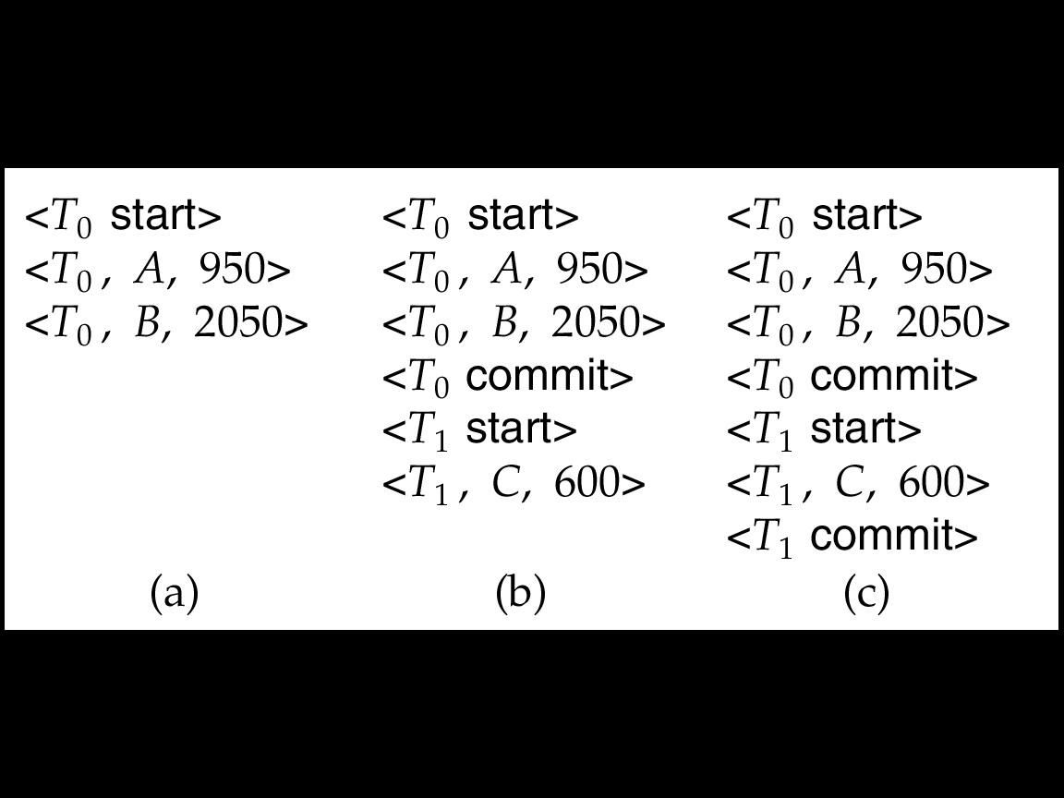
Database Recovery
Deferred Database Modification(cont)
Below we show the log as it appears at three instances of time.
If log on stable storage at time of crash is as in case:
(a) No redo actions need to be taken
(b) redo(T₀) must be performed since <T₀ commit> is present
(c) redo(T₀) must be performed followed by redo(T₁) since
<T₀ commit> and <T_{i} commit> are present

Slide 43
Database Recovery
Checkpoints
Problems in recovery procedure as discussed earlier :
searching the entire log is time-consuming
we might unnecessarily redo transactions which have already
output their updates to the database.
Streamline recovery procedure by periodically performing checkpointing
Output all log records currently residing in main memory onto stable storage.
Output all modified buffer blocks to the disk.
Write a log record < checkpoint> onto stable storage.

Slide 44
Database Recovery
Checkpoints(cont)
During recovery we need to consider only the most recent transaction T_{i} that started before the checkpoint, and transactions that started after T_{i}.
Scan backwards from end of log to find the most recent <checkpoint> record
Continue scanning backwards till a record <T_{i} start> is found.
Need only consider the part of log following above start record. Earlier part of log can be ignored during recovery, and can be erased whenever desired.
For all transactions (starting from T_{i} or later) with no <T_{i} commit>, execute undo(T_{i}). (Done only in case of immediate modification.)
Scanning forward in the log, for all transactions starting from T_{i} or later with a <T_{i} commit>, execute redo(T_{i}).

Slide 45
Database Recovery
Example of Checkpoints
T₁ can be ignored (updates already output to disk due to checkpoint)
T₂ and T₃ redone.
T₄ undone
T_{c}
T_{f}
T₁
T₂
T₃
T₄
checkpoint
system failure

Slide 46
Database Recovery
Shadow Paging
Shadow paging is an alternative to log-based recovery; this scheme is useful if transactions execute serially
Idea: maintain two page tables during the lifetime of a transaction –the current page table, and the shadow page table
Store the shadow page table in nonvolatile storage, such that state of the database prior to transaction execution may be recovered.
Shadow page table is never modified during execution
To start with, both the page tables are identical. Only current page table is used for data item accesses during execution of the transaction.
Whenever any page is about to be written for the first time
A copy of this page is made onto an unused page. [to be a new current page]
The current page table is then made to point to the copy
The update is performed on the copy

Slide 47
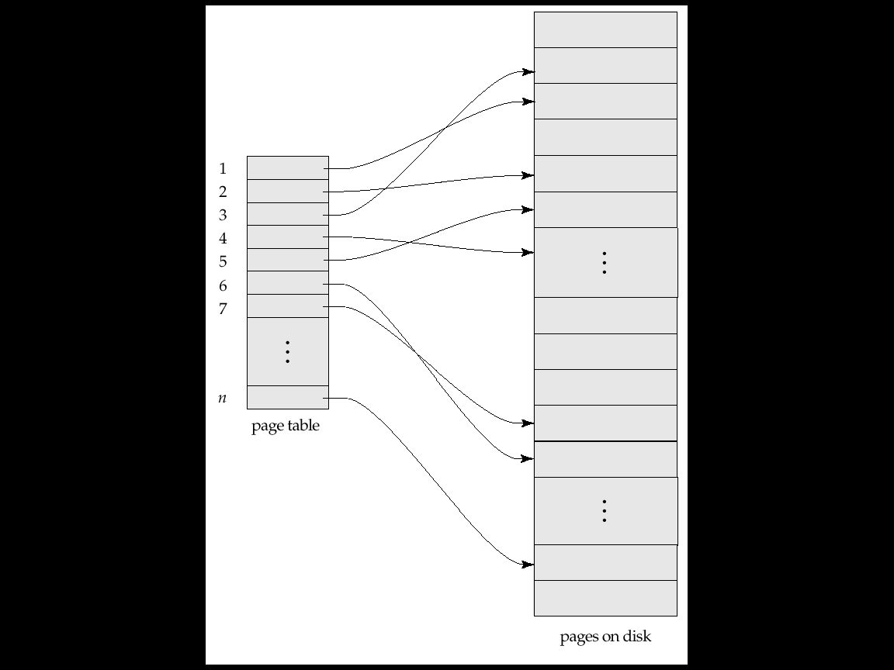
Database Recovery
Sample Page Table

Slide 48
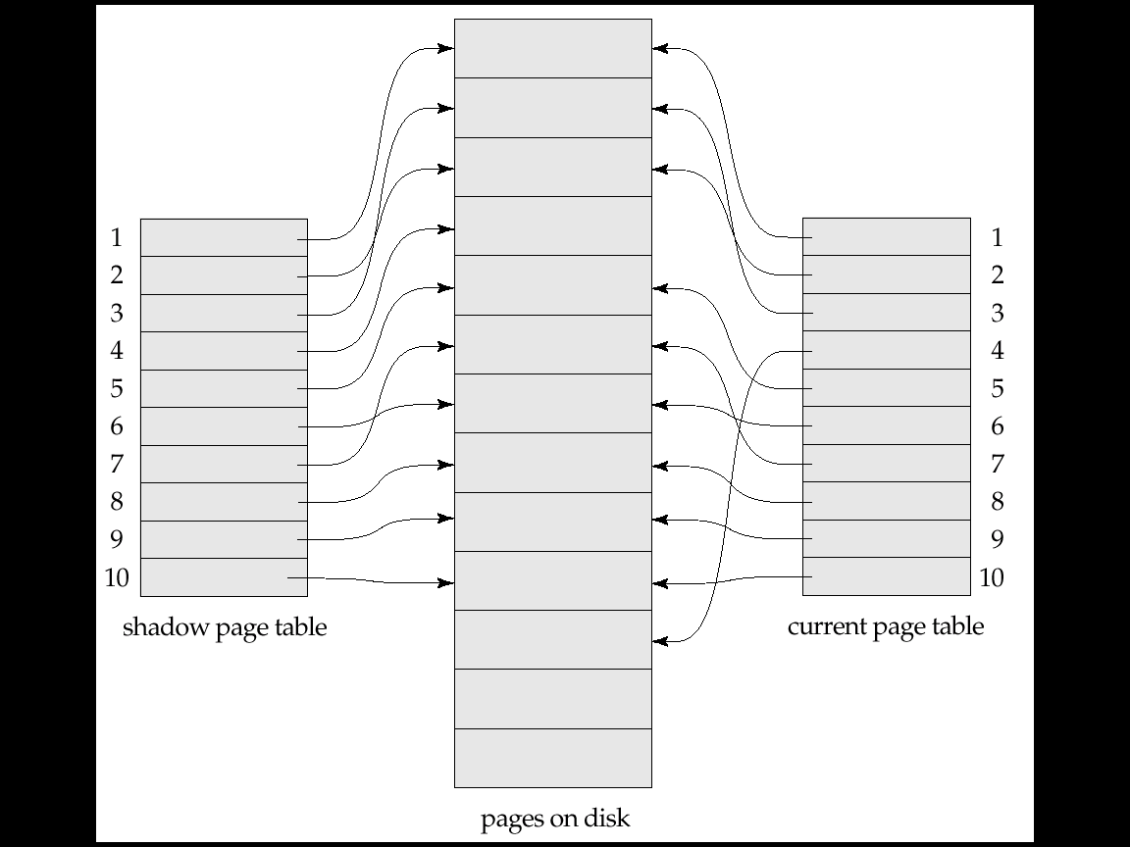
Database Recovery
Example of Shadow Paging
Shadow and current
page tables after write
to page 4

Slide 49
Database Recovery
Shadow Paging (cont)
To commit a transaction :
Flush all modified pages in main memory to disk
Output current page table to disk
Make the current page table the new shadow page table, as follows:
keep a pointer to the shadow page table at a fixed (known) location on disk.
to make the current page table the new shadow page table, simply update the pointer to point to current page table on disk
Once pointer to shadow page table has been written, transaction is committed.
No recovery is needed after a crash — new transactions can start right away, using the shadow page table.
Pages not pointed to from current/shadow page table should be freed (garbage collected).

Slide 50
Database Recovery
Shadow Paging(cont)
Advantages of shadow-paging over log-based schemes
no overhead of writing log records
recovery is trivial
Disadvantages :
Copying the entire page table is very expensive
Can be reduced by using a page table structured like a B⁺-tree
No need to copy entire tree, only need to copy paths in the tree that lead to updated leaf nodes
Commit overhead is high even with above extension
Need to flush every updated page, and page table
Data gets fragmented (related pages get separated on disk)
After every transaction completion, the database pages containing old versions of modified data need to be garbage collected
Hard to extend algorithm to allow transactions to run concurrently
Easier to extend log based schemes

Slide 51
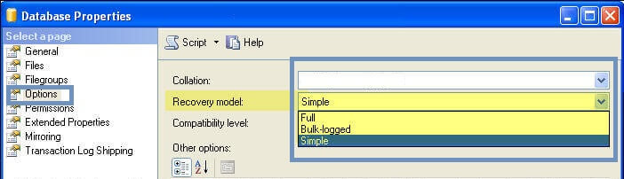
Type of recover and How to make different type of recovery
Types of recovery models :-
All SQL Server database backup, restore, and recovery operations are based on one of three available recovery models:
SIMPLE
FULL
BULK_Logged

Slide 52
Type of recover and How to make different type of recovery
Simple Recovery Model :-
basic recovery model which helps the user to restore full and differential backups.
Though this model is easy to manage, it is reliable only when data is not critical.
This model may not allow to restore database to a given point in time.
The user may only restore it to the actual time when full or differential backup has occurred.
this Simple Recovery Model is recommended in the following conditions
If the database is for testing or development need only.
If DBA can afford the chance of losing modifications in transactions after the backup.
If data is not crucial and can be recreated when needed

Slide 53
Type of recover and How to make different type of recovery
Full Recovery Model :-
It is a reliable model as compared to Simple Recovery Model as it helps to restore the lost data completely.
This model allows point-in-time recovery of the database provided the user has all the valid database backups along with transactional log tail backup.
In full recovery model, you also need to back up transaction log files to avoid its growth.
Choose the Full Recovery Model in the following cases :-
If data is crucial and point-in-recovery is required.
You are using Database Mirroring, Always On Availability Groups, etc
If bearing data loss is not at all an option.

Slide 54
Type of recover and How to make different type of recovery
Bulk-logged Recovery Model :-
This model is almost similar to full recovery model except that it uses minimal logging (only information required to recover the transaction is logged).
It supports point-in-time recovery but helps in reducing the processing time.
this model is a little risky as the data may get lost if the logs since the most recent backup are damaged.
Select Bulk-logged Recovery Model for the following conditions :-
If you don’t want to perform bulk operations while using critical data that cannot be lost.
If minimal logging is required to reduce more log file growth.

Slide 55
database failure
System Failures and Recovery:-
Critical point : contents of main storage are lost, in particular, the database buffers are lost. e.g. CPU failure.
How to recover ?
UNDO the transactions in progress at the time of failure. e.g. T₃ ,T₅
REDO the transactions that successfully complete but did not write to the physical disk.
tc
tf
Time
T1
T2
T3
T4
T5
T1: no need to be undone or redone
?
T2, T4: must be redone
T3, T5: must be undone
?
check point
system failure

Slide 56
database failure
Media Failures and Recovery:-
Critical point:
Some portion of the secondary storage is damaged.
How to recover?
load the database to new device from the most recent archive copy (old DB.)
(2) use the log (both active and archive) to redo all the transactions that are completed since that dump was taken.
Note: Assume log dose not fail.
(Duplex log to avoid log failure.)
Old DB
log
New DB
Report
Back p.8-13

Slide 57
database failure
System Failures and Recovery:-
How does the system know: which transaction to redo and which to undo?
<1> Taking a Check point:
at certain prescribed intervals
involves:
writing the contents of the database buffers out to the physical database. e.g. disk
writing a special checkpoint record (contains a list of transactions which are in progress) e.g. {T2, T3} in progress
tc
tf
Time
T1
T2
T3
T4
T5
T1: no need to be undone or redone
?
T2, T4: must be redone
T3, T5: must be undone
?
check point
system failure

Slide 58
database failure
System Failures and Recovery:-
Decide undo and redo list
Decide the undo list and redo list by the following procedure :
STEP1:
UNDO-list = list of transactions given in the checkpoint record = {T2, T3}
REDO-list = { }
STEP2:
Search forward through the log, starting from the checkpoint, to the end of log:
if a 'BEGIN TRANSACTION' is found => add to UNDO-list {T2, T3, T4,T5}
if a 'COMMIT' is found => remove from UNDO-list to REDO-list
UNDO-list = {T3, T5}
REDO-list = {T2, T4}
Undo System works backward through the log, undoing the UNDO-List.
Redo System then works forward through the log, redoing the REDO-List
undo
write to disk

Slide 59
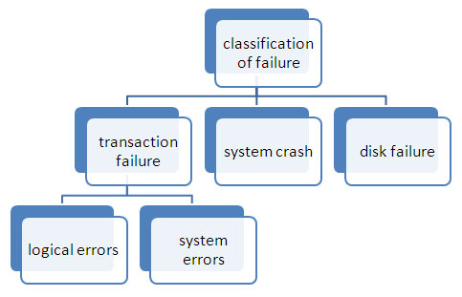
database failure definition and types of failures
Database Failure :-
it occurs due to hardware malfunction or a bug in the database software or the operating system itself.
It causes the loss of the content of volatile storage and brings transaction processing
to a halt. Where it could affect nonvolatile content depending on its failure type.

Slide 60
database failure definition and types of failures
Types of Failures :-
Transaction failure :-
The transaction failure occurs when it fails to execute. If a few transaction or process is hurt, then this is called as transaction failure.
Reasons for a transaction failure could be :-
Logical errors: If a transaction cannot complete due to some code error or an internal error condition, then the logical error occurs.
Syntax error: It occurs where the DBMS itself terminates an active transaction because the database system is not able to execute it.

Slide 61
database failure definition and types of failures
Hardware Failure :- (hardware such as: RAM, CPU, physical Disk)
Hardware failures may include memory errors, disk crashes, bad disk sectors, and disk full of errors among others. Hardware failures can also be attributed to overloading (use of under-capacity components) and wear out of mechanical parts.
Disk Failure :-
It occurs where hard-disk drives or storage drives used to fail frequently.
Disk failure occurs due to the formation of bad sectors, disk head crash, and unreachability to the
disk or any other failure, which destroy all or part of disk storage.
Software Failure :- (software such as: operating system, management programs)
software failures may include failures related to software such as operating system, DBMS software and application programs.
Both Software and hardware failure can contribute toward system failure/crash.

Slide 62
THANK YOU

