Slide 1

Implementation of Health Monitoring System using ESP32 & AWS
Distribuited Systems & Cloud/Edge Computing
Students:
Mahmoud Mohamed & Mahmoud Helal
Date : 05/07/2024

Slide 2
Introduction
Integration of IoT in Health Monitoring;
System Tracks Heart Rate, Temperature and Air Quality
ESP32 and AWS IoT Core
Objectives:
Health Monitoring;
Data Storage;
Threshold Alerts;
Real-Time Monitoring
Reporting

Slide 3
Analysis:
Functional Requirements:
Health Monitoring;
Data Transmission and Storage ;
Threshold Alerts;
Reporting.
Non-Functional Requirements:
Low Latency;
Availability and accessibility;
High Accuracy.
Overview of the Meta-Model

Slide 4
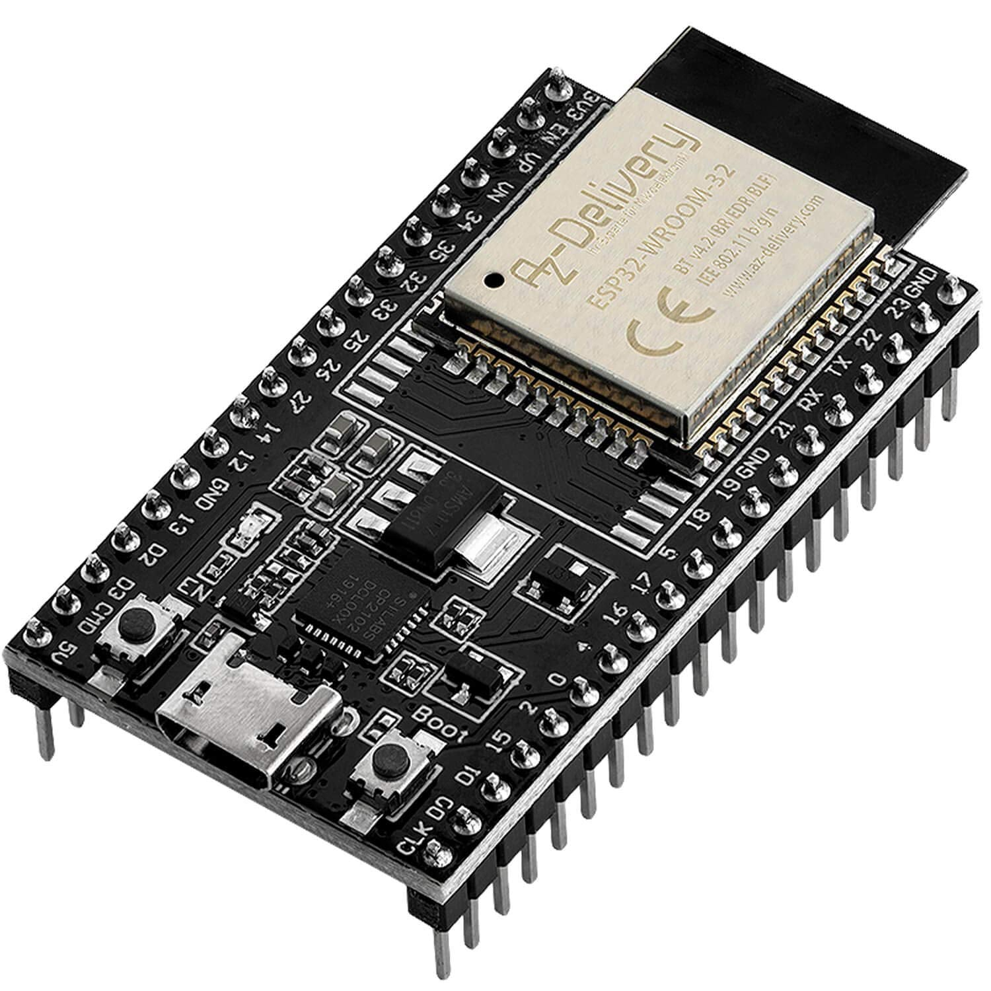
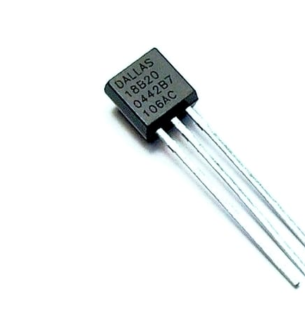
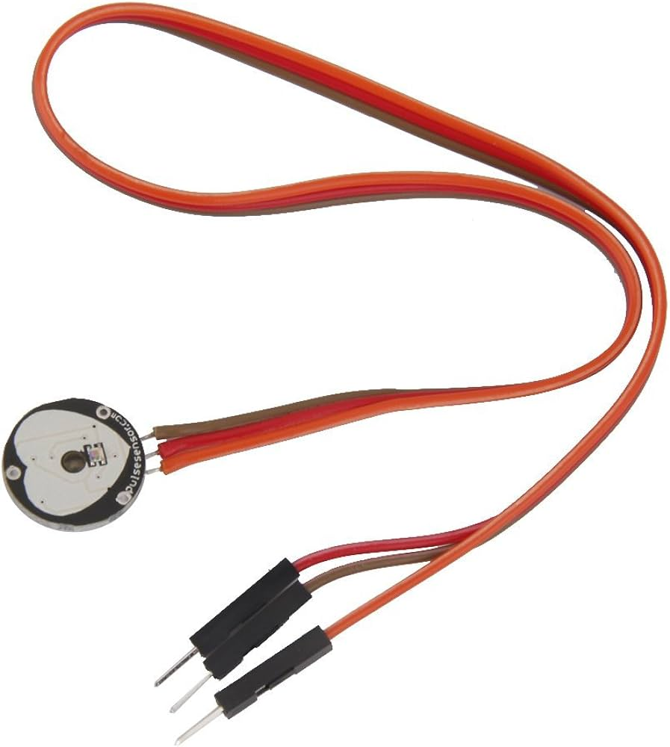
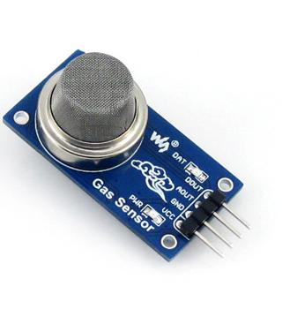
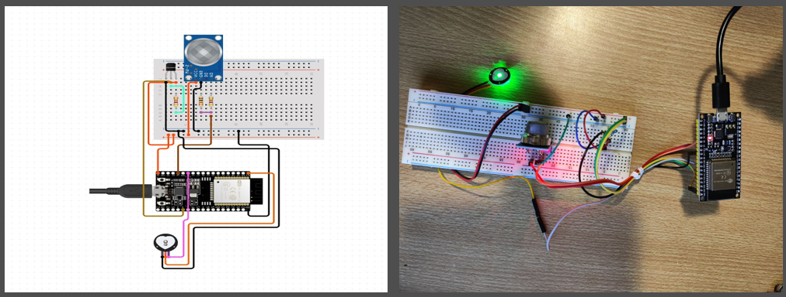
Hardware Design:
Components:
ESP32 Microcontroller
Heart Rate Sensor
Temperature Sensor
Gas Sensor
Connection between sensors and ESP32
Model | GPIO Pins
ICQUANZX | 34
DS18B20 | 17
MQ-2 | 35

Slide 5




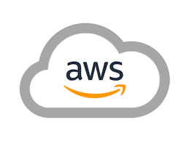
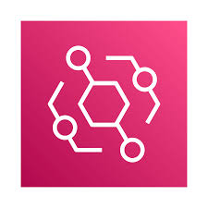

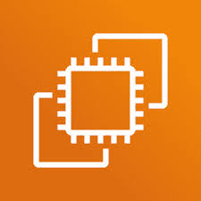


Software Design
Components:
Pub/Sub;
Data Processing;
Data Base;
Notifier;
Event Generator;
Reporting Module;
Computing Module;
Others.
User Interface.

Slide 6
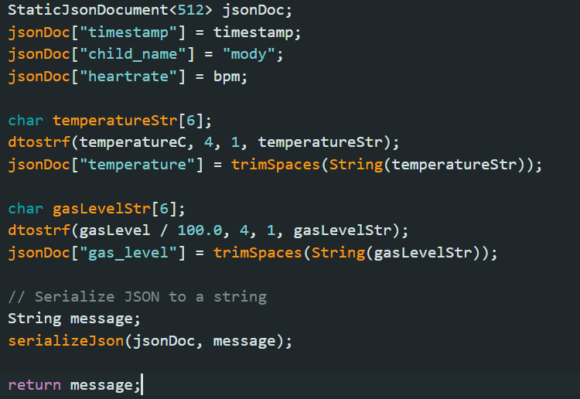
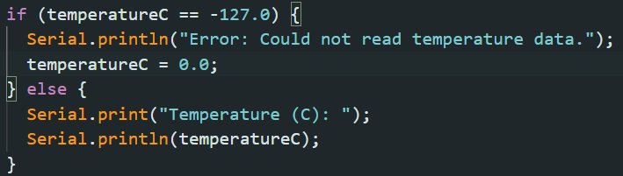
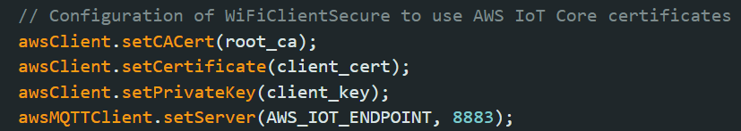
Hardware Implementation
ESP32 Setup:
Wi-fi Setup;
Message creating.
MQTT Communication:
Broker configuration;
Secure data transmission.
Sensors Configuration:
Functionality check;
Adjustments of sensors output signal.

Slide 7
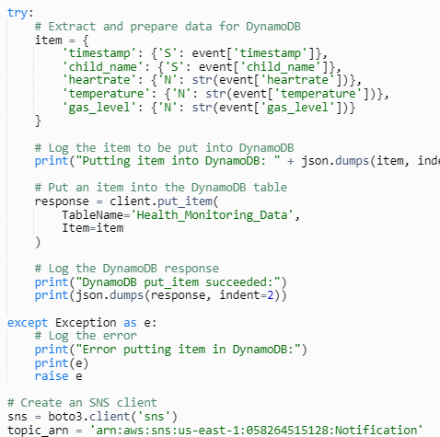
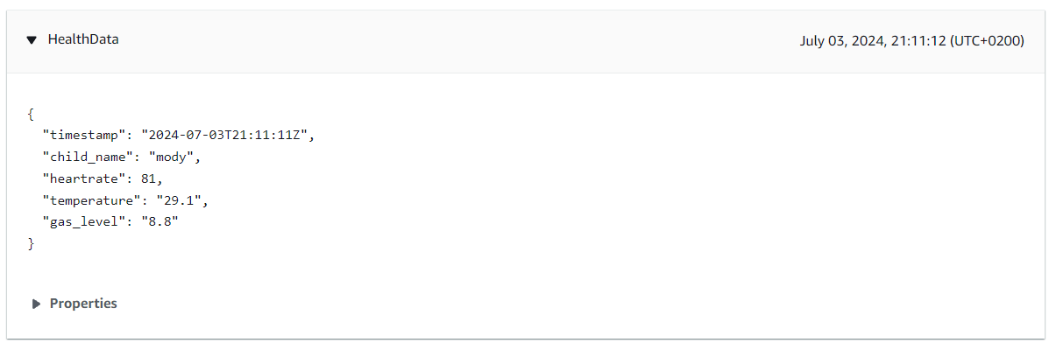
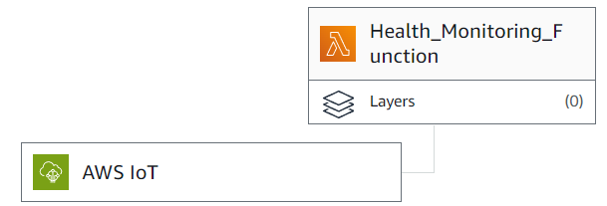
Software Implementation (1/4)
AWS IoT Core:
Managing ESP as a Thing;
Topic Subscription.
AWS Lambda:
Data processing and Storage.
Threshold checks and SNS alerts.

Slide 8
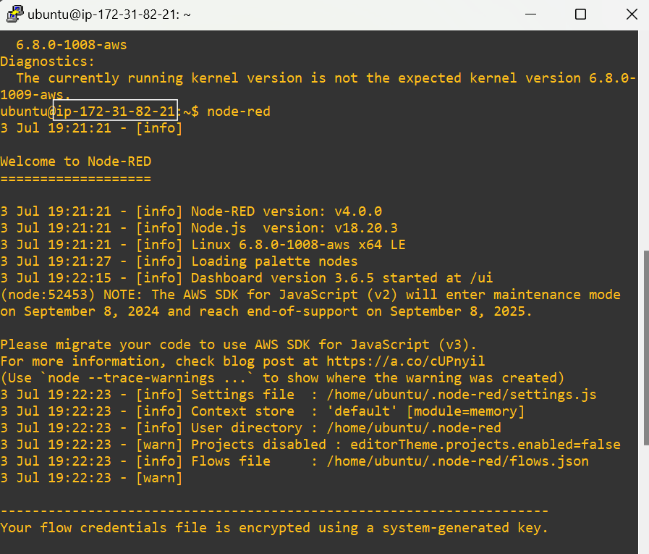
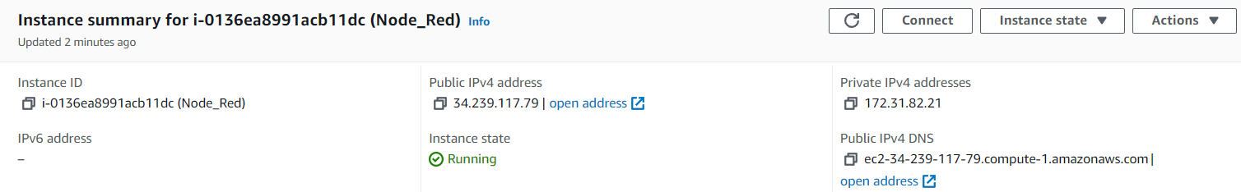
Software Implementation (2/4)
Node-Red:
Installation and Flow Creation on EC2
Real-Time Dashboard.

Slide 9
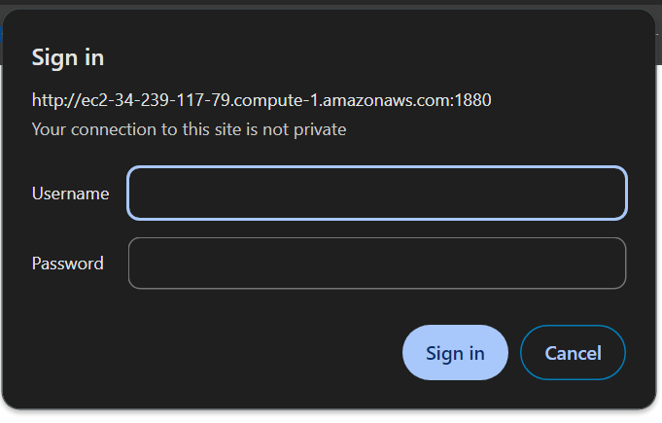
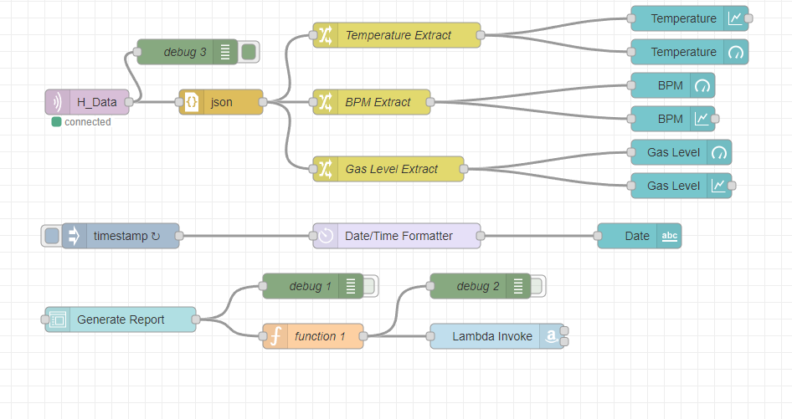
Software Implementation (3/4)
Node-Red:
Installation and Flow Creation on EC2
Real-Time Dashboard.

Slide 10
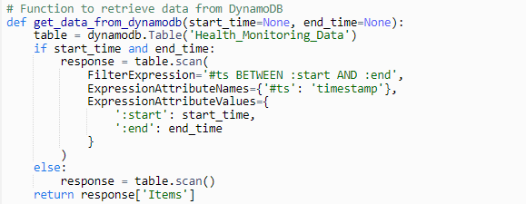
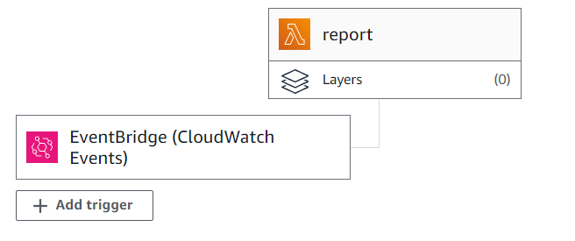
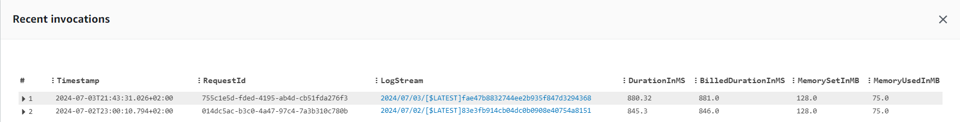
Software Implementation (4/4)
Periodic Report:
Lambda Function for periodic CSV Report Generation
Scheduling Periodicity with EventBridge
Emailing via SES
On-Demand Report:
Custom report based on specified date range

Slide 11
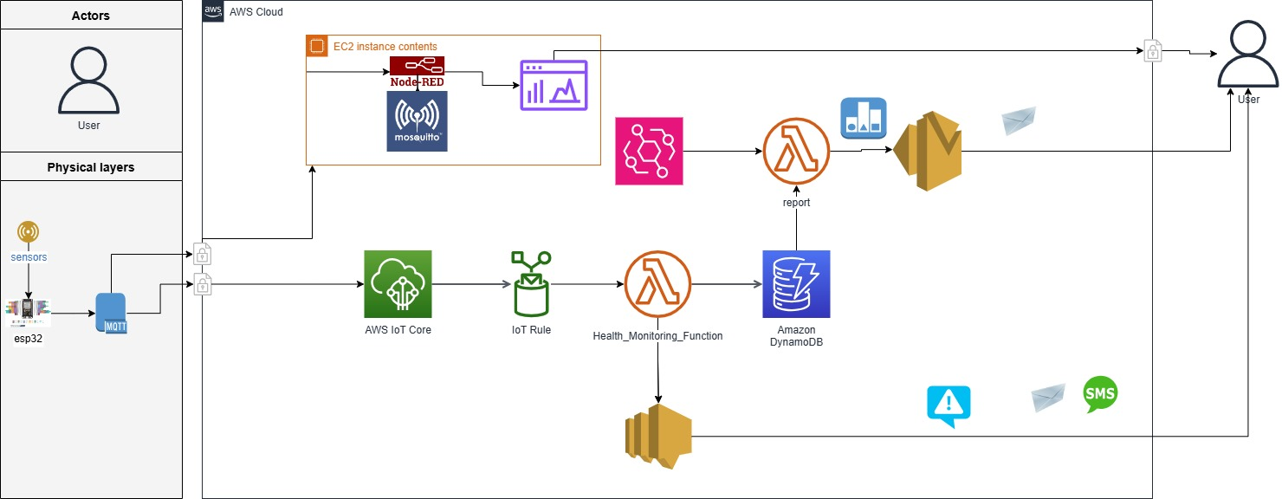
System Overview

Slide 12
Testing Process
Access AWS Console.
Open in different tabs the different services involved.
Open Putty and load Node-Red.
Connect the device.
Monitor the behavior on the different services.
Check the received notifications.
Dashboard: http://ec2-34-239-117-79.compute-1.amazonaws.com:1880/ui
Node-Red Flows: http://ec2-34-239-117-79.compute-1.amazonaws.com:1880/#flow/1bd1e80598ff14aa

Slide 13
Future Enhancements
Adding GPS Module.
Applying Machine Learning to predict possible future diseases.

Slide 14

Thanks for your attention

