Slide 1
Smart Home Manager
Mohamed Mahmoud 252048
Vacca Andrea 252416
Thiam Papa 252113

Slide 2
Index
Introduction
Project Objective
Project Phases – Overview
Results

Slide 3
Introduction
The IoT Mobile project focuses on creating an intelligent system for remote monitoring, including temperature, humidity, and brightness and control of fan and light. Through the integration of hardware, software, and mobile apps, we have developed a comprehensive solution for managing environmental information.

Slide 4
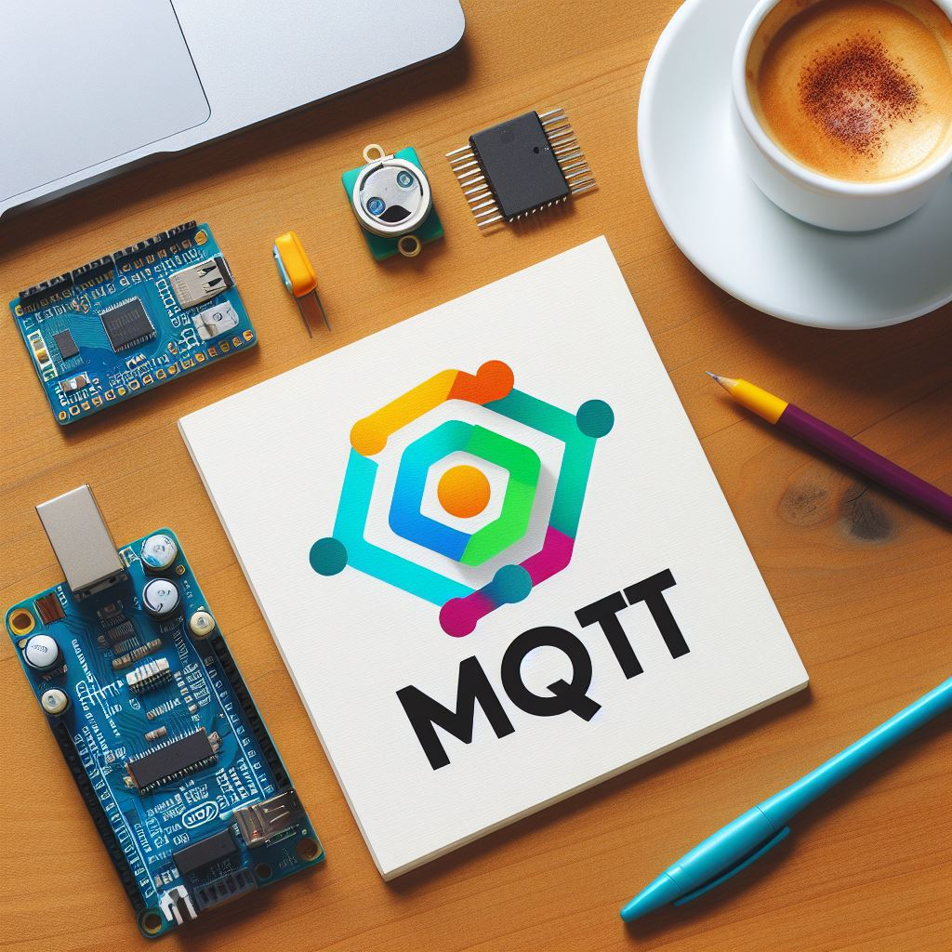
Project Objective
The primary goal of this innovative project is to engineer a sophisticated IoT ecosystem that facilitates the remote observation and management of critical environmental parameters, such as temperature, humidity, and luminosity. This system is adeptly designed to interface with a user-friendly mobile application, enabling users to effortlessly control fans and lighting based on real-time data.
The system’s intelligence is further exemplified by its ability to automatically adjust indoor conditions in response to outdoor environmental readings. This dynamic interaction ensures an optimal living or working space, tailored to the preferences and comfort of the occupants.
By integrating advanced sensors and smart control mechanisms, the project aims to deliver a seamless and intuitive experience, empowering clients to make informed decisions and take appropriate actions for energy efficiency and environmental comfort.

Slide 5
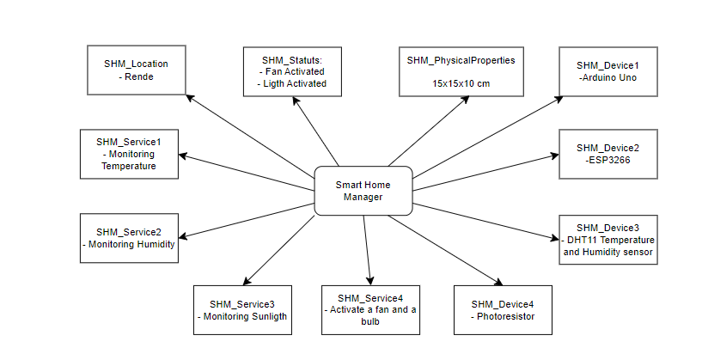
Project Objective
Meta Model

Slide 6
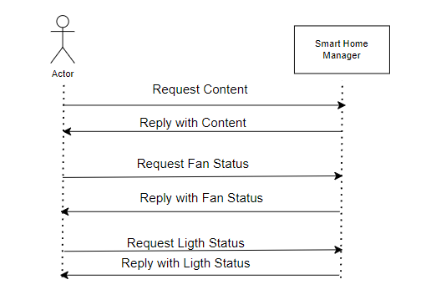
Project Objective
Use Case

Slide 7
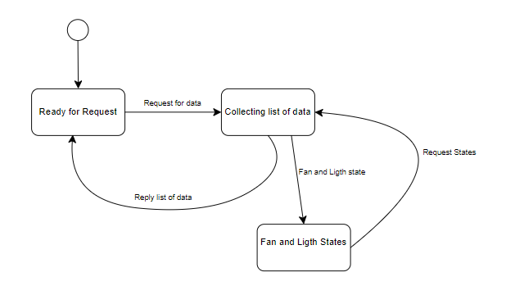
Project Objective
State Machine

Slide 8

Project Phases – Overview
Phase 1: Physical Realization of the Project
Phase 2: Implementation of the IoT System
Phase 3: Development of the Mobile App

Slide 9
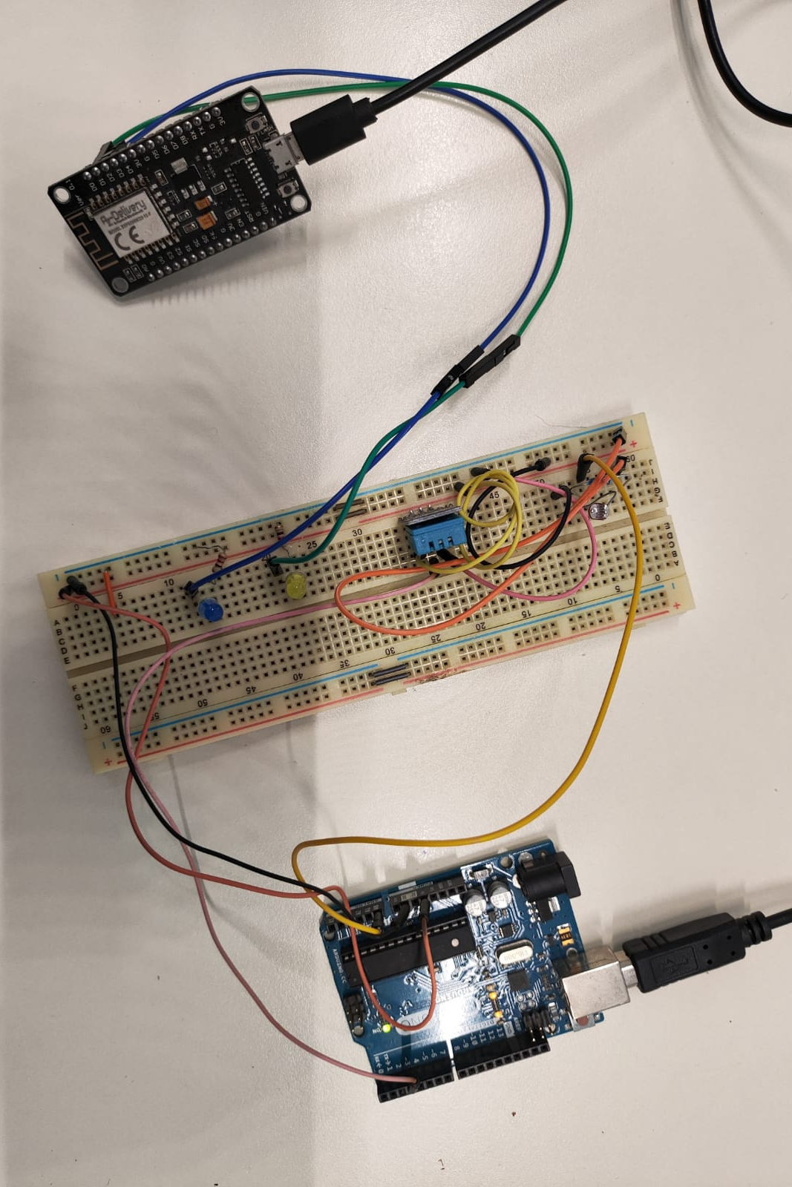
Phase 1: Physical Realization of the Project
Components Used:
Microcontrollers: Arduino and ESP8266.
Sensors: Combined humidity and temperature sensor, brightness sensor.
Other components: LEDs for controlling a fan and light, jumper wires.

Slide 10


Phase 2 - Implementation of the IoT System

Slide 11
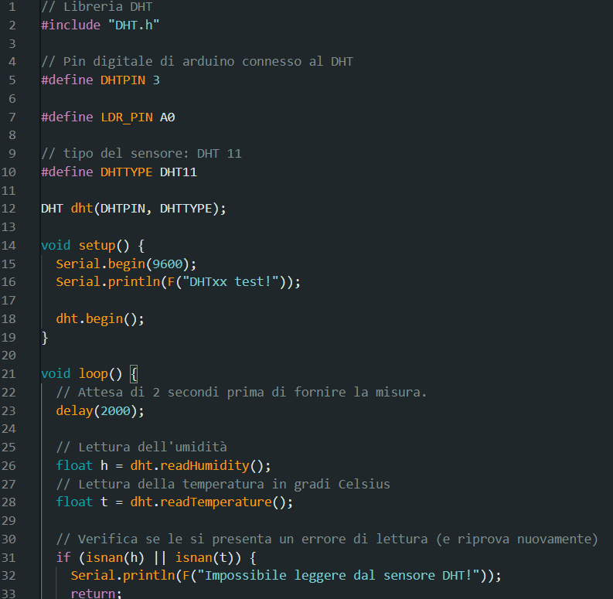
Phase 2 - Implementation of the IoT System
This code demonstrates how to collect environmental data using an Arduino and a DHT sensor. It’s commonly used in applications like weather stations or smart home systems.

Slide 12
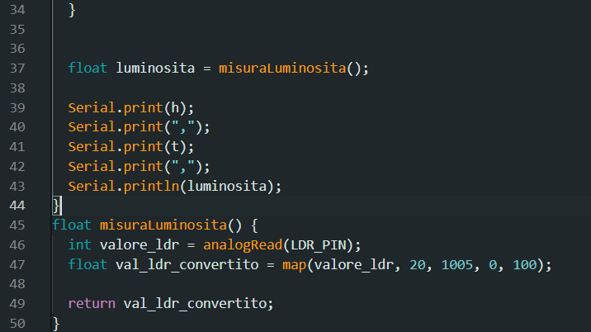
Phase 2 - Implementation of the IoT System
This snippet demonstrates how to read sensor data using an Arduino and an LDR. Send data to Node-Red using The serial port.

Slide 13
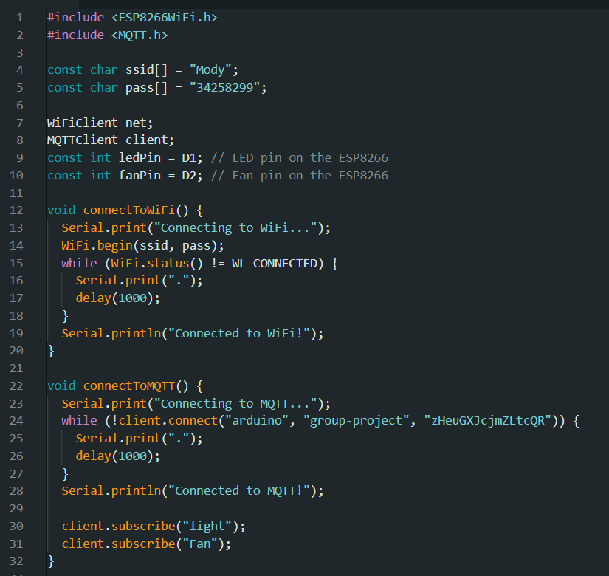
Phase 2 - Implementation of the IoT System
This snippet demonstrates It subscribes to topics (“light” and “Fan”) for receiving messages.

Slide 14
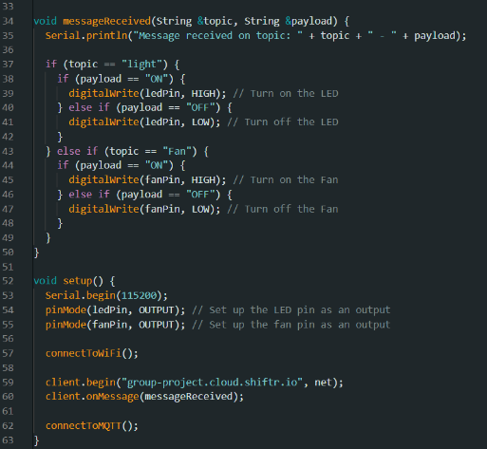
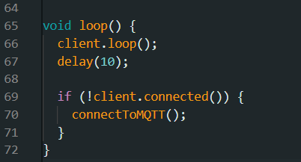
Phase 2 - Implementation of the IoT System
This snippet demonstrates It subscribes to topics (“light” and “Fan”) for receiving messages.

Slide 15
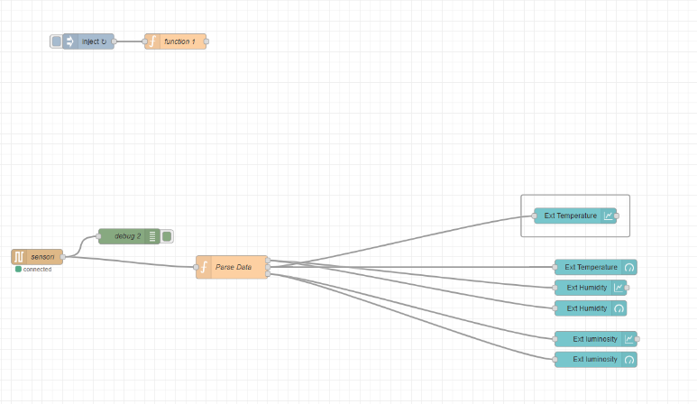
Phase 2 - Implementation of the IoT System
This Node-RED flow diagram processes and visualizes environmental data from a connected sensor.
In summary, this flow collects data from a sensor, processes it, and visualizes it in real-time using charts and gauges for easy monitoring.

Slide 16
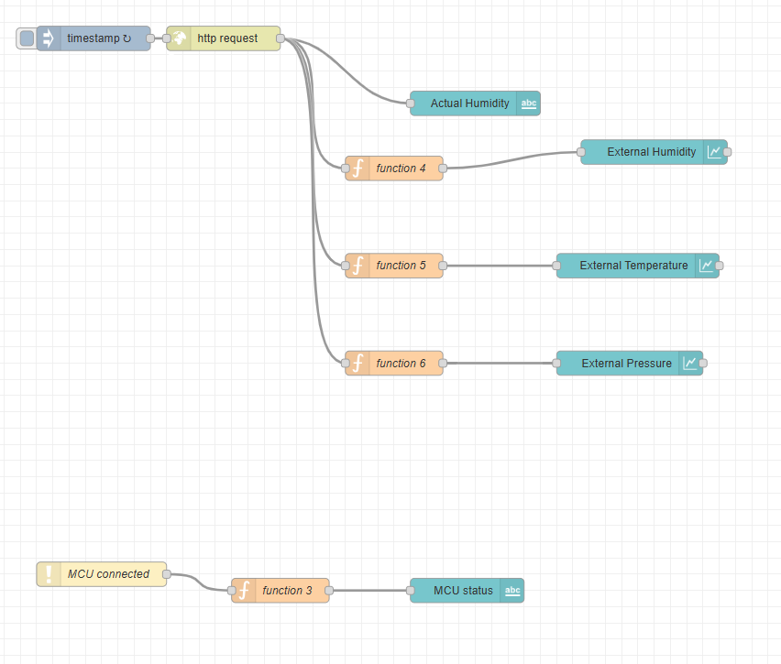
Phase 2 - Implementation of the IoT System
This Node-RED flow diagram processes and visualizes environmental data obtained via an HTTP request and monitors the status of a connected microcontroller unit (MCU).
The data for outdoor weather are taken by the following URL: https://api.openweathermap.org/data/2.5/weather?q=rende&appid=4ba3003394231a9fa9a7995ea8dba94d

Slide 17
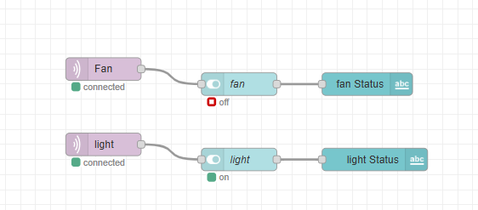
Phase 2 - Implementation of the IoT System
This Node-RED flow diagram is used to monitor and manage smart home devices, showing their connectivity and operational status through a user interface. It’s a visual representation of home automation technology, where devices like fans and lights can be controlled remotely and their statuses can be monitored in real-time.

Slide 18
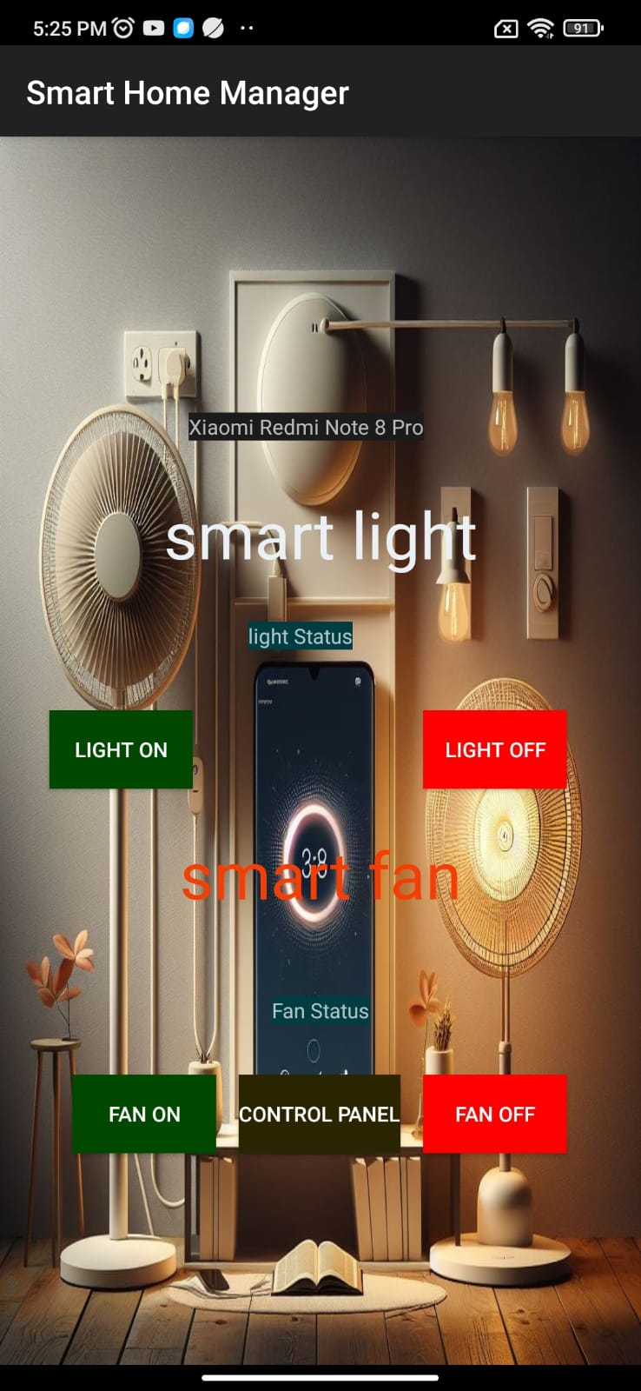
Phase 3 - Development of the Mobile App
The image shows a Smart Home Manager application interface on a smartphone. It features controls for a smart light and a smart fan, each with an on and off toggle.
The control panel is used to monitor the data.

Slide 19
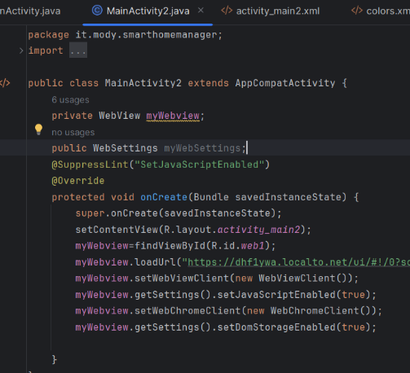
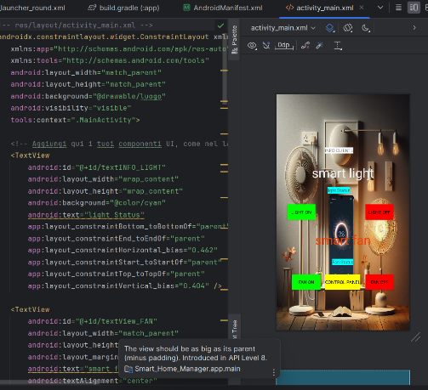
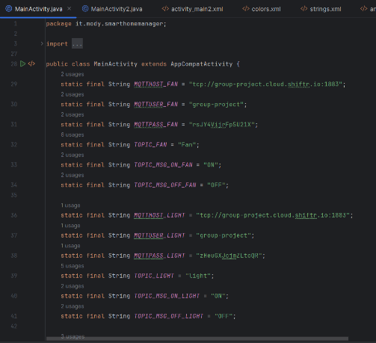
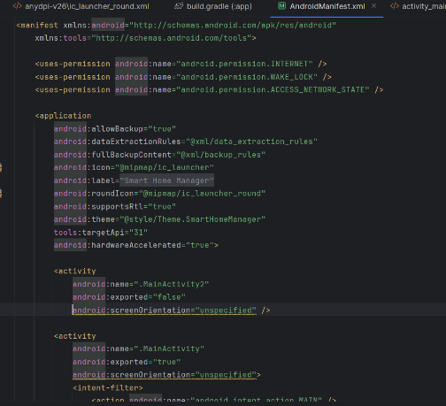
Phase 3 - Development of the Mobile App
Some code used to create the application

Slide 20
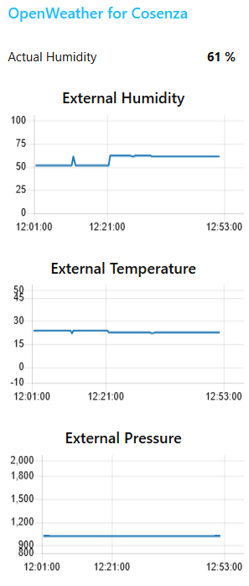
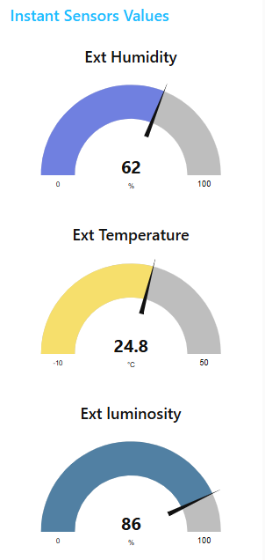
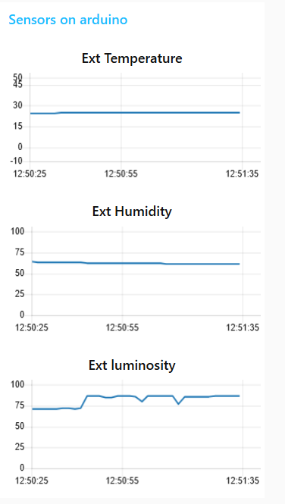
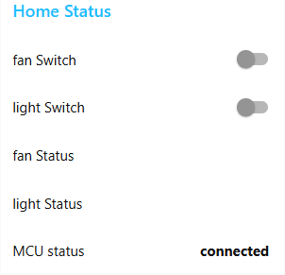
Results

Slide 21

THANK YOU!
Mohamed Mahmoud 252048
Vacca Andrea 252416
Thiam Papa 252113

