Slide 1
Maica_Presentation
Is there any links between Economy and Share Market growth?
Ash Tao, Chris Burley, Maica Tran and Sabrina Tsan

Slide 2
Things contribute to share_price:
Fluctuations in the prices of financial assets in the stock market can sometimes seem to be inconsistent with what is happening in the rest of the economy – what’s sometimes referred to as the ‘real economy’.
The market value of a company should reflect how much cash investors believe the firm will make in the future. If changes in the broader economy are likely to affect company performance, then this should lead to changes in share prices. But it is important to emphasise that investors will consider not only what is happening now, but also what is likely to occur in the future.
Research has shown that a considerable proportion of the variation in share prices can be explained by key economic variables such as industrial production, inflation and interest rates, as well as changes in the dividends that companies pay to shareholders (Cutler et al, 1988). The evidence suggests that expectations about future changes in the economy play an important role in current pricing, although there may be some feedback effects involved, as changes in the stock market may actually cause changes in the wider economy.

Slide 3
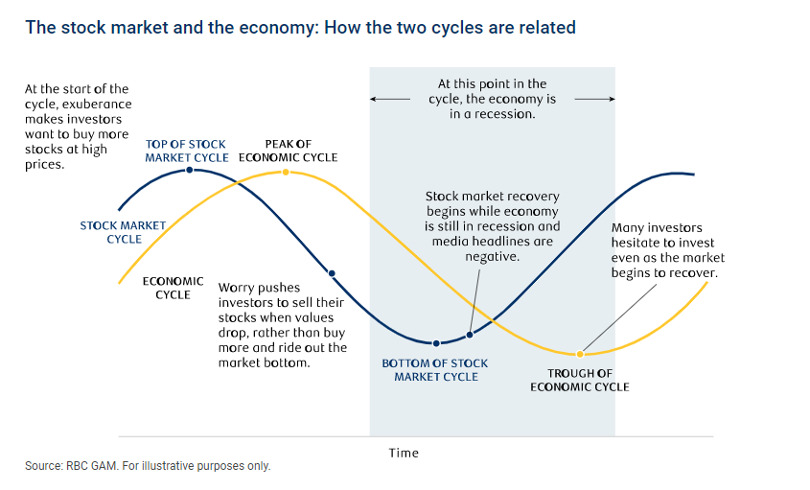

Slide 4
