Slide 1

INSTITUT FRESNEL · OPTICAL MICROSCOPY
Confocal Microscopy Quiz
Corrigé complet — DAPI / AF488 / AF568
Scénario Cellules HeLa fixées marquées DAPI (noyau), AF488 (actine), AF568 (protéine membranaire). Objectif : acquérir un z-stack 3D sur confocal.
DAPI — noyau
AF488 — actine
AF568 — membrane
7 Questions

Slide 2
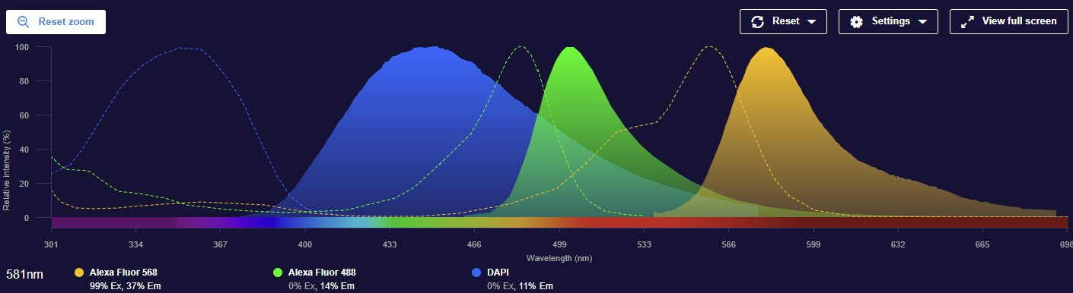
Q1
QCM
Laser Selection
2 / 22
Which laser combination is best suited to excite DAPI, Alexa Fluor 488, and Alexa Fluor 568?
Excitation (dashed) & emission (filled) spectra — FPbase
A
405 nm / 488 nm / 514 nm
B
405 nm / 488 nm / 638 nm
C
405 nm / 488 nm / 561 nm
D
488 nm / 514 nm / 561 nm

Slide 3
Q1
RÉPONSE
Laser Selection
3 / 22
Which laser combination is best suited to excite DAPI, Alexa Fluor 488, and Alexa Fluor 568?
A
405 nm / 488 nm / 514 nm
B
405 nm / 488 nm / 638 nm
✓
405 nm / 488 nm / 561 nm
D
488 nm / 514 nm / 561 nm

Slide 4
Q1
EXPLICATIONS
Laser Selection
4 / 22
A
514 nm is a rare Argon laser line absent from modern confocals.
✕
B
638 nm targets far-red dyes like AF647, not AF568.
✕
C
405 nm → DAPI (ex ~360 nm). 488 nm → AF488 (ex ~493 nm). 561 nm → AF568 (ex ~578 nm). Perfect match.
✓
D
No 405 nm line — DAPI would not be excited at all.
✕

Slide 5
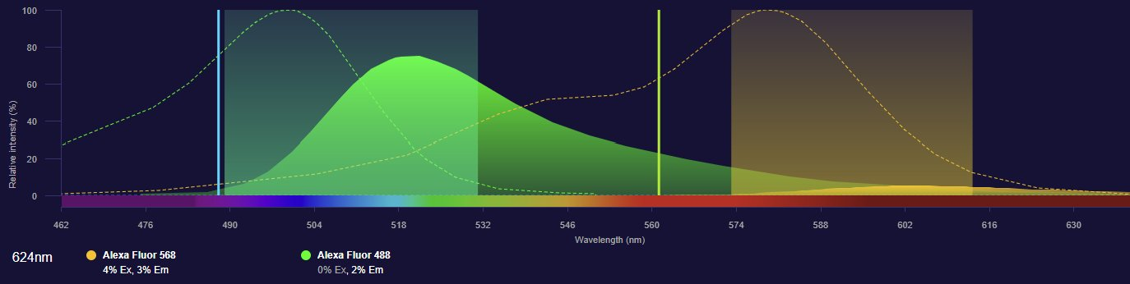
Q2
QCM
Spectral Bleed-Through
5 / 22
Simultaneous acquisition: orange signal appears in actin (green-only) structures. Most likely cause?
Green box: AF488 detection window. Orange box: AF568 detection window — FPbase
A
The 561 nm laser directly excites AF488
B
AF488 emission tail bleeds into the AF568 detection window (spectral bleed-through)
C
AF568 is also excited at 488 nm, generating signal in actin
D
The pinhole is too large, mixing focal planes

Slide 6
Q2
RÉPONSE
Spectral Bleed-Through
6 / 22
Simultaneous acquisition: orange signal appears in actin (green-only) structures. Most likely cause?
A
The 561 nm laser directly excites AF488
✓
AF488 emission tail bleeds into the AF568 detection window (spectral bleed-through)
C
AF568 is also excited at 488 nm, generating signal in actin
D
The pinhole is too large, mixing focal planes

Slide 7
Q2
EXPLICATIONS
Spectral Bleed-Through
7 / 22
A
561 nm cannot excite AF488 (absorption essentially zero at 561 nm).
✕
B
AF488 emission tail extends into the AF568 detection window. Eliminated by sequential acquisition.
✓
C
AF568 does have ~4% cross-excitation at 488 nm, but this causes orange signal in orange-labelled structures, not in actin.
✕
D
Large pinhole causes Z-mixing, not cross-channel contamination.
✕

Slide 8
Q3
QCM
Objective — Oil vs. Water
8 / 22
Which 63× objective is better suited for fixed HeLa cells mounted in Mowiol?
63× / NA 1.2 — Water. Better index match with biological samples (n ≈ 1.33)
A
63× / NA 1.4 — Oil. Higher NA → better resolution; oil matches Mowiol (n ≈ 1.52)
B
Both equivalent — NA does not affect resolution on fixed cells
C
63× / NA 1.2 — Water is always better for fluorescence imaging
D

Slide 9
Q3
RÉPONSE
Objective — Oil vs. Water
9 / 22
Which 63× objective is better suited for fixed HeLa cells mounted in Mowiol?
63× / NA 1.2 — Water. Better index match with biological samples (n ≈ 1.33)
A
63× / NA 1.4 — Oil. Higher NA → better resolution; oil matches Mowiol (n ≈ 1.52)
✓
Both equivalent — NA does not affect resolution on fixed cells
C
63× / NA 1.2 — Water is always better for fluorescence imaging
D

Slide 10
Q3
EXPLICATIONS
Objective — Oil vs. Water
10 / 22
A
Water (n=1.33) creates severe index mismatch with Mowiol (n=1.52) → strong spherical aberration.
✕
B
Oil (n=1.515) ≈ Mowiol (n=1.52) → minimal aberration. NA 1.4 gives r = 0.61×488/1.4 = 213 nm vs 248 nm for NA 1.2.
✓
C
NA directly determines lateral resolution: r = 0.61 λ/NA.
✕
D
Water is better for LIVE imaging where sample n ≈ 1.33. Fixed cells in Mowiol require oil.
✕

Slide 11
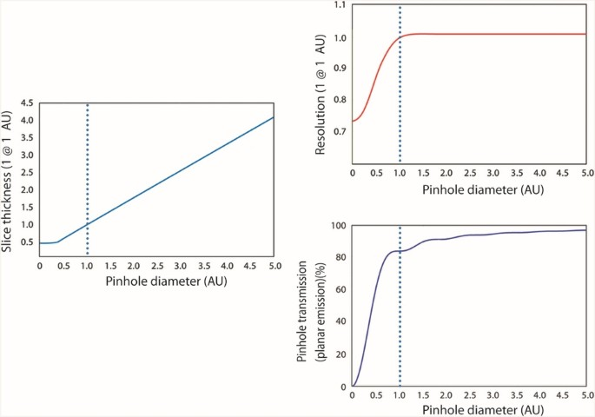
Q4
QCM
Pinhole Size Trade-off
11 / 22
You reduce the pinhole from 2 AU to 0.5 AU. According to the graphs, what is the main trade-off?
Slice thickness (left), lateral resolution (top right), transmission (bottom right) vs pinhole diameter
A
Better axial resolution AND more signal — always reduce the pinhole
B
No change in axial resolution — pinhole only affects brightness
C
Thinner optical section, but sharply reduced light transmission → lower SNR
D
Better lateral resolution only — section thickness not affected by pinhole

Slide 12
Q4
RÉPONSE
Pinhole Size Trade-off
12 / 22
You reduce the pinhole from 2 AU to 0.5 AU. According to the graphs, what is the main trade-off?
A
Better axial resolution AND more signal — always reduce the pinhole
B
No change in axial resolution — pinhole only affects brightness
✓
Thinner optical section, but sharply reduced light transmission → lower SNR
D
Better lateral resolution only — section thickness not affected by pinhole

Slide 13
Q4
EXPLICATIONS
Pinhole Size Trade-off
13 / 22
A
Signal drops steeply below 1 AU — clearly visible in the transmission graph.
✕
B
The slice thickness graph shows a clear improvement in section thinness as pinhole closes.
✕
C
1 AU = optimal compromise: 84% transmission + good z-sectioning. At 0.5 AU, only ~40% light passes.
✓
D
The resolution graph shows only marginal lateral improvement. The main gain is in z-sectioning, not lateral.
✕

Slide 14
Q5
QCM
Mounting Setup
14 / 22
63× oil objective (NA 1.4, designed for coverslip #1.5). Which mounting setup gives best image quality?
Glass slide + PBS (n=1.33) + cells on coverslip #1.5 + no medium + oil
A
Plastic Petri dish (n=1.59) + culture medium + cells on plastic + oil from below
B
Glass slide + Mowiol (n≈1.52) + cells on coverslip #1.5 + oil
C
Glass slide + water (n=1.33) + cells on coverslip #1 (0.13 mm) + oil
D

Slide 15
Q5
RÉPONSE
Mounting Setup
15 / 22
63× oil objective (NA 1.4, designed for coverslip #1.5). Which mounting setup gives best image quality?
Glass slide + PBS (n=1.33) + cells on coverslip #1.5 + no medium + oil
A
Plastic Petri dish (n=1.59) + culture medium + cells on plastic + oil from below
B
Glass slide + Mowiol (n≈1.52) + cells on coverslip #1.5 + oil
✓
Glass slide + water (n=1.33) + cells on coverslip #1 (0.13 mm) + oil
D

Slide 16
Q5
EXPLICATIONS
Mounting Setup
16 / 22
A
PBS (n=1.33) creates index mismatch with oil (n=1.515). Severe spherical aberration in Z.
✕
B
Plastic (n=1.59) mismatches oil (n=1.515). Plastic thickness is also uncontrolled and much too thick.
✕
C
Mowiol (n≈1.52) ≈ oil (n=1.515) ≈ glass → minimal aberration. Coverslip #1.5 = 0.17 mm matches objective correction. Cells are on the coverslip closest to the objective.
✓
D
Two errors: (1) water n=1.33 mismatches oil. (2) Coverslip #1 = 0.13 mm ≠ 0.17 mm — objective is not corrected for this thickness. Cells must be on the coverslip closest to the objective.
✕

Slide 17
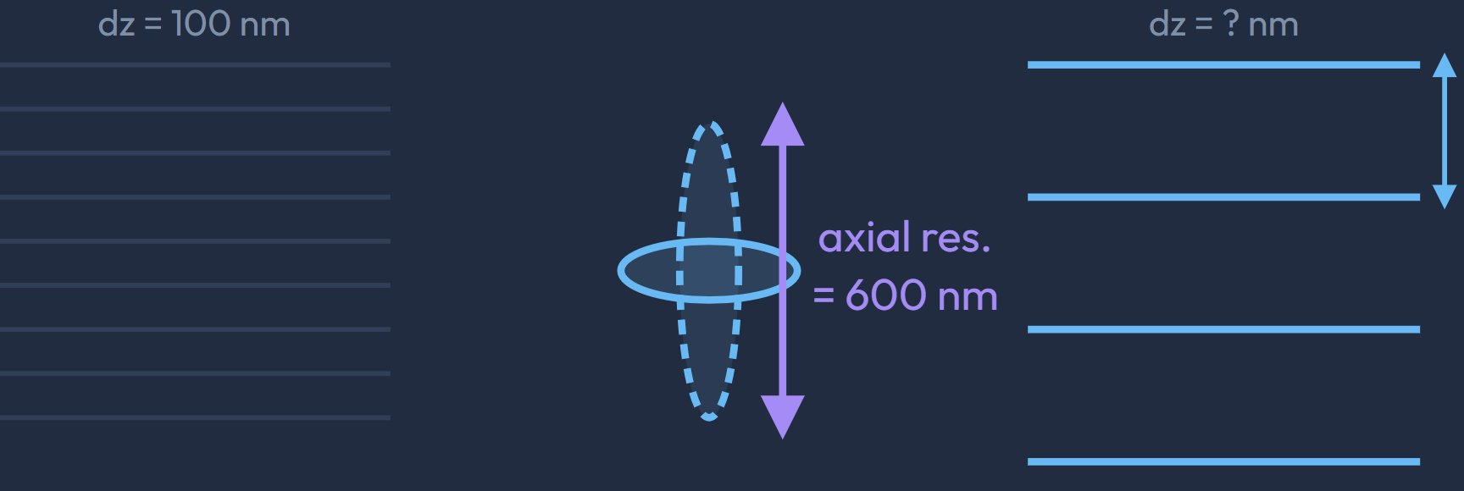
Q6
QCM
Z-Step & Nyquist Criterion
17 / 22
Axial resolution = 600 nm. Which z-step satisfies the Nyquist criterion?
Oversampled (dz=100 nm, left) vs Nyquist sampling (dz=?, right) — axial PSF = 600 nm
A
1200 nm — twice the axial resolution
B
600 nm — equal to the axial resolution
C
300 nm — half the axial resolution (Nyquist criterion)
D
100 nm — the smaller the better

Slide 18
Q6
RÉPONSE
Z-Step & Nyquist Criterion
18 / 22
Axial resolution = 600 nm. Which z-step satisfies the Nyquist criterion?
A
1200 nm — twice the axial resolution
B
600 nm — equal to the axial resolution
✓
300 nm — half the axial resolution (Nyquist criterion)
D
100 nm — the smaller the better

Slide 19
Q6
EXPLICATIONS
Z-Step & Nyquist Criterion
19 / 22
A
1200 nm = 2× resolution → severe under-sampling, loss of axial structures.
✕
B
Sampling at exactly the resolution still under-samples (need at least 2 samples per period).
✕
C
Nyquist: dz ≤ resolution / 2 = 600/2 = 300 nm. The right panel shows 3 slices sampling the 600 nm PSF.
✓
D
100 nm = over-sampling: no information gain, more photobleaching, longer acquisition time.
✕

Slide 20
Q7
BONUS
Bonus — Photobleaching
20 / 22
Signal drops in later-acquired channels during z-stack. Which statements correctly explain or address photobleaching?
A
AF568 bleaches faster than DAPI because rhodamine-based dyes are generally less photostable than coumarins
B
Sequential acquisition (one laser at a time) always reduces total photobleaching vs simultaneous
C
Reducing laser power and compensating with higher detector gain preserves fluorophore lifetime
D
Acquiring the z-stack bottom → top protects the brightest planes from bleaching
E
Increasing z-step from 300 nm to 1 µm significantly reduces photobleaching
🎁 Question bonus — sélectionnez toutes les réponses que vous pensez correctes

Slide 21
Q7
RÉPONSE
Bonus — Photobleaching
21 / 22
Signal drops in later-acquired channels during z-stack. Which statements correctly explain or address photobleaching?
✓
AF568 bleaches faster than DAPI because rhodamine-based dyes are generally less photostable than coumarins
B
Sequential acquisition (one laser at a time) always reduces total photobleaching vs simultaneous
✓
Reducing laser power and compensating with higher detector gain preserves fluorophore lifetime
D
Acquiring the z-stack bottom → top protects the brightest planes from bleaching
E
Increasing z-step from 300 nm to 1 µm significantly reduces photobleaching

Slide 22
Q7
EXPLICATIONS
Bonus — Photobleaching
22 / 22
A
Rhodamines (AF568) are less photostable than coumarins (DAPI). Visible in the steeper decay curve.
✓
B
Sequential acquisition reduces bleed-through but does NOT reduce total bleaching — each plane is still illuminated the same total time per channel.
✕
C
Bleaching rate ∝ intensity². Halving laser power reduces bleaching ~4×. Compensating with gain only adds shot noise — a good trade-off.
✓
D
Acquisition direction has no meaningful effect on bleaching. The brightest planes are not predictably at the bottom.
✕
E
Fewer slices reduce total volume illumination but violate the Nyquist criterion (300 nm was already the minimum). Each slice still bleaches at the same rate.
✕

