Slide 1
PolicyGuard AI
PILOT REVIEW · MBA ZG583 MANAGEMENT OF AI PRODUCTS
A compliance assistant for insurance underwriting document audit and policy renewal
TEAM011 · Joydev Pain · 2025MB26105
All data, rules, companies and people are fictional. Business figures are planning assumptions.
Notes:
Introduce PolicyGuard AI, TEAM011, and that this is a pilot review.

Slide 2
Audit gaps surface too late, when they cost the most
PROBLEM AND STAKES
Every policy folder must meet set rules for structure, naming and content
Staff check folders one at a time, by hand
Gaps often surface during a third-party audit, or at renewal
Extra headcount adds cost, and reviews stay inconsistent
12,000
commercial property folders a year
45 min
analyst time per folder
$1.35M
annual review cost at $150/h onsite
Planning assumptions for a hypothetical mid-size US insurer. Not company data.
1
Notes:
Every policy folder must survive an audit. People check them one at a time, so an auditor or a renewal often finds the gap first.

Slide 3
The analyst sees a gap first, and answers for it if it is missed
USER AND WORKFLOW
Today: Meera, underwriting operations analyst
Two decisions the product improves
Open folder
→
Check names
→
Read documents
→
Compare by hand
Each finding
confirm, reject or escalate, with a reason
Legacy naming varies, so much of the day goes to routine checks.
“I don't want an auditor to find something that I signed off.”
The renewal
renew, review or hold, on complete evidence
Persona is illustrative and not yet validated through interviews.
TEAM011 · PolicyGuard AI
2
Notes:
Meera sits where the problem starts: she is the first to see a gap, and carries the blame if she misses one. I am improving two decisions: what to do with each finding, and the renewal decision.

Slide 4
Scripts read file names, but this work needs reading documents
WHY AI, AND WHY NOW
Option | Limit
File-name script | Found 8 of 30 planted defects
Repository | Stores documents, and cannot judge them
Checklist | Same manual reading
More analysts | Cost rises with volume
Why now
Multimodal models read digital and scanned PDFs
Structured output can require a quote, page and rule for each finding
APIs remove model training, at an illustrative 2.5 cents a folder
Not automated: sign-off or renewal.
Defect count from synthetic test folders.
3
Notes:
A file-name script found 8 of 30 defects. Multimodal models and structured output now make quoted evidence practical at about 2.5 cents a folder. I am not automating sign-off or renewal.

Slide 5
One folder, one decision loop, and no chat box
PRODUCT CONCEPT AND MVP
Read documents
→
Retrieve rules
→
Show evidence
→
Score and suggest
→
Human decides
→
Audit log
In the MVP
Left out on purpose
One commercial property folder at a time
Structure, naming and content checks
Rule, quote, page and confidence on each finding
Renewal suggestion, sign-off and report
Bulk scanning
Automatic renewal or sign-off
Pricing and auto-remediation
Policy system integration
TEAM011 · PolicyGuard AI
4
Notes:
Read, retrieve rules, show evidence, score, human decision, audit log. No chat box: the product is built around a decision, not a conversation.

Slide 6
The hard choices: what I rejected, delayed and overrode
CORE PM ARTIFACTS AND DECISIONS
Decision | Call | Reason
AI approves renewals | Rejected | High value on paper, but regulatory and customer harm if wrong
Risk pricing from folders | Rejected | Fairness and regulatory exposure
RAG scored low in RICE | Kept in MVP | It carries the AI hypothesis; without it, this is the same script
Bulk scan | Delayed to Phase 3 | An unproven model at scale multiplies its errors
Build vs buy vs API | API-first RAG | Value lies in the insurer's rules and review process, not in owning a model
First wedge | Commercial property | Clear documents, and less personal data than health
Full PRD, RICE and roadmap are in the report and Appendix.
5
Notes:
Rejected AI approval and risk pricing. RICE ranked RAG low, and I kept it anyway because it carries the AI hypothesis. Bulk scan waits until accuracy is proven.

Slide 7
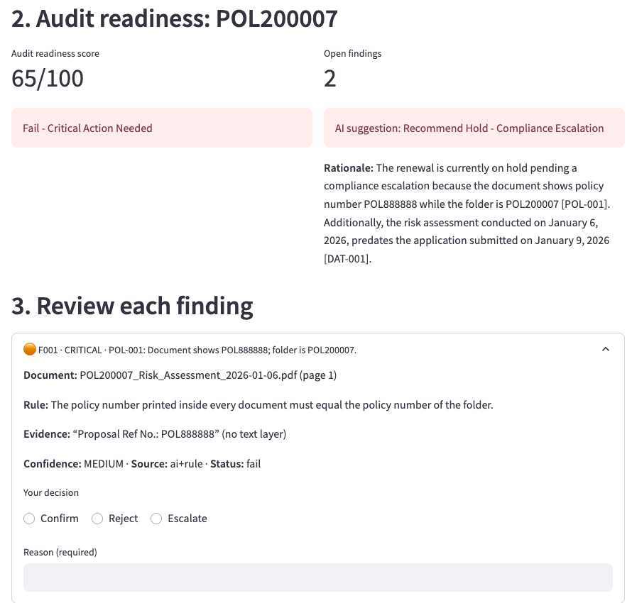
Live demo: a folder with valid names fails on its content
PROTOTYPE WALKTHROUGH
Fail, 65/100, Hold: a wrong policy number and date order, found inside scanned documents
Evidence: rule, quote and why confidence is only MEDIUM
Human decision: a reason is required, and sign-off stays locked until complete
Record: audit log and report
AI off: Not Scored, with no recommendation
Backup screenshot, in case the live demo or network fails. Synthetic folder POL200007.
6
Notes:
Demo: 1) POL200007 fails on content; 2) evidence and confidence; 3) human decisions; 4) sign-off and report; 5) remove the key: Not Scored. Use this screenshot if the live demo fails.

Slide 8
Testing changed the product, and the results are promising, not proof
METRICS AND EVIDENCE
12 unseen synthetic folders | PolicyGuard AI | File-name script
Defects found | 16 of 16 | 4 of 16
False alarms | 1 | 2
Critical missed (of 3) | 0 | 2
Renewals as expected | 12 of 12 | n/a
What testing exposed
First prototype scored 100/100 when the AI failed; it now gives Not Scored
14 of 14 hid a skipped critical rule; signature rules now always run
One finding changed between runs; repeatability is now a gate
Data is tidy and synthetic, so real accuracy is likely to be lower
The 95% confidence interval still allows recall near 79%.
Holdout set run once, after the code was frozen.
7
Notes:
My first prototype scored 100/100 when the AI failed. Later, 14 of 14 hid a skipped critical rule. Holdout found 16 of 16 with one false alarm, and one result changed between runs. That is promising, not proof.

Slide 9
People are the cost, and time savings pay it back
ECONOMICS AND LAUNCH RISKS
Scenario ($360k one-time) | Net / year | Payback
Downside: time −20% | $164k | 26 months
Time savings, −40% | $434k | 10 months
Time savings, −50% | $569k | 8 months
−40% + 1 avoided remediation | $584k | 7 months
−50% + 1 avoided remediation | $719k | 6 months
Launch blockers
Critical recall below 95% on real data
Any fabricated evidence in the 100-finding audit
No privacy approval for the chosen provider
Metrics to track in the pilot
Analyst time, rejection rate, usefulness, and gaps found that manual review missed
All people roles at $150/h onsite. Model cost is under 1% of the $178k annual run cost. Avoided remediation is upside with no evidence yet.
All figures are planning assumptions, to be replaced by Phase 0 measurements.
8
Notes:
Inference is under 1% of run cost. At $150 an hour, time savings alone pay back $360,000 in about 8 to 10 months; at only 20% time saved, about 26 months. Avoided remediation is upside. Top blockers: critical recall, fabricated evidence, privacy approval.

Slide 10
Pilot, not scale
FINAL RECOMMENDATION
Fund a 12-week controlled pilot: commercial property, 6–8 analysts, shadow mode first.
Enter the pilot if
Scale only if
Stop if
Critical recall ≥ 95%
Fabricated evidence: 0 of 100
Repeatability ≥ 95%
Privacy sign-off
Analyst time −40%
≥ 70% rate it useful
Rejection rate 10–40%
Funded rulebook owner
Critical misses can't be controlled
Rejection stays above 40%
Privacy approval is refused
TEAM011 · PolicyGuard AI
9
Notes:
12 weeks, commercial property, 6 to 8 analysts, shadow mode first. Offline gates to enter; time and trust gates to scale; privacy or a 40% rejection rate stops it.

