Slide 1
MBA ZG583 · MANAGEMENT OF AI PRODUCTS · CAPSTONE
UniConnect Operations OS
An AI-assisted academic operations platform running across a 40-campus higher-education network. Product review for a pilot decision.
Manoj Kumar Panchothi · 11 September 2026
Notes:
This is a product review, not a project report. The ask at the end is a pilot decision on five campuses. The platform already runs the operational day; what is being decided is the AI layer on top of it.

Slide 2
01
The same operational day, forty times over
Fees to reconcile, daily reports to write and review, attendance to record, problems to route — every working day, at every campus. Before the platform it lived in spreadsheets, email and WhatsApp. The platform fixed the structure. What remains is a reading problem.
40
2.5 hrs
1–2 days
campuses filing a free-text report every working day
between the 16:00 filing deadline and the 18:30 sign-off
typical lag before a serious issue is escalated
The failure is not a missing feature. It is that decision quality falls as the network grows, because the reading does not scale.
Notes:
Operational drag in an education network is paid in student experience — blocked class access, unresolved facility problems, exam-day failures. Adding headcount to read reports scales cost linearly with campuses, which is the economics we are trying to escape.

Slide 3
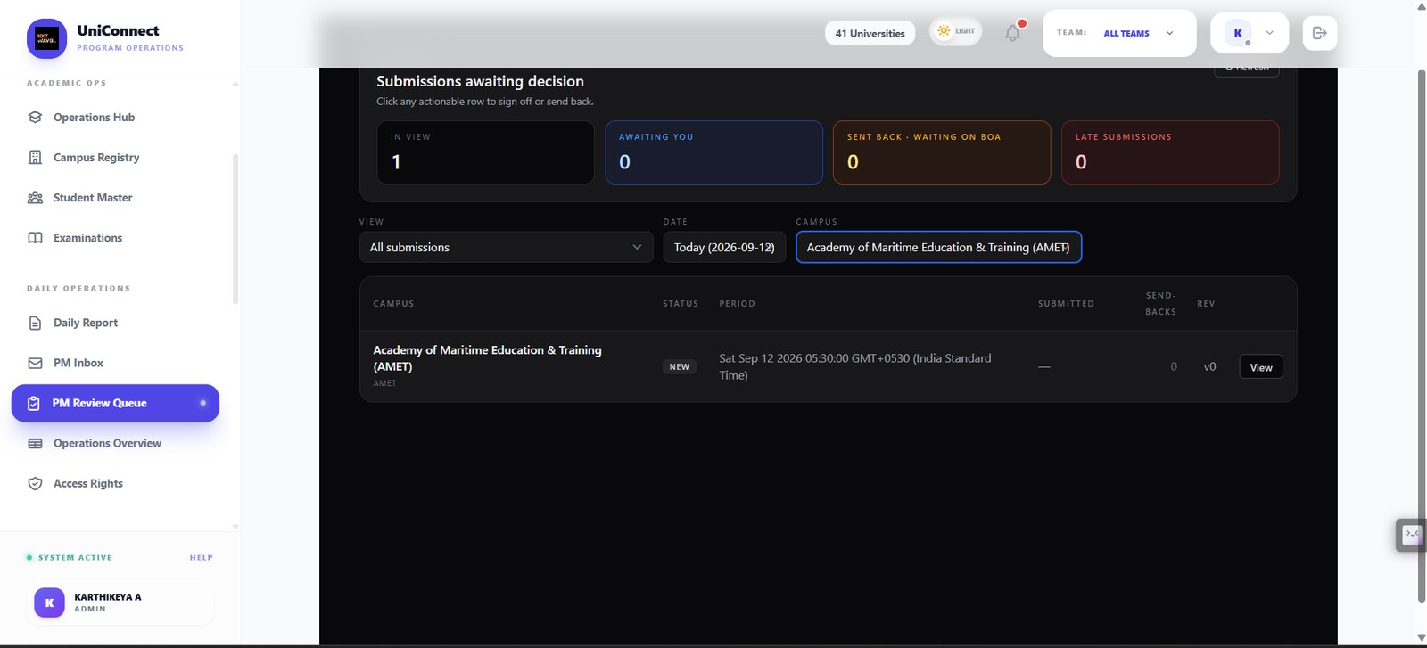
02
Who feels it, and when
Business Operations Associate
Programme Manager / COS
Academic Operations Lead
Files one campus report before 16:00
Wants it accepted first time
Re-sends when it is sent back
Reviews ten to twelve campuses nightly
Must find the three that need tonight
Signs off or escalates
Plans exam cycles per campus
Portions, papers, seating, invigilation
Rebuilt in spreadsheets today
The reviewer’s evening is the moment the product is designed around
submit → 16:00 deadline → AI-assisted triage → human review → sign off / send back / escalate → immutable audit
The review surface today: submissions awaiting a decision, in arrival order, with no ranking applied.
Notes:
Named roles, a real cut-off time, a real sign-off deadline. This is not a generic persona — it is the workflow the platform already enforces.

Slide 4
03
Why AI, and why not
Rules and dashboards already handle this
They cannot handle this
A fee number that drops
Attendance below target
A report not filed by 16:00
Any numeric threshold breach
"lab machines down again since Monday"
Buried in paragraph four of a routine report
Written by forty different people
A language problem, not a numbers problem
Why now
The network reached 40 campuses — the reading load crossed what a small central team can absorb.
The platform now supplies both things AI needs here: structured context to ground on, and an existing human approval step to catch it when wrong.
Inference is a per-call cost in fractions of a rupee, so the entry cost is near zero rather than a licence commitment.
Where AI is deliberately absent: fee arithmetic, permission enforcement, approval states and audit records stay deterministic — they must be exactly correct and defensible to an auditor.
Notes:
Two kinds of AI in this platform: language AI that reads and drafts, and optimisation AI that searches and places — exam seating is constraint satisfaction, not a language model. They fail in completely different ways and need different evaluation.

Slide 5
04
Platform, plus one narrow wedge
PLATFORM — live in production
One database, one permission model, one audit trail. Fees · daily operations spine · tasks · campaigns · assessments and exam papers · faculty · budgets · meetings · academic operations hub
INTELLIGENCE LAYER — a feature, not a second product
Reads the operational text nobody has time to read, states how confident it is, and routes each item to the right human with the evidence attached. Switch it off and the platform still runs.
MVP — five campuses, one cluster, one academic month, assist-only
In scope
Out of scope
Summary with cited source sentence
Severity and confidence ranking
Override with structured reason
Weekly labelled evaluation sample
Any automatic approval
Any student-facing message
Predictive scoring of a named person
Model write access to operational tables
Notes:
The MVP is intentionally narrow because the binding risk is trust and workflow fit, not model capability. A wider MVP gives a more impressive demo and a less trustworthy answer.

Slide 6
05
The decisions worth defending
Layer | Decision | Why
Model / inference | API — Google Gemini | Quality is adequate, cost is per-call, switching cost stays in our code
Workflow, permissions, audit | Build | The differentiation, and the part that must be exactly correct
Database, hosting, queues | Buy — Supabase, Railway, Redis | Row-level security at the database layer for a fraction of the cost
Identity, mail, calendar | Partner — Google Workspace | The institution already runs on it
Deferred: predictive student-risk scoring
Rejected: AI-scored staff performance
The training data reflects recording habits more than student behaviour, and a wrong prediction attaches to a named student.
It turns an operations tool into a surveillance instrument, which destroys the honest daily reporting the platform depends on.
Notes:
The two refusals matter more than the approvals. Cost of error was added as a scoring dimension alongside value and effort, and it is what moved these two out.

Slide 7
06
Phases end at proof gates, not at dates
Phase 2 does not start because Phase 1 finished. It starts because Phase 1 met a measured threshold.
Phase | Focus | Gate before proceeding
0 — done | Deterministic platform; narrative summaries and meeting intelligence live | Adopted as the daily system of record
1 — MVP pilot | Daily operations triage on five campuses for one month, assist-only, with the evaluation harness | Recall, groundedness, override band and reviewer trust all met
2 — expansion | All 40 campuses; cross-campus patterns; OCR intake; budget completeness checks | Cost per campus-month within ceiling; zero scoping breaches
3 — assisted exams | Paper equivalence assistance and portion inference, faculty approval mandatory | Zero AI-only paper approvals; academic governance sign-off
4 — productisation | Assess offering the platform to peer institutions | Two stable quarters and a defensible support model
Two AI ideas were cut from this plan rather than sequenced later: predictive student-risk scoring and AI-scored staff performance. Cost of error, not value, is what removed them.
Notes:
A roadmap with dates invites the question of whether dates slipped. A roadmap with gates invites the question of whether thresholds were met, which is the conversation we want.

Slide 8
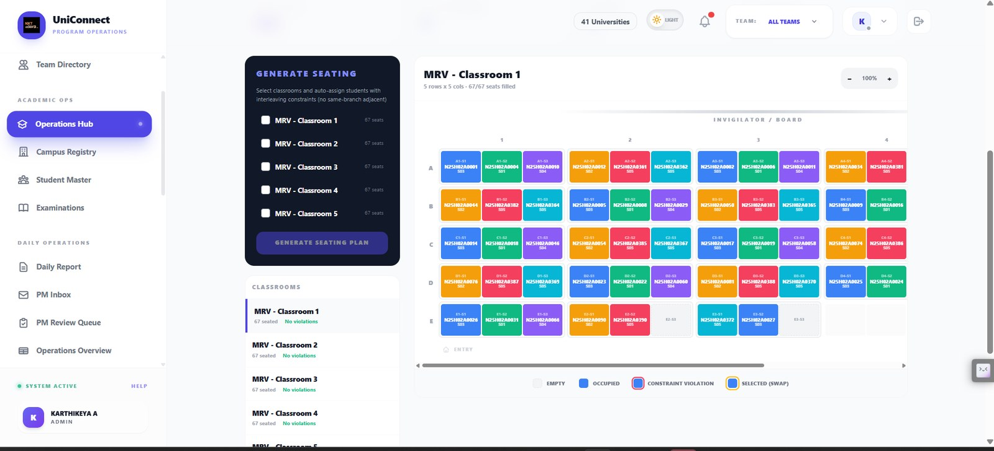
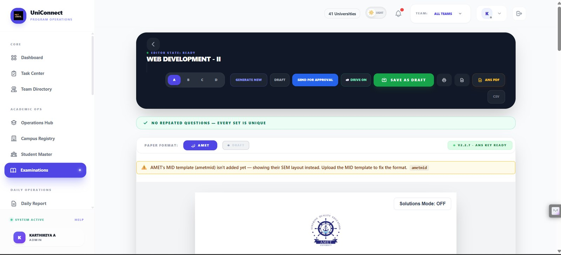
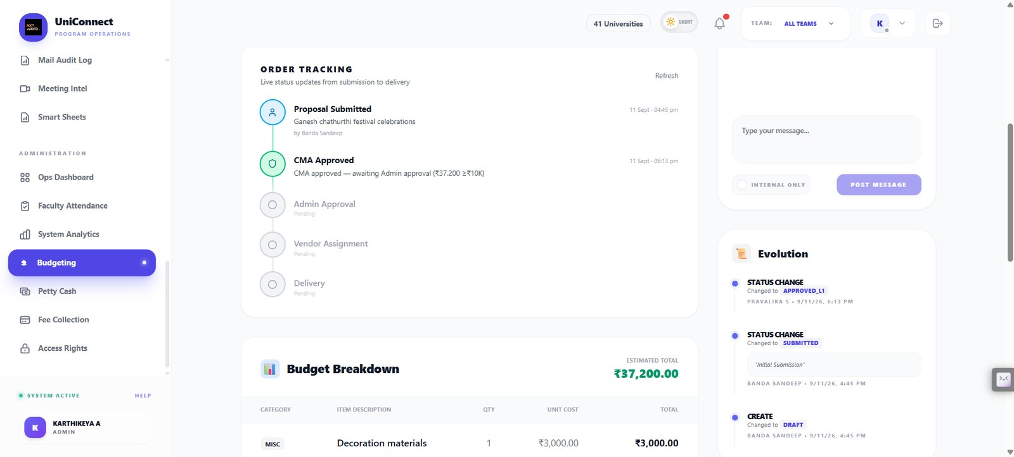
07
The prototype is the production system
Paper generation ends at Send for Approval — a person approves, and any question can be swapped.
Seating allocation: 67 of 67 seats filled, interleaving constraint satisfied, every classroom reporting no violations. An invalid plan is flagged, never silently emitted.
The budget path: no AI anywhere in it, threshold rule printed on the screen.
Notes:
Not a mock-up. Live at uniconnect-app.up.railway.app, public repository, 66 captioned screens in the appendix. The advantage is real workflow fit; the obligation is precision about what is live and what is designed.

Slide 9
08
How we would know it worked
Two baselines run alongside the pilot, so the comparison is measured rather than argued: today’s chronological queue, and a rules-only ordering that could be built in a week.
Gate | Threshold, fixed before the pilot
Serious-issue recall on the weekly labelled sample | ≥ 0.90 sustained over four weeks
Summary statements not supported by the source | ≤ 2% of sampled statements
Reviewer override rate | Between 10% and 25% — two-sided
Campus-scoping or permission violations | Exactly zero — absolute blocker
The override band is deliberately two-sided. Below 10% is not success — it is the first symptom of reviewers rubber-stamping, which is the failure this design fears most.
Notes:
Ground truth is built three ways: implicit labels from every reviewer decision, a stratified sample of thirty reports labelled independently each week, and correction labels from overrides. Rubric versioned alongside the prompt.

Slide 10
09
Economics: one campus, one month
Inference and infrastructure per campus, plus amortised maintenance, must stay materially below the loaded cost of the reviewer and associate hours removed — at every campus count between five and forty.
Why it should hold
What could break it
A daily report is a small amount of text
~22 working days bounds call volume
The hours displaced are managerial
Context size growing beyond seven days
Extending to high-volume, low-value items
Both controlled by pinned configuration
Rupee figures are computed from measured pilot volumes and current API pricing rather than presented as an estimate. A fabricated cost table would be the fastest way to lose the argument.
Scaling risks: latency at the 16:00 burst · linear cost growth · per-campus exception creep · governance overhead · single-builder dependency
Notes:
The platform is internal, so the test is an internal value case — stricter than an external product, because there is no revenue line to hide behind. Key-person dependency on one builder is the most serious operational risk in the submission.

Slide 11
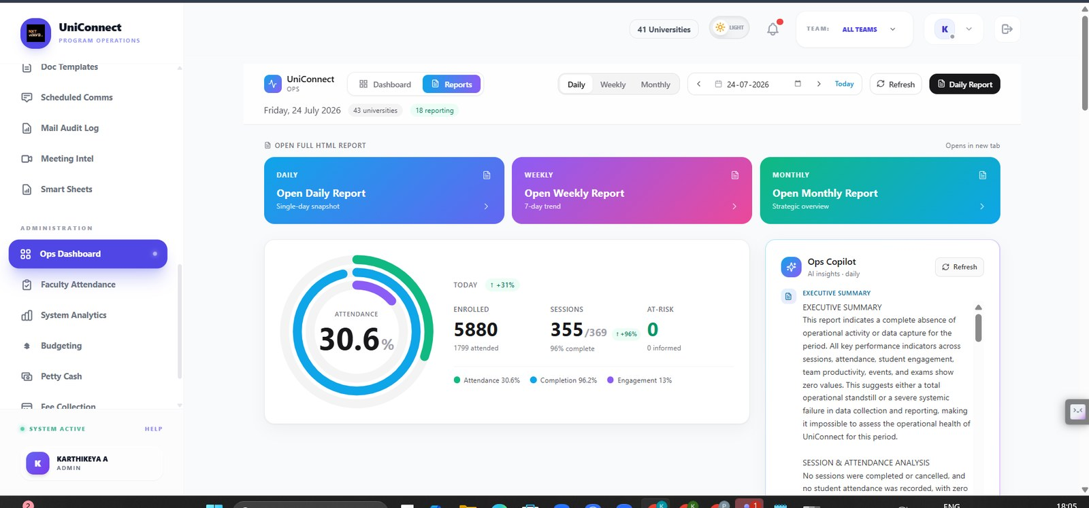
10
The risk that actually worries us
Automation complacency: reviewers stop reading the source reports, oversight becomes ceremonial, and the platform has made the institution less informed while appearing more informed.
Controls that follow from it
AI cannot advance a state or send a message
Every generated claim cites its source sentence
Rules can raise severity, never lower it
Auto-sign-off disabled on serious items
Override reasons read by a human weekly
Row-level security at the database, not the app
Identifiers stripped before the API call
Risk R1, demonstrated rather than asserted: on this day the generated summary reported a complete absence of activity, on a screen showing 355 of 369 sessions completed.
Notes:
Launch blockers are absolute: any cross-campus exposure, ungrounded statements above five per cent, recall below 0.90, no data-minimisation step, no one-flag rollback, or any proposal to use this for staff assessment.

Slide 12
RECOMMENDATION
Pilot. Five campuses, one academic month, assist-only.
Scale the deterministic platform across all 40 campuses in parallel. Do not extend AI into exam approval, student-facing communication or staff evaluation until the gates are met.
We expand when
We stop when
Recall holds at 0.90 for four weeks
Ungrounded statements stay under 2%
Override rate sits inside 10–25%
Reviewers say the queue changed their order
Any cross-campus data exposure, even once
Ungrounded statements above 5%
Override rate below 10% — rubber-stamping
Anyone proposes using it to rate staff
A team that can say precisely what would make them stop is a team worth funding.
Notes:
Close on the recommendation, not the demo. State the stopping conditions as confidently as the reasons to proceed.

