Slide 1

IdeaHub AI
AI-Assisted Transformation Discovery, Qualification and Prioritisation
From fragmented ideas and process signals to evidence-based, human-governed transformation decisions.
Qualify the problem before funding the technology.
TEAM0022 | MBA ZG583 – Management of AI Products
Ravi Theja Kumar Pothulluru • Prathamesh Sandeep Nigade
Notes:
[Sources],Visual on this slide was generated with Microsoft Copilot.,[/Sources]

Slide 2

Transformation teams do not lack ideas, they lack comparable decisions.
Transformation teams struggle to determine what deserves investment and which intervention is appropriate.
Fragmented intake
Ideas arrive through email, workshops, spreadsheets and informal discussion.
Incomplete evidence
Volume, effort, data readiness and business impact are often missing.
Reviewer dependency
Assessment quality varies with individual experience and preferred technologies.
Weak traceability
Decision rationale, assumptions and rejected alternatives are difficult to reconstruct.
Result: louder advocates and more sophisticated technology can outrank stronger business opportunities.
Notes:
[Sources],Visual on this slide was generated with Microsoft Copilot.,[/Sources]

Slide 3
IdeaHub AI is the decision layer between discovery and investment.
Buyer: Enterprise Transformation / Automation / AI CoE. Two entry paths. One consistent qualification framework. Final accountability stays human.
Business-led entry
A stakeholder submits a transformation, automation or AI idea using normal business language.
IdeaHub AI
Human-governed outcome
Interpret → Clarify → Assess → Recommend
Value • Feasibility • Risk • Evidence
Compare process redesign, rules, automation and AI.
Accept • Modify • Request information • Reject
Final outcomes: Explore, Prototype, Pilot or Candidate for Prioritisation.
Process-led entry
A Process Mining or process-analysis finding identifies a bottleneck, rework loop, delay or exception.
Primary user
Decision user
Supporting users
Transformation Analyst / Automation or AI CoE Analyst
Transformation Lead / CoE Lead
Process Owner • Process Mining Analyst • Architect • Risk and Governance

Slide 4
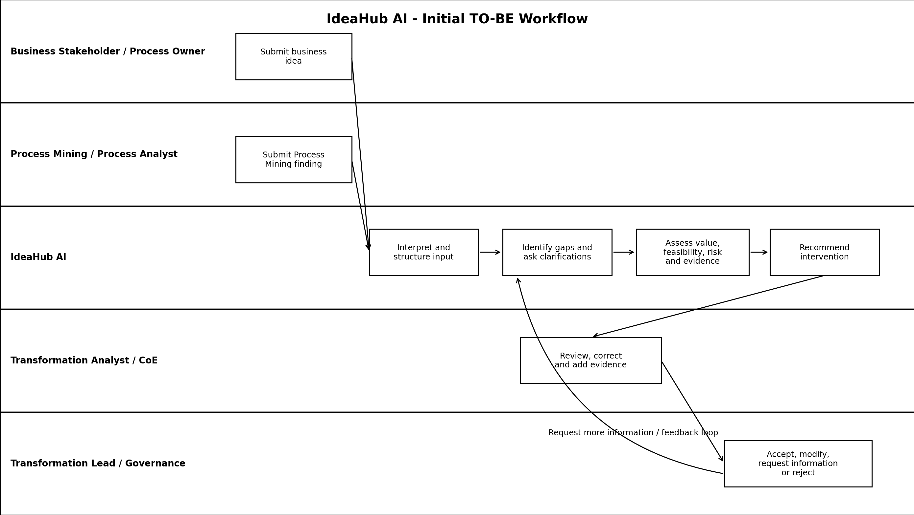
Initial TO-BE workflow
AI structures, clarifies, assesses and recommends. Humans validate, challenge and decide.
Process Mining identifies what is happening.
IdeaHub AI helps decide what should be done.

Slide 5
One workflow connects messy input to accountable action.
The flow exposes evidence and uncertainty before asking a human to approve the outcome.
1
2
3
4
5
6
1. Intake
2. Interpret
3. Clarify
4. Assess
5. Recommend
6. Review
Business idea or Process Mining finding
Structure problem, stakeholder and evidence
Identify gaps and ask contextual questions
Value, feasibility, risk and evidence strength
Compare intervention options and explain rationale
Accept, modify, request information or reject
Trust by design
Least-complex intervention
Human accountability
Facts, AI inferences and unknowns are separated.
The best outcome may be redesign, rules, automation or AI.
The authorised reviewer owns the final transformation decision.

Slide 6
AI, rules and human judgment each have a defined job
IdeaHub AI is a hybrid decision-support product, not an autonomous funding engine.
Artificial Intelligence
Deterministic Logic
Human Decision Rights
• Interpret opportunity narratives
• Extract business and process information
• Identify material gaps
• Generate contextual clarification
• Classify the opportunity
• Recommend an intervention
• Explain evidence, assumptions and risk
• Apply defined scoring criteria
• Enforce thresholds
• Trigger mandatory governance
• Control workflow states
• Require specialist review
• Preserve consistent approval conditions
• Confirm the business context
• Correct interpretation
• Add or challenge evidence
• Override the recommendation
• Accept, refine or reject
• Authorise funding and delivery progression
Core product principle: AI improves the decision, but does not own the decision.

Slide 7
The MVP is a complete qualification loop, not a collection of AI features.
The first release proves the core decision loop before portfolio expansion.
R1 – Must demonstrate
Explicitly out of scope
1. Accept a business idea or Process Mining finding
2. Interpret unstructured information
3. Identify information gaps
4. Generate clarifying questions
5. Assess value, feasibility, risk and evidence
6. Recommend the least-complex suitable intervention
7. Explain rationale, assumptions and gaps
8. Support human review and override
• Full Process Mining engine
• Autonomous funding approval
• Automatic implementation
• Detailed delivery estimation
• Enterprise resource optimisation
• Proprietary foundation model
Evidence required before expansion
• Reviewers find the assessment useful
• Gaps are identified before recommendations
• AI does not force-fit complex technology
• Rationale is understandable and challengeable
• Human override is effective and traceable

Slide 8
The demonstrator proves IdeaHub AI does not force-fit one technology.
The same product logic produces a different intervention for each synthetic scenario.
Vendor Invoice Approval
Employee Leave Approval
Workflow Automation +
Generative AI Assistance
Unstructured exceptions justify AI; structured approvals stay workflow-driven.
Business Rules +
Workflow Automation
Rejects AI agents because explicit rules are sufficient.
Customer Complaint Resolution
Process Mining Approval Loop
Bounded Agentic AI +
Human Financial Approval
Agents add value in multi-system work, but autonomy is constrained.
Process Redesign +
Validation Rules
Process Mining exposes the issue; root-cause intervention is non-AI.
Live walkthrough: scenario drop-down → six interactive stages → recorded human decision

Slide 9
Evaluation asks one question: does AI improve decisions over credible baselines?
Measure product outcomes, AI quality, human control and guardrails together.
Product Outcomes
AI Quality
Human Review
Guardrails
Qualification time
Extraction agreement
Override rate and reasons
No invented facts
Clarification cycles
Gap-detection agreement
Reviewer confidence
No AI force-fit
Assessment completeness
Recommendation reasonableness
Ability to challenge
No unexplained recommendation
Decision traceability
Explainability
Specialist escalation
No high-risk bypass
Initial evaluation uses representative synthetic scenarios and comparison with manual and rules-only baselines. Targets should be set after a baseline is established, not invented in advance.

Slide 10

Responsible AI is embedded in the product workflow
The largest risks are specific to transformation investment decisions.
Hallucinated facts
Show facts, AI inferences and unknowns separately.
Persuasive-description bias
Score defined business evidence, not writing quality.
Technology force-fit
Compare redesign, rules and automation before advanced AI.
Automation bias
Require visible evidence, override and reviewer responsibility.
Process Mining misread
Validate root cause and business impact before investment.
Notes:
[Sources],Visual on this slide was generated with Microsoft Copilot.,[/Sources]

Slide 11
Illustrative unit economics + a distinct decision-layer position
Sir-requested view: economics and competition on one slide.
ILLUSTRATIVE COST PER QUALIFIED OPPORTUNITY
COMPETITIVE / ALTERNATIVE POSITION
Manual
$250
Manual / spreadsheet
Flexible but effort-heavy and reviewer-dependent.
IdeaHub AI
$122.50
Rules-only assessment
Predictable but weak with ambiguous narratives.
Illustrative difference
Illustrative break-even
Generic GenAI
$127.50 per assessment
~393 opportunities at $50k fixed cost
Strong language capability; lacks governed product framework.
Process Mining
Synthetic assumptions: 4.0h analyst + 1.0h reviewer vs 1.5h + 0.75h; $50/hour; $10 AI/platform variable cost.
Shows process behaviour; does not decide intervention investment.
IdeaHub AI
Connects signal → qualification → intervention → human decision.
Differentiation: not the most sophisticated model, but better, more consistent and explainable transformation investment decisions.

Slide 12
Roadmap: validate the decision loop before expanding the platform
Three releases, each requiring a separate continue / revise / stop decision.
R1
R2
R3
Opportunity Qualification MVP
Discovery & Prioritisation
Enterprise Transformation Intelligence
Structure and assess one opportunity
Outcome
Validate interpretation, gaps, recommendation and human review
Process Mining-led discovery and multi-opportunity comparison
Outcome
Create an evidence-based candidate backlog
Integrations, configurable criteria, portfolio analytics and benefit tracking
Outcome
Support enterprise investment decisions
Progression gate
User value • recommendation quality • reviewer trust • operational feasibility • manageable risk

Slide 13
AI accelerated the build. Human judgment shaped the product.
Microsoft Copilot was used for ideation, artefact drafting, risk challenge and scenario generation.
Where AI helped
Where humans corrected AI
Resulting product principle
• Compared candidate topics
• Explored scope alternatives
• Drafted Product Management artefacts
• Generated UX and trust alternatives
• Challenged risk and edge cases
• Generated synthetic scenarios
• Accelerated documentation
• Narrowed broad enterprise scope
• Kept Process Mining as an input
• Removed unsupported benefit claims
• Rejected automatic AI-first recommendations
• Preserved human decision rights
• Limited R1 to one opportunity loop
AI generates options and structures evidence.
Humans decide scope, customer value, risk, governance and what not to build.
The build process reflects the same Human-in-the-Loop philosophy as the product.

Slide 14
Recommendation: PROTOTYPE
Validate the core qualification loop before committing to Pilot or Scale.
Evidence required for the next investment decision
Next decision gate
✓
Users can structure and clarify opportunities successfully.
Continue only if we can demonstrate:
✓
IdeaHub AI identifies material evidence gaps.
Value over baseline
+
Responsible data use
+
Trusted human review
✓
Recommendations are credible and avoid AI force-fit.
✓
Rationale is understandable and challengeable.
✓
Human override is effective and traceable.
✓
AI provides material value beyond a rules-only baseline.
IdeaHub AI improves transformation decisions. It does not make them autonomous.

