Slide 1
ReconPilot
AI-assisted reconciliation break investigation and resolution for Indian financial institutions
MBA ZG583 Management of AI Products · Capstone · Team1010 · November 2026
Raksha Kalegowda (2025MB26160) · Nicole Maria Gomes (2025MB26037) · Gurvinder Kaur (2025MB26010) · Achal Tiwari (2025MB26002) · Gokulkrishnan (2025MB26210) · Thirumanoor Venkata Phani Bhushan (2025MB26070)
Notes:
Recommendation up front: pilot preparation, not production.

Slide 2
Matching is solved; investigating breaks is not
Breaks = items that disagree across internal ledger, bank statement and payment-gateway settlement
Analysts compare three files field by field, recall rules and search past cases by memory
Recurring root causes are rarely fixed upstream
UPI, NEFT and IMPS volumes multiply the items each institution must reconcile
The decision we improve
"What caused this break, and what should I do about it?"
Evidence status
Problem framing is a team assumption. No customer interviews yet — discovery is phase 1.

Slide 3
Target users in Indian financial institutions
Reconciliation analyst
When a break appears in today's UPI/NEFT reconciliation, I want to see why and what fixed similar breaks, so I can resolve it correctly before cut-off.
Operations manager
When breaks pile up near month-end, I want to see high-risk and recurring breaks, so I can allocate analysts and push upstream fixes.
Risk / audit (secondary)
When I review a resolved break, I want the evidence and the approver, so I can confirm the control operated.

Slide 4
Competitors: strong incumbents, mid-market gap unvalidated
 | Duco | SmartStream | Fractal Recon Assist | ReconPilot
Vendor AI claim | AI matching, label prediction, agentic workspace | "Affinity" observational-learning ML | Positions on faster resolution, accuracy, prevention | None implemented: rules + hand-weighted similarity
Focus | Large FIs, no-code cloud | Large banks, enterprise | Large enterprises | UPI/NEFT/IMPS, mid-size Indian FIs
Our angle | — | — | Near-identical positioning to ours | India-first formats, explainability, simulator + radar
Build the investigation layer; partner for matching and connectors. Vendor descriptions are from public trade-press and vendor pages, not product trials.

Slide 5
Product: one decision loop, five screens, human in control
Ingest
ledger · bank · gateway
Reconcile
match + detect breaks
Investigate
DNA · cause · cases
Simulate
compare actions
Decide
named analyst + audit
Prevent
recurring radar
Break DNA: structured fingerprint (type, amount/date gaps, reference similarity, sources)
Probable root cause with evidence and rule IDs; similar historical cases with outcomes
Next best action with confidence; below 55 the suggestion becomes Investigate (analyst decides)
No automatic resolution or posting — every decision needs a named analyst

Slide 6
Architecture and the actual AI role
Capability | Technique today | Trained ML? | LLM? | Future
Matching & break detection | Deterministic rules (R01–R08, R28 currency guard) | No | No | Keep deterministic
Root cause | Hand-written rules (R09–R19, R28) | No | No | Learned classifier vs rule baseline
Break DNA & similar cases | Hand-weighted feature similarity + nearest-case retrieval | No | No | Learned weights
Next best action | Rule map; history override only under R24 | No | No | Calibrated ranking
Confidence | Additive evidence points, uncalibrated | No | No | Calibration on outcomes
Next.js 16 + TypeScript · engines run in browser and API routes · IndexedDB or Supabase · Vercel · 28 rules · no external AI API
"Learning" = recorded outcomes are retrieved later. Nothing is retrained.

Slide 7
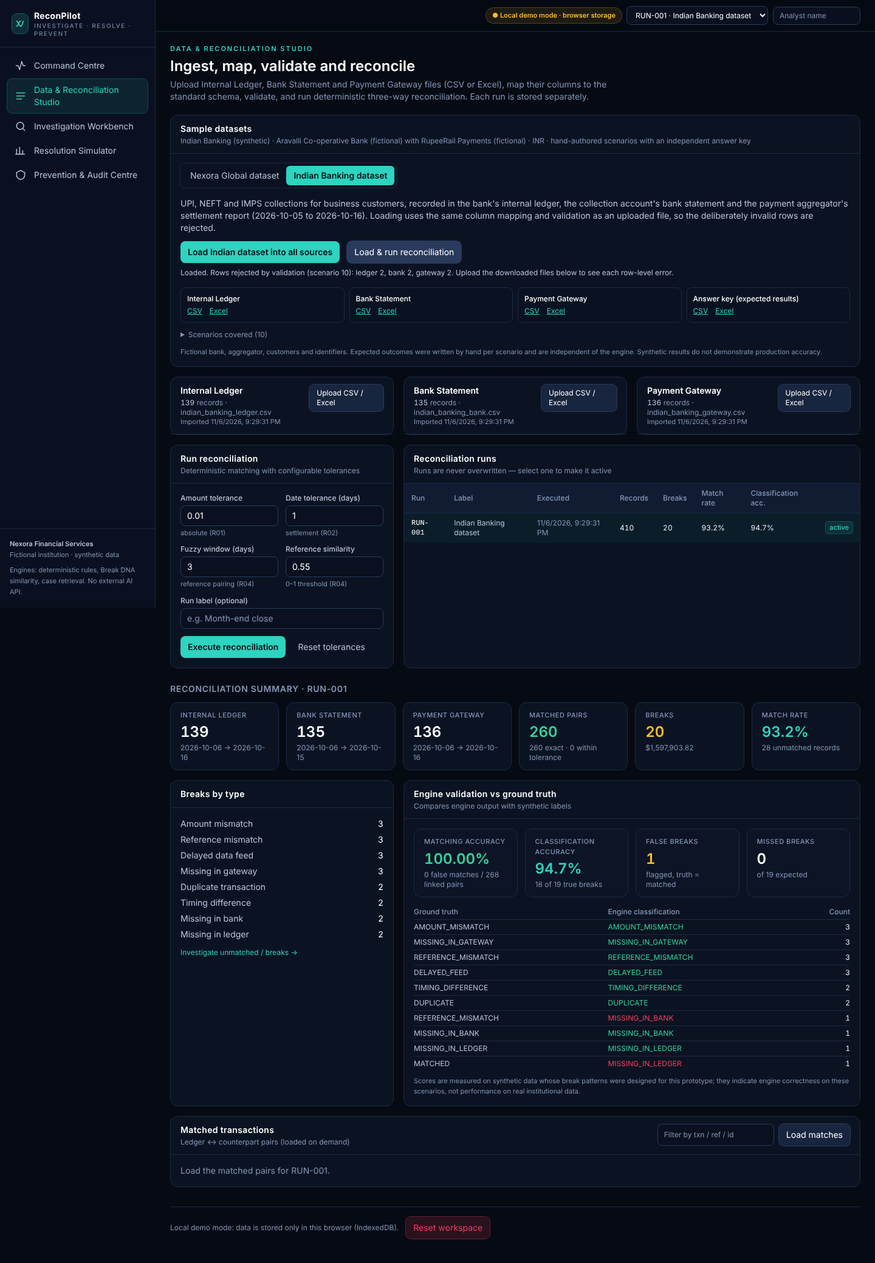
Walkthrough: Indian Banking demo in five minutes
Studio → Sample datasets → Indian Banking (fictional Aravalli Co-op Bank + RupeeRail aggregator, INR)
Load & run: 260 matched pairs, 20 breaks; 6 invalid rows rejected with row-level errors
Workbench: open the gateway fee-netting break (MDR + GST) and the transposed IMPS reference
Simulator → approve with analyst name → audit log and Recurring Break Radar
Nexora Global multi-currency dataset remains unchanged alongside

Slide 8
Evaluation: strong on designed cases, misses kept visible
Known failures (kept visible)
Paise rounding read as FX rounding (R10, conf. 90) · bank-substituted reference → false "missing in ledger" · 5 action misses (14/19): paise case, 2 R24 history overrides, 2 R23 low-confidence Investigate
Not real-world accuracy
Team-written scenarios (not blind). Nexora reported separately: 100% matching, 97.4–98.5% classification. 57 tests pass.

Slide 9
Business model: illustrative ROI, every input assumed
Scenario (assumed) | Breaks/mo | Min/break | ₹/hr | Time saved | Op. cost/mo | Net saving/mo | Break-even
A · Small co-op bank | 2,000 | 20 | 500 | 20% | ₹45,000 | ₹21,667 | 13.5%
B · NBFC / mid-size bank | 10,000 | 20 | 650 | 25% | ₹1,00,000 | ₹4,41,667 | 4.6%
C · Large payments ops | 40,000 | 15 | 800 | 30% | ₹2,40,000 | ₹21,60,000 | 3.0%
Monetisation (assumed): annual SaaS tiered by break volume + implementation fee
Main cost: rule upkeep and support; model/API cost today ₹0 (no external AI)
Freed hours are capacity, not cash. Not customer savings. Small co-op case is marginal → mid-size first

Slide 10
Risks, controls and launch blockers
Main risks
Wrong recommendation accepted → misstatement or delayed customer refund
Over-trust in uncalibrated confidence
INR rated riskier by currency-agnostic thresholds (R20)
History overrides from synthetic outcomes (R24)
Controls in place
Human approval for every decision (R25)
Low-confidence Investigate suggestion (R23)
Currency guard (R28) and row-level validation
Audit log of imports, runs, decisions — not tamper-proof
Launch blockers
No authentication in the cloud app — real financial data prohibited
No tamper-evident audit
Per-currency thresholds and domestic-rounding rule missing
xlsx 0.18.5 advisory; no security review

Slide 11
Roadmap with measurable proof gates
1
2
3
4
Discovery · 4–6 wks
≥6/10 confirm investigation is the main time sink; ≥2 shadow-pilot partners
Pilot readiness · 6–8 wks
Auth + roles, four-eyes, INR thresholds, tamper-evident audit; no high security findings
Shadow pilot · 8–12 wks
Root-cause acc. ≥80%; median time −20%; false resolutions not worse
Learned models · after pilot
Beat rule baseline by ≥5 pts on held-out data; calibrated confidence

Slide 12
Recommendation: PILOT preparation — not production
Proven: the investigation workflow, explainable logic, human-in-the-loop control and an independent evaluation method on two synthetic datasets
Not proven: time savings, real-world accuracy, buyer demand vs Duco / SmartStream / Fractal
Next investment buys evidence: discovery interviews and a shadow pilot on anonymised data, after closing the launch blockers
Repo: github.com/krish19098/Reconpilot · Live: reconpilot-omega.vercel.app

