Slide 1

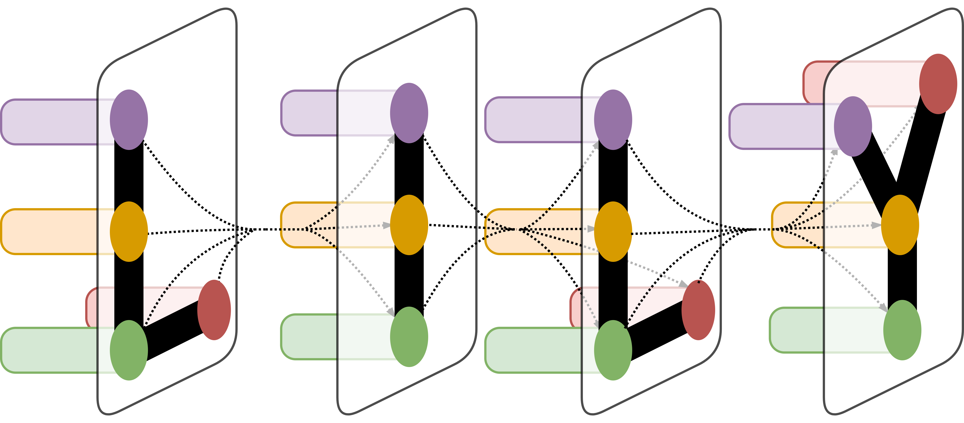

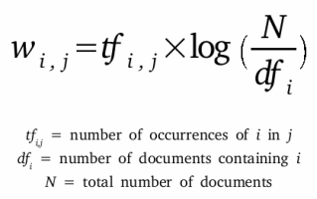
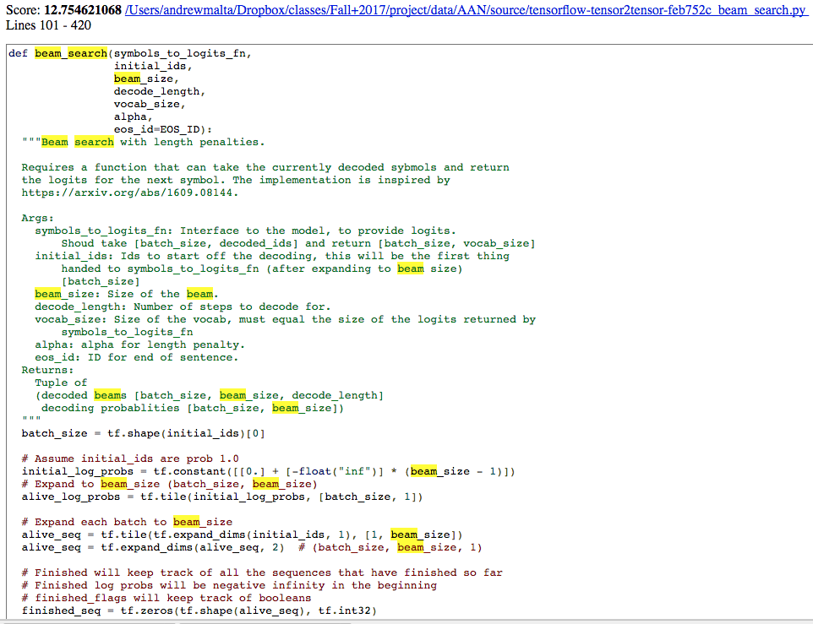
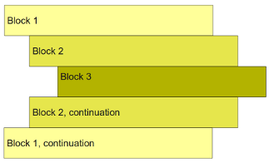
Using Jedi, a static analysis tool for python source code, I was able to extract useful structures from the code such as classes and function definitions.
In this phase of the project I extracted the names, starting line numbers, parent scopes, and docstrings of the named entities in the source files.
While I had the starting line numbers, I needed to determine where each code fragment ended to enable the search application on top of this data.
I worked around this problem by exploiting the fact that indentation in python source code is not only required, but it also is the way that the Python compiler identifies where a code block ends. Using this property, I was able to infer where the end line of classes and functions were by computing when the indentation in the source code returned to the indentation in the starting line.
Lastly, in order to perform efficient search that used term frequency in the calculation of relevance, I devised a way to calculate term frequencies in Python souce code, including breaking apart camel case naming patterns in the the various named entities.
Python Source Code Search
Andrew Malta¹
¹Computer Science, Yale College, New Haven, CT
LILY Lab
Abstract
Static Analysis
Search
There exists a vast amount of source code publicly available on Github; however, there do not exist many easy ways to search for relevant code to particular tasks on the granular level of functions and classes. My project is focused on the construction of productivity tools for programmers and computer scientists, leveraging source code that can be extracted from Github. The initial stages of the project involve identifying repositories within a particular area of computer science; for example, repositories that deal with natural language processing and related fields. Professor Radev has collected a set of resources on the following topics, which can be found at the All About NLP (AAN) database. Next using static analysis of the code and information retrieval, this project aims to make this python source code indexable and searchable. The end result of this project will be an end-to-end system that given a query returns a number of relevant code snippets that demonstrate how the specified topic can be implemented in code.
Using Jedi, a static analysis tool for python source code, I was able to extract useful structures from the code such as classes and function definitions.
In this phase of the project I extracted the names, starting line numbers, parent scopes, and docstrings of the named entities in the source files.
While I had the starting line numbers, I needed to determine where each code fragment ended to enable the search application on top of this data.
I worked around this problem by exploiting the fact that indentation in python source code is not only required, but it also is the way that the Python interpreter identifies where a code block ends. Using this property, I was able to infer where the end line of classes and functions were by computing when the indentation in the source code returned to the indentation in the starting line.
Lastly, in order to perform efficient search that used term frequency in the calculation of relevance, I devised a way to calculate term frequencies in Python source code, including breaking apart camel case naming patterns in the the various named entities.
I ranked the search results using a variant of the popular tf-idf (term frequency–inverse document frequency) statistic in the information retrieval community.
In particular to deal with the difference in length of the target documents, I normalize the term-frequency statistic inversely proportional to a weighted sum of the number of lines of code in the selection and the number of unique terms in the document.
For each term in the query, I calculate a normalized term-frequency and multiply it by the log of the inverse document frequency of the term. The final ranking of the query relevance to the document is then the sum of these products.
Lastly, due to the fact that the name of the function, class, or file usually holds increased relevance to the task that it is performing, the scoring function awards higher scores to code with matches in the name of the source object.
Results From Demo
The top result when searching for “beam search* filtering for functions and searching both docstring and code
Data Collection
Conclusion
I Collected all of the Github links listed in the resources of the LILY Lab’s “All About NLP” website.
Using these links I wrote code to programmatically download archives of the repositories that each link references from AAN.
With the archives of each of the repositories, I recursively extracted all of the source files from the unzipped repositories and stored them to avoid naming collisions.
Of the 465 repositories extracted from the scrape of AAN’s resources, I was able to create a dataset of 10,138 python source files. This was enough to get interesting search results, yet manageable enough to not have to use distributed computing to make the search fast.
Across these python source files I was able to find 84,317 functions and 15,127 classes, many with docstrings that improve the results of the search process.
I think that with a bit more work this kind of tool can be extremely useful for new and experienced
programmers alike. I can see two primary use cases for a tool like this:
A place to search for example code before heading to stack overflow to ask a question.
A tool to explore a new topic that you are interested to learn more about.
Figure 1. A depiction of whitespace code blocks in the Python programming language
Demo
References
To demonstrate the working application, I built an web interface in Flask which allows the user to search through the corpus of source code.
In this web application the user can enter a query, specify whether they are looking for matches in functions, classes, or entire files, and can choose to search through just the docstrings or all of the lines in each code fragment.
1. Collin McMillan, Mark Grechanik, Denys Poshyvanyk, Qing Xie, and Chen Fu. 2011. Portfolio: finding relevant functions and their usage. In Proceedings of the 33rd International Conference on Software Engineering (ICSE ‘11). ACM, New York, NY, USA, 111-120. DOI: https://doi.org/10.1145/1985793.1985809
2. Sushil Bajracharya, Trung Ngo, Erik Linstead, Yimeng Dou, Paul Rigor, Pierre Baldi, and Cristina Lopes. 2006. Sourcerer: a search engine for open source code supporting structure-based search. In Companion to the 21st ACM SIGPLAN symposium on Object-oriented programming systems, languages, and applications (OOPSLA ‘06). ACM, New York, NY, USA, 681-682. DOI: http://dx.doi.org/10.1145/1176617.1176671
3. McMillan, C., Grechanik, M., Poshyvanyk, D., Fu, C., & Xie, Q. (2012). Exemplar: A Source Code Search Engine for Finding Highly Relevant Applications. IEEE Transactions on Software Engineering, 38(5), 1069–1087. https://doi.org/10.1109/tse.2011.84
4. Ramos, Juan. "Using tf-idf to determine word relevance in document queries." Proceedings of the first instructional conference on machine learning. Vol. 242. 2003.

