Slide 1

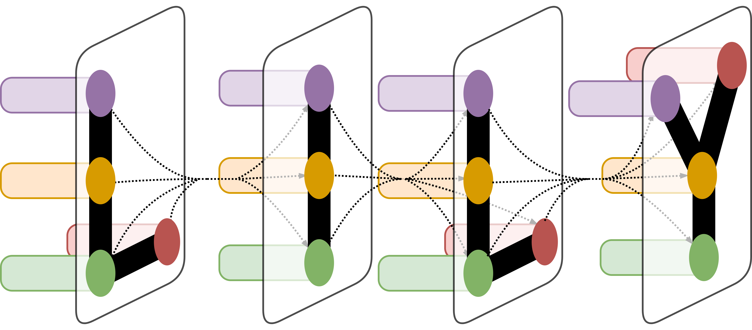
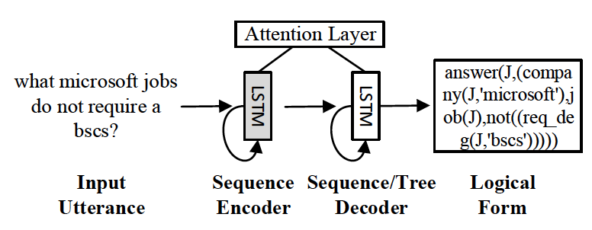
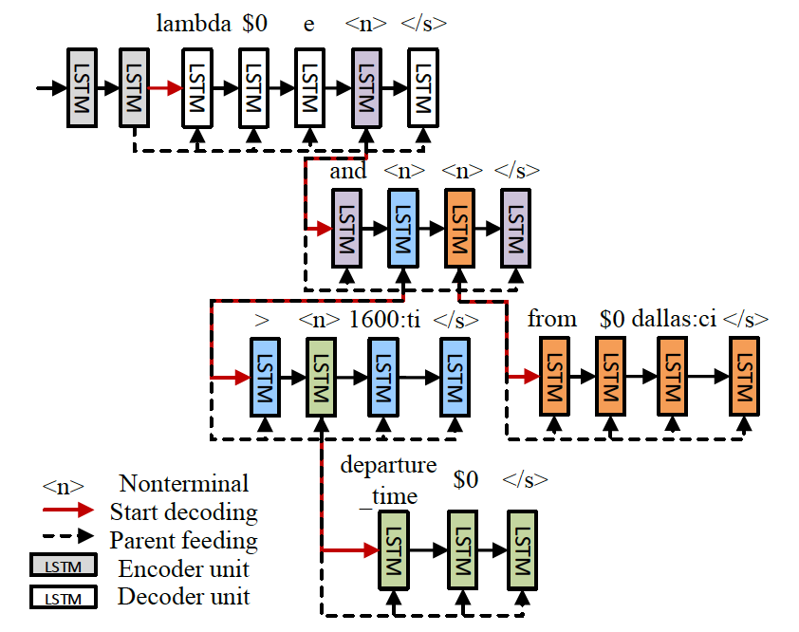
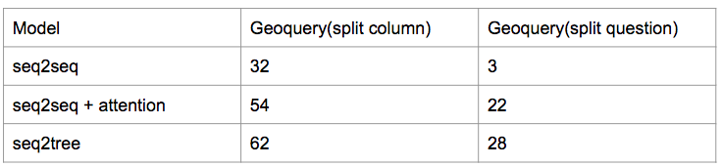
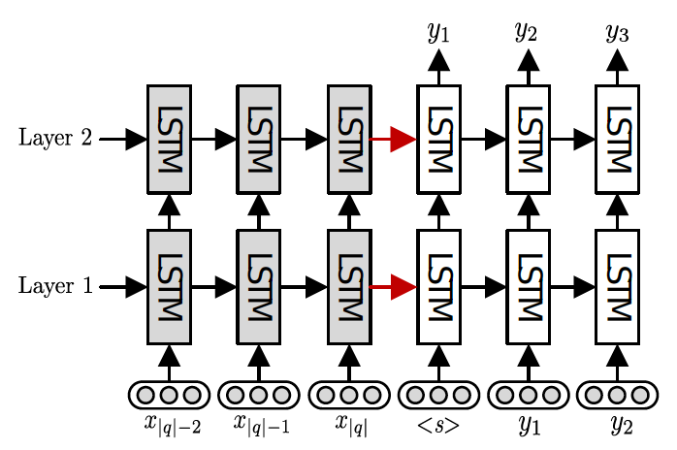
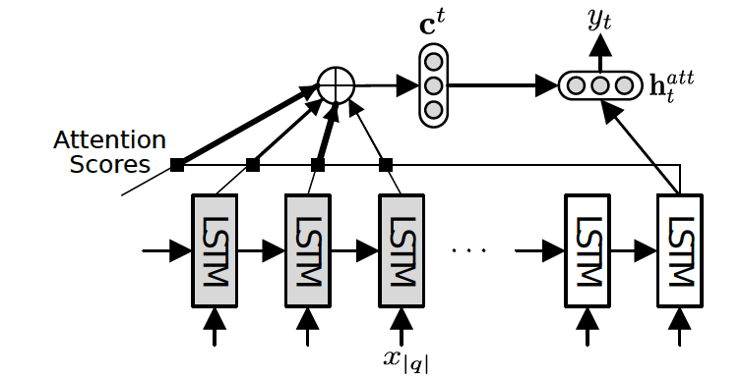
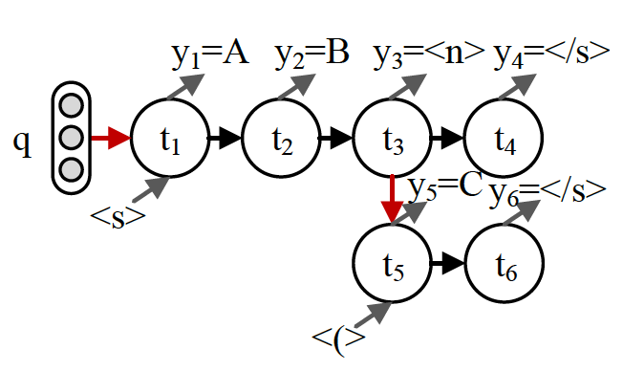
Natural Language to SQL(nl2sql)
Zilin Zhang
Department of Computer Science, Yale University
LILY Lab
Introduction
The project of Natural Language to SQL(nl2sql) focuses on extracting SQL query from natural language problem with database schema. In this project, I helped annotated databases with questions and SQL labels. I also wrote SQL parser which generates training and dev data for the project. The problem of nl2sql can be issued as semantic parsing problem. Semantic parsing aims at mapping natural language to machine interpretable meaning representations. Traditional approaches rely on high-quality lexicons, manually-built templates, and linguistic features which are either domainor representation-specific. In this project, we borrow the idea of seq2seq and seq2tree and present a general method based on an attention-enhanced encoder-decoder model. We encode input utterances into vector representations, and generate their sql by conditioning the output sequences or trees on the encoding vectors.
Results
Figure 1. Input utterances and their logical forms are encoded and decoded with neural networks. An attention layer is used to learn soft alignments.
Table 1. Results of models in Geoquery dataset
The above table shows that seq2tree model is superior to seq2seq model. This is expeced since seq2tree explicitly models compositional structure. In Geoquery(split column), seq2tree outperforms seq2seq by 30% and seq2seq+attention by 8%. In Geoquery(split question), seq2tree outperforms seq2seq by 25% and seq2seq+attention by 6%. We find that adding attention can substantially imrpoves performance.
Materials and Methods
Figure 3. Sequence-to-tree (SEQ2TREE) model with a hierarchical tree decoder.
We aim to learn a model which maps natural language input to a SQL query representation. Our model consists of an encoder which encodes natural language into a vector representation and a decoder which generates SQL query based on the encoding vector. In this project, we come up with two models, sequence-to-sequence (seq2seq) model and sequence-to-tree (seq2tree) model respectively. The encoder and decoder of seq2seq are two different L-layer recurrent neural networks with long short-term memory(LSTM) until which recursively process tokens one by one. However, the seq2seq model ignores the hierarchical structure of SQL query. In order to solve this question, we come up with seq2tree model, which consists of a hierarchical tree decoder. We also adopt attention mechanism to better predict the current token.
Conclusion
Figure 2. Sequence-to-sequence (SEQ2SEQ) model with two-layer recurrent neural networks.
In this project we presented an encoder-decoder neural netowork model for mapping natural language to SQL query. We first encode the input natural language utterances into vectors and then use decoder to generate their corresponding SQL query. Considering the drawback of basic sequence decoder, we introduce a new kind decoder which takes hiearacture into consideration. And we also use an attention mechanism to improve performance. The result shows that the approach performs competitively wihout domain or representation specific features.
Acknowledgement
Figure 4. A SEQ2TREE decoding example for the logical form “A B (C)”.
Figure 5. Attention scores are computed by the current hidden vector and all the hidden vectors of encoder. Then, the encoder-side context vector ct is obtained in the form of a weighted sum, which is further used to predict yt.
I sincerely appreciate the instruction from professor Drago and the help from Tao Yu and Rui Zhang.

