Slide 1

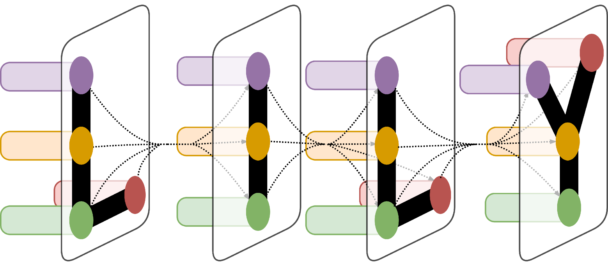
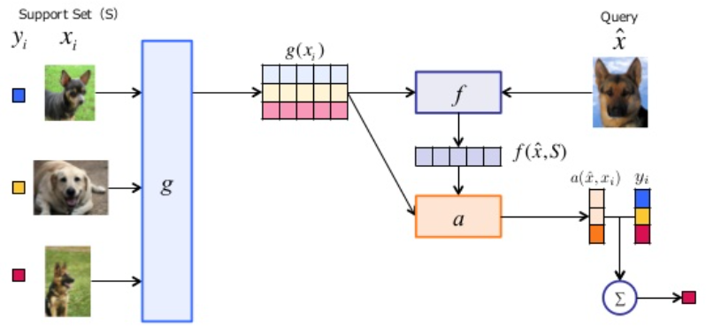
Exploring Matching Networks for Cross Language Information Retrieval
Gaurav Pathak, Javid Dadashkarimi, Dragomir Radev
Yale University, New Haven, CT
LILY Lab
Introduction
The Material Project at LILY (Language, Information and Learning at Yale) Lab has task called Cross Language Information Retrieval (CLIR) where documents and queries are in different languages. Of particular interest to the task is making a CLIR system that is able to adapt well to a language that has few training corpora. Deep learning and neural networks are notorious for their large requirement for a large amount of training data. Therefore, different architectures/methods need to be sought out for making a system capable of working with such languages.
With this goal in mind, Matching networks seemed to be a good fit for this problem. This is due to two reasons, first, CLIR is a task where one matches queries to documents, similar to the matching paradigm being explored in this setting. Second, Matching Networks as discussed here are designed to a) learn using low number of examples and b) work for unseen classes without changes to the trained network. Thus, it could be a promising method to use for CLIR
Testing/Results
Problem N-way K-shot | EP1 train_acc | EP10 train_acc | EP50 train_acc | EP100_train_acc | EP150 train_acc
20,1 | 0.3125 | 0.5 | 0.6525 | 0.8145 | 0.9375
5,1 | 0.4375 | 0.65625 | 0.71875 | 0.875 | 0.96875
Validation Acc | 0.1985 | 0.3175 | 0.4934 | 0.6423 | 0.90625
Training the network to learn from few examples appears to have a reasonable performance, especially in the Omniglot database.
There are two main ways to constructthe embedding functions. The first, simple way is to simply run each example in the support set through a CNN and use these results to compute pairwise cosine similarities. The second method is to use the entire support set as well as the particular example in the support set to construct the embedding. This should is able to capture contextual meaning
Running the code with the first embedding structure described above gives around a 90% training accuracy and 80% validation accuracy after training for 150 epochs in a 20 way 1 shot challenge. For a simpler task, i.e. a 5 way 1 shot challenge, the network performed better, with a validation accuracy of around 90%
Table 1. Table of results
Materials and Methods
The problem was framed as follows:
Given a Support set S with images/inputs x and labels y, predict the label/probability distribution for a new input x1. It is to be noted that the inputs x and labels that comprise the support set in testing have not been seen by the network in training.
In order to do the matching, a criteria is required to compare the input with the support set. In order to do this contextual embeddings are used. There are two embedding functions, ones for the support set and one for the query. The cosine distance between the outputs of these two embedding functions are used to calculate the probability distribution over all possible classes
While exploring this method, the Omniglot dataset was used. This is one of the datasets used by Vinyals et al in their paper “Matching Networks for One Shot Learning” to benchmark performance of the method
Figure 1. A graph that shows something.
Conclusion/Next Steps
This shows good promise in the task of learning from a few examples. It needs to be seen how well it generalizes to other domains, tasks with more classes/training examples etc.
In order to use it for the CLIR task, firstly the embedding functions need to be changes to an architecture more suited to CLIR. To explore this the next step would be to change the dataset being used from Omniglot to a more language specific task such as the Penn Treebank as don by Vinyals et al.
Acknowledgement
Figure 1. Graphical Representation of the architecture
Oriol Vinayls, Charles Blundell, Timothy Lillicrap, Koray Kavukcuoglu, Daan Wierstra, Matching Networks for One Shot Learning
https://github.com/AntreasAntoniou/

