Slide 1

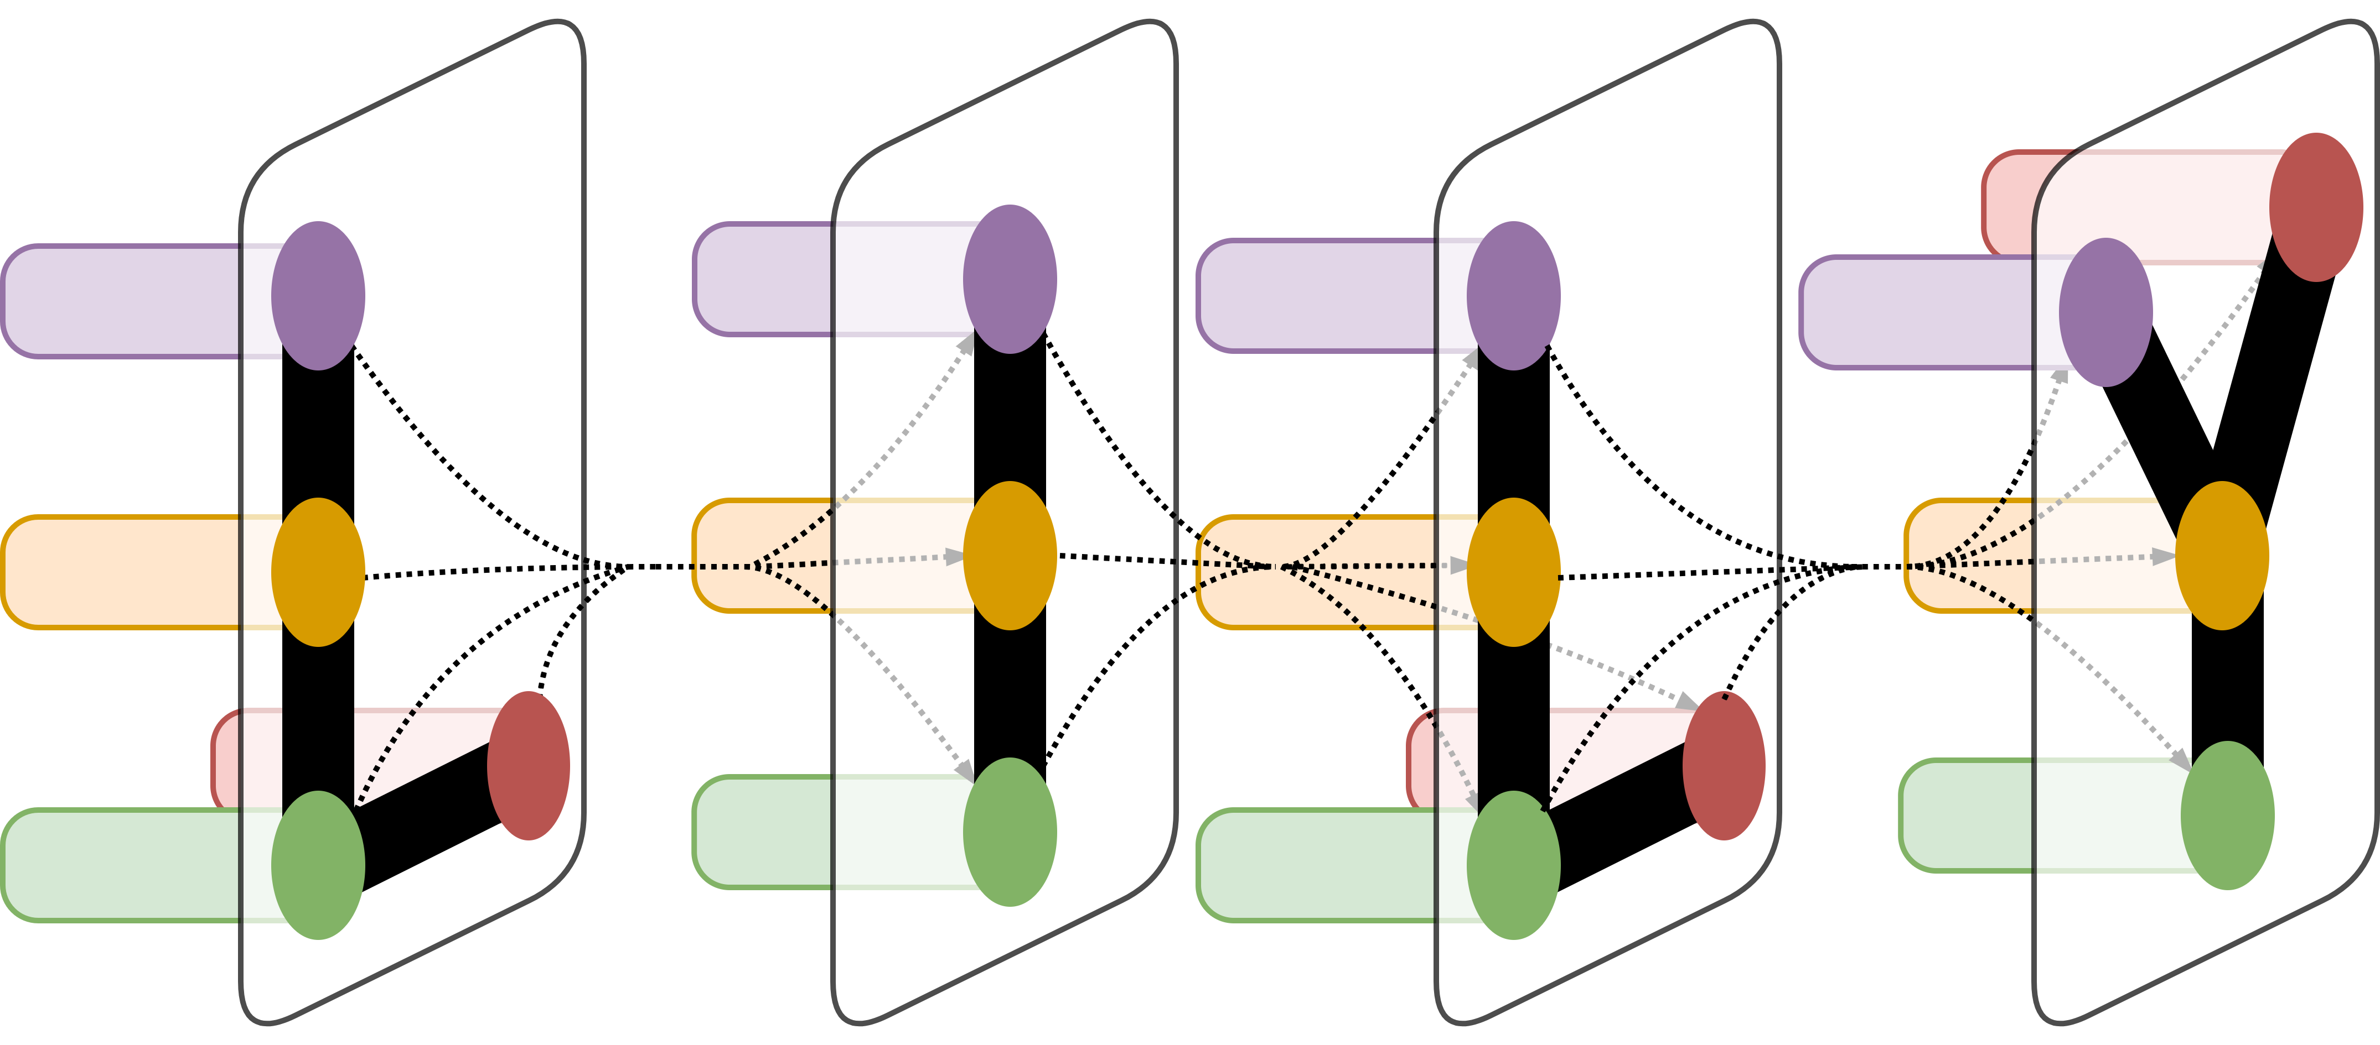
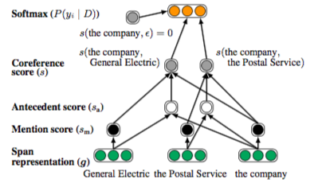
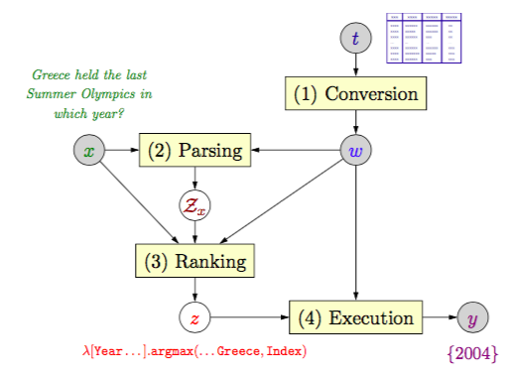
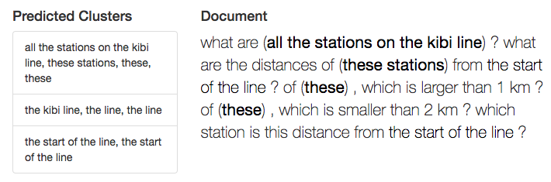
Sequential Question Answering Using Neural Coreference Resolution
Summer Wu,¹ Dragomir Radev PhD¹
¹Department of Computer Science, Yale University, New Haven, CT
LILY Lab
Introduction
Position | Original | Modified (w/coref)
0 | what are all the stations on the kibi line? | what are all the stations on the kibi line?
1 | what are the distances of these stations from the start of the line? | what are the distances of all the stations on the kibi line from the start of the kibi line?
2 | of these, which is larger than 1 km? | of all the stations on the kibi line , which is larger than 1 km?
3 | of these, which is smaller than 2 km? | of all the stations on the kibi line , which is smaller than 2 km?
4 | which station is this distance from the start of the line? | which station is this distance from the start of the kibi line?
Results
The most effective question answering systems currently use semantic parsers to map natural language queries to intermediate logical forms to answers. While this may work well for standalone questions, it fails to handle more complex sets of sequential questions that include references to previously asked questions. Here we present a method for applying neural network-based coreference resolution techniques to the task of improving sequential question answering. This work first reproduces and then builds off of recent work in end-to-end neural coreference resolution, semantic parsing on semi-structured tables, and the first sequential question answering (SQA) dataset. SQA is an expansion of WikiTableQuestions, a series of natural language question-answer pairs written about a set of semi-structured data tables from Wikipedia.
Name | Japanese | Distance (km) | Connections | Location
Bizen-Mikado | Bei Qian San Men | 1.9 |  | Kita-ku, Okayama
Daianji | Da An Si | 3.3 |  | Kita-ku, Okayama
… | … | … | … | …
Hattori | Fu Bu | 16.2 |  | Soja
Higashi-Soja | Dong Zong She | 18.8 |  | Soja
Soja | Zong She | 20.4 | Hakubi Line Ibara Railway Ibara Line | Soja
I ran experiments across three different combinations of of splits and attributes, the results of which are summarized in Table 3.
In each case, the model accuracy on the modified training set was slightly higher than the model accuracy on the original training set, but the model accuracy on the modified test set was slightly lower than that on the original. As improving the accuracy on the test set is the primary goal, this could be a sign of overfitting to the training set. Then again, since the differences are so small, more experiments need to be run to confirm that this is a trend and did not occur by chance. Additionally, a broader set of attributes should be tested to determine whether they caused the poor performance.
Table 1. Sample excerpt from one of the WikiTableQuestions data tables; our task is to answer questions based on this table.
Table 2. Before and after using the predicted clusters to replace coreferences and preprocess input data.
Materials and Methods
Conclusion
Word embeddings were trained using an end-to-end neural network on the OntoNotes CoNLL 2012 Shared Task dataset, consisting of coreference data from genres including newswire, telephone conversations, and web data. The embeddings were then used to configure a coreference resolution model that predicts clusters of mentions.
Sequential questions from the SQA dataset were combined into a single block of text before being input into the coreference model, returning a set of predicted clusters. The first (with the required caveat of being the most specific) reference was then used to replace all the later references.
The modified SQA dataset was converted to LispTree in preparation for applying Stanford’s Semantic Parsing with Execution (SEMPRE) toolkit for training semantic parsers.
Using SEMPRE, floating parser experiments were conducted on various splits of the data using different parameters such as dataset and beam size.
The results do not look very promising. However, that doesn’t mean coreference is ineffectual on answering sequential questions, especially since coreference resolution aligns with our semantic constructions of questions and FP. Instead, the results suggest that either more parameters need to be tweaked, or perhaps this dataset isn’t the best fit for the problem.
Personally, I found this experience to be a wonderful introduction to NLP research as well as a fantastic learning opportunity. Digging through cutting edge research papers, reproducing their work, and eventually adding my own touch, was challenging, but ultimately rewarding. This problem of improving SQA fascinates me, and I hope to continue working on it a little longer.
Figure 1. In the first step of the coreference model (not pictured), mention scores are assigned and entities with low scores are pruned. In the second step of the model (above), the coreference score is the sum of the antecedent and mention scores.
Figure 3. How does floating parser work? First, the dataset is converted into a knowledge graph, w. x is placed into the knowledge base and parsed into logical forms Z- the highest form z is executed and returns the answer y.
Experiment | Train | Test
Dev Set (n = 100) | 0.659 | 0.165
Dev Set M (n = 100) | 0.668 | 0.146
Dev Set (beam size = 50) | 0.610 | 0.325
Dev Set M (beam size = 50) | 0.614 | 0.317
Dev Set | 0.614 | 0.320
Dev Set M | 0.622 | 0.316
Test Set | 0.598 | 0.328
Test Set M | 0.601 | 0.327
Acknowledgement
Thank you to Professor Dragomir Radev for advising, Rui Zhang for coreference related pointers, and Dr. Mohit Iyyer for sending me scripts that allowed me to replicate his experiments. Additionally, thank you to Kenton Lee and the researchers he worked with, as well as Panupong Pasupat, and the researchers he worked with, for making their respective experiments extensible and open source.
Figure 2. Visualization of the predicted coreference clusters output by the neural network, with their corresponding locations in the document bolded.
Table 3. A selection of experiments, M means run on a dataset that was ”modified” with coreference preprocessing.

