Slide 1
Independent Project Natural Language to SQL
Zilin Zhang

Slide 2
Introduction
The problem of nl2sql can be formatted as semantic parsing problem. Traditional approaches rely on high-quality lexicons, manually-built templates, and linguistic features which are either domain or representation-specific. In this project, we borrow the idea of seq2seq and seq2tree and present a general method based on an attention-enhanced encoder-decoder model.

Slide 3
Summary of my work
Implement SQL parser for the project to preprocess train/test/dev data
Annotate databases, which have questions and sql labels
Apply seq2seq & seq2tree models to nl2sql

Slide 4
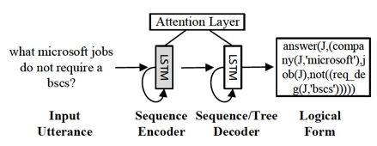
Basic encoder-decoder model

Slide 5
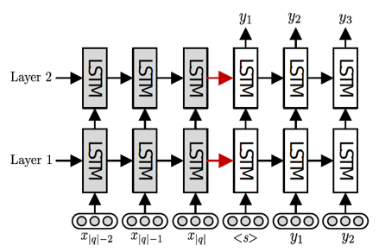
seq2seq

Slide 6
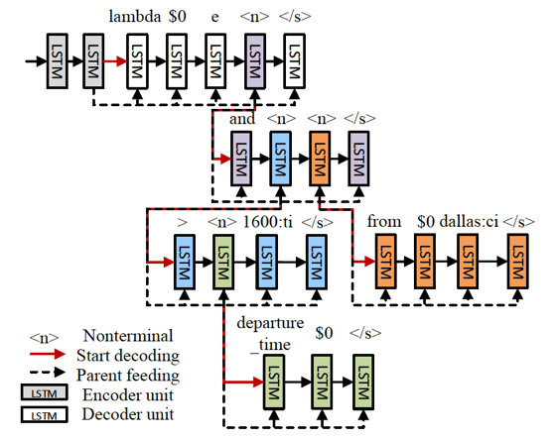
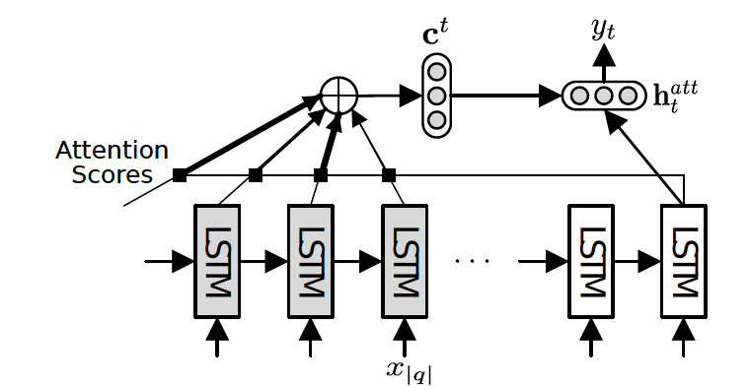
seq2tree
Aim to solve the problem of seq2seq(ignore the hierachical structure of sql).
Generate sequence level by level.

Slide 7
Results
Model | Geoquery | ATIS
seq2seq | 84.6 | 84.2
seq2seq - attention | 72.9 | 75.7
seq2tree | 87.1 | 84.6
seq2tree - attention | 76.8 | 77.5

Slide 8
