Slide 1
Matching Networks for Cross language Information Retrieval
Gaurav Pathak
Mentor: Javid Dadashkarimi
Advisor: Dragomir Radev

Slide 2
Learning from a few examples
Unlike humans, neural networks need a large number of examples to learn new concepts/classes etc.
This makes it infeasible for tasks with few training examples
CLIR for low frequency languages is one such task
I explore the paper “Matching Networks for One Shot Learning” by Vinyals et al from Google DeepMind

Slide 3
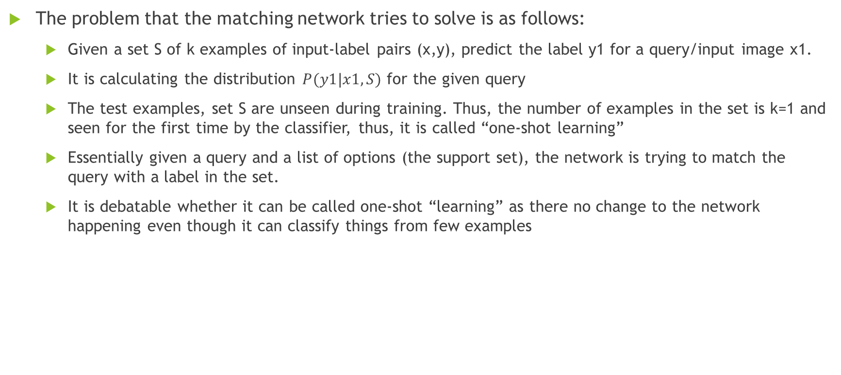
Problem Description
The problem that the matching network tries to solve is as follows:
Given a set S of k examples of input-label pairs (x,y), predict the label y1 for a query/input image x1.
It is calculating the distribution $P(y1|x1, S)$ for the given query
The test examples, set S are unseen during training. Thus, the number of examples in the set is k=1 and seen for the first time by the classifier, thus, it is called “one-shot learning”
Essentially given a query and a list of options (the support set), the network is trying to match the query with a label in the set.
It is debatable whether it can be called one-shot “learning” as there no change to the network happening even though it can classify things from few examples

Slide 4
Methodology
The zero shot matching is done in a process very similar to a kNN classifier
In order to do the matching, a criteria is required to compare the input with the support set. In order to do this, contextual embeddings are used. There are two embedding functions, ones for the support set and one for the query. The cosine distance between the outputs of these two embedding functions are used to calculate the probability distribution over all possible classes

Slide 5
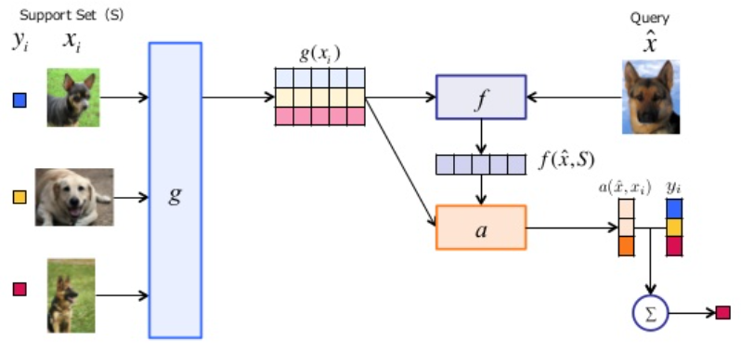
Architecture

Slide 6
Results
Problem N-way K-shot | EP1 train_acc | EP10 train_acc | EP50 train_acc | EP100_train_acc | EP150 train_acc
20,1 | 0.3125 | 0.5 | 0.6525 | 0.8145 | 0.9375
5,1 | 0.4375 | 0.65625 | 0.71875 | 0.875 | 0.96875
Validation Acc | 0.1985 | 0.3175 | 0.4934 | 0.6423 | 0.90625

Slide 7
Further Areas of Exploration
Extension into natural language problems (done on Penn Treebank by Vinyals et al)
Ability to adapt to different domains (ImageNet vs Omniglot)
Different Embedding functions
Full Contextual embeddings

Slide 8
Thanks

