Slide 1
Tree-to-Tree Neural Semantic Parsing
Jack Koch

Slide 2
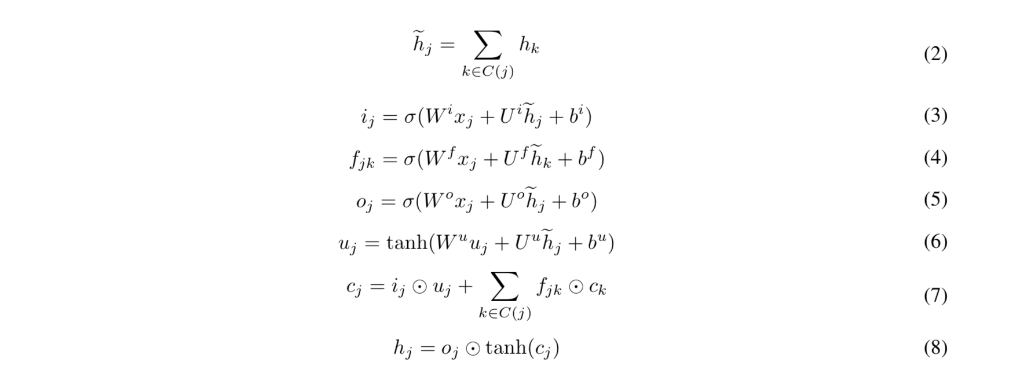
Tree Encoder (Child-Sum Tree LSTM)

Slide 3
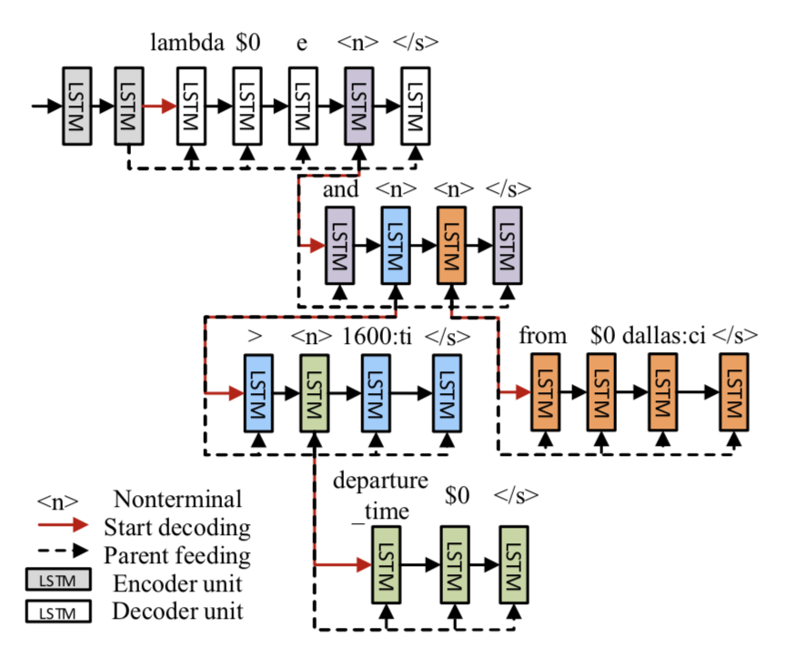
Tree Decoder

Slide 4
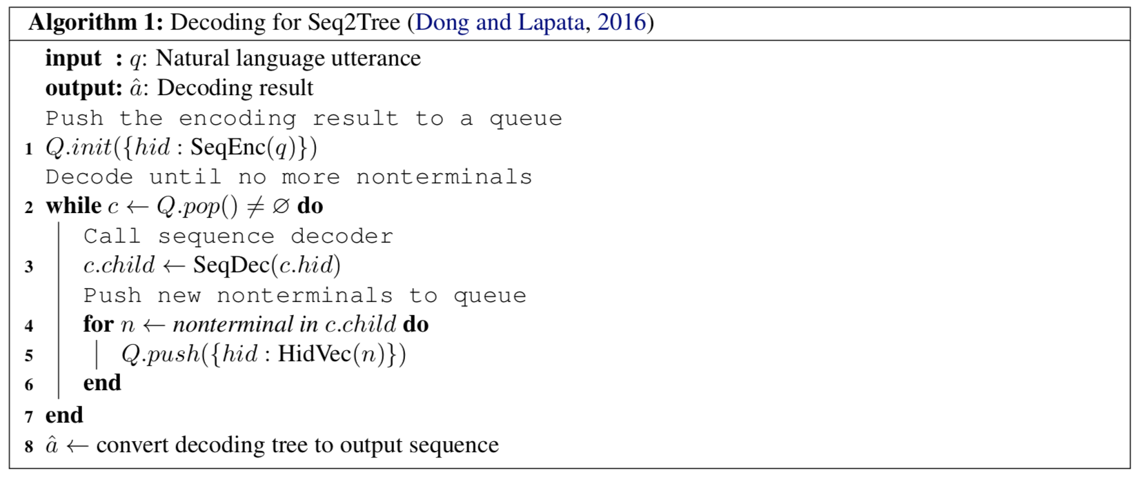
Tree Decoder

Slide 5
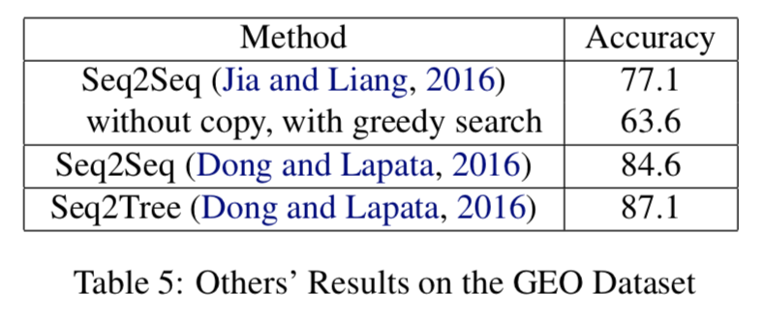
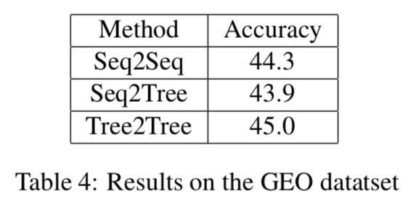
Results

Slide 6
Analysis
Accuracy metric
GRU vs LSTM
Beam search
Bidirectional encoder
Batch sizing

Slide 7
Continued Work
Paper for EMNLP submission in may will feature more encoders, more extensive hyperparameter tuning, and results on more datasets

