Slide 1
Generating SQL from Complex Natural Language Questions
James Ma, Tao Yu, Prof. Dragomir Radev

Slide 2
Introduction
Converting NL2SQL is a current research topic of interest
WikiSQL
Seq2SQL
SQLNet
This project focuses on two things:
A new dataset in the domain of NL2SQL
Baseline performance metrics

Slide 3
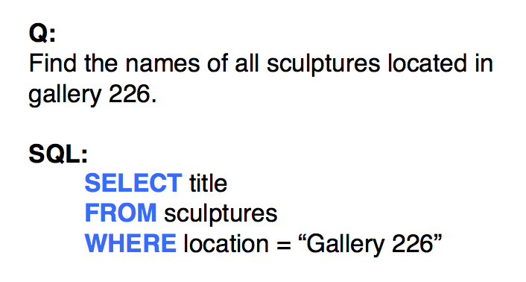
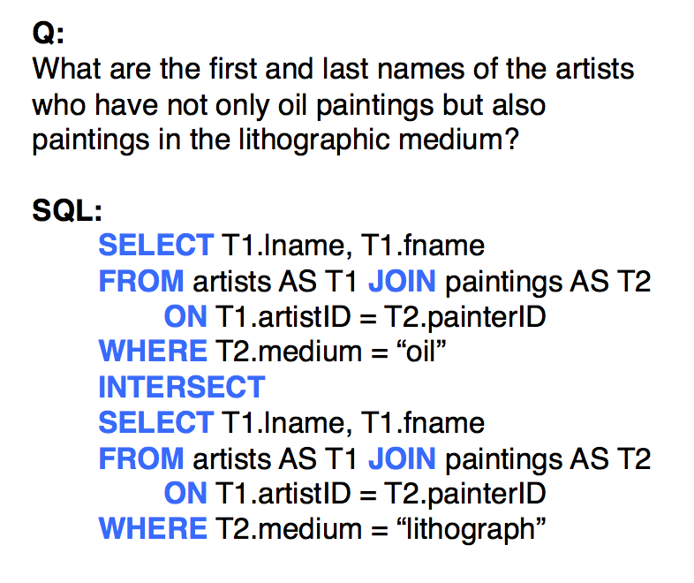
Data

Slide 4
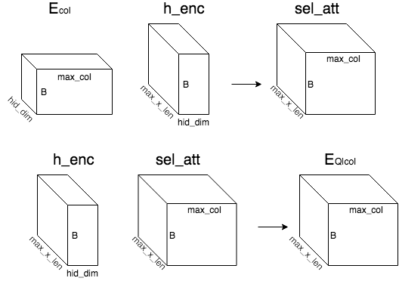
Approach

Slide 5
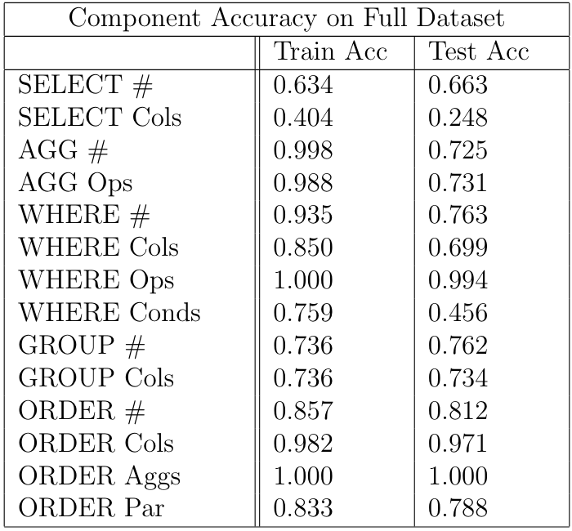
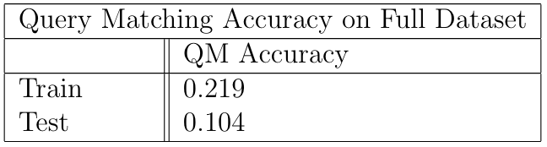
Results

Slide 6
Conclusions
This project establishes baseline performance metrics for this new NL2SQL task
It is clear that there is progress to be made
Future research direction:
Subquery prediction
Exploring alternatives to SQLNet

