Slide 1
Deep Learning for the Soft Cutoff Problem
Miles Saffran

Slide 2


Introduction
The MATERIAL project
The soft cutoff problem
Metric of evaluation
Figure 3. French loss in the simple model
Figure 3. French loss in the simple model

Slide 3
Materials and Methods
Data collection
Input features
Query embedding
Document length
Indri document score
Construction
TensorFlow

Slide 4
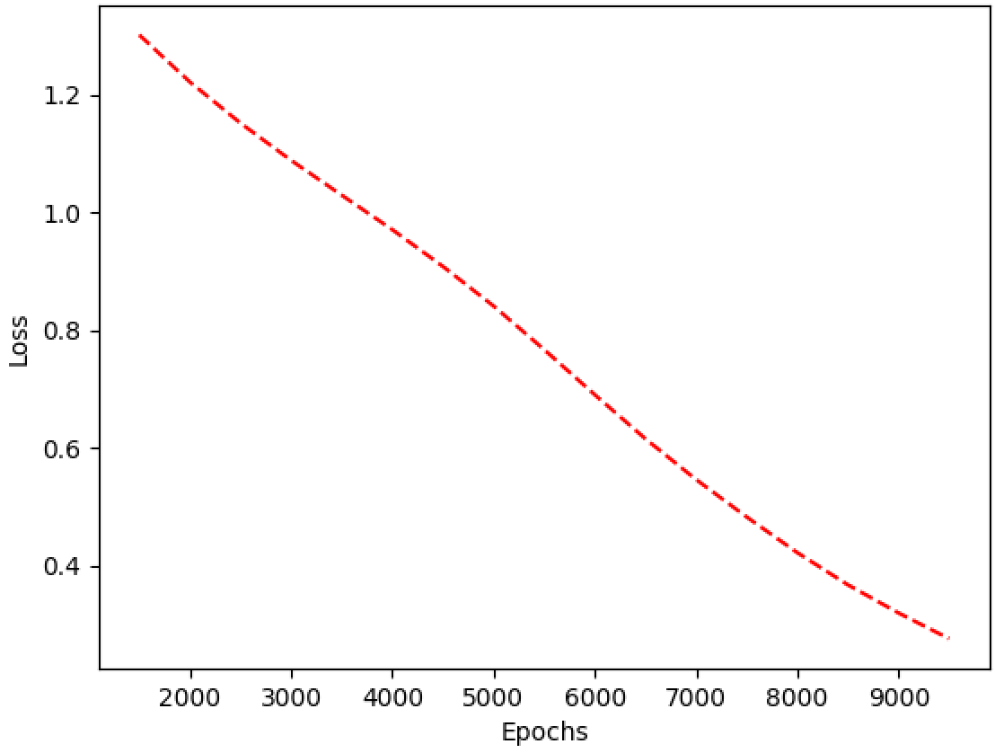
Results
Figure 1. Training loss over epochs

Slide 5
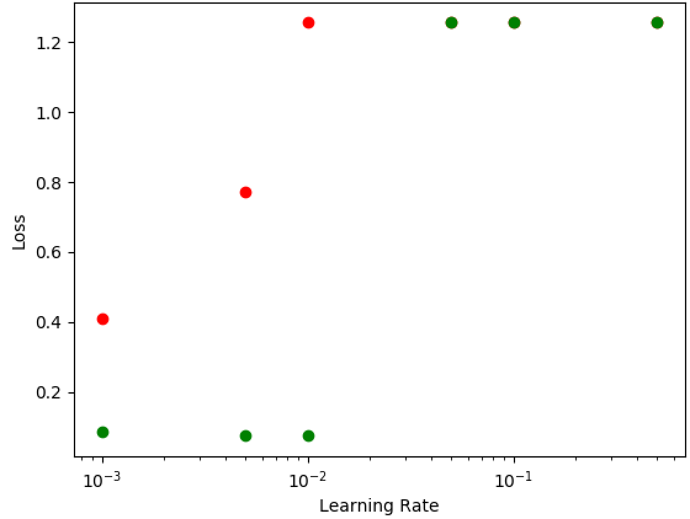
Results
Figure 2. English loss with different learning rates

Slide 6
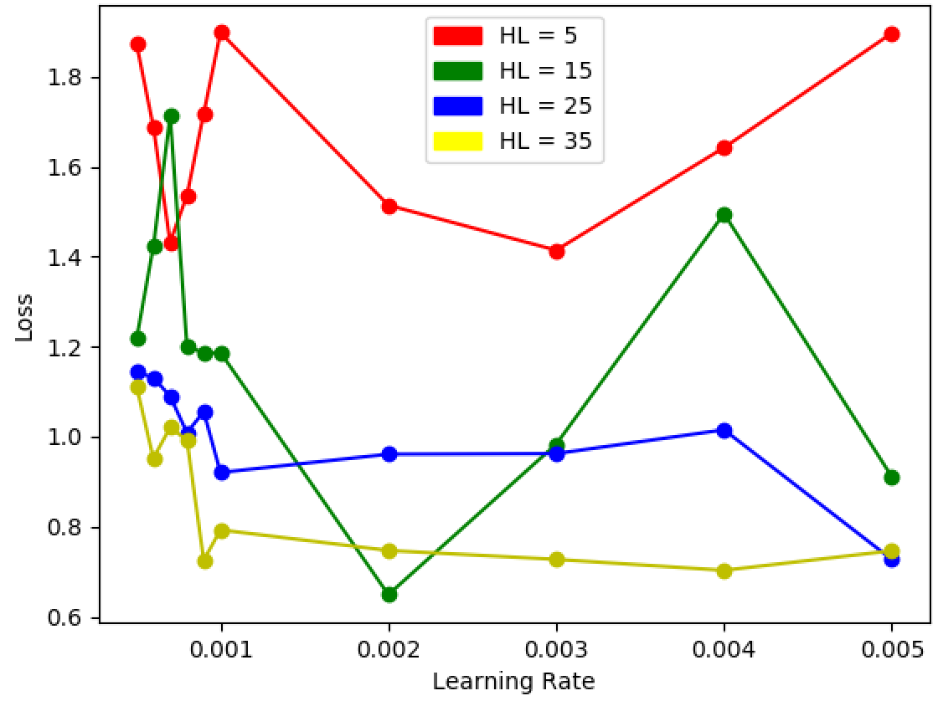
Results
Figure 3. French loss in the simple model

Slide 7
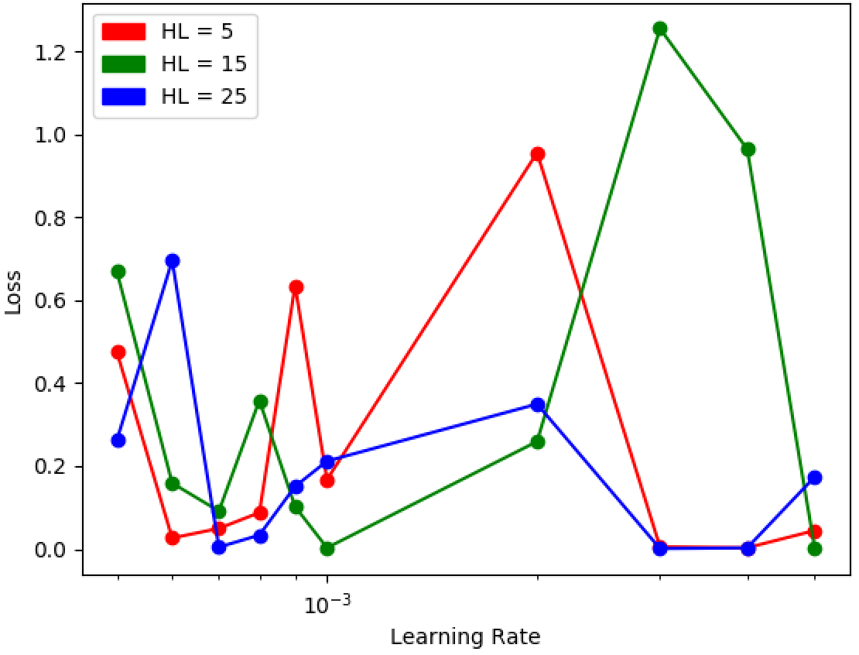
Results

Slide 8
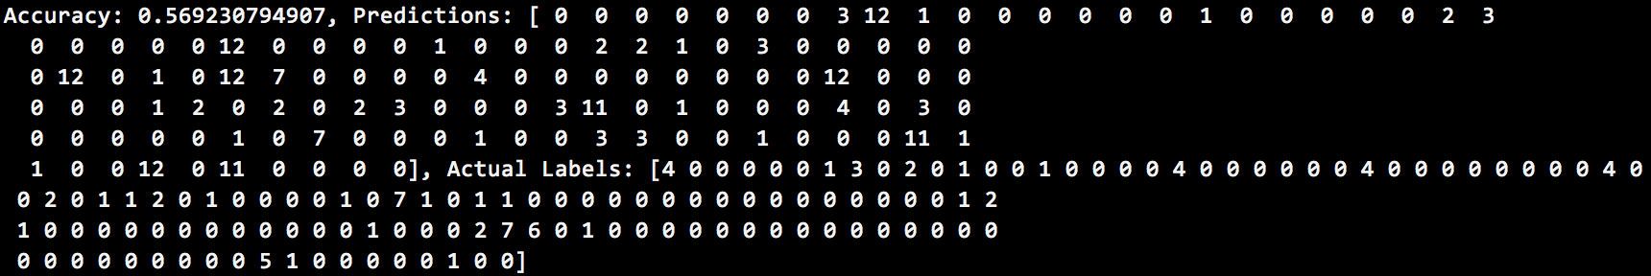
Results

Slide 9
Results
Variance in performance
.1 on English to English (optimal .14)
.15 on Tagalog to Swahili (optimal .35)

Slide 10
Conclusion
Add more features
Use more training data
Include dropout and regularization

