Slide 1
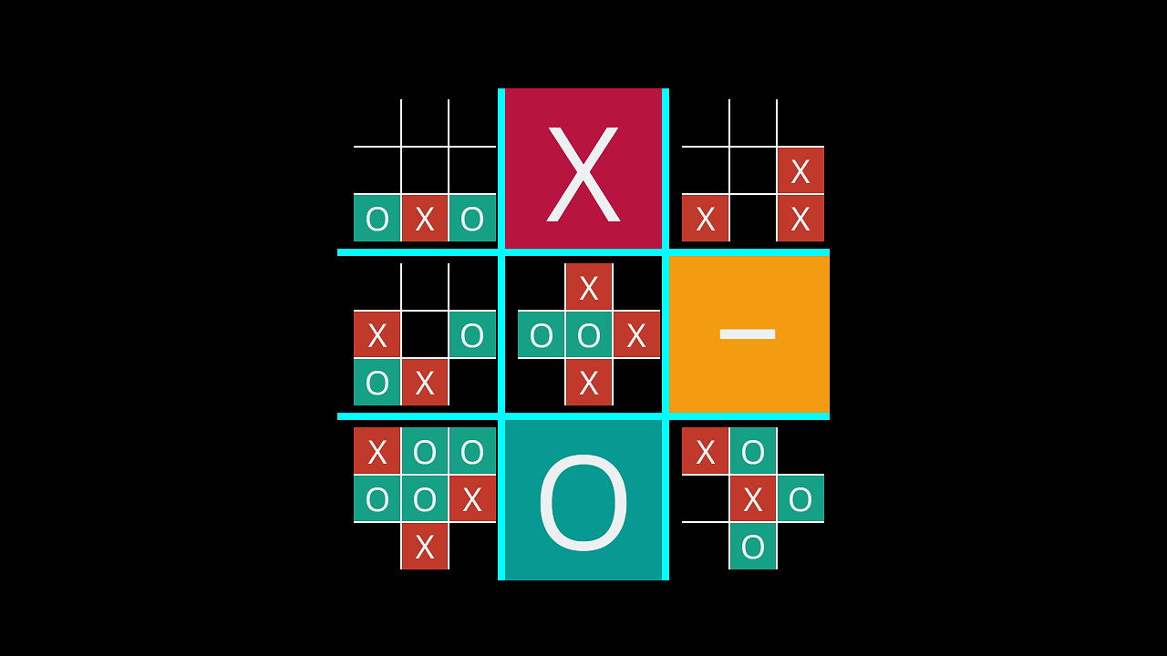
Tec –Tac -Toe
By:Majd Mashaleh
Dr.Moa'ath

Slide 2
Introduction to Tic-Tac-Toe: The Classic Strategy Game
Tic-Tac-Toe, a timeless game enjoyed by all ages, is played on a 3x3 grid. The objective is simple: to be the first to align three of your marks—either X or O—in a straight line. Here's a breakdown of the rules:
Player Requirement: Tic-Tac-Toe is a two-player game, fostering friendly competition and strategic thinking.
Mark Selection: Players must choose their mark, either X or O, before the game begins and stick with it throughout the game.
Turn-Based Gameplay: Players take turns placing their mark on an empty square, with only one mark allowed per turn.
Permanent Marks: Once placed, marks cannot be moved or removed from the grid.
Winning Conditions: Victory is achieved by forming a straight line of three marks, whether horizontally, vertically, or diagonally.
The game ends when either a player achieves the winning condition or when all nine squares are filled. In the latter case, if no player has formed a winning line, the game is declared a tie.

Slide 3
The minmax algorithm :
The aim of employing the Minimax algorithm is to teach computers how to play games in such a way that they become virtually unbeatable.
At its core, minmax is a decision-making algorithm built of a maximizer and minimizer concept ,So you try to maximize your won while your opponent is trying to minimize their loss
Minimax identifies the best possible move by exploring all possible moves and evaluating their outcomes. This is achieved by a utility function or evaluation function, which measures the desirability of a particular game state.
on the code I used the utility function which is a measurement of how valuable the final result on that tree is.

Slide 4
How the utility function work ?
The utility function assigns a value to each game state (board configuration). It reflects how favorable that state is for a particular player.
In Tic-Tac-Toe, we can define the utility function as follows:
1 for a win (X wins)
0 for a tie (draw)
-1 for a loss (O wins)

Slide 5
current state
x’s turn
goal:maximize x
3
maximizer
1*3=3
0
-2
minimizer
0
-1*2=-2
maximizer
0*1=0
1*1=1
0*1=0

Slide 6
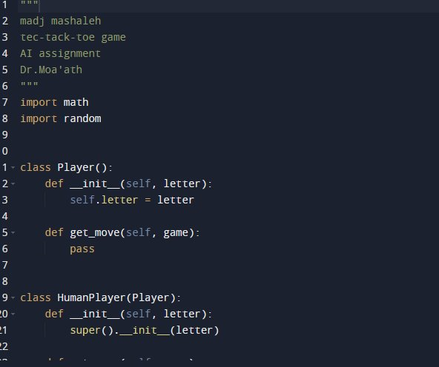
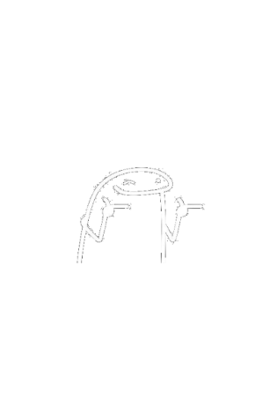
now let’s see the code

Slide 7
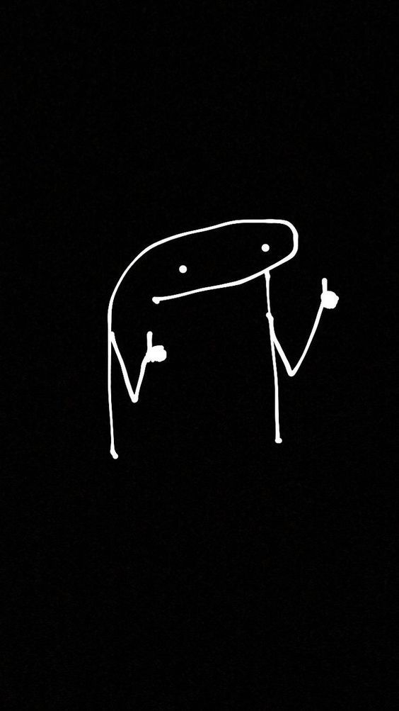
any questions?

