Slide 1
STORY1
File created on: 10/29/2023 3:04:43 AM

Slide 2
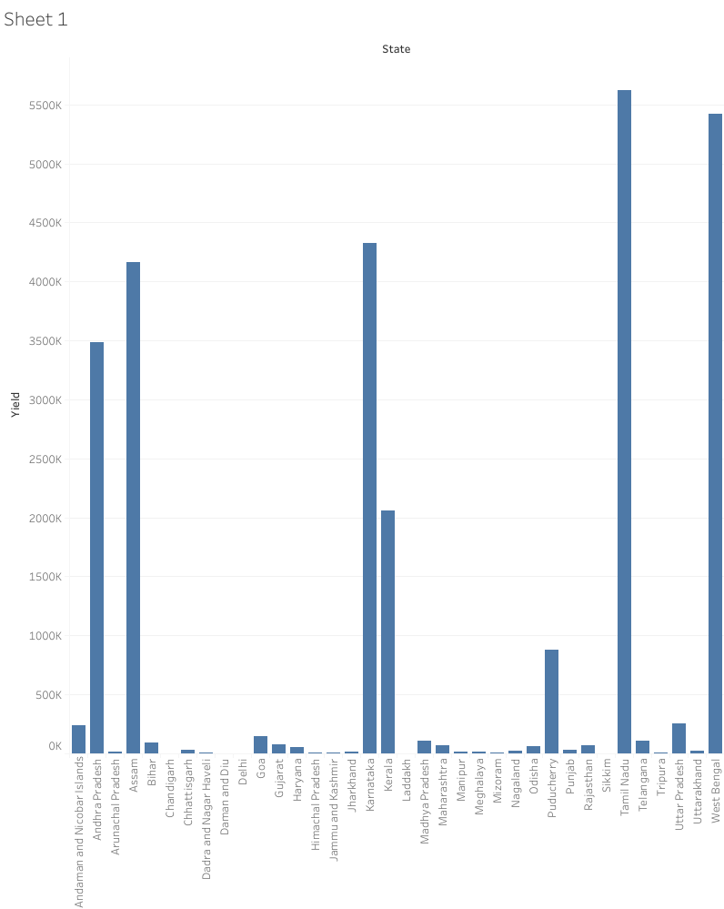

Slide 3
