Slide 1
STORY2
File created on: 10/29/2023 3:07:17 AM

Slide 2
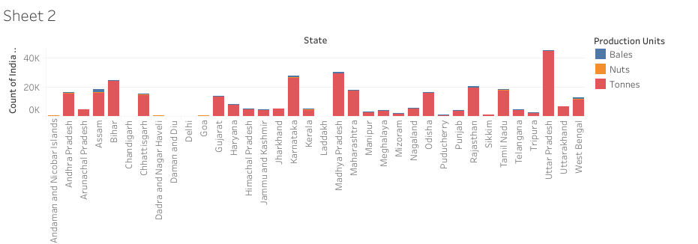

Slide 3
