Slide 1
STORY3
File created on: 10/29/2023 3:12:07 AM

Slide 2
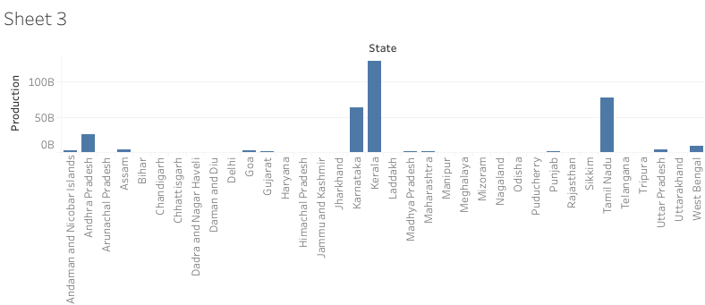

Slide 3
