Slide 1
STORY4
File created on: 10/29/2023 3:14:43 AM

Slide 2
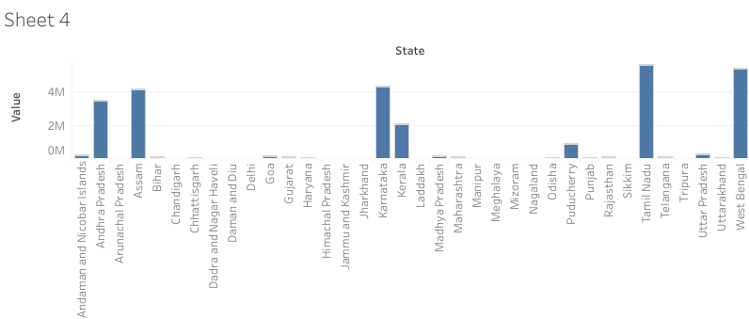

Slide 3
