Slide 1
STORY5
File created on: 10/29/2023 3:18:39 AM

Slide 2
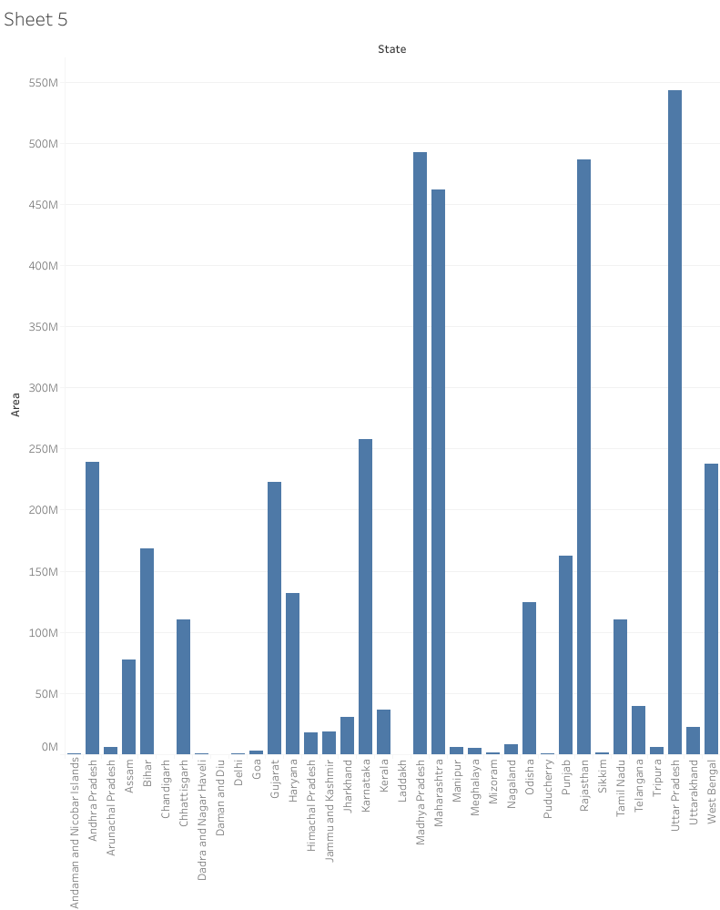

Slide 3
