Slide 1
STORY6
File created on: 10/29/2023 3:22:11 AM

Slide 2
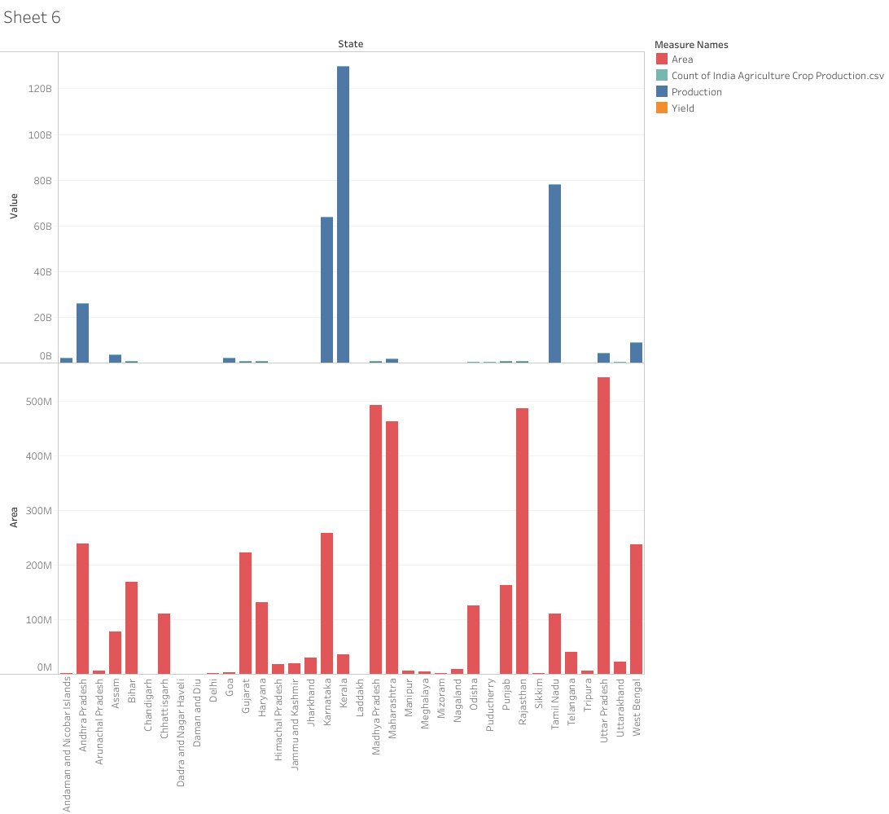

Slide 3
