Slide 1
Week 1
Introduction to Tinkercad

Slide 2
Agenda
What is 3D modeling?
What is Tinkercad?
Why Tinkercad?
Interface Basics
Navigating the workspace
Basic shapes
Group and Ungroup
Holes / Slots
Task: Nameplate / Keychain
Assignment (Optional)

Slide 3
What is 3D modeling?
Creating digital 3D objects
Used in engineering, product design, games, movies
Foundation for 3D printing

Slide 4
What is Tinkercad?
Free, web-based 3D design tool
Beginner-friendly
Works on any browser

Slide 5
Why Tinkercad?
Simple interface
Teaches core modeling concepts
Fast results
Perfect transition into advanced CAD

Slide 6
Interface Basics
Workplane
Shapes panel
Toolbar (Group, Align, Mirror)
Navigation tools

Slide 7
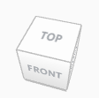
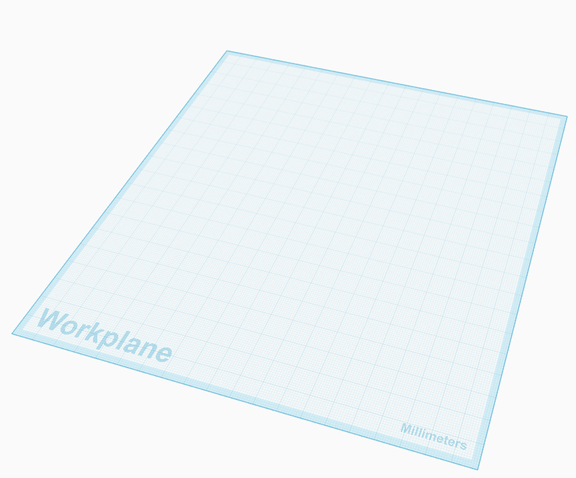
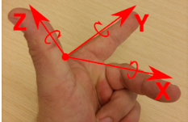
Navigating the workspace
Right-click: rotate view
Mouse wheel: zoom
Shift + right-click: pan
Fit view (F key)

Slide 8
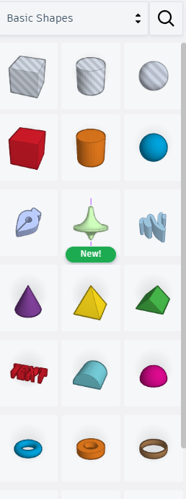
Basic shapes
Cubes, cylinders, spheres
Move, scale, rotate

Slide 9


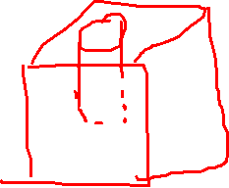
Group and Ungroup
Combine shapes
Remove (subtractive) shapes
Create complex models
Ctrl + G
Ctrl + Shift+ G
Notes:
Bundle group combines the shapes but it will not exclude the holes and considered the transparency as it is.

Slide 10
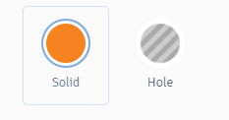
Holes / Slots
Turn shapes into cutters
Make openings and slots

Slide 11
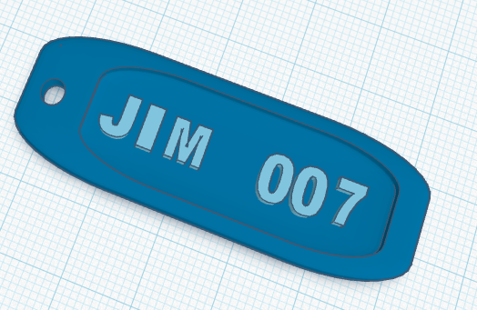
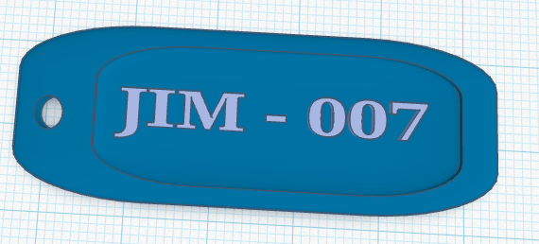
Task: Nameplate / Keychain
Add box + resize
Add text
Add ring
Group & export STL

Slide 12
Assignment
Create 3 models with:
5+ shapes
1 hole
Grouping

Slide 13
References
File:Logo-tinkercad-wordmark.svg - Wikimedia Commons
Tinkercad - Wikipedia

Slide 14
Thank You
Q/A

