Slide 1
Week 2
Precision & Accuracy

Slide 2
Agenda
Precision tools
Ruler Tool
Align Tool
Measurements
Patterns
Advanced Holes
Symmetry concepts
Task: Castle/House
Assignment (Optional)

Slide 3


Precision tools (Ruler tool)
Exact dimensions
Edit scale numerically

Slide 4

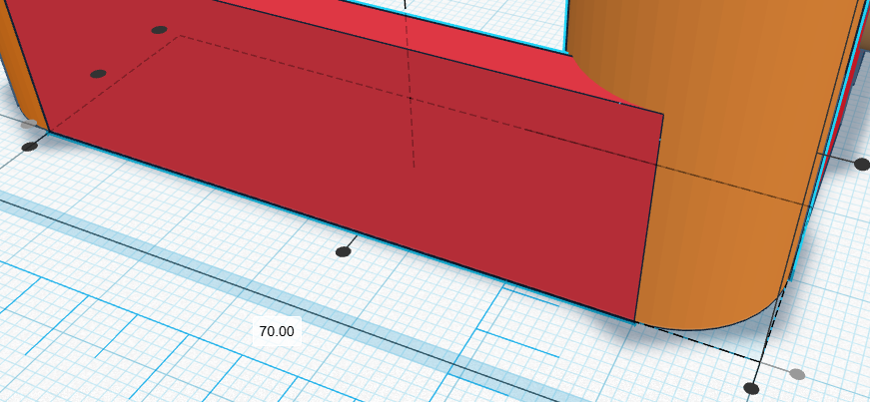
Precision tools (Align tool)
Align shapes easily
Centering & symmetry
Limitation: Centering point
Notes:
Alt + Shift + white box drag to scale symmetrically
Alt + white box height to increase the height in both directions

Slide 5

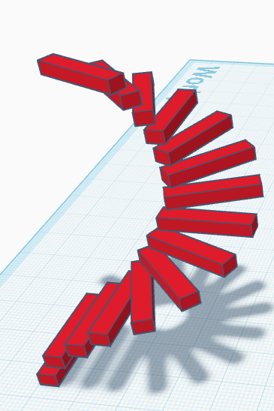
Patterns (Duplicate and Repeat)
Create patterns
Uniform spacing

Slide 6
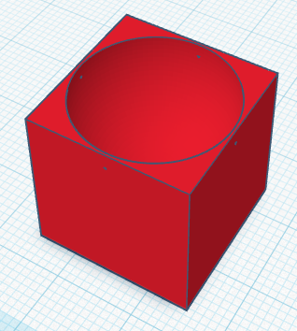
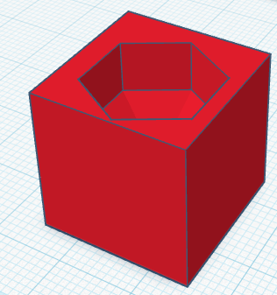
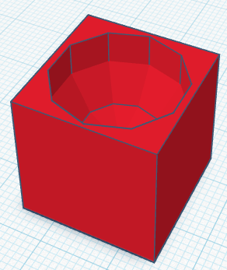
Advanced Holes
Internal cavities
Multi-shape cutouts

Slide 7

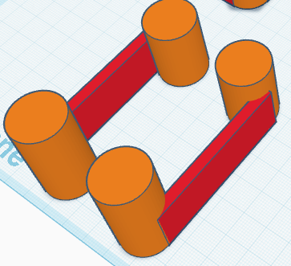
Symmetry Concepts
Mirroring shapes
Using align + duplicate

Slide 8
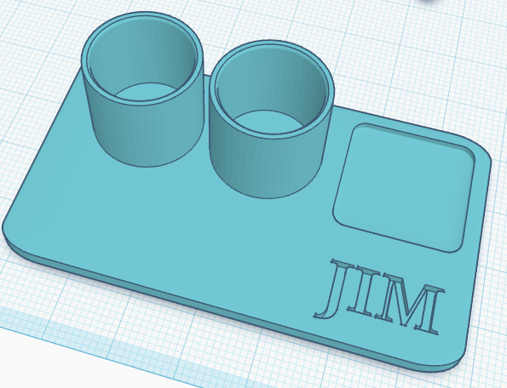
Task (Desk organizer)
Compartment design
Repeated shapes
Holes/ Slots for trays & cups

Slide 9

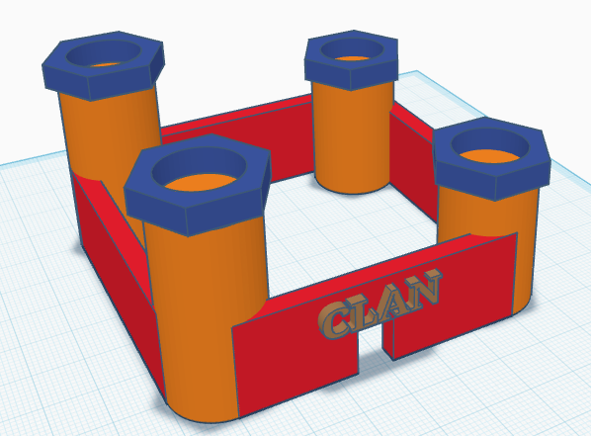
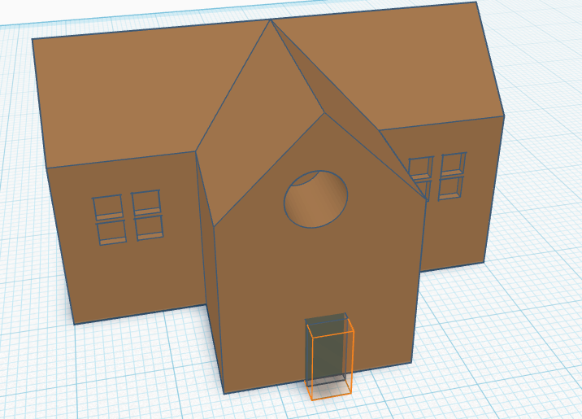
Assignment
One design with:
3 compartments
Repeated shapes
2 types of holes

Slide 10
References
File:Logo-tinkercad-wordmark.svg - Wikimedia Commons
Tinkercad - Wikipedia

Slide 11
Thank You
Q/A

