Slide 1
Week 3
Intermediate Modeling

Slide 2
Agenda
Review of Week 1 and Week 2
Extrude
Revolve
Importing SVG Files
2D drawing to Assembly
Project: A coffee Mug
Project: Mobile phone Stand
Innovation

Slide 3
Review of Week 1 and Week 2
Navigation
Grouping
Alignment
Precision tools

Slide 4
Shape Generators
Parametric shapes
Gears, threads, curved forms

Slide 5

Importing SVG Files
Convert 2D shapes to 3D
Logos, silhouettes

Slide 6
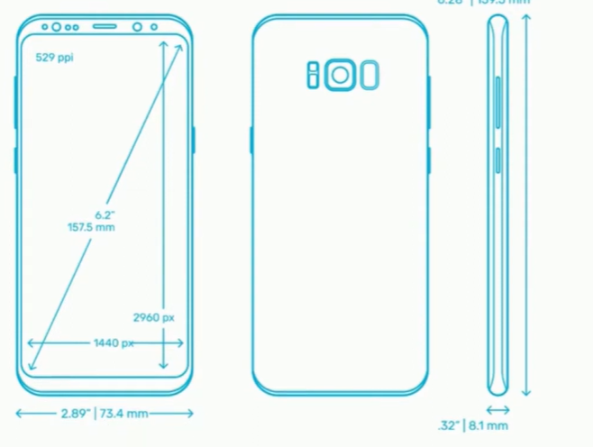
2D Drawing to Assembly
Mobile virtual model
Why we need it?

Slide 7
Complex Geometry
Stacking + merging shapes
Organic forms

Slide 8
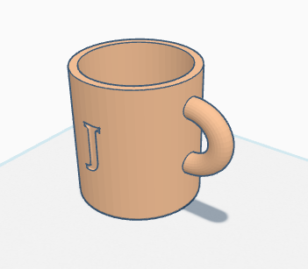
Project
Coffee Mug

Slide 9
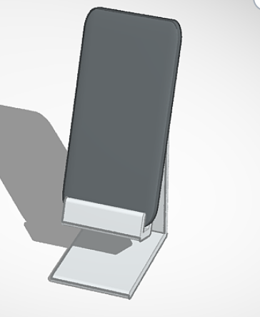
Project
Mobile Phone Stand
Create a 2-part assembly
A virtual mobile model
Phone Stand
Use Align tool and navigation tool to verify

Slide 10
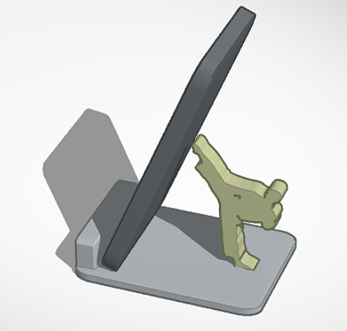
Innovation
Male Karate Mobile Stand

Slide 11
References
File:Logo-tinkercad-wordmark.svg - Wikimedia Commons
Tinkercad – Wikipedia
51vkvCLy+nL._AC_SX522_.jpg (522×781)
Online SVG image converter

Slide 12
Thank You
Q/A

