Slide 1
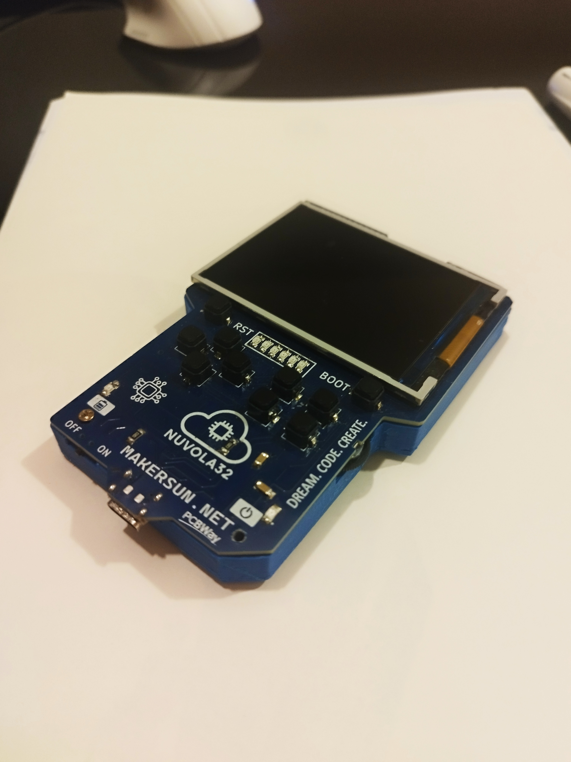
MAKERSUN.NET
PRESENTS
NUVOLA32
ESP32-S3 Breakout Board
DREAM. CODE. CREATE.
ESP32-S3
N16R8
Wi-Fi + BT
Blue Case
Manufactured by PCBWay

Slide 2
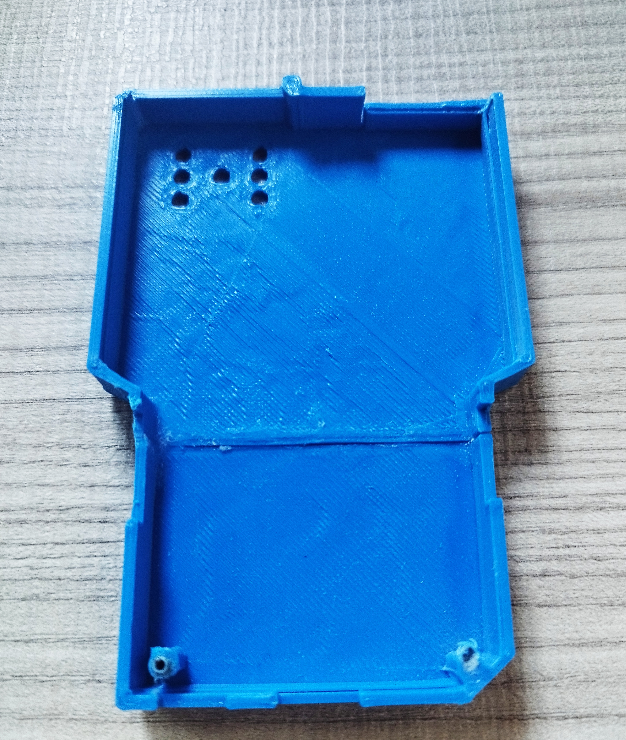
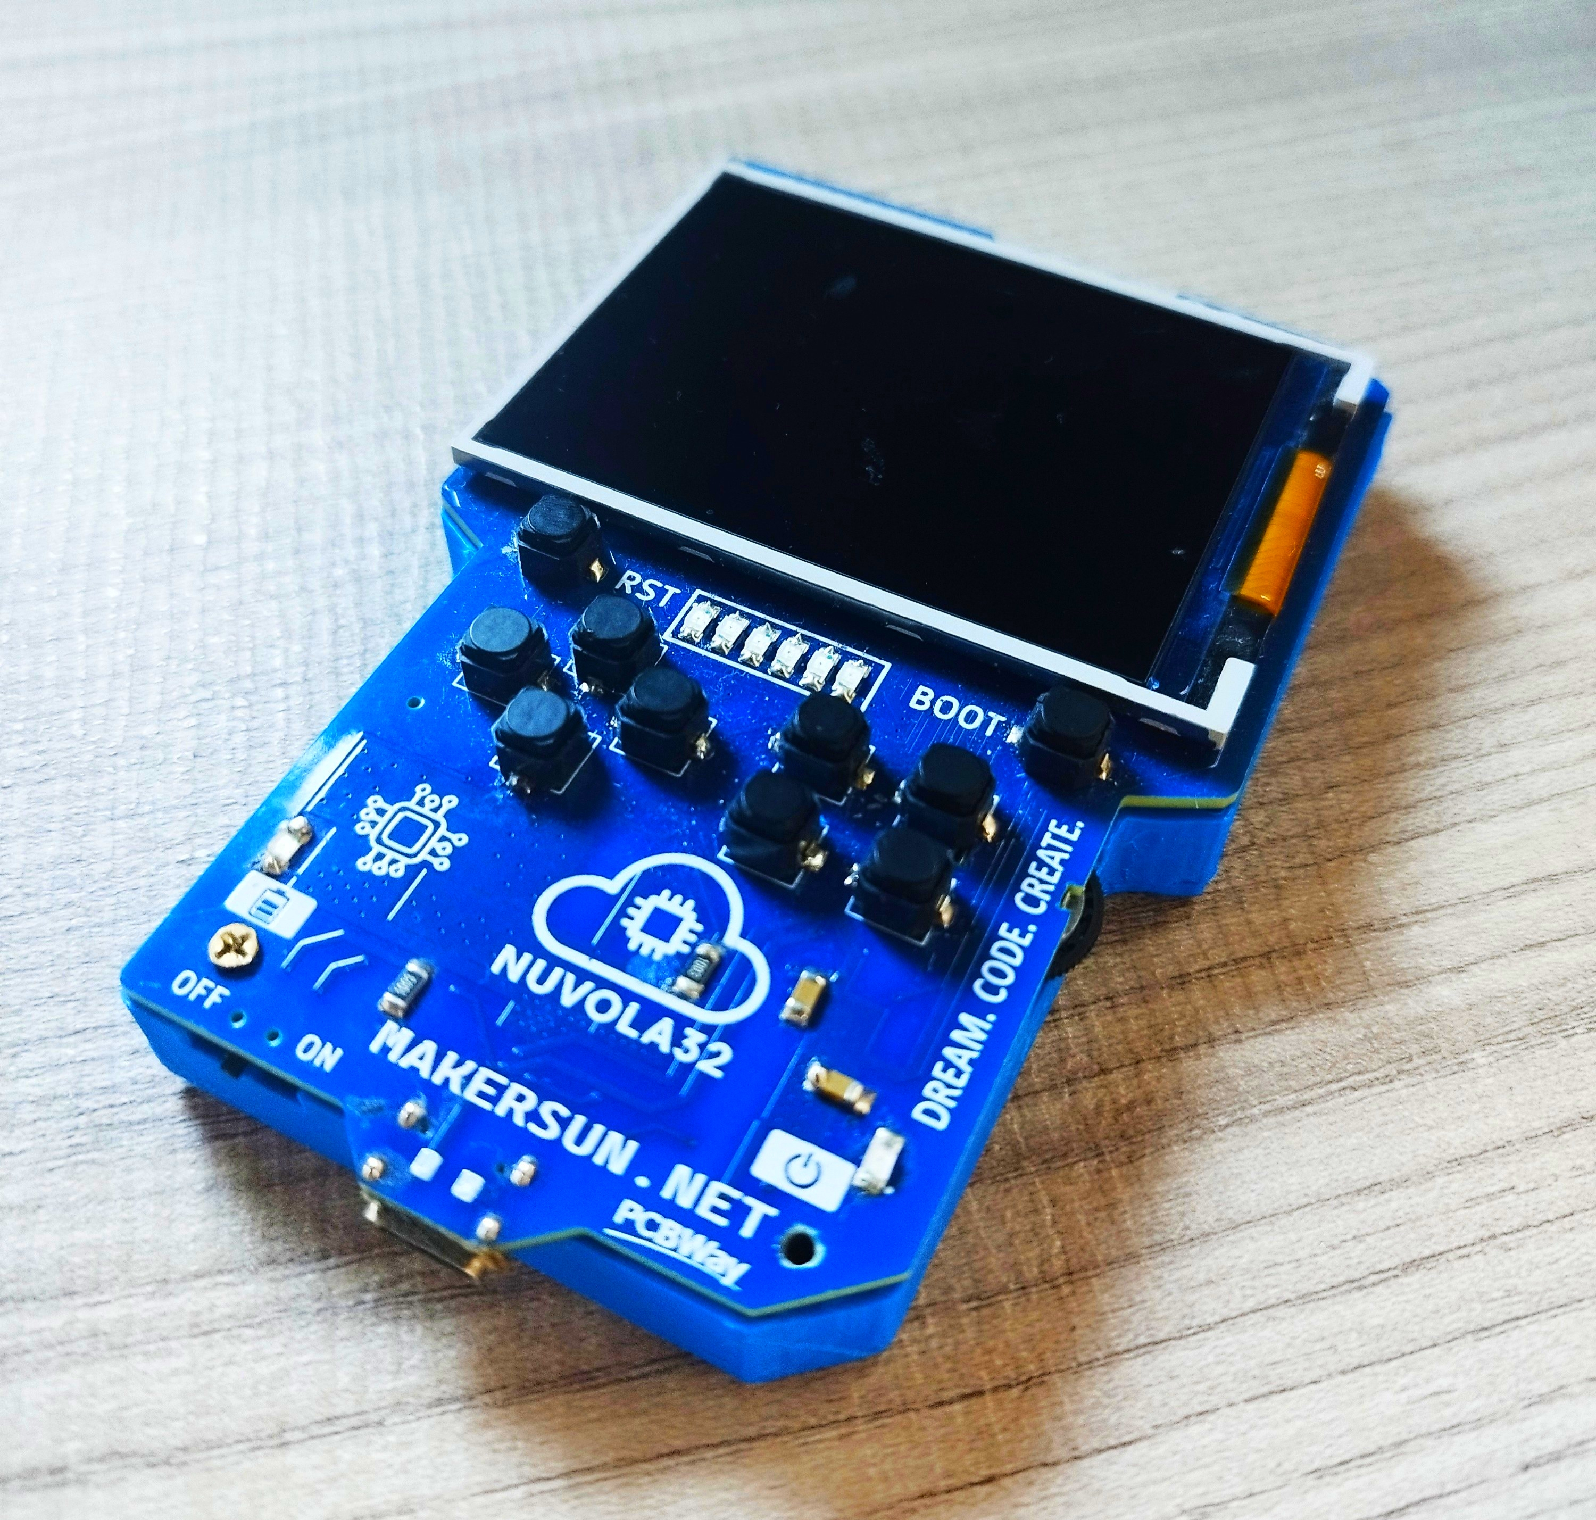
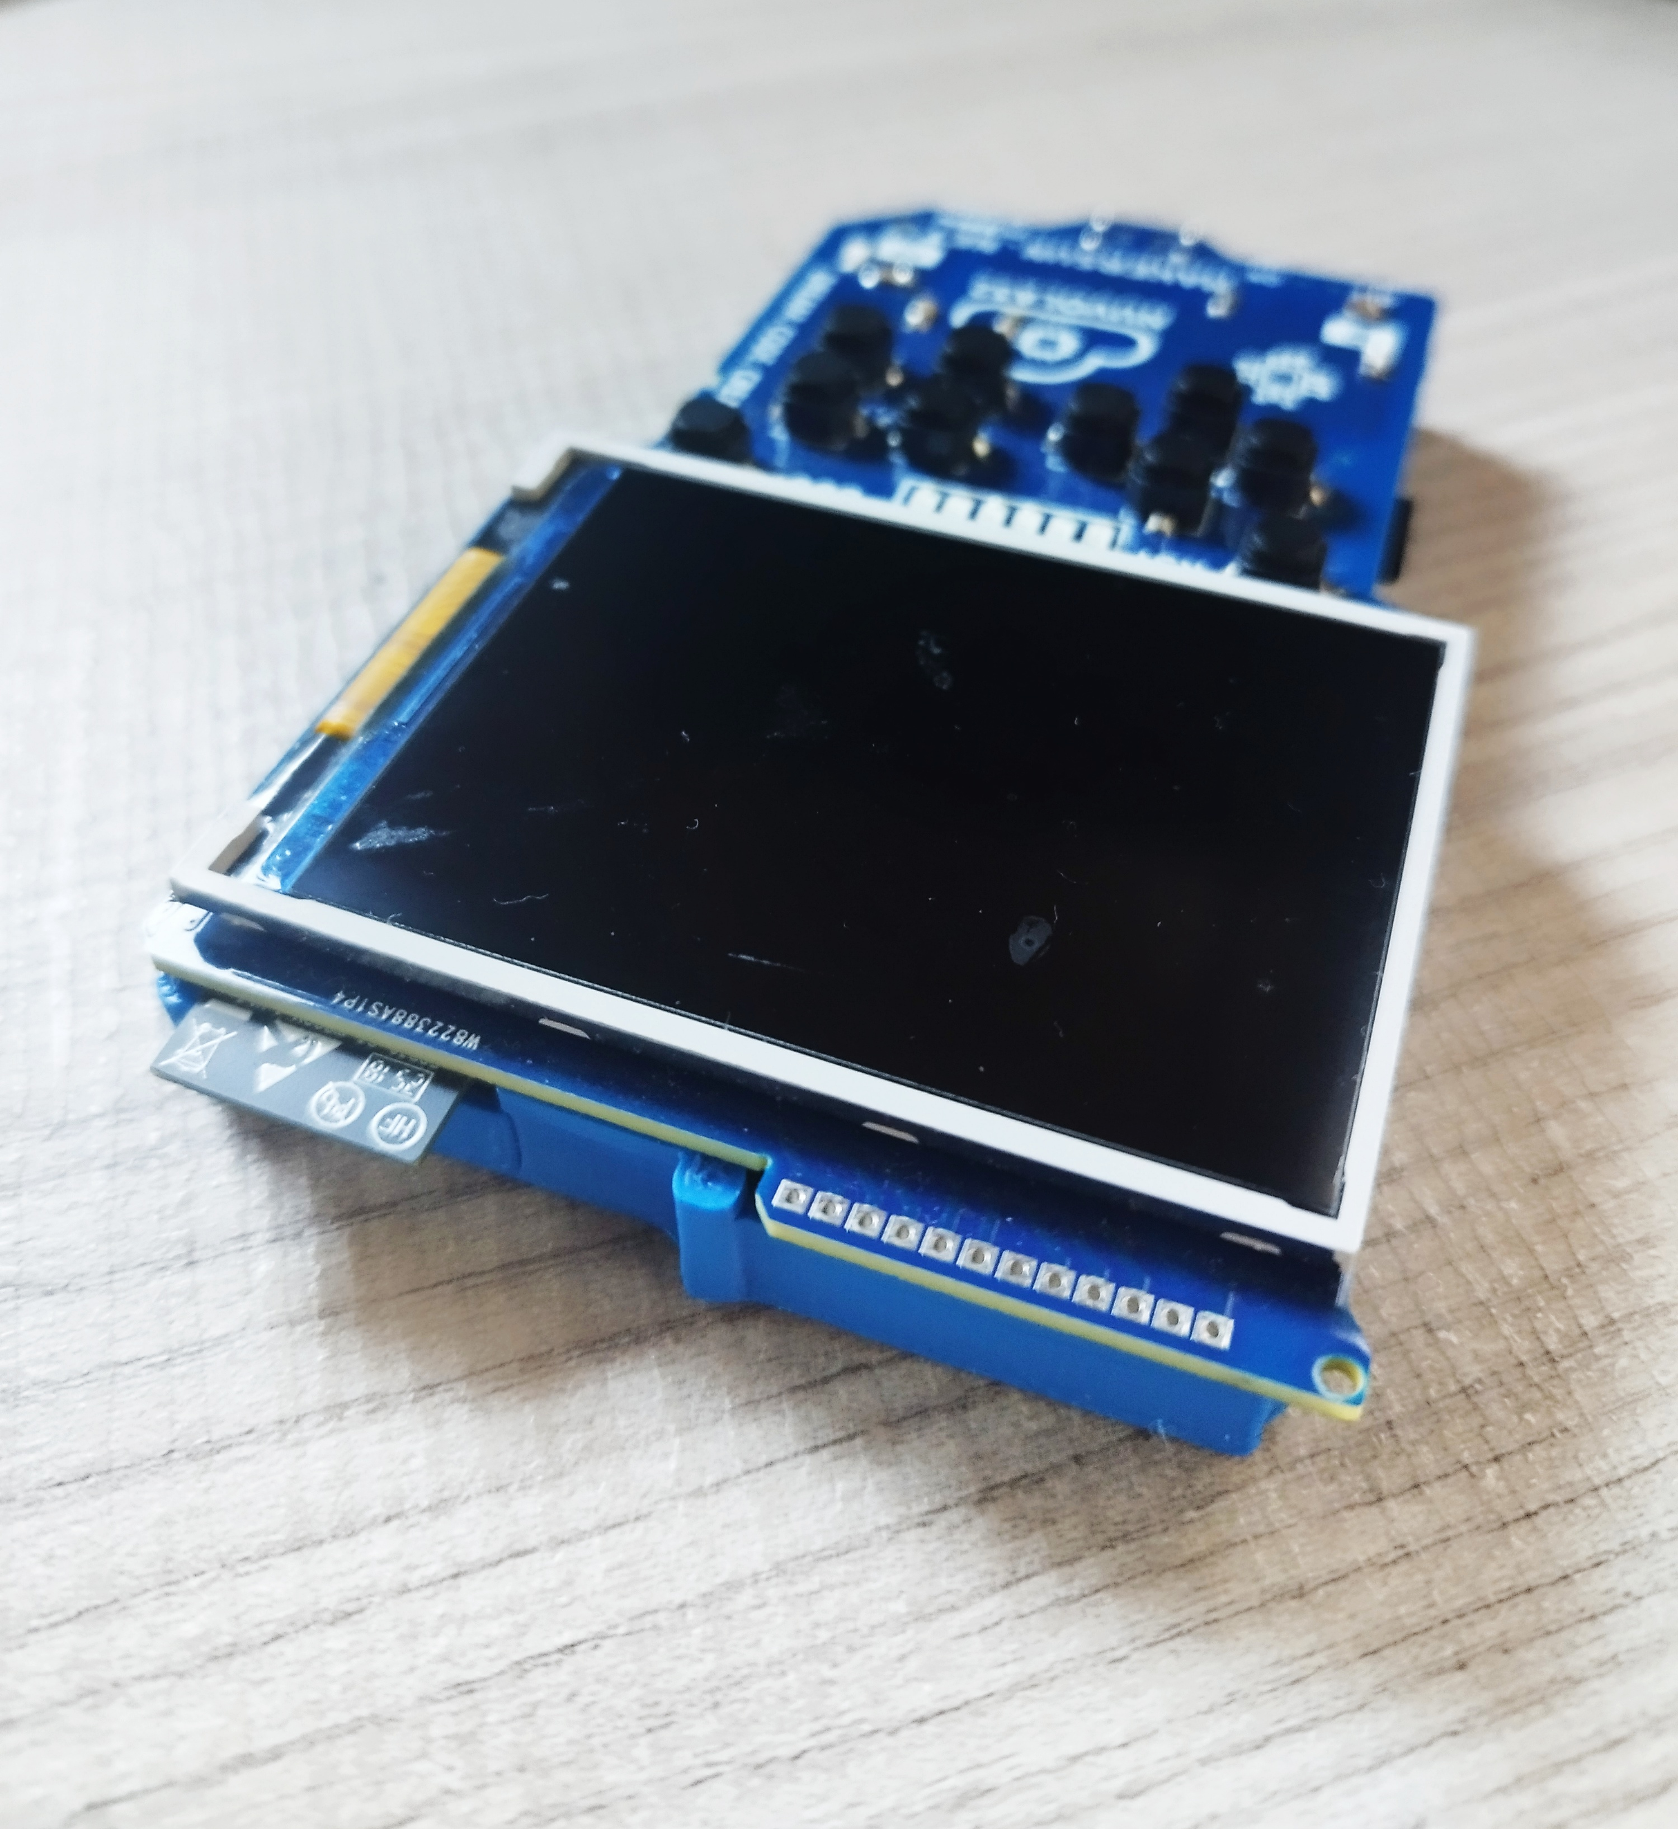
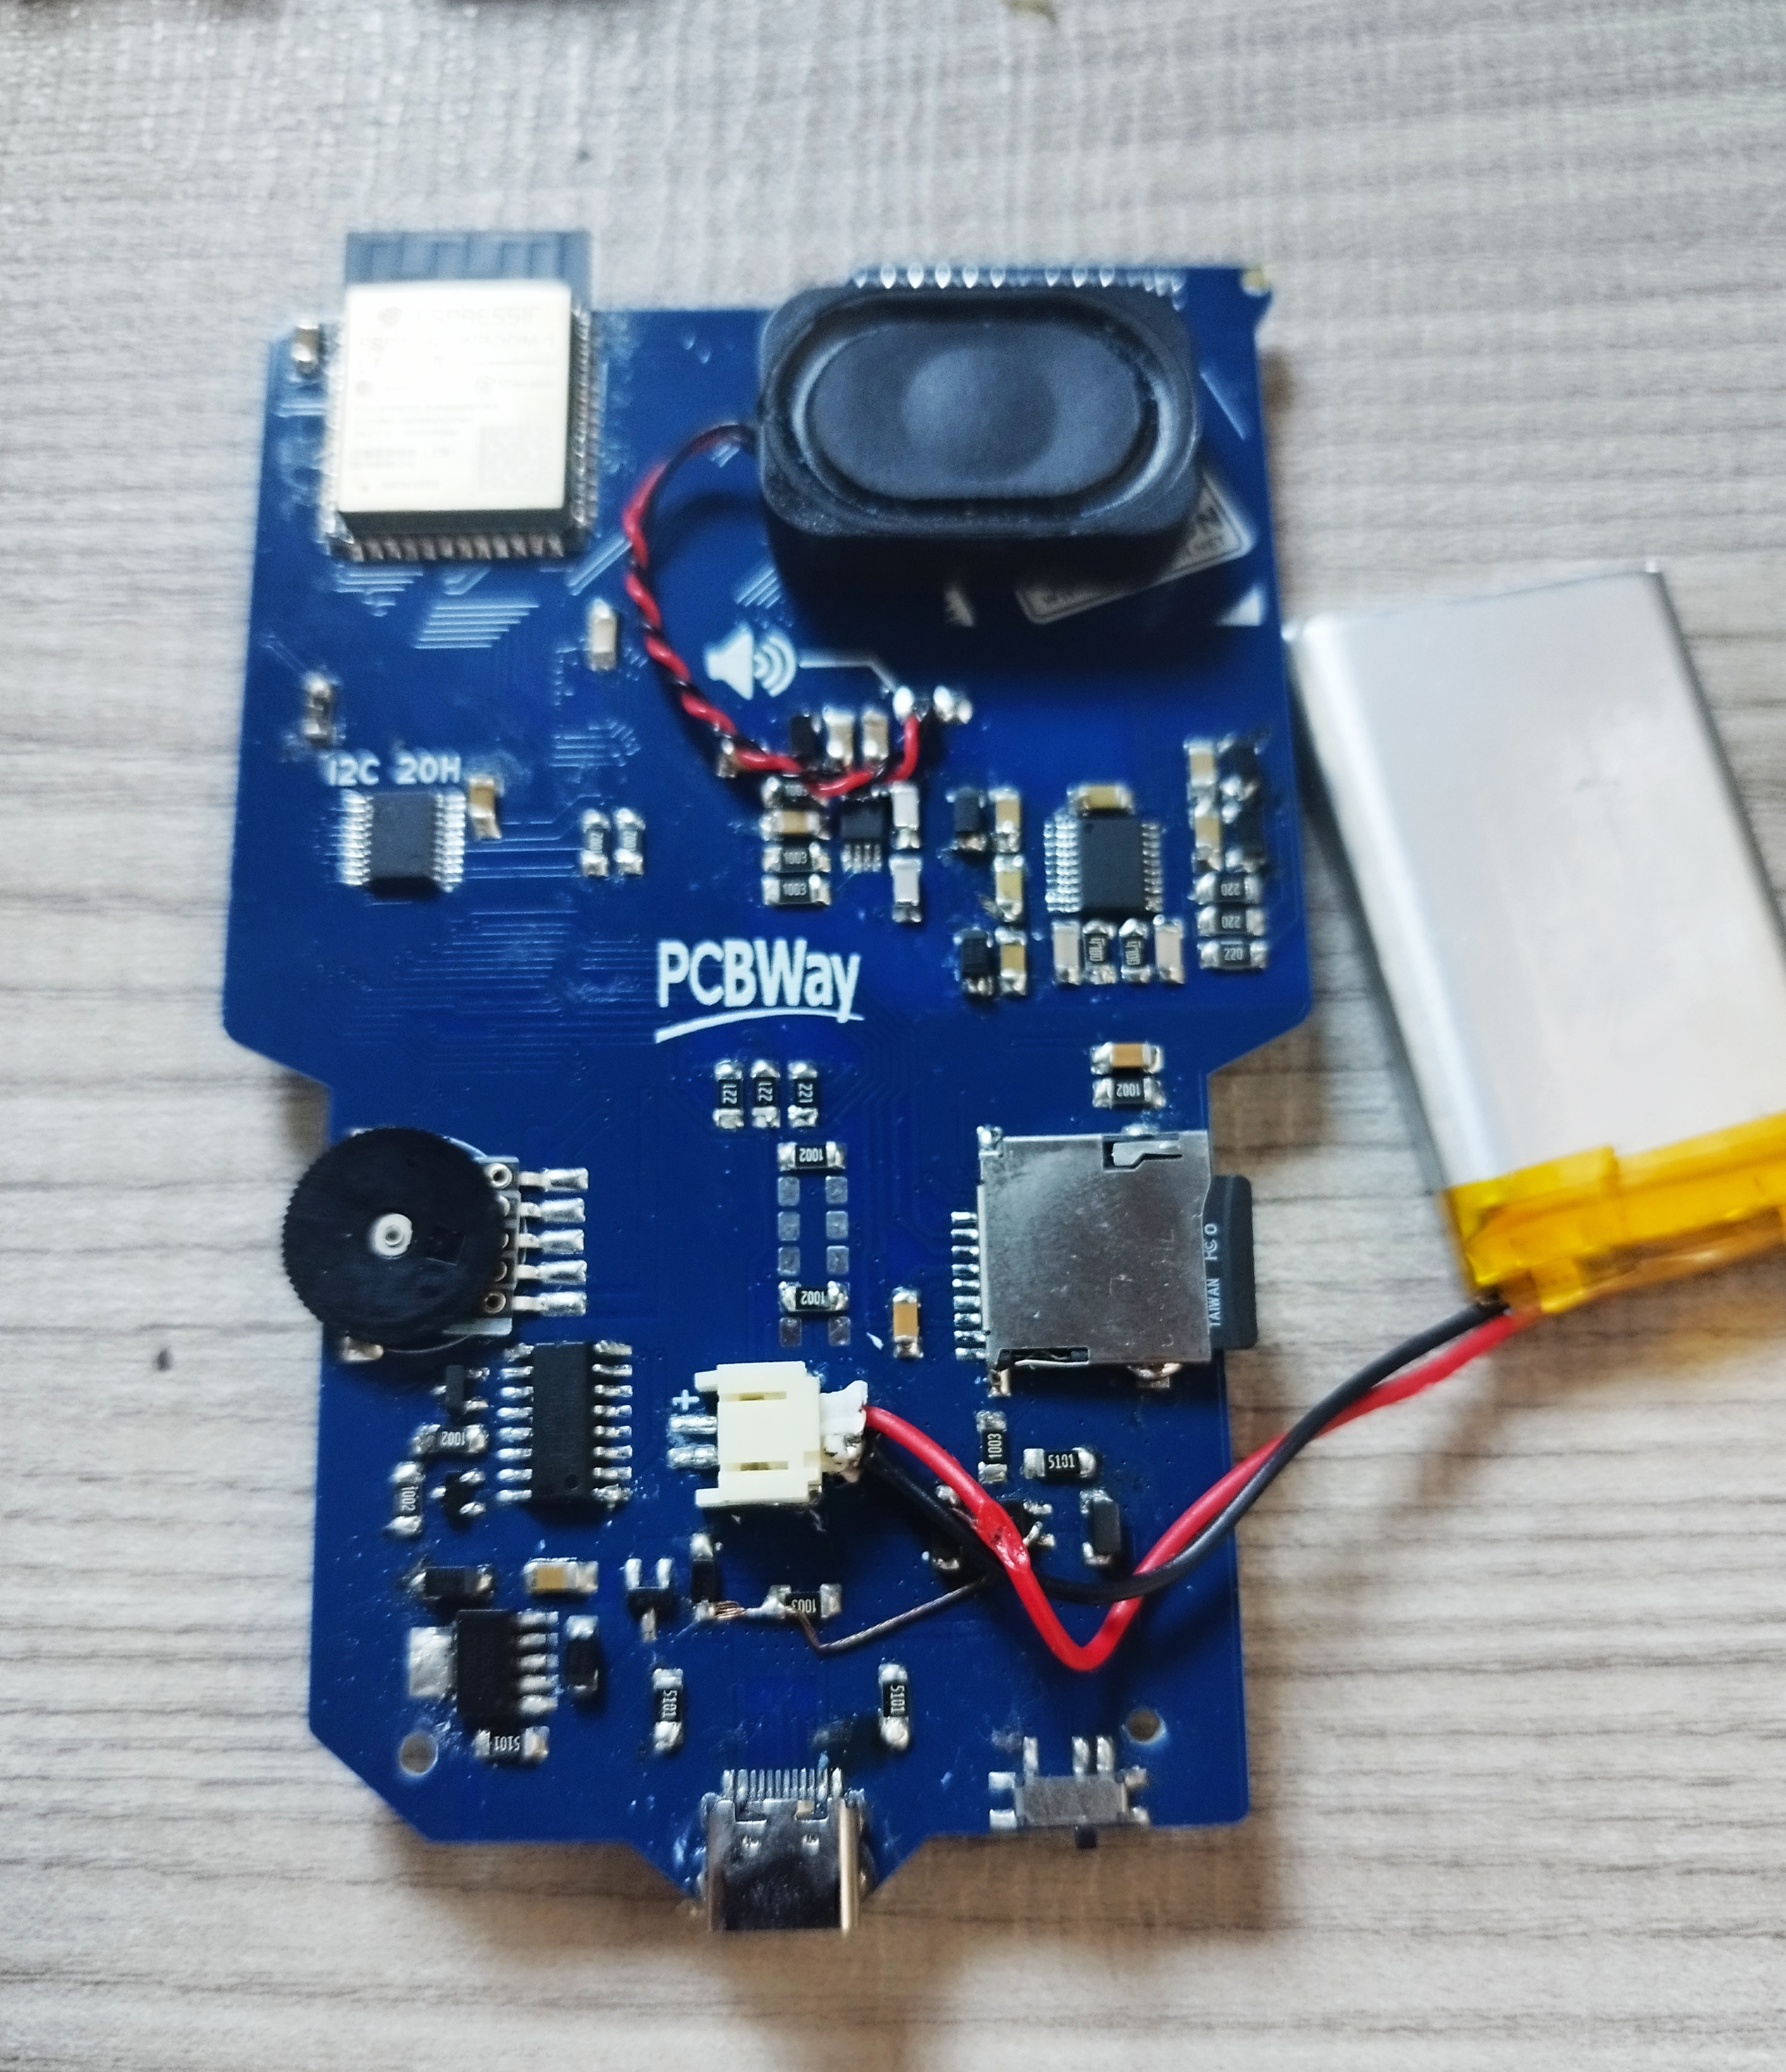
NUVOLA32 — ESP32-S3 Breakout Board
OVERVIEW
What is NUVOLA32?
NUVOLA32 is a powerful development board based on the ESP32-S3, designed for makers, hobbyists, and professional developers who want to rapidly prototype IoT devices, audio systems, gaming consoles, and display interfaces — all on a single compact board.
2.4” DISPLAY
SD Card
ILI9341 TFT Display on SPI1 Interface
SPI0 Interface
LED
3W AUDIO
6 x CharliePlexing on GPIO 3 9 10
PCM5102 I2S DAC + Class-D Audio Amplifier + Speaker + Side Volume Pot
USB-C
LiPo Battery
CH340C for Arduino IDE / IDF
Auto-reset circuit for easy upload
USB/Battery automatic power selection + Charge LED Indicator

Slide 3
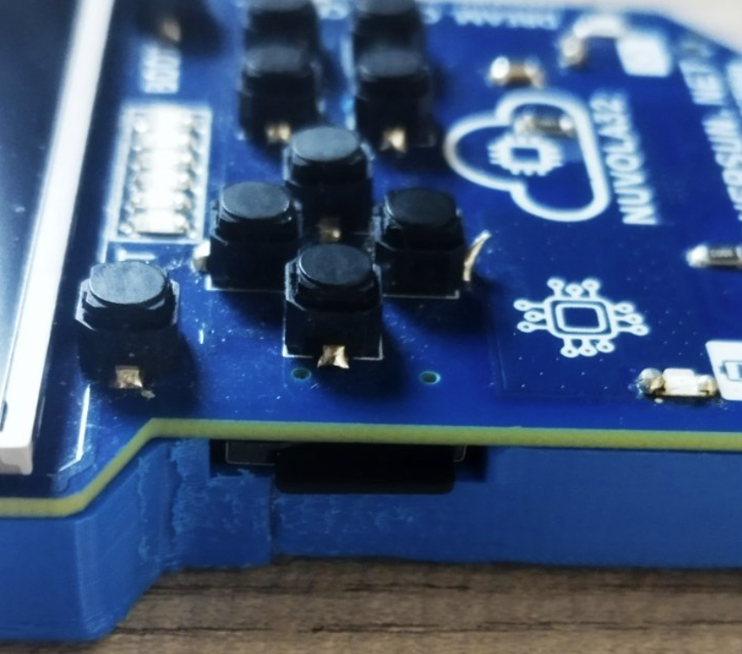
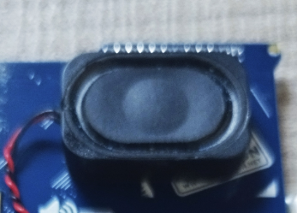
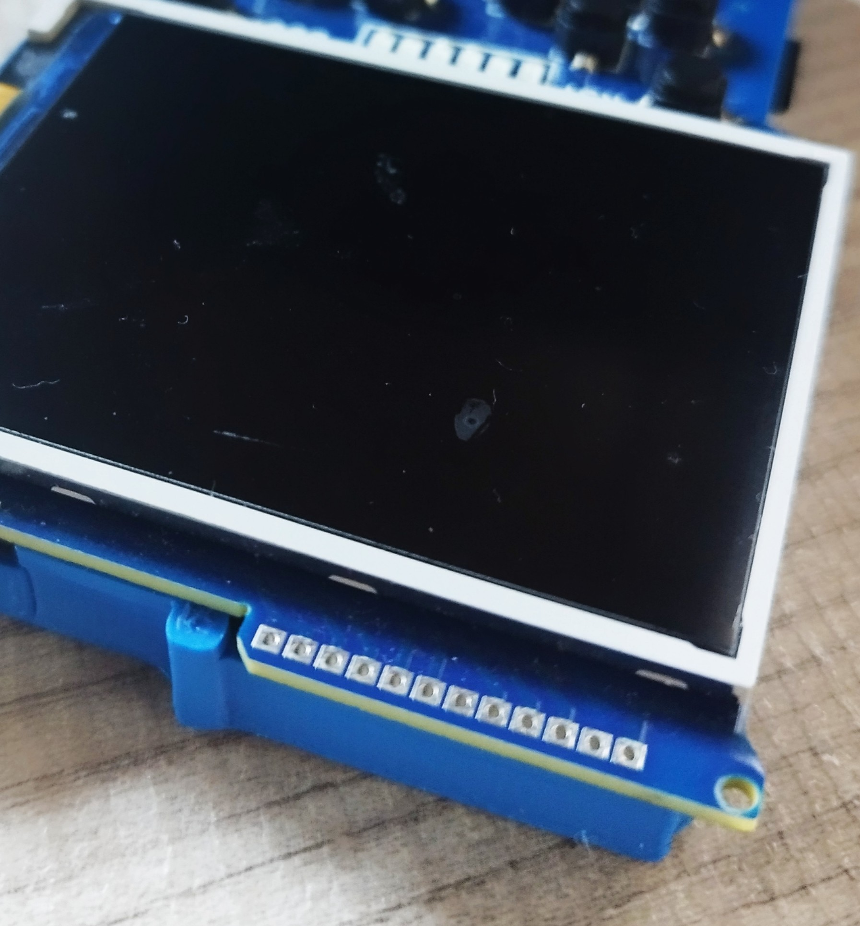
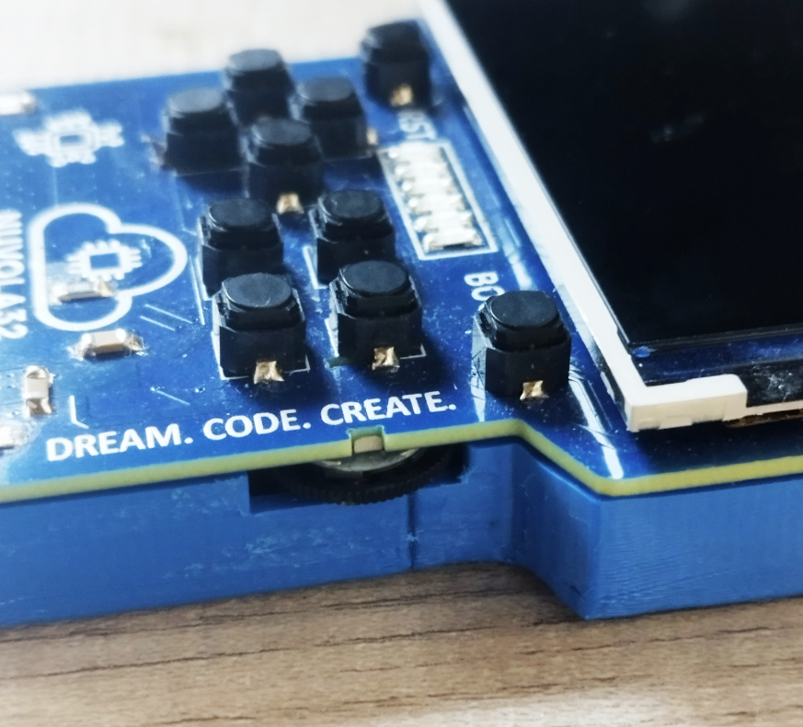
FEATURES
Volume Pot
Speaker
SD Card Slot
GPIO Expansion Slot
1 - VCC
RESET
IO0 Button
2 - GND
3 - MISO
LiPo Charging State LED
Power LED
4 - CLK
SPI0 Shared with SD
5 - MOSI
6 - GND
Power Switch
7 - SCL
8 - SDA
9 - GPIO8
10 - GPIO2
11 - GPIO1
12 - GND

Slide 4
FEATURES
Wi-Fi & Bluetooth 5
USB-C & Auto-Reset
Battery Management
8 I2C Buttons
ESP32S3-WROOM-1 N16R8
Built-in dual-band connectivity
CH340C for Arduino IDE / IDF
Auto-reset circuit for easy upload
MCP73831 battery charger
Battery monitor on GPIO6
PCF8574 via I2C
RST + BOOT included
3W Audio Output
2.4" TFT Display
SD Card Slot
GPIO Expansion Slot
PCM5102 I2S audio
Built-in 3W speaker output
Side volume potentiometer
ILI9341 320×240 px
Dedicated SPI1
SPI0 interface
Expandable storage
12-pin header: VCC, GND,
SPI0 shared, I2C, GPIO

Slide 5
USE CASES
Perfect for every project
01
02
03
04
IoT & Smart Home
Portable Console
Audio Station
Rapid Prototyping
Sensors, home automation, cloud dashboards. Built-in Wi-Fi ready for MQTT, HTTP, WebSocket.
TFT display + 8 buttons + 3W audio = complete retro gaming platform out-of-the-box.
Audiophile-grade PCM5102 I2S DAC. Wi-Fi streaming, SD Card player, DSP equalizer. Side volume knob for direct control.
RST/BOOT, auto-reset, USB-C: zero config. From idea to firmware in minutes with Arduino IDE or IDF.

Slide 6
TECHNICAL SPECIFICATIONS
Module
ESP32S3-WROOM-1 N16R8
Buttons
8x tactile via PCF8574 (I2C) + RESET + BOOT
Flash
16 MB
LEDs
6x Charlieplexing
PSRAM
8 MB
Display
ILI9341 2.4" TFT 320×240 px (SPI1)
Wireless
Wi-Fi 802.11 b/g/n + Bluetooth 5 / BLE
Audio
PCM5102 I2S DAC + 3W Amplifier + Side Volume Pot
USB
Type-C (CH340C), Arduino IDE & ESP-IDF
Storage
MicroSD Card Slot (SPI0)
Power
USB-C 5V or LiPoly Battery
Switch
Physical ON/OFF
Battery Charger
MCP73831, charging via USB-C
Case
Custom blue protective enclosure
Battery Monitor
GPIO6
Manufacturer
PCBWay

Slide 7
NUVOLA32
The future of your maker projects is here.
Who is it for?
Where to buy?
Makers & Hobbyists
🌐 Official Website
makersun.net
Students & University researchers
Professional IoT developers
🏭 Manufacturer
PCBWay
Retrogaming enthusiasts
📦 Open Source
Files & schematics available
Rapid prototypers
DREAM. CODE. CREATE.

