Slide 1
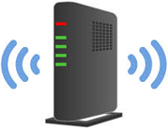

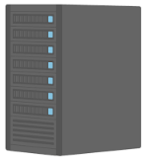
ESP32_Cam_FW
WiFi
ESP32_Cam_Controller
ESP32-WROVER Board
WiFi Router
Network
ESP32_Cam_AnalysisServer
（ImageAnalyzer.py）
Android Smartphone
MQTT
Broker
Server
Mail Server

