Slide 1

SELFISHNESS AND SELF LOVE ERICH FROMM
CONTENTS:
Introduction.
Calvin’s thoughts.
Kant’s thoughts.
Stirner’s thoughts.
Nietzsche’s thoughts.
Summing up.
Q&A Session
Muhammad Arham Khan & Bora Kurucu
ENG 101 - 93

Slide 2


Introduction to the TEXT
FROMM believes current views about selfishness are objectionable.
Two different types of doctrines on actions exist:
Being selfish.
Being selfless and loving others.
One may only be selfless, or selfish; no compromise or alternates exists.
The question is: Top what extent must one be selfless or selfish?

Slide 3
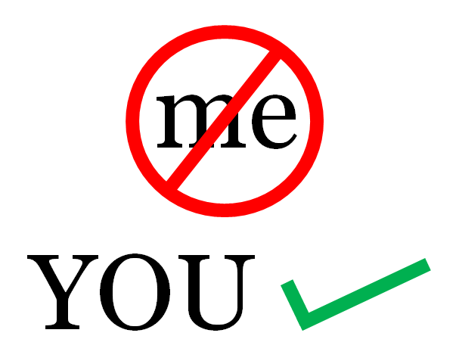
What CALVIN believed.
His ideology makes an important part of FROMM’s thoughts.
Deeply believed in following God for all guidance.
Believed man is primarily bad, and does not possess the power to do good himself.
Asks humans to forget their self, lose all desires and let God lead the way.
Wants humans to destroy their own image in their minds.
Thought being selfish is demolishes a human’s conscience.
POINT-OF-VIEW: BE SELFLESS (Self-love aka Selfishness must be avoided)!
FROMM’s view on CALVIN
Believes Calvin’s ideas are a classic expression of the his own thesis (one can only be selfless or selfish, nothing in between)

Slide 4

What KANT believed.
It is ones duty to strive for other’s happiness and well-being.
But unlike Calvin, it is permitted to achieve joy for self.
Yet, clarifies that it won’t be counted as a “virtue”.
Ego, irrational self-love and pleasure in self must be avoided.
must hold Moral laws above everything.
DUTY is the most important thing!
Also thinks man is essentially bad, and must be bound by a moral law.
SUMMARY: Be SELFLESS (But it okay to find joy for self too).
FROMM’s view on KANT
In support of his views
Explains his views in depth, and the choice of language testifies of his ideas being concurrent with those of FROMM.

Slide 5

What STIRNER believed.
Denounces the love that demands sacrifice for other’s happiness.
Promotes egoism
His ideologies are an outcome of rebellion against the forces of his time.
FROMM’s view on STIRNER
Believes his hatred for love will promote egoism.
His opinion is a bit exaggerated.

Slide 6

What NIETZSCHE believed.
Similar to Stirner, also denounces love and altruism (considering them weak).
Considers sacrificing many to gain your own purpose is the right choice.
Promotes selfishness and guiltlessness.
Wants egoism and sadness to be promoted.
Promotes survival of fittest.
But, was against weak love (loving others & not yourself)
Left this mystery unsolved.
FROMM’s view on NIETZSCHE
Believes his views are outcome of a rebellion against the authorities.
Thinks anxiety and insecurity fueled nietzsche’s thoughts.
But his ideas don’t define his personailty.
Thinks Nietzsche permitted loving others, if one loves themselves enough.

Slide 7
SUMMING UP
Stirner and Nietzsche believe loving others unconditionally is a weakness, and supported egoism, selfishness and self-love.
Calvin and Kant promoted the idea of selflessness, though Kant was a bit lenient in his ideas.
FROMM personally supports the idea of selflessness, but is against Calvinism (destroying all personal desires and motives).
FROMM thinks such suppression of personality is an excuse to avoid rebellions and outlaws.
FROMM states that the idea of selflessness is promoted in almost all walks of life just to ensure that humans comply by rules.

Slide 8
Q & A SESSION
SOME SELF-REFLECTION MAYBE?

