Slide 1
Oedipus’ SINS: FATE OR FREE WILL AT Play?
Muhammad Arham Khan – 21701848 – CS
Section 15

Slide 2
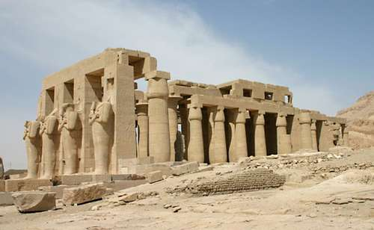
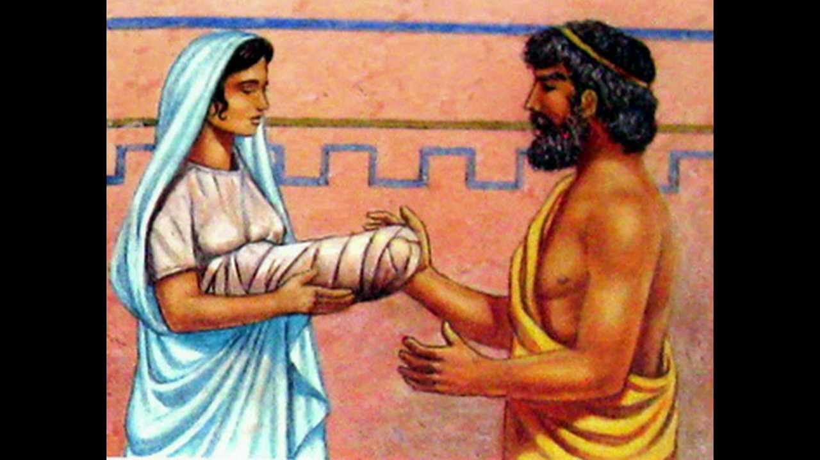
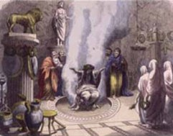
OEDIPUS’ STORY I
Born to Laius and Jocasta, King and Queen of Thebes.
Laius given a prediction by Delphi the Oracle that “doom would strike him down at the hands of his son” (pg. 201).
To avoid his fate, Laius orders the 3-days old Oedipus be left in mountains to die.
The baby luckily ends up in the hands of Polypus and Merope, the King and Queen of Corinth.
Oedipus grows up, learns his fate from the same fate as Laius from Oracle.

Slide 3
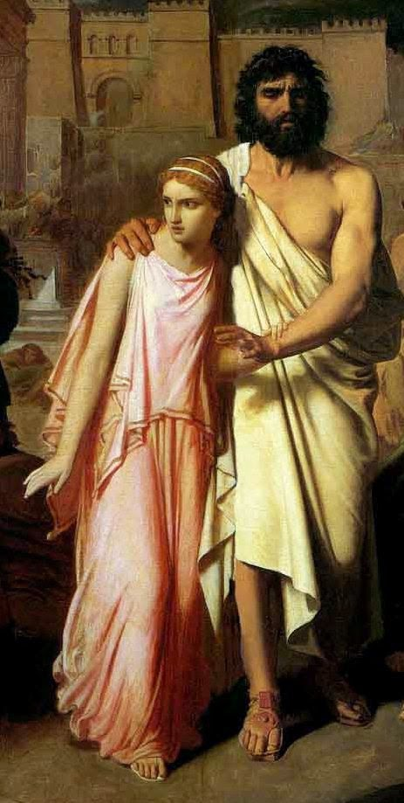

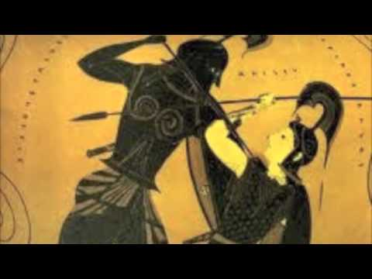
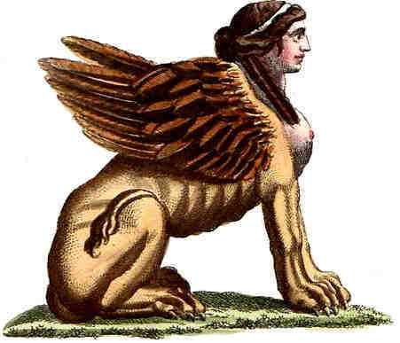
OEDIPUS’ STORY II
To avoid fate, runs away, gets in a quarrel on his way, kills Laius and his servants.
reaches Thebes, defeats the Sphinx and gets rewarded with the Throne.
Marries Jocasta, all the while happy that he’d avoided a tragic fate.
Years later, a plague hits Thebes and Oracle tells the killer of Laius has to be found and punished to save the city.
Investigation begins, Oedipus realizes he’s the killer he’s been looking for and that although he tried very hard, he fulfilled the prophecy and committed the grave sins.

Slide 4
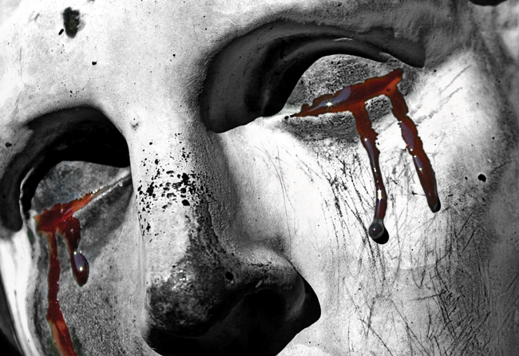
THE SAVIOUR’S SINS
INCEST
Oedipus sleeps with/ marries/ has children with his own mother Jocasta
Since incest is a social/ religious Taboo…
Hence, committing a major sin
PATRICIDE
Although unintentionally, Oedipus kills his father Laius
At Phocis, a “a place where two branching roads meet” (pg 202)

Slide 5

FATE: THE PREDETERMINED PATH
Fate is a predetermined course of events.
It’s like the entire story of someone’s life written before they’re even born
The notion of fate enforces that humans as individuals have no power/ control over what we do in our lives.
Support the existence of an entity (maybe God) that controls the events that happen in our lives.
The oracle informed both Laius and Oedipus about their fate.

Slide 6
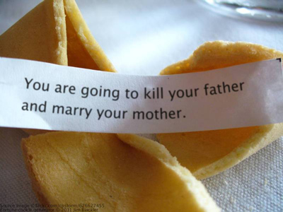
HUMANS AGAINT FATE
Laius tries averting the prophecy (his fate) by getting his son killed
Oedipus tries avoiding his fate by running far away from his parents (in Corinth) to an unknown city and starting a new life
As McHugh states: “Laius’ attempt to assert his free will is foiled when fate intervenes, in the form of the “good will” of a Shepherd who spares the infant’s life”
Fate intervenes and saves Oedipus against all odds and nurtures him for his tragic end
As Tiresias says “Make no mistake you are a doom born man” (pg 67)

Slide 7
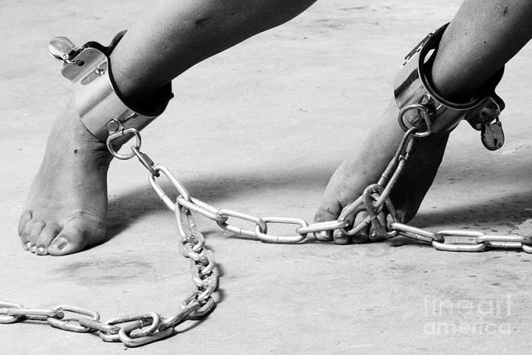
THE INESCAPABILITY of fate
No matter how hard both tried to escape their fate,
Oedipus survives
Fate miraculously crosses Oedipus’ and Laius’ paths at the place where the three roads meet
Of all the possibilities, Oedipus gets thrown off-road, gets angry
and commits his first sin: Patricide
Miraculously ends up in Thebes (of the countless cities)
Defeat sphinx, is offered the throne and marriage with Jocasta and hence, unconsciously Oedipus commits his second sin: Incest

Slide 8
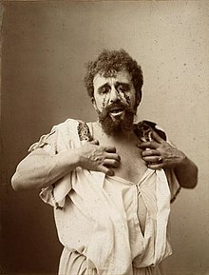
Oedipus: fated to doom?
No matter how hard he/ his father tried…
No matter how much they believed they’d escaped their fate…
Oedipus unconsciously follows fate’s mysterious path
And rather than avoiding his fate, meets it heads-on
So, the question is: WAS OEDIPUS IN CONTROL OF HIS LIFE? DID HE HAVE ANY FREE WILL IN HIS ACTIONS?

Slide 9

THE NOTION OF FREE WILL
Free will: the ability to have liberty to act on your desires/ thoughts.
It pivots the entire responsibility of our actions on us
No-one else governs what we do!
So, what did Oedipus willingly do? Were his sins committed out of free will?

Slide 10
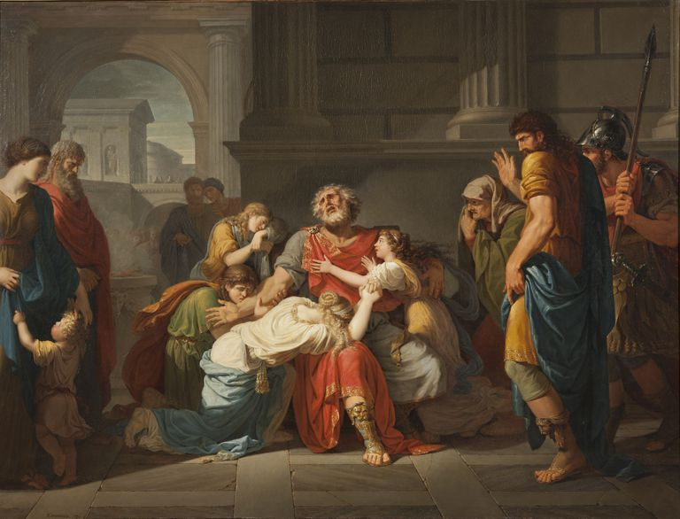
DID OEDIPUS PRACTICE HIS FREE WILL?
Considering the notion of freewill…
The act Oedipus performed consciously (willingly) were:
Ignoring his fate and running away from it
Isolating himself from Corinth and his parents
Running to a new city and starting anew
Hence, the actions he committed under his freewill were against the prophecies and so, against his fate.

Slide 11

OEDIPUS’ PRIDE: THE FINAL TRAP OF FATE?
Although numerous people warned him to quit his search, a proud Oedipus willingly continued his pursuit of killer.
Tiresias warned: “you are the murderer you hunt” (pg 180)
Jocasta, having realized the truth pleaded: “I beg you, don’t do this” (pg. 222)
But Oedipus, slave to his own pride goes on
So, although he didn’t practice his free will while committing the actions, he did conform his acts
And sealed his fate entirely willingly.

Slide 12

OEDIPUS’ FREE WILL: A STRING OF HIS FATE?
Throughout his life, he assumed he’d avoided fate using free will
And that he had adhered to his respectable character
But his free will to avoid his fate was what made it true!
As McHugh states: “compulsively continued his search for the murderer despite the warnings he received”
Ended up falling the trap of fate and releasing the grave truth to public
So, Oedipus free will was fate’s path in disguise…
So does he stand at fault?

Slide 13
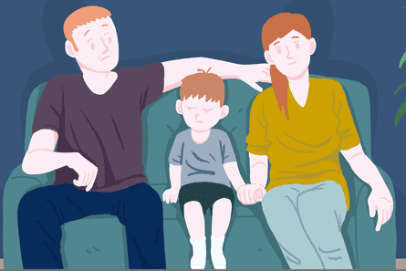
PSYCHOANALYSIS: Unconscious inclinations
According to the father of psychoanalysis, Zigmann Floyd
As published in his paper, Oedipus’ complex states:
Male infants/ children are naturally attracted to their mother
And consider the fathers as enemies, willing to eliminate them
Hence, Oedipus’ sins are subconsciously embed in everyone’s minds
But, Oedipus never got to be with his parents long enough.
And his subconscious never governed his actions.
So, who/ what’s responsible for the “Saviors” sins?

Slide 14
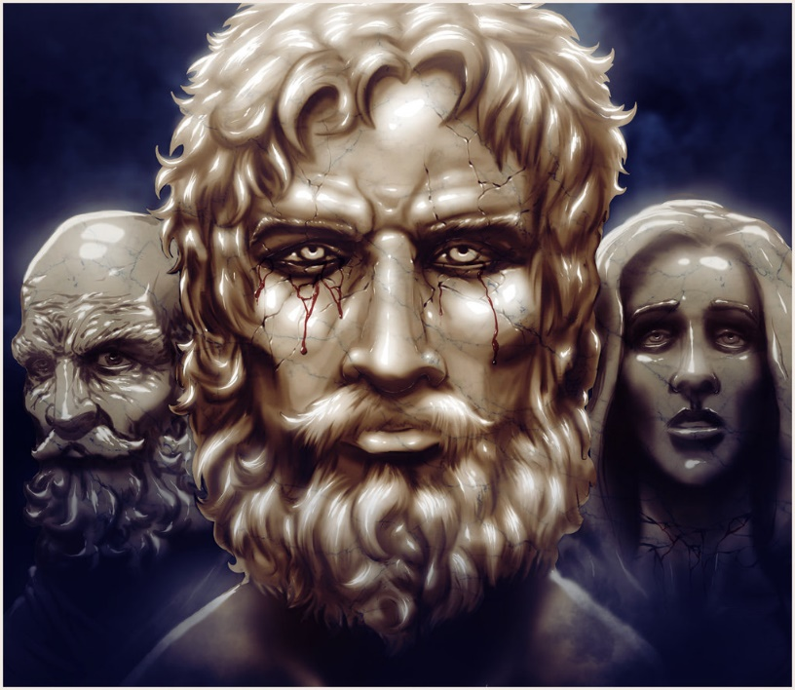
WHO TO BLAME?
Oedipus’ was predestined to commit incest and patricide according to the prophecy
Although Oedipus’ actions were governed by his fate, his realization of those sins could’ve been avoided, if he wasn’t proud and thirsty for knowledge
Regardless, he actively tried avoiding his fate throughout his life
He and Laius tried to hold a “conflict between the all-powerful will of the gods and the vain efforts of human beings” ( The interpretation of dreams, ch5)
Hence…

Slide 15
CONCLUSION
No matter how hard he tried averting the prophecy using his free will, Oedipus kept falling in the trap of fate.
Hence, Oedipus stands innocent because he didn’t have any control over his life and it was fate at play.
He was predestined to “doom”
OEDIPUS’s TRAGIC LIFE WAS A RESULT OF FATE’s ILL-PLAY
Considering this conclusion and the story of Oedipus,
It is apparent that humans are never fully responsible for their actions and hence,
The concept of free will is shadowed by fate!

Slide 16
REFERENCES
http://www.worldcat.org/title/literary-theme-fate-versus-free-will/oclc/877172917&referer=brief_results
http://www.umsl.edu/~gradyf/theory/Freudipusrex.htm
Sophocles: The Three Theban Plays (Oedipus The King).

