Slide 1

BY TEAM SEMICOLONS;

Slide 2
DECIDING WHAT TO WEAR IS A HASSLE, RIGHT ?

Slide 3
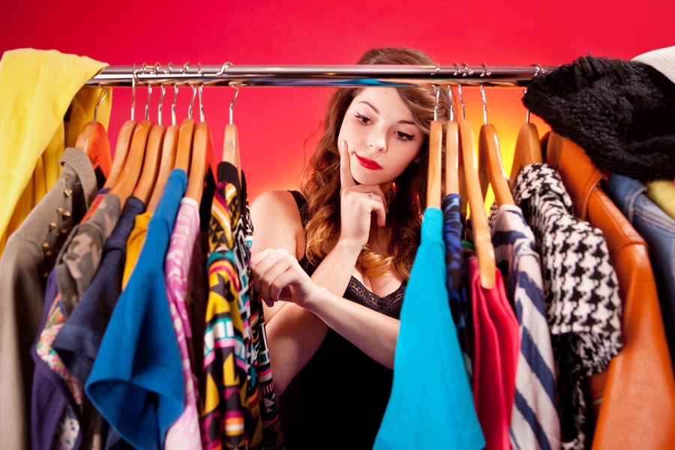

Slide 4
PEOPLE SPEND HOURS MAKING THE RIGHT DRESS CHOICE..

Slide 5
A CLEVER SOLUTION ?

Slide 6
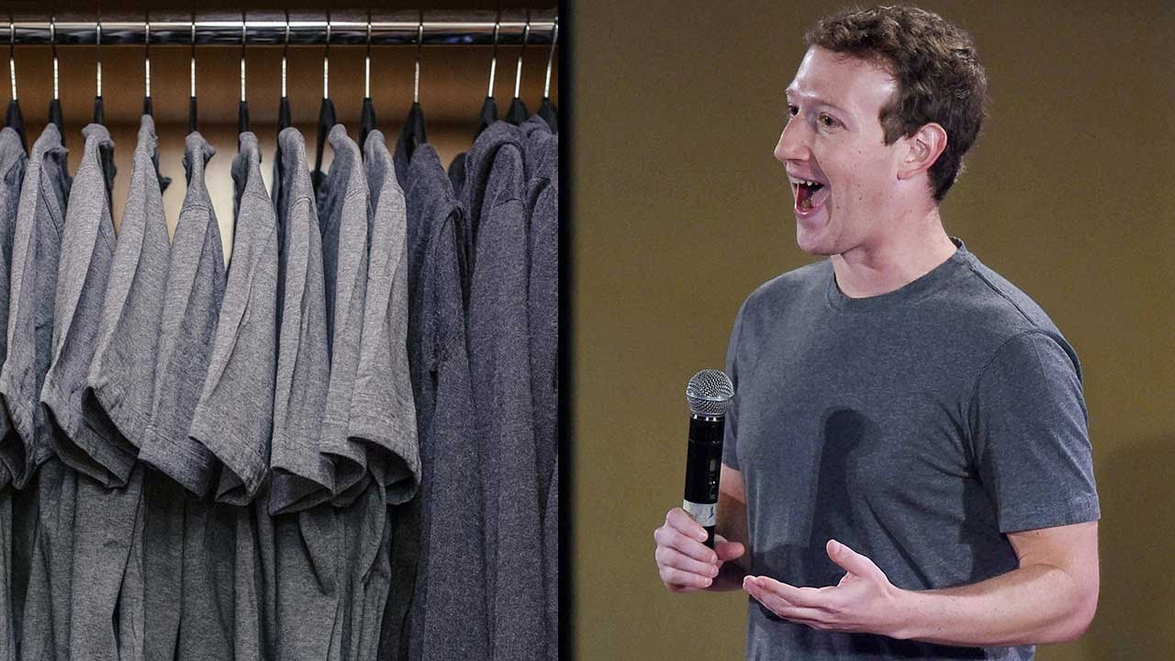

Slide 7
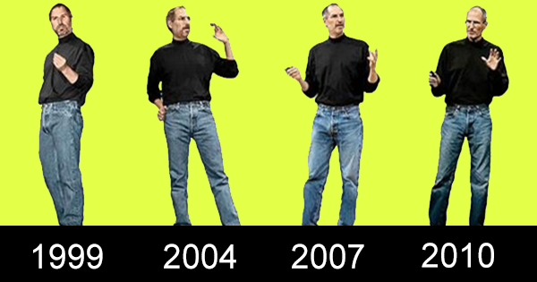

Slide 8
NOT CLEVER ENOUGH RIGHT ?

Slide 9

TEAM SEMICOLONS PRESENTS ESTIUM A SMART WARDROBE ORGANIZER

Slide 10
is a WARDROBE ORGANIZER
Which allows you to:
ORGANIZE,
MANAGE, and
ACCESS your wardrobe anytime, anywhere.

Slide 11
is a SOCIAL NETWORK
Which allows you to socially:
SUGGEST DRESSES,
LEARN STYLE TRENDS, and
GET LATEST OFFERS.

Slide 12
is designed to be
SIMPLE, Less cluttered and EASY to use.
Targeted towards: the busy public.

Slide 13
THE FEATURES

Slide 14
INDEX WARDROBE Items
SNAP PICTURE
INDEX WITH DATA TAGS
SAVE.

Slide 15
CREATE NEW LOOKS
SAVE THE DRESS COMBINATIONS YOU LIKE to “LOOKBOOK”
PERSONALIZED LOOKS
SHARE LOOKS AMONG “CIRCLES”

Slide 16
DRESS SUGGESTIONS
SUGGESTS DRESSES EVERYDAY, based on:
THE WEATHER
THE OCCASION
LATEST TRENDS
EVENTS ON THE CALENDAR
RANDOMIZES NEW LOOKS, or SUGGESTS LOOKS FROM THE “LOOKBOOK”

Slide 17
SUGGESTs NEW ITEMS
Uses GOOGLE SHOPPING API
SUGGESTS DESIRABLE CLOTHES (based upon user preference)
SUGGESTS LATEST DISCOUNTS/ OFFERS.

Slide 18
SOCIAL FEATURES
DRESS SUGGESTIONS AMONG “CIRCLES”
WISHLISTS
VIEWING FRIENDS WARDROBES (if they allow you..)
ALLOWS YOU TO CHOOSE WHICH ARTICLES DO YOU WANT TO SHARE WITH CIRCLES.

Slide 19
DONATION TAB
SAVES THE LAST-USE DATES OF CLOTHES
SUGGESTS TO DONATE IF AN ARTICLE HASN’T BEEN WORN IN A WHILE
UPON DONATION, ARTICLE REMOVED FROM WARDROBE
ADDED UNDER A “DONATED” TAB.

Slide 20
SYNCHRONIZES YOUR WARDROBE ON ALL DEVICES
All wardrobe data stores locally (to allow internet-free usage)
Synchronizes data to an online firebase data clutter
SYNC data automatically when internet found
To make sharing and “CIRCLES” implementation faster and more streamlined.

Slide 21
DRESS/ EVENT CALENDAR
USES GOOGLE CALENDAR API
FUTURE DRESS PLANNER FEATURE, (allows planning ahead of time)
SPECIFY EVENTS IN THE CALENDAR (to allow dress suggestions based on event)

Slide 22
FASHION TRENDS
A SECTION, THAT GRABS LATEST DESIGN TRENDS AND DISPLAYS THEM IN A ORGANIZED MANNER
THE SECTION ALSO KEEPS YOU UPDATE WITH THE LASTEST INCOMING ARTICLES FROM MAJOR BRANDS.

Slide 23
LAUNDRY TAB
App has a tab that allows you to select which clothes are in laundry
App doesn’t show them in suggestions while clothes are away
This way, you also know which items are away for laundry, something we usually forget.

Slide 24
TECHS USED
Google Firebase
Google Material Design Library
Florent37 design and transition APIs
Android Platform (Java)
HTTPS based data-transfer-security.

Slide 25
THANKS! ~drops the mic
Muhammad Arham Khan, Mohamad Fakhouri, AmirHossein Maghsoudi, Sayed Abdullah Qutb, Esra Nur Deniz, Sarah Javaid, Ahmet Berk Eren

