Slide 1
3-4-5
Introduction

Slide 2
3.1 Introduction
3.2 Classes, Objects, Member Functions and Data Members
3.3 Overview of the Chapter Examples
3.4 Defining a Class with a Member Function
3.5 Defining a Member Function with a Parameter
3.6 Data Members, set Functions and get Functions
3.7 Initializing Objects with Constructors
3.8 Placing a Class in a Separate File for Reusability
3.9 Separating Interface from Implementation
3.10 Validating Data with set Functions
3.11 (Optional) Software Engineering Case Study: Identifying the Classes in the ATM Requirements Document
3.12 Wrap-Up

Slide 3
4.1 Introduction
4.2 Algorithms
4.3 Pseudocode
4.4 Control Structures
4.5 if Selection Statement
4.6 if...else Double-Selection Statement
4.7 while Repetition Statement
4.8 Formulating Algorithms: Counter-Controlled Repetition
4.9 Formulating Algorithms: Sentinel-Controlled Repetition
4.10 Formulating Algorithms: Nested Control Statements
4.11 Assignment Operators
4.12 Increment and Decrement Operators
4.13 (Optional) Software Engineering Case Study: Identifying Class Attributes in the ATM System
4.14 Wrap-Up

Slide 4
5.1 Introduction
5.2 Essentials of Counter-Controlled Repetition
5.3 for Repetition Statement
5.4 Examples Using the for Statement
5.5 do…while Repetition Statement
5.6 switch Multiple-Selection Statement
5.7 break and continue Statements
5.8 Logical Operators
5.9 Confusing Equality (==) and Assignment (=) Operators
5.10 Structured Programming Summary
5.11 (Optional) Software Engineering Case Study: Identifying Objects’ States and Activities in the ATM System
5.12 Wrap-Up

Slide 5
3.1 Introduction
Typically
  Programs will consist of
    Function main and
    One or more classes
      Each containing data members and member functions

Slide 6
3.4 Defining a Class With a Member Function
Class definition
  Tells compiler what member functions and data members belong to the class
  Keyword class followed by the class’s name
  Class body is enclosed in braces ({})
    Specifies data members and member functions

Slide 7
3.4 Defining a Class With a Member Function (Cont.)
Member function definition
  Return type of a function
    Indicates the type of value returned by the function when it completes its task
    void indicates that the function does not return any value
  Function names must be a valid identifier
  Parentheses after function name indicate that it is a function
  Function body contains statements that perform the function’s task
    Delimited by braces ({})
Access-specifier public:
  Indicates that a member function or data member is accessible to other functions and member functions of other classes

Slide 8
3.4 Defining a Class With a Member Function (Cont.)
Using a class
  A class is a user-defined type (or programmer-defined type)
    Can be used to create objects
      Variables of the class type
    C++ is an extensible language
  Dot operator (.)
    Used to access an object’s data members and member functions
    Example
      myGradeBook.displayMessage()
        Call member function displayMessage of GradeBook object myGradeBook

Slide 9
3.5 Defining a Member Function with a Parameter
Function parameter(s)
  Information needed by a function to perform its task
Function argument(s)
  Values supplied by a function call for each of the function’s parameters
    Argument values are copied into function parameters
Returning a value from a function
  A function that specifies a return type other than void
    Returns a value to its calling function

Slide 10
3.6 Data Members, set Functions and get Functions
Local variables
  Variables declared in a function definition’s body
    Cannot be used outside of that function body
  When a function terminates
    The values of its local variables are lost
Attributes
  Exist throughout the life of the object
  Represented as data members
    Variables in a class definition
  Each object of class maintains its own copy of attributes

Slide 11
3.6 Data Members, set Functions and get Functions (Cont.)
Access-specifier private
  Makes a data member or member function accessible only to member functions of the class
  private is the default access for class members
  Data hiding

Slide 12
Software Engineering Observations
As a rule of thumb, data members should be declared private and member functions should be declared public. (We will see that it is appropriate to declare certain member functions private, if they are to be accessed only by other member functions of the class.)

Slide 13
3.6 Data Members, set Functions and get Functions (Cont.)
Software engineering with set and get functions
  public member functions that allow clients of a class to set or get the values of private data members
  Allows the creator of the class to control how clients access private data
  Should also be used by other member functions of the same class

Slide 14
3.7 Initializing Objects with Constructors
Constructors
  Functions used to initialize an object’s data when it is created
    Call made implicitly when object is created
    Must be defined with the same name as the class
    Cannot return values
      Not even void
  Default constructor has no parameters
    The compiler will provide one when a class does not explicitly include a constructor
      Compiler’s default constructor only calls constructors of data members that are objects of classes

Slide 15
Software Engineering Observation
Data members can be initialized in a constructor of the class or their values may be set later after the object is created. However, it is a good software engineering practice to ensure that an object is fully initialized before the client code invokes the object’s member functions. In general, you should not rely on the client code to ensure that an object gets initialized properly.

Slide 16
#include <iostream>
using namespace std;
class GradeBook{
public:
GradeBook( int no ){
setCourseNo( no );
}
GradeBook( ){
courseNo = 0;
}
void setCourseNo( int no ){
if ((no >= 100) && (no <= 999))
courseNo = no;
else{
cout << "invalid grade" << endl;
courseNo = 0;
}
}
int getCourseNo( ){
return courseNo;
}
allProgram.cpp
// file continues
void displayMessage( int no ){
cout << "Welcome to CS " << no ;
cout << "!" << endl;
}
void displayMessage( ){
cout << "Welcome to CS ";
cout << getCourseNo() << "!";
cout << endl;
}
private:
int courseNo;
}; // end of class
int main( ){
GradeBook gb1(101), gb2;
gb2.displayMessage();
gb2.setCourseNo(201);
gb2.displayMessage();
return 0;
}

Slide 17
3.8 Placing a Class in a Separate File for Reusability
.cpp file is known as a source-code file
Header files
  Separate files in which class definitions are placed
    Allow compiler to recognize the classes when used elsewhere
  Generally have .h filename extensions
Driver files
  Program used to test software (such as classes)
  Contains a main function so it can be executed

Slide 18
3.9 Separating Interface from Implementation
Interface
  Describes what services a class’s clients can use and how to request those services
    But does not reveal how the class carries out the services
    A class definition that lists only member function names, return types and parameter types
      Function prototypes
  A class’s interface consists of the class’s public member functions (services)
Separating interface from implementation
  Client code should not break if implementation changes, as long as interface stays the same

Slide 19
3.9 Separating Interface from Implementation (Cont.)
Separating interface from implementation (Cont.)
  Define member functions outside the class definition, in a separate source-code file
    In source-code file for a class
      Use binary scope resolution operator (::) to tie each member function to the class definition
    Implementation details are hidden
      Client code does not need to know the implementation
  In header file for a class
    Function prototypes describe the class’s public interface

Slide 20
#include preprocessor directive
#include preprocessor directive
  Used to include header files
    Instructs C++ preprocessor to replace directive with a copy of the contents of the specified file
  Quotes indicate user-defined header files
    Preprocessor first looks in current directory
      If the file is not found, looks in C++ Standard Library directory
  Angle brackets indicate C++ Standard Library
    Preprocessor looks only in C++ Standard Library directory

Slide 21
#ifndef __GRADEBOOK_H
#define __GRADEBOOK_H
class GradeBook{
public:
GradeBook( int no );
GradeBook( );
void setCourseNo( int no );
int getCourseNo( );
void displayMessage( int no );
void displayMessage( );
private:
int courseNo;
}; // end of class
#endif
GradeBook.h
#include <iostream>
using namespace std;
#include "GradeBook.h"
GradeBook::GradeBook( int no ){
setCourseNo( no );
}
GradeBook::GradeBook( ){
courseNo = 0;
}
void GradeBook::setCourseNo( int no ){
if ((no >= 100) && (no <= 999))
courseNo = no;
else{
cout << "invalid grade" << endl;
courseNo = 0;
}
}
int GradeBook::getCourseNo( ){
return courseNo;
}
void GradeBook::displayMessage(int no){
cout << "Welcome to CS " << no ;
cout << "!" << endl;
}
void GradeBook::displayMessage( ){
cout << "Welcome to CS ";
cout << getCourseNo() << "!" << endl;
}
GradeBook.cpp
#include "GradeBook.h"
int main( ){
GradeBook gb1(101), gb2;
gb2.displayMessage();
gb2.setCourseNo(201);
gb2.displayMessage();
return 0;
}
program.cpp

Slide 22
3.9 Separating Interface from Implementation (Cont.)
The Compilation and Linking Process
  Source-code file is compiled to create the class’s object code (source-code file must #include header file)
    Class implementation programmer only needs to provide header file and object code to client
  Client must #include header file in their own code
    So compiler can ensure that the main function creates and manipulates objects of the class correctly
  To create executable application
    Object code for client code must be linked with the object code for the class and the object code for any C++ Standard Library object code used in the application

Slide 23
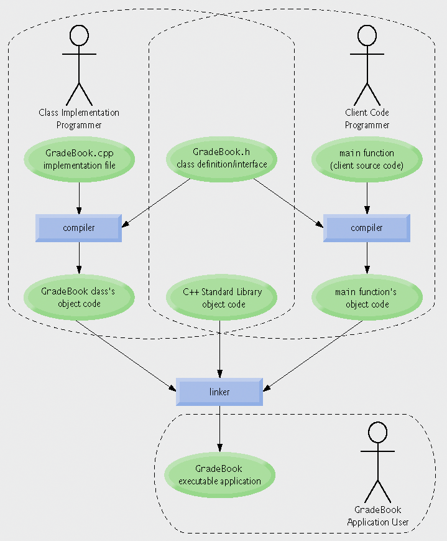
Fig.3.14 | Compilation and linking process that produces an executable application.

Slide 24
Software Engineering Observation 3.6
Making data members private and controlling access, especially write access, to those data members through public member functions helps ensure data integrity.
Error-Prevention Tip 3.5
The benefits of data integrity are not automatic simply because data members are made private—the programmer must provide appropriate validity checking (e.g., in set functions) and report the errors.

Slide 25
4.4 Control Structures
Three types of control statements
  Sequence statement
    Programs executed sequentially by default
  Selection statements
    if, if…else, switch
  Repetition statements
    while, do…while, for
Combined in one of two ways
  Control statement stacking
    Connect exit point of one to entry point of the next
  Control statement nesting

Slide 26
4.5 if Selection Statement
if
  Performs action if condition true
if…else
  Performs one action if condition is true, a different action if it is false
Pseudocode
  If student’s grade is greater than or equal to 60
  print “Passed”
  Else
  print “Failed”
C++ code
  if ( grade >= 60 )
  cout << "Passed";
  else
  cout << "Failed";
Any expression can be used as the condition
  If it evaluates to false, it is treated as false

Slide 27
Portability Tip 4.1
For compatibility with earlier versions of C, which used integers for Boolean values, the bool value true also can be represented by any nonzero value (compilers typically use 1) and the bool value false also can be represented as the value zero.

Slide 28
4.7 while Repetition Statement
Action repeated while some condition remains true
Pseudocode
  While there are more items on my shopping list
  Purchase next item and cross it off my list
while loop repeats until condition becomes false
Example
  int product = 1;
  while ( product <= 100 ){
  cout << product << endl;
  product++;
  }

Slide 29
Example:
Write a class function that takes grades from the user and returns their average to the caller
First draft (may have some bugs)
double GradeBook::computeAvg(){
int grade, sum, count;
cout << "Enter grades (negative value to stop): ";
cin >> grade;
while (grade >= 0){
sum += grade;
count++;
cout << "Enter grades (negative value to stop): ";
cin >> grade;
}
return sum / count;
}

Slide 30
Example:
Write a class function that takes grades from the user and returns their average to the caller
Final version (bugs are fixed)
double GradeBook::computeAvg(){
int grade, sum = 0, count = 0;
cout << "Enter grades (negative value to stop): ";
cin >> grade;
while (grade >= 0){
sum += grade;
count++;
cout << "Enter grades (negative value to stop): ";
cin >> grade;
}
if (count)
return static_cast <double> (sum) / count;
else
return 0;
}

Slide 31
Common Programming Error 5.1
Floating-point values are approximate, so controlling counting loops with floating-point variables can result in imprecise counter values and inaccurate tests for termination.
Error-Prevention Tip 5.1
Control counting loops with integer values.

Slide 32
Notes
Uninitialized variables
  Contain “garbage” (or undefined) values
Notes on integer division and truncation
  Integer division
    When dividing two integers
    Performs truncation
      Fractional part of the resulting quotient is lost

Slide 33
Notes
Unary cast operator
  Creates a temporary copy of its operand with a different data type
    Example
      static_cast< double > ( total )
        Creates temporary floating-point copy of total
  Explicit conversion
Promotion
  Converting a value (e.g. int) to another data type (e.g. double) to perform a calculation
  Implicit conversion

Slide 34
Notes
Formatting floating-point numbers
  Parameterized stream manipulator setprecision
    Specifies number of digits of precision to display to the right of the decimal point
    Default precision is six digits
  Nonparameterized stream manipulator fixed
    Indicates that floating-point values should be output in fixed-point format
      As opposed to scientific notation (3.1 × 10³)
  Stream manipulator showpoint
    Forces decimal point to display

Slide 35
Assignment Operators
Increment and Decrement Operators
(Preincrement, postincrement, predecrement, postdecrement)
Operator precedence

Slide 36
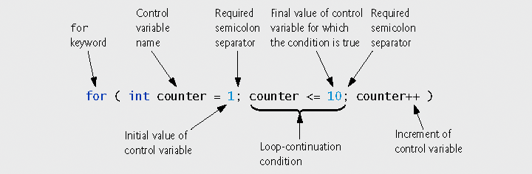
5.3 for Repetition Statement
for repetition statement
  Specifies counter-controlled repetition details in a single line of code
Fig. 5.3 | for statement header components.

Slide 37
Example:
Write a code fragment that calculates the factorial of a given positive number N
int N, product;
cin >> N;
product = 1;
for ( int i = 1; i <= N; i++ )
product *= i;
cout << "Factorial of " << N << " is " << product << endl;

Slide 38
5.5 do…while Repetition Statement
do…while statement
  Similar to while statement
  Tests loop-continuation after performing body of loop
    Loop body always executes at least once
Good Programming Practice 5.9: Always including braces in a do...while statement helps eliminate ambiguity between the while statement and the do...while statement containing one statement.

Slide 39
Example:
Write a code fragment that calls a function (for example, factorial function) until the user wants to stop
char ans;
int N;
do {
cout << "Enter a number: ";
cin >> N;
factorial(N);
cout << "Do you want to stop (Y or N)? ";
do {
cin >> ans;
} while (ans != 'Y' && ans != 'y' &&
ans != 'N' && ans != 'n');
} while (ans == 'N' || ans == 'n');

Slide 40
5.6 switch Multiple-Selection Statement
switch statement
  Used for multiple selections
  Tests a variable or expression
    Compared against constant integral expressions to decide on action to take
      Any combination of character constants and integer constants that evaluates to a constant integer value

Slide 41
5.6 switch Multiple-Selection Statement (Cont.)
switch statement
  Controlling expression
    Expression in parentheses after keyword switch
  case labels
    Compared with the controlling expression
    Statements following the matching case label are executed
      Braces are not necessary around multiple statements in a case label
      A break statements causes execution to proceed with the first statement after the switch
        Without a break statement, execution will fall through to the next case label
  default case
    Executes if no matching case label is found
    Is optional

Slide 42
Example:
Write a code fragment that takes an integer grade and displays its letter equivalent, calculated by the following rules
A: 90-100, B: 80-89, C: 70-79, D: 60-69, F: 0-59
int grade;
char letter;
cin >> grade;
if (grade < 0 || grade > 100)
cout << "Invalid grade\n";
else {
switch (grade / 10){
case 10:
case 9: letter = 'A'; break;
case 8: letter = 'B'; break;
case 7: letter = 'C'; break;
case 6: letter = 'D'; break;
default: letter = 'F'; break;
}
cout << "Your letter grade is " << letter << endl;
}

Slide 43
Integer Data Types
Integer data types
  short
    Abbreviation of short int
    Minimum range is -32,768 to 32,767
  long
    Abbreviation of long int
    Minimum range is -2,147,483,648 to 2,147,483,647
  int
    Equivalent to either short or long on most computers
  char
    Can be used to represent small integers
  Portability Tip 5.4: Because ints can vary in size between systems, use long integers if you expect to process integers outside the range –32,768 to 32,767 and you would like to run the program on several different computer systems.

Slide 44
5.7 break and continue Statements
break/continue statements
  Alter flow of control
break statement
  Causes immediate exit from control structure
  Used in while, for, do…while or switch statements
continue statement
  Skips remaining statements in loop body
    Proceeds to increment and condition test in for loops
    Proceeds to condition test in while/do…while loops
  Then performs next iteration (if not terminating)
  Used in while, for or do…while statements

Slide 45
Logical Operators
&& (logical AND), || (logical OR), ! (logical NOT)
Operator precedence and associativity
Confusing Equality (==) and Assignment (=) Operators

