Slide 1
7
Arrays

Slide 2
7.1 Introduction
7.2 Arrays
7.3 Declaring Arrays
7.4 Examples Using Arrays
7.5 Passing Arrays to Functions
7.6 Case Study: Class GradeBook Using an Array to Store Grades
7.7 Searching Arrays with Linear Search
7.8 Sorting Arrays with Insertion Sort
7.9 Multidimensional Arrays
7.10 Case Study: Class GradeBook Using a Two-Dimensional Array
7.11 Introduction to C++ Standard Library Class Template vector
7.12 (Optional) Software Engineering Case Study: Collaboration Among Objects in the ATM System
7.13 Wrap-Up

Slide 3
7.1 Introduction
Arrays
  Data structures containing related data items of the same type
  Always remain the same size once created
    Are “fixed-size” entities
  Character arrays can also represent strings
  Dynamically allocated (pointer-based) arrays
  LATER!!!

Slide 4
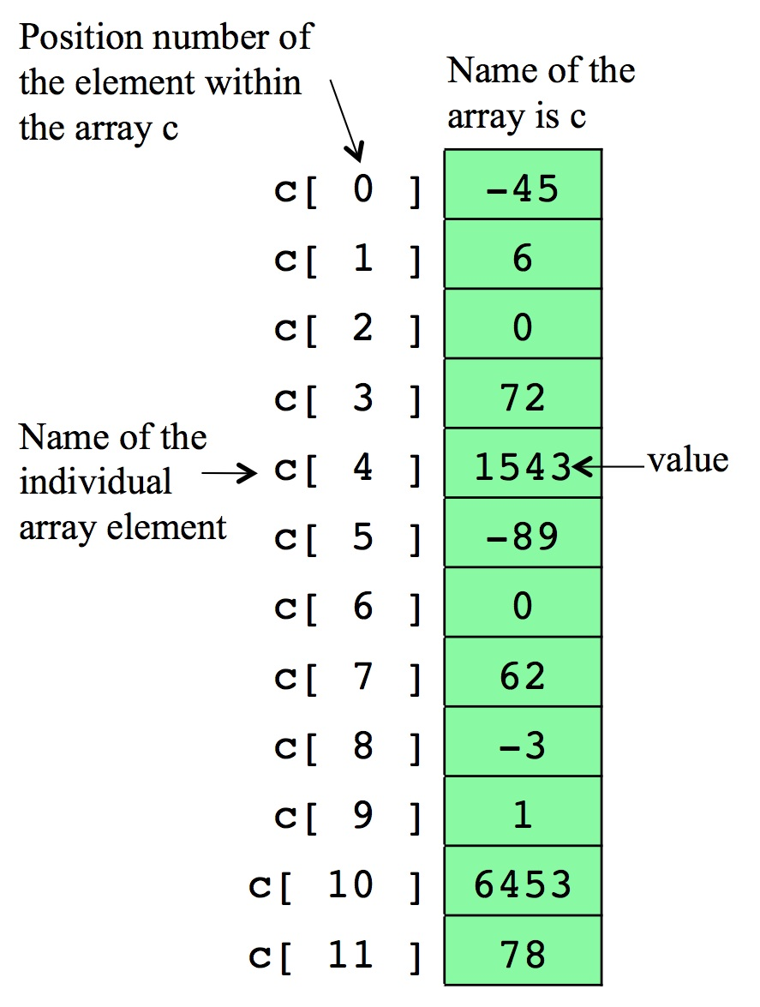
7.2 Arrays
Array
  Consecutive group of memory locations
    All of which have the same type
  Index (also called subscript)
    Position number used to refer
    to a specific location/element
    Place in square brackets
      Must be positive integer or
      integer expression
    First element has index zero
    Example (assume a = 5 and b = 6)
      c[ a + b ] += 2;
        Adds 2 to array element c[ 11 ]

Slide 5
7.2 Arrays
Brackets used to enclose an array subscript are actually an operator in C++
C++ has no array bounds checking
  Does not prevent the computer from referring to an element that does not exist
    Could lead to serious execution-time errors

Slide 6
Common Programming Error
Referring to an element outside the array bounds is an execution-time logic error. It is not a syntax error.
Portability Tip
The (normally serious) effects of referencing elements outside the array bounds are system dependent. Often this results in changes to the value of an unrelated variable or a fatal error that terminates program execution.

Slide 7
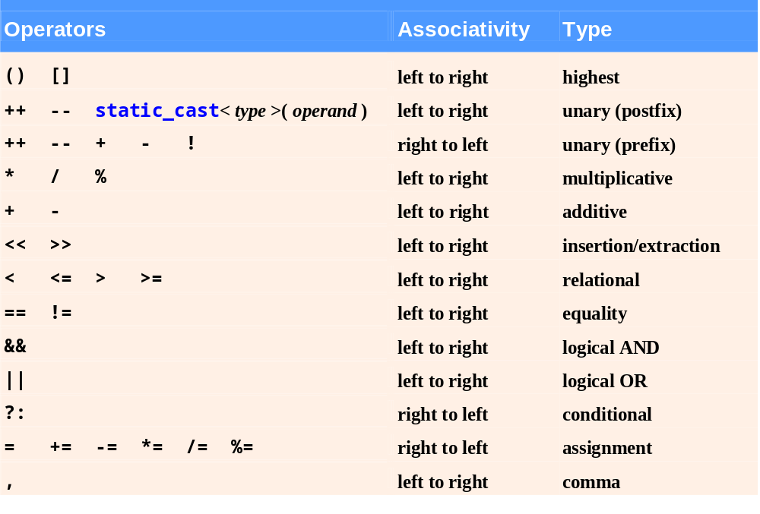
Fig.7.2 | Operator precedence and associativity.

Slide 8
7.3 Declaring Arrays
Declaring an array
  Arrays occupy space in memory
  Programmer specifies type and number of elements
    int c[ 12 ];
  Array’s size must be an integer constant greater than zero
  Arrays can be declared to contain values of any non-reference data type
  Multiple arrays of the same type can be declared in a single declaration
    Use a comma-separated list of names and sizes

Slide 9
7.4 Initializing Arrays
The elements of local arrays have garbage values
You can initialize the elements at the time of array declaration, using an initializer list
  Items enclosed in braces ({})
  Items in a list separated by commas
    int n[] = { 10, 20, 30, 40, 50 };
    Since the array size is omitted in the declaration, the compiler determines the size of the array based on the size of the initializer list
    Creates a five-element array
    The array elements are initialized with the values of
    10, 20, 30, 40, 50, respectively

Slide 10
7.4 Initializing Arrays
The elements of local arrays have garbage values
You can initialize the elements at the time of array declaration, using an initializer list
  If fewer initializers than elements in the array
    Remaining elements are initialized to zero
    int n[ 10 ] = { 0 };
      Explicitly initializes the first element to zero
      Implicitly initializes the remaining nine elements to zero
  If more initializers than elements in the array
    Compilation error

Slide 11
7.4 Specifying the Array Size
You can specify the array size with a constant variable
  Using constant variables to specify array sizes makes programs more scalable and eliminates “magic numbers”
Constant variables (name constants or read-only variables)
  Declared using the const qualifier
  Must be initialized with a constant expression when they are declared and cannot be modified thereafter
    Common Programming Error 7.4: Not assigning a value to a constant variable when it is declared is a compilation error
    Common Programming Error 7.5: Assigning a value to a const. variable in an executable statement is a compilation error.
  Can be placed anywhere a constant expression is expected

Slide 12
Common Programming Error
Only constants can be used to declare the size of automatic and static arrays. Not using a constant for this purpose is a compilation error.
Good Programming Practice
Defining the array size as a constant variable instead of a literal constant makes programs clearer. This technique eliminates so-called magic numbers.
For example, repeatedly mentioning the size 10 in array-processing code for a 10-element array gives the number 10 an artificial significance and can unfortunately confuse the reader when the program includes other 10s that have nothing to do with the array size.

Slide 13
Simple Example
Write a code fragment that reads grades from a user and summarizes the distribution of these grades creating a histogram
  Read the grades until the user enters an invalid grade
  int hist[11] = {0};
  cin >> grade;
  while (grade >= 0 && grade <= 100){
  hist[ grade/10 ]++;
  cin >> grade;
  }

Slide 14
7.4 Character Arrays
Character arrays can be used to store and manipulate strings
  Arrays may be of any type, including chars
    We can store character strings in char arrays
  Can be initialized using a string literal
    char string1[] = "Hi";
      is equivalent to
    char string1[] = { 'H', 'i', '\0' };
  Array contains each character plus a special string-termination character called the null character ('\0')

Slide 15
7.4 Character Arrays
Character arrays can be used to store and manipulate strings
  A character array representing a null-terminated string can be output with cout and <<
  cout << string1;
  Can also input a string directly into a character array from the keyboard using cin and >>
  cin >> string1;
    cin >> may read more characters than the array can store
    Common Programming Error: Not providing cin >> with a character array large enough to store a string typed at the keyboard can result in loss of data in a program and other serious runtime errors

Slide 16
7.5 Passing Arrays to Functions
To pass an array argument to a function
void modifyArray( int arr[], int arraySize );
Specify the array name without brackets
  Suppose the array hourlyTemperatures is declared as
int hourlyTemperatures[ 24 ];
  The function call should be
  modifyArray( hourlyTemperatures, 24 );
  and this call passes array hourlyTemperatures and its size to the function modifyArray
  You should pass the array size as another argument so the function can know the number of elements in the array

Slide 17
7.5 Passing Arrays to Functions
A function call passes the starting address of an array
  So the function knows where the array is located in memory
  However, the function does not know where the array ends Thus, you have to pass the array size as another parameter
A caller gives the called function a direct access to the caller’s data (the elements of the array)
  The called function can manipulate this data (array elements)

Slide 18
7.5 Passing Arrays to Functions
Functions that take arrays as arguments
  Function parameter list must specify array as a parameter
  void modArray( int b[], int arraySize );
  The array parameter may include the size of the array (inside the square brackets)
    The compiler will ignore it, though
      The compiler only cares about the address of the first element
Function prototypes may include parameter names
  But the compiler will ignore them
  Parameter names may be left out of the function prototypes

Slide 19
7.5 Passing Arrays to Functions
const array parameters
  Qualifier const
  Prevent modification of the values of array elements in the caller by code in the called function
  Elements in the array are constant in the function body
  Enables the programmer to prevent accidental modification of data

Slide 20
Example: Extend class GradeBook to store grades of multiple students
class GradeBook{
public:
const static int studentNo = 10;
GradeBook(int, const int []);
// ...
private:
int courseNo;
int grades[studentNo];
};
GradeBook::GradeBook(int no, const int S[]){
courseNo = no;
for (int i = 0; i < studentNo; i++)
grades[i] = S[i];
}
int main(){
int A[GradeBook::studentNo];
GradeBook G(201, A);
return 0;
}

Slide 21
Example: Extend class GradeBook to store grades of multiple students
static data members
  Also called class variables
  Variables for which each object of a class does not have a separate copy
    One copy is shared among all objects of the class
  Can be accessed even when no objects of the class exist
    Use the class name followed by the binary scope resolution operator and the name of the static data member

Slide 22
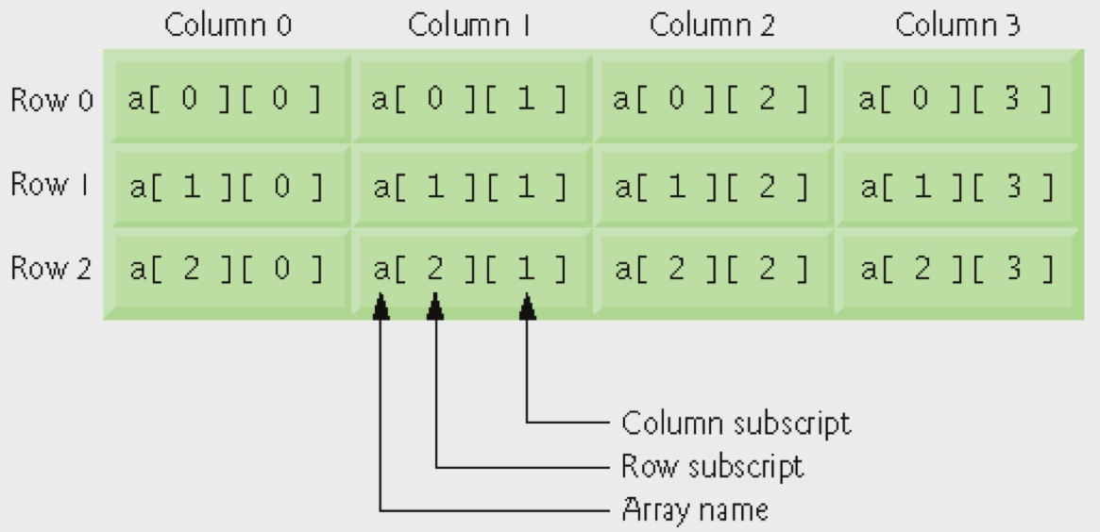
7.9 Multidimensional Arrays
Multidimensional arrays with two dimensions (2-D arrays)
  Represent tables of values with rows and columns
  In general, an array with m rows and n columns is called
  an m-by-n array
  Elements referenced with two subscripts ([ x ][ y ])
  int a[ 3 ][ 4 ];
Multidimensional arrays can have more than two dimensions

Slide 23
7.9 Multidimensional Arrays
Initializing two-dimensional arrays
  Initializing a 2-D array b using an initializer list
    int b[ 2 ][ 2 ] = { { 1, 2 }, { 3, 4 } };
    1 and 2 initialize b[ 0 ][ 0 ] and b[ 0 ][ 1 ]
    3 and 4 initialize b[ 1 ][ 0 ] and b[ 1 ][ 1 ]
    int b[ 2 ][ 2 ] = { { 1 }, { 3, 4 } };
    Row 0 contains values 1 and 0 (implicitly initialized to zero)
    Row 1 contains values 3 and 4

Slide 24
7.9 Multidimensional Arrays
Multidimensional array parameters
  Size of the first dimension is not required
    Similar to passing a one-dimensional array
  Size of the subsequent dimensions are required
    The compiler must know how many elements to skip to move to the second element in the first dimension
    void printArray( const int a[][ 3 ] );
    The function will skip row 0’s 3 elements to access row 1’s elements (for example to access a[ 1 ][ x ])

Slide 25
Example: Extend class GradeBook to store multiple grades of multiple students
class GradeBook{
public:
const static int studentNo = 10;
const static int testNo = 3;
GradeBook(int, const int [][testNo]);
double getAverage(const int [], int);
void displayStudentAverages();
private:
int courseNo;
int grades[studentNo][testNo];
};
int main(){
int A[GradeBook::studentNo][GradeBook::testNo];
// ...
GradeBook G(201, A);
G.displayStudentAverages();
return 0;
}

Slide 26
GradeBook::GradeBook(int no, const int S[][testNo]){
courseNo = no;
for (int i = 0; i < studentNo; i++)
for (int j = 0; j < testNo; j++)
grades[i][j] = S[i][j];
}
double GradeBook::getAverage(const int A[], int no){
double avg = 0.0;
for (int i = 0; i < no; i++)
avg += A[i];
if (no)
return avg / no;
return 0;
}
void GradeBook::displayStudentAverages(){
for (int i = 0; i < studentNo; i++)
// call the getAverage function for the i-th student
cout << << endl;
}

