Slide 1
8
Pointers

Slide 2
8.1 Introduction
8.2 Pointer Variable Declarations and Initialization
8.3 Pointer Operators
8.4 Passing Arguments to Functions by Reference with Pointers
8.5 Using const with Pointers
8.6 Selection Sort Using Pass-by-Reference
8.7 sizeof Operators
8.7 Pointer Expressions and Pointer Arithmetic
8.9 Relationship Between Pointers and Arrays
8.10 Arrays of Pointers
8.11 Case Study: Card Shuffling and Dealing Simulation
8.12 Function Pointers
8.13 Introduction to Pointer-Based String Processing
8.13.1 Fundamentals of Characters and Pointer-Based Strings
8.13.2 String Manipulation Functions of the String-Handling Library
8.14 Wrap-Up

Slide 3
8.1 Introduction
Pointers
  Powerful, but difficult to master
  Can be used to simulate pass-by-reference
  (which is especially important in C programming language)
  Can be used to create and manipulate dynamic data structures

Slide 4
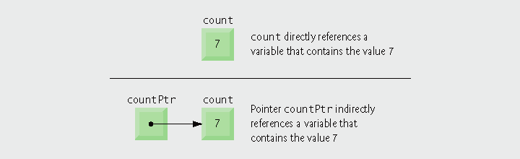
8.2 Pointer Variable Declarations and Initialization
Pointer variables
  Contain memory addresses as values
    Normally, variable contains specific value (direct reference)
    Pointers contain address of variable that has specific value (indirect reference)
Indirection
  Referencing value through pointer
Fig. 8.1 | Directly and indirectly referencing a variable.

Slide 5
8.2 Pointer Variable Declarations and Initialization
Pointer declarations
  * indicates variable is a pointer
    int *myPtr;
    Declares pointer to int, of type int *
    int *myPtr1, *myPtr2;
    Multiple pointers require multiple asterisks
Pointer initialization
  Initialized to 0, NULL, or an address
    0 or NULL points to nothing (null pointer)
  Initialize pointers to prevent pointing to unknown or uninitialized areas of memory

Slide 6


8.3 Pointer Operators
Address operator (&)
  Returns memory address of its operand
  int y = 5;
  int *yPtr;
  yPtr = &y;
  assigns the address of variable y to pointer variable yPtr
    Variable yPtr “points to” y
    yPtr indirectly references variable y’s value
Fig. 8.3 | Representation of y and yPtr in memory.

Slide 7
8.3 Pointer Operators
* operator
  Also called indirection operator or dereferencing operator
  Returns synonym for the object its operand points to
  *yPtr returns y (because yPtr points to y)
  Dereferenced pointer is an lvalue
      *yptr = 9;

Slide 8
Common Programming Error 8.2
Dereferencing a pointer that has not been properly initialized or that has not been assigned to point to a specific location in memory could cause a fatal execution-time error, or it could accidentally modify important data and allow the program to run to completion, possibly with incorrect results.

Slide 9
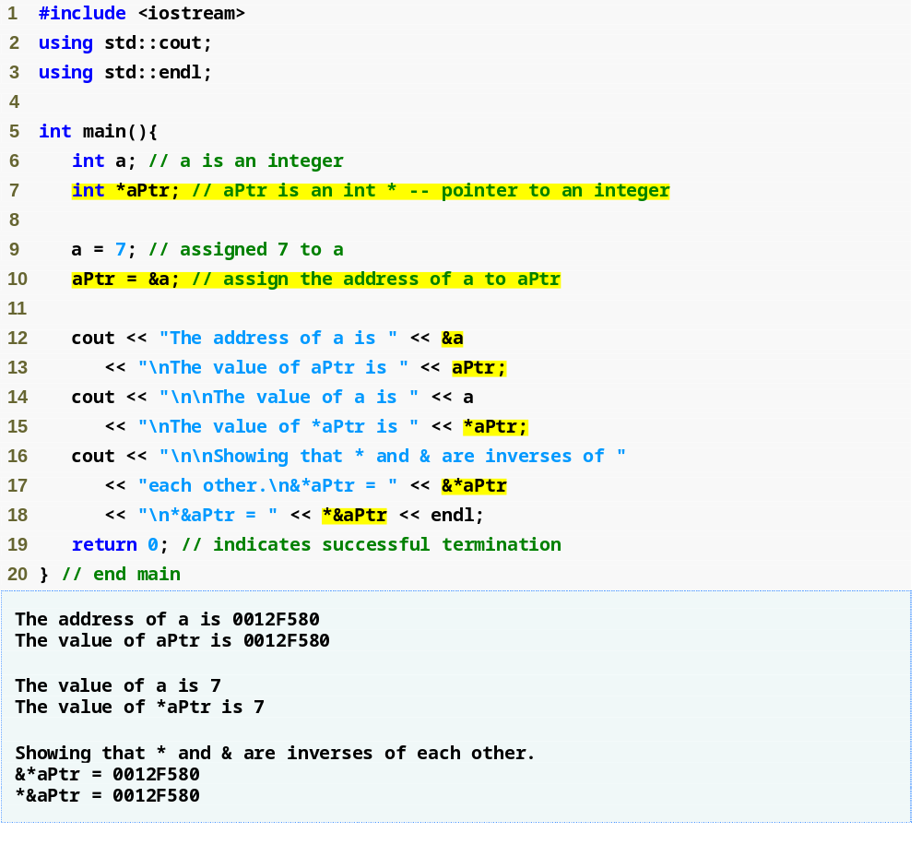
Outline
fig08_04.cpp

Slide 10
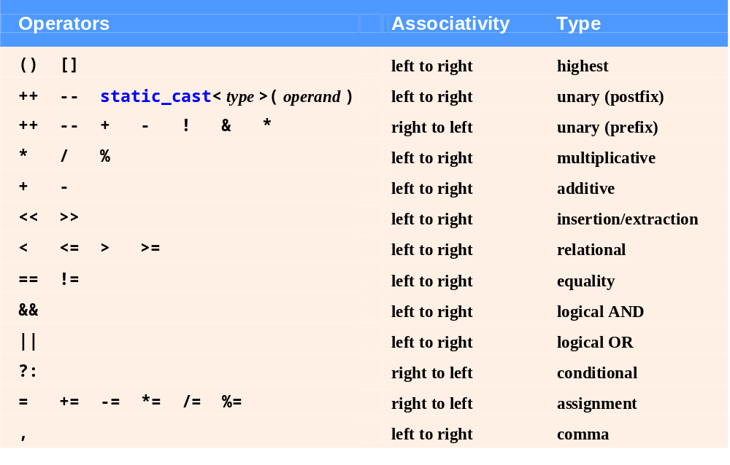
Fig. 8.5 | Operator precedence and associativity.

Slide 11
8.4 Passing Arguments to Functions by Reference with Pointers
Passing pointer arguments
  Simulates pass-by-reference
    Use pointers and indirection operator
  Pass address of argument using & operator
  Arrays not passed with & because array name is already a pointer

Slide 12
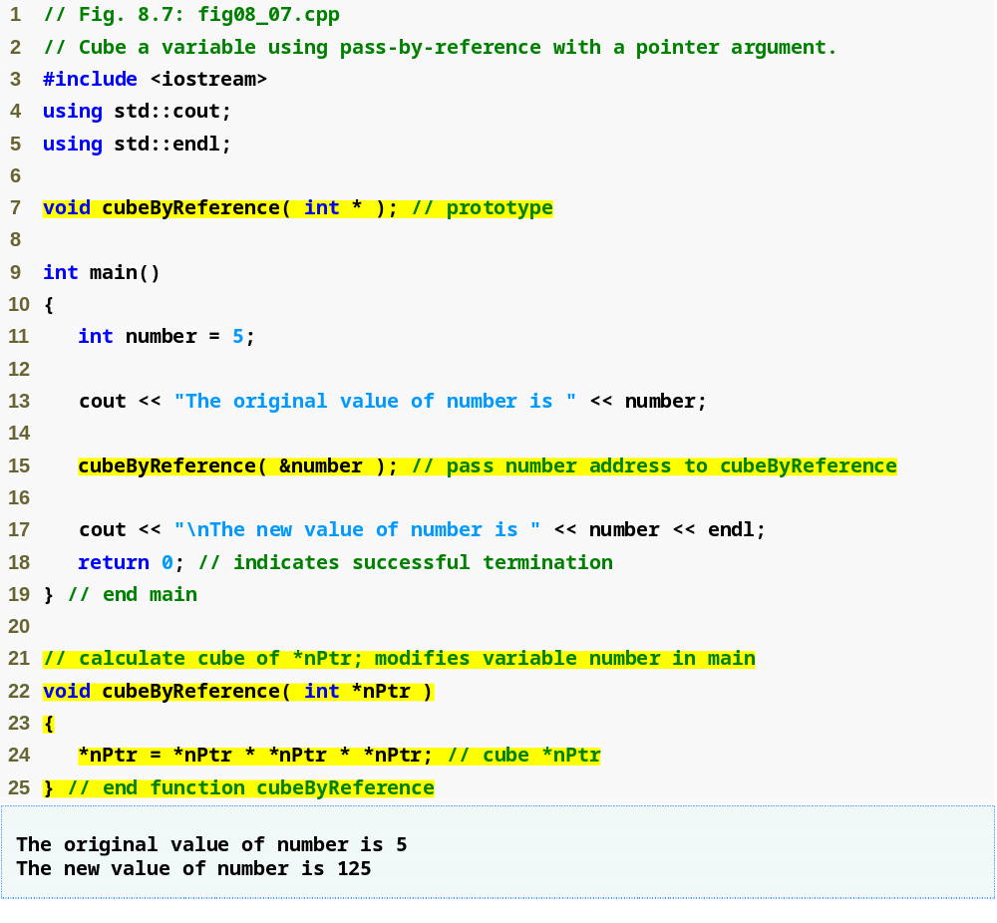
Outline
fig08_07.cpp
(1 of 1)

Slide 13
8.5 Using const with Pointers
const qualifier
  Indicates that value of variable should not be modified
  const used when function does not need to change the variable’s value
Principle of least privilege
  Award function enough access to accomplish task, but no more
  Example
    A function that displays the elements of an array, takes array and int indicating length
      Array contents are not changed – should be const
      Array length is not changed – should be const

Slide 14
8.5 Using const with Pointers
Nonconstant pointer to nonconstant data
  Data can be modified through the dereferenced pointer
  Pointer can be modified to point to other data
Nonconstant pointer to constant data
  Pointer can be modified to point to any appropriate data item
  Data cannot be modified through this pointer
Constant pointer to nonconstant data
  Always points to the same memory location
    Can only access other elements using subscript notation
  Must be initialized when declared
  Data can be modified through the pointer
  Default for an array name

Slide 15
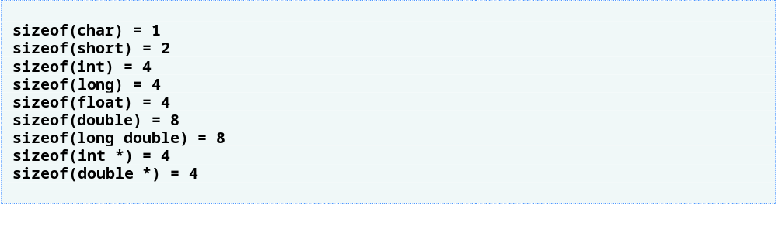
8.7 sizeof Operators
sizeof operator
  Returns size of operand in bytes
  Can be used with
    Variable names
    Type names
    Constant values
  The number of bytes used to store a particular data type may vary between systems.

Slide 16
8.8 Pointer Expressions and Pointer Arithmetic
Pointer arithmetic
  Increment/decrement pointer (++ , --)
  Add/subtract an integer to/from a pointer (+ , += , - , -=)
  Pointers may be subtracted from each other
  Pointer arithmetic is meaningless unless performed on a pointer to an array

Slide 17
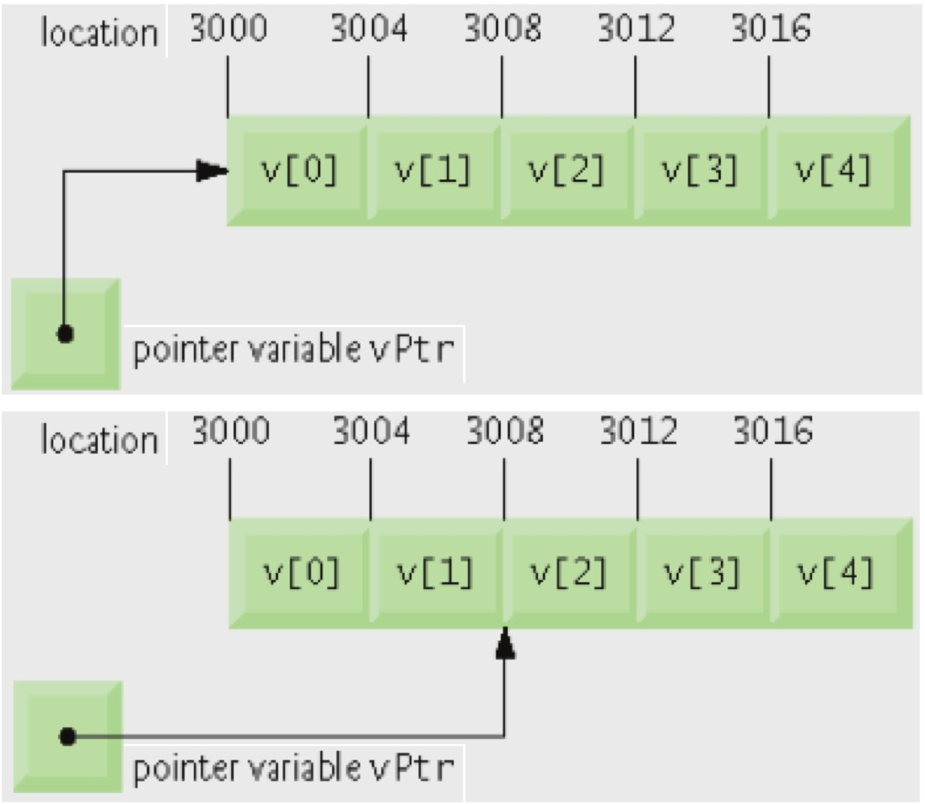
8.8 Pointer Expressions and Pointer Arithmetic
5 element int array on a machine using 4 byte ints
  vPtr = &v[ 0 ];
    vPtr points to first element v[ 0 ], at location 3000
  vPtr += 2;
    sets vPtr to 3008 (3000 + 2 * 4); vPtr points to v[ 2 ]
Subtracting pointers
  Returns number of elements
  between two addresses
  vPtr2 = &v[ 2 ];
  vPtr = &v[ 0 ];
  vPtr2 - vPtr is 2

Slide 18
Common Programming Error 8.9
Using pointer arithmetic on a pointer that does not refer to an array of values is a logic error.

Slide 19
8.8 Pointer Expressions and Pointer Arithmetic
Pointer assignment
  Pointer can be assigned to another pointer if both are of the same type
    If not the same type, cast operator must be used
    Exception: pointer to void (type void *)
      Generic pointer, represents any type
      No casting needed to convert pointer to void *
      Casting is needed to convert void * to any other type
      void pointers cannot be dereferenced

Slide 20
8.8 Pointer Expressions and Pointer Arithmetic
Pointer comparison
  Use equality and relational operators
  Compare addresses stored in pointers
    Comparisons are meaningless unless pointers point to members of the same array
  Commonly used to determine whether or not pointer is 0 (null pointer)

Slide 21
8.9 Relationship Between Pointers and Arrays
Arrays and pointers are closely related
  Array name is like a constant pointer
  Pointers can do array subscripting operations
Although array names are pointers to the beginning of the array, array names cannot be modified in arithmetic expressions, because array names are constant pointers

Slide 22
8.9 Relationship Between Pointers and Arrays
Accessing array elements with pointers
  Assume declarations:
  int b[ 5 ];
  int *bPtr;
  bPtr = b;
  Element b[ n ] can be accessed by *( bPtr + n )
    Called pointer/offset notation
  Addresses
    &b[ 3 ] is the same as bPtr + 3
  Array name can be treated as pointer
    b[ 3 ] is the same as *( b + 3 )
  Pointers can be subscripted (pointer/subscript notation)
    bPtr[ 3 ] is the same as b[ 3 ]

Slide 23
Dynamic Memory Management:
Dynamic memory management
  Enables programmers to allocate and deallocate memory for any built-in or user-defined type
  Performed by operators new and delete
  For example, dynamically allocating memory for an array instead of using a fixed-size array

Slide 24
Dynamic Memory Management
Operator new
  Allocates (i.e., reserves) storage of the proper size for an object at execution time
  Calls a constructor to initialize the object
  Returns a pointer of the type specified to the right of new
  Can also be used to dynamically allocate any fundamental type (such as int or double) or any class type
Free store
  Sometimes called the heap
  Region of memory assigned to each program for storing objects created at execution time

Slide 25
Dynamic Memory Management
Operator delete
  Destroys a dynamically allocated object
  Calls the destructor for the object
  Deallocates (i.e., releases) memory from the free store
  The memory can then be reused by the system to allocate other objects
Not releasing dynamically allocated memory when it is no longer needed can cause the system to run out of memory prematurely. This is sometimes called a “memory leak”
There is no garbage collection in C or C++

Slide 26
Dynamic Memory Management
new operator can be used to allocate arrays dynamically
  To dynamically allocate a 10-element integer array
  int *gradesArray = new int[ 10 ];
  Size of a dynamically allocated array
    Specified using any integral expression that can be evaluated at execution time

Slide 27
Dynamic Memory Management
To delete a dynamically allocated array
  delete [] gradesArray;
  This deallocates the array to which gradesArray points
  If the pointer points to an array of objects
    First calls the destructor for every object in the array
    Then deallocates the memory
  If the statement did not include the square brackets ([]) and gradesArray pointed to an array of objects
    Only the first object in the array would have a destructor call

Slide 28
Dynamic 1-D arrays
int *grades, no, i;
cout << "No of students: ";
cin >> no;
grades = new int[no];
for (i = 0; i < no; i++){
cout << "Enter the grade: ";
cin >> grades[i];
}
for (i = 0; i < no; i++)
cout << grades[i] << endl;
delete []grades;
Write a code fragment that takes first the number of students and then their grades from the user. After displaying the values of the grades, your code should deallocate the corresponding array.

Slide 29
Dynamic
2-D arrays
(pointers of pointers)
float **grades;
int *examNo, studentNo, i, j;
cout << "No of students: ";
cin >> studentNo;
grades = new float *[studentNo];
examNo = new int [studentNo];
for (i = 0; i < studentNo; i++){
cout << "No of exams for " << i;
cin >> examNo[i];
grades[i] = new float[examNo[i]];
for (j = 0; j < examNo[i]; j++)
cin >> grades[i][j];
}
for (i = 0; i < studentNo; i++)
for (j = 0; j < examNo[i]; j++)
cout << grades[i][j];
for (i = 0; i < studentNo; i++)
delete [] grades[i];
delete [] grades;
delete [] examNo;
Write a code fragment that takes first the number of students and then the grades that these students get from multiple exams. Note that each student may take a different number of exams. After displaying the values of the grades, your code should deallocate the corresponding array.

Slide 30
Dynamic
2-D arrays
(array of pointers)
const int size = 5;
int *triangle[size], i, j;
for (i = 0; i < size; i++){
triangle[i] = new int[i + 1];
for (j = 0; j < i + 1; j++)
triangle[i][j] = i + 1;
}
for (i = 0; i < size; i++){
for (j = 0; j < i + 1; j++)
cout << triangle[i][j];
cout << endl;
}
for (i = 0; i < size; i++)
delete [] triangle[i];
Write a code fragment that stores an acute triangle with the help of digits. The height of this triangle should be 5 and each row should be filled with its row number. That is, your array should contain
1
22
333
4444
55555
After drawing the triangle on the screen, your code should deallocate the corresponding array.

Slide 31
Dynamic 1-D arrays
int *takeGrade1(int *no){
int i, *grades;
cout << "No of students: ";
cin >> *no;
grades = new int[*no];
for (i = 0; i < *no; i++){
cout << "Enter grade: ";
cin >> grades[i];
}
return grades;
}
int main(){
int *stGrades, stNo, i;
stGrades = takeGrade1(&stNo);
cout << "Grades: " << endl;
for (i = 0; i < stNo; i++)
cout << stGrades[i] << endl;
delete []stGrades;
return 0;
}
Consider the first example again. But this time, write a function that takes the number of students and their grades from the user, stores the grades in an array, and returns the array and its size to the caller.
Then, write a main function that calls your function and makes the deallocations after displaying the grades.
Do not use pass-by-reference. If necessary, simulate pass-by-reference using pointers.
Passing the number of students to our function by reference with pointers and returning the grades array

Slide 32
Dynamic 1-D arrays
Output of the program:
No of students: 3
Enter grade: 89
Enter grade: 56
Enter grade: 76
Grades:
89
56
76
Consider the first example again. But this time, write a function that takes the number of students and their grades from the user, stores the grades in an array, and returns the array and its size to the caller.
Then, write a main function that calls your function and makes the deallocations after displaying the grades.
Do not use pass-by-reference. If necessary, simulate pass-by-reference using pointers.
Passing the number of students to our function by reference with pointers and returning the grades array

Slide 33
Dynamic 1-D arrays
int takeGrade2(int *grades){
int i, no;
cout << "No of students: ";
cin >> no;
grades = new int[no];
for (i = 0; i < no; i++){
cout << "Enter grade: ";
cin >> grades[i];
}
return no;
}
int main(){
int *stGrades, stNo, i;
stNo = takeGrade2(stGrades);
cout << "Grades: " << endl;
for (i = 0; i < stNo; i++)
cout << stGrades[i] << endl;
delete []stGrades;
return 0;
}
Consider the first example again. But this time, write a function that takes the number of students and their grades from the user, stores the grades in an array, and returns the array and its size to the caller.
Then, write a main function that calls your function and makes the deallocations after displaying the grades.
Do not use pass-by-reference. If necessary, simulate pass-by-reference using pointers.
This program does not work correctly. WHY???

Slide 34
Dynamic 1-D arrays
Output of the program:
No of students: 3
Enter grade: 89
Enter grade: 56
Enter grade: 76
Grades:
-1073743257
0
-1073743249
Consider the first example again. But this time, write a function that takes the number of students and their grades from the user, stores the grades in an array, and returns the array and its size to the caller.
Then, write a main function that calls your function and makes the deallocations after displaying the grades.
Do not use pass-by-reference. If necessary, simulate pass-by-reference using pointers.
This program does not work correctly. WHY???

Slide 35
Dynamic 1-D arrays
int takeGrade3(int **grades){
int i, no;
cout << "No of students: ";
cin >> no;
*grades = new int[no];
for (i = 0; i < no; i++){
cout << "Enter grade: ";
cin >> (*grades)[i];
}
return no;
}
int main(){
int *stGrades, stNo, i;
stNo = takeGrade3(&stGrades);
cout << "Grades: " << endl;
for (i = 0; i < stNo; i++)
cout << stGrades[i] << endl;
delete []stGrades;
return 0;
}
Consider the first example again. But this time, write a function that takes the number of students and their grades from the user, stores the grades in an array, and returns the array and its size to the caller.
Then, write a main function that calls your function and makes the deallocations after displaying the grades.
Do not use pass-by-reference. If necessary, simulate pass-by-reference using pointers.
Passing the grades array to our function by reference with pointers and returning the number of students

Slide 36
Dynamic 1-D arrays
Output of the program:
No of students: 3
Enter grade: 89
Enter grade: 56
Enter grade: 76
Grades:
89
56
76
Consider the first example again. But this time, write a function that takes the number of students and their grades from the user, stores the grades in an array, and returns the array and its size to the caller.
Then, write a main function that calls your function and makes the deallocations after displaying the grades.
Do not use pass-by-reference. If necessary, simulate pass-by-reference using pointers.
Passing the grades array to our function by reference with pointers and returning the number of students

Slide 37
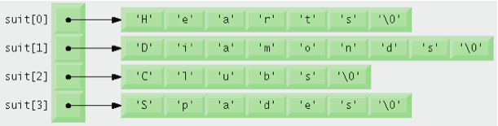
8.11 Example: Card Dealing
Using an array of C-style strings (string array)
  Array does not store strings, only pointers to strings
  const char *suit[ 4 ] = { "Hearts", "Diamonds",
  "Clubs", "Spades" };
  Each element of suit points to a char * (string)
  "Hearts", "Diamonds", "Clubs", and "Spades" are somewhere in memory
  suit array has fixed size (4), but strings can be of any size
  Commonly used with command-line arguments to function main

Slide 38
8.13.2 C-Style String Library
C-style string handling library <cstring> provides functions to
  Manipulate C-style string data
  Compare C-style strings
  Search C-style strings for characters and other C-style strings
  Tokenize C-style strings (separate them into logical pieces)

Slide 39
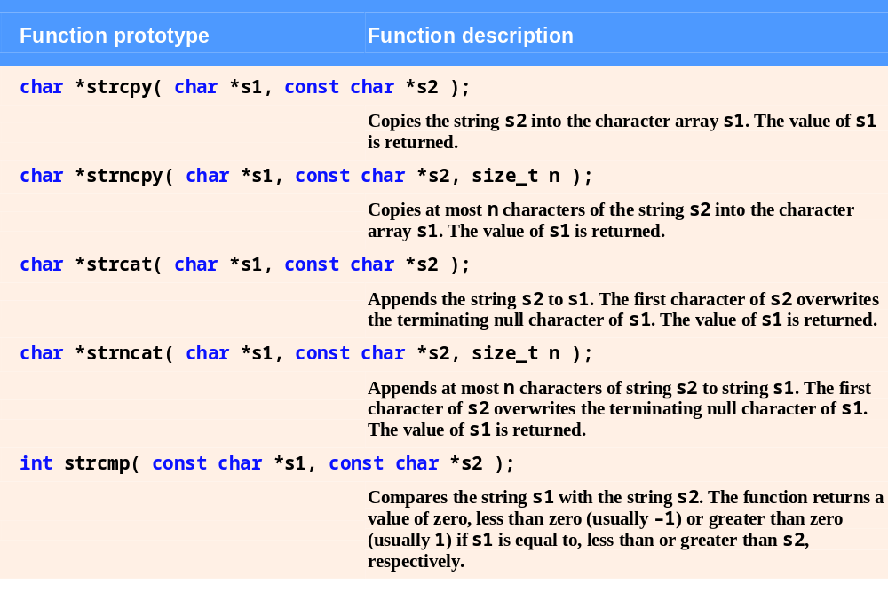
Fig. 8.30 | String-manipulation functions of the cstring library (Part 1 of 2)

Slide 40
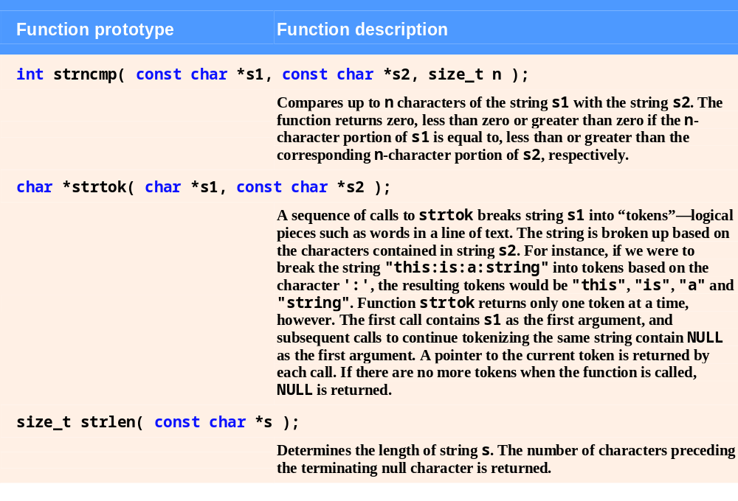
Fig. 8.30 | String-manipulation functions of the cstring library (Part 1 of 2)

